Slide 1

INSight
Discover Instagram Popularity

Slide 2


Motivation
Context: photo and video-sharing social networking. Instagram is the 4st downloaded mobile app with younger generations. Influencers growing up on Instagram.
Needs: Predict the popularity of a given Instagram account and post.
Vision: Instagram accounts gaining popularities can increase advertising values, social, and political strategies.

Slide 3
Data Sources
Instagram API – Limited
Web Scraping – Selenium
1000 influencer (exclude celebrities) features:
User Info | Posts Info
Username | Hashtags
Description (Youtube/Gmail/urls) | Image content
Number of followers | Image size
Number of likes | Image pixel
Number of posts | Location

Slide 4
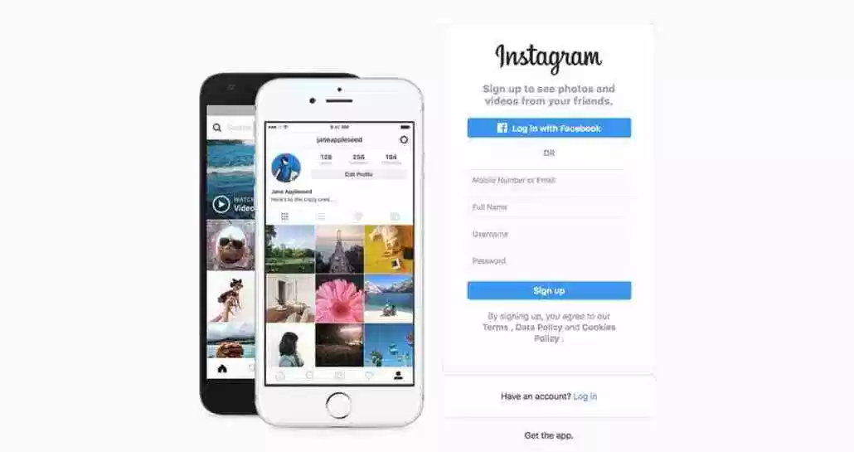

Approach
Data Wrangling
Model
Prediction
Perform feature engineering
NLP features
Dimension reduction
XGboost
CNN
NLP
Does new post beyond the previous average likes?
Desired outcome
App/website

