Slide 1
Steel Industry Energy Consumption
Justin Yang

Slide 2

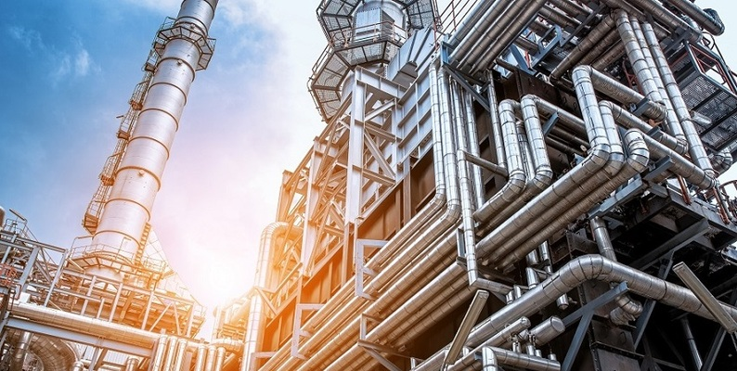
Data Overview and Goals
Korea Electric Power Corporation dataset from 2018
Records Data Every 15 Minutes on Various Attributes
Usage_kWh (Active Power)
Lagging and Leading Power
Load Type
CO2 expenditure
Goal: Can we forecast Active Power/Energy Usage for the Next Month
Maximum Usage: More important b/c High Spikes can disturb the power system

Slide 3
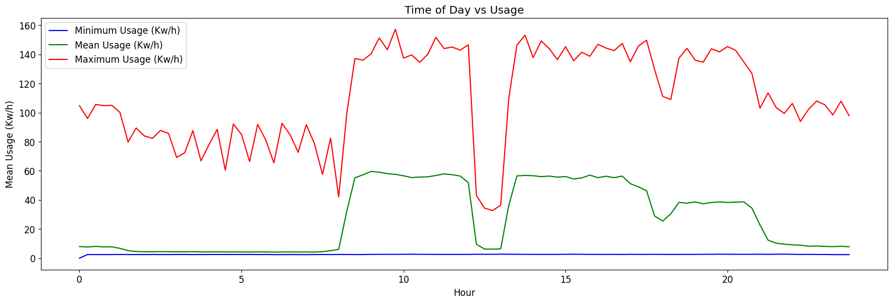
We observe that Usage is correlated with the average working hours (9-5)

Slide 4
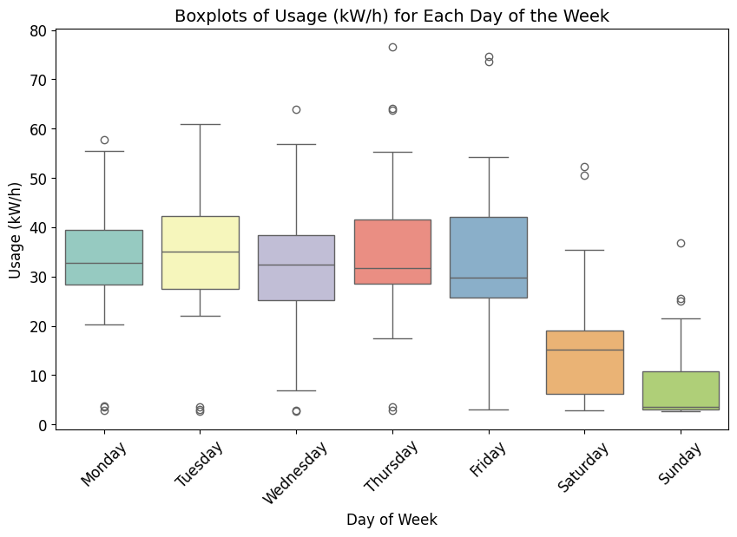
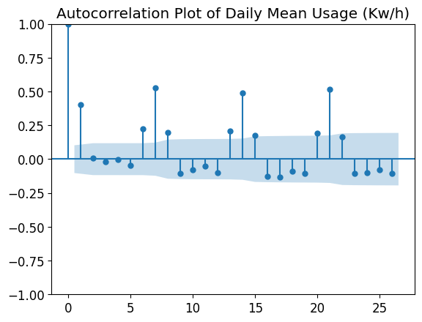
We confirm the Usage follows the traditional seven-day work week

Slide 5
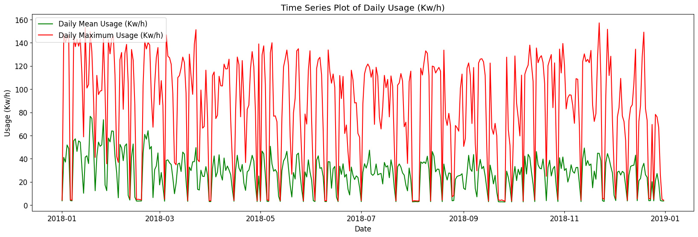
The Daily Average and Maximum Usage Remain Fairly Stationary Around Their Respective Averages

Slide 6
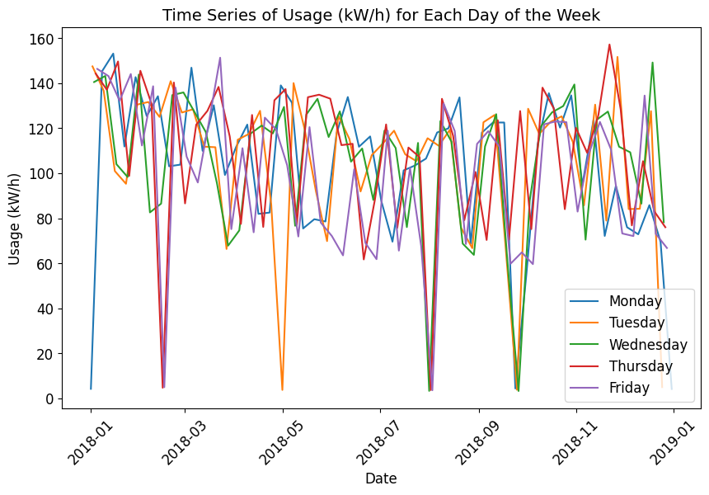
The Usage Consumption also aligns with national holidays and other public celebrations
Lunar New Year
Children’s Day
Liberation Day
Chuseok

Slide 7
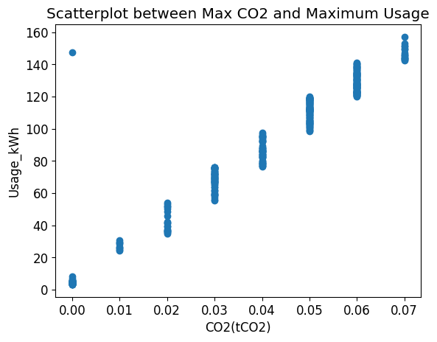
There is an Extremely Strong Positive Relationship between CO2 and Maximum Usage: In Production

Slide 8
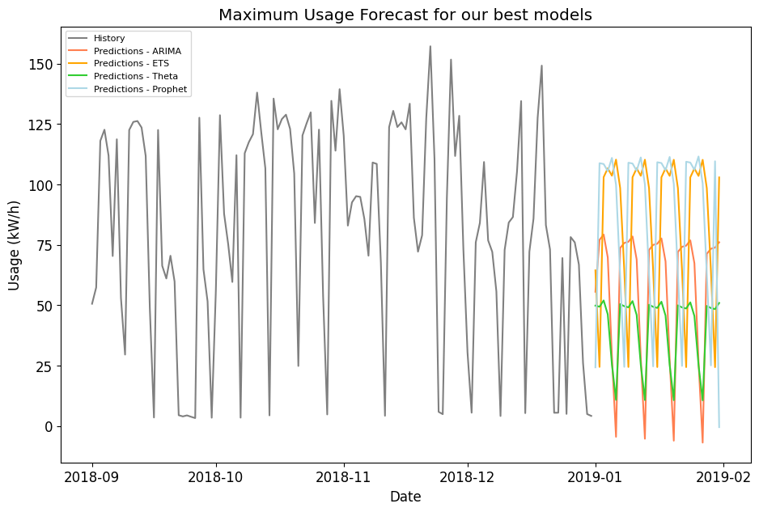
We initially fitted four different Forecasting models to attempt to Forecast the Maximum Daily Usage

Slide 9
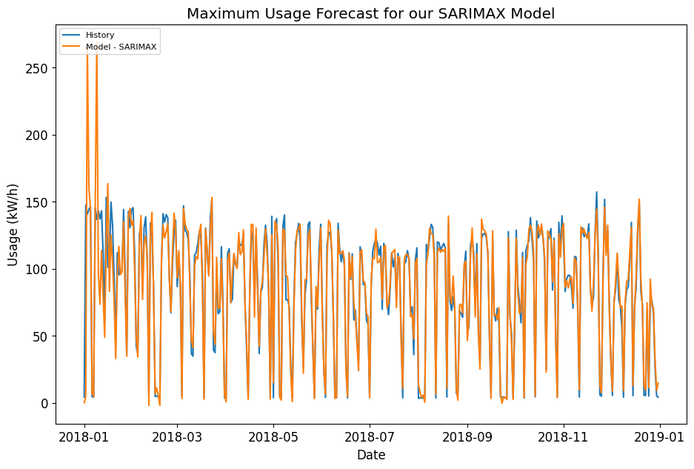
Our Best Model utilized Continuous CO2 Expenditure that accurately corresponds to Maximum Usage

Slide 10
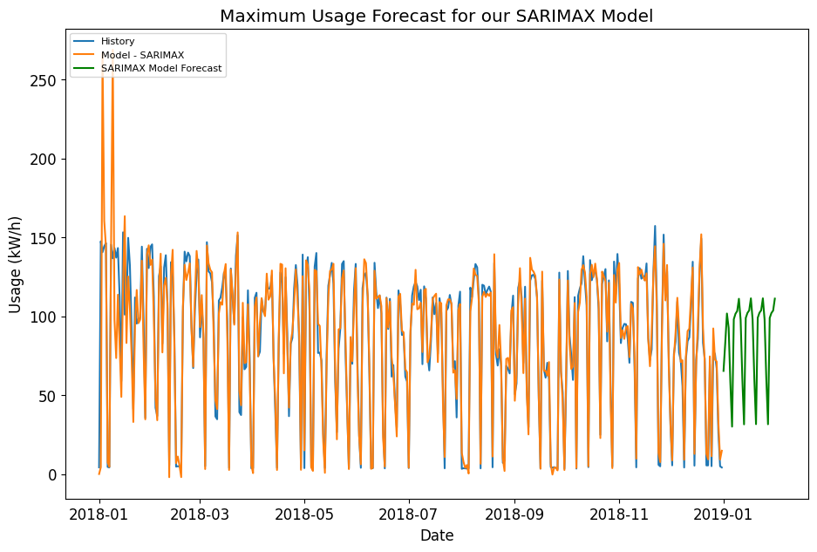
Using a Predictive Model to Forecast CO2, we utilize those predictions to project Future Maximum Usage

Slide 11
Conclusion and Next Steps
Analysis: The data exhibits general trends consistent with Public Working Patterns (hourly, daily, monthly, and yearly on a piecewise multiscale)
Fitted Model: Accurate in Capturing History, but hard to capture extremes without overfitting ( to be further investigated - random or can be modeled)
Predictable Data: Correlated with CO2 expenditure (production) and local events & traditions
Next Steps:
Improve on working model
Compare with other models and methods
Factor in global market demand and related factors
More tests before deployment into usage

