Slide 1

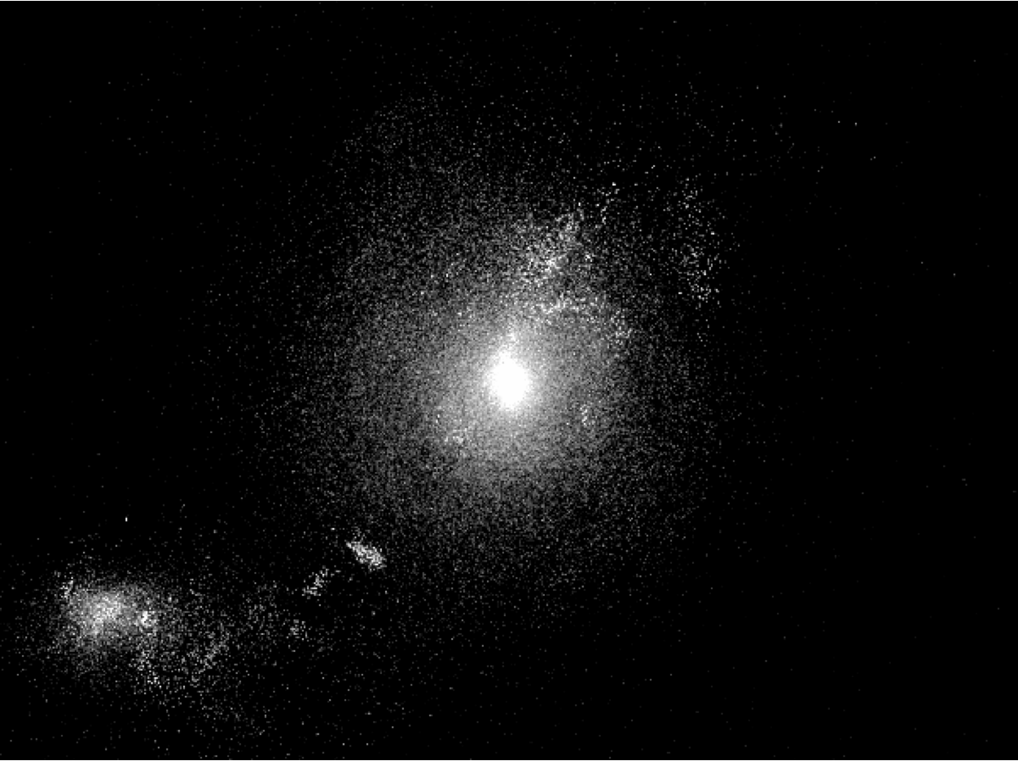
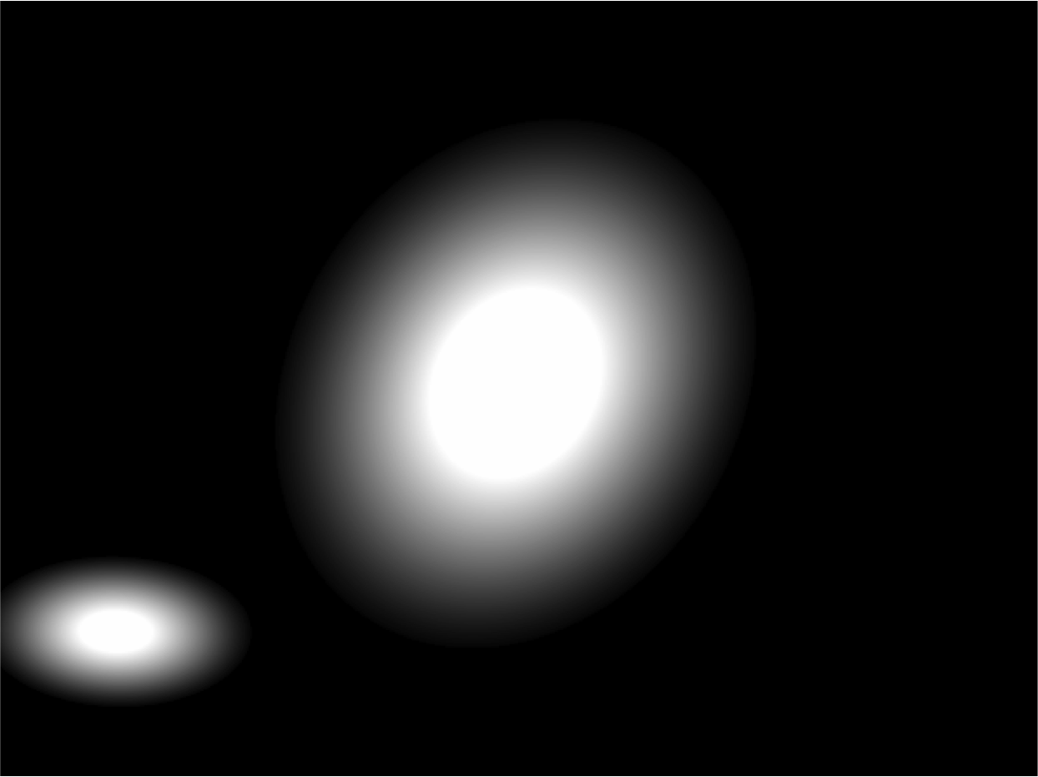
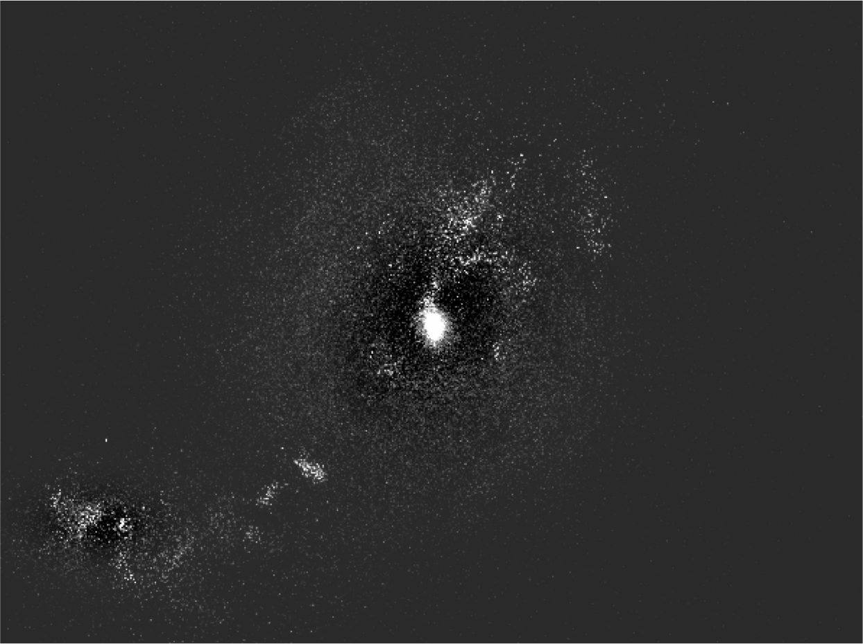
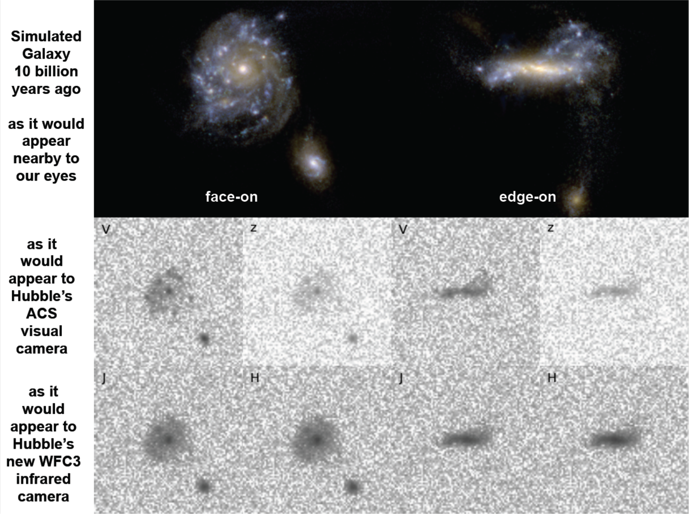
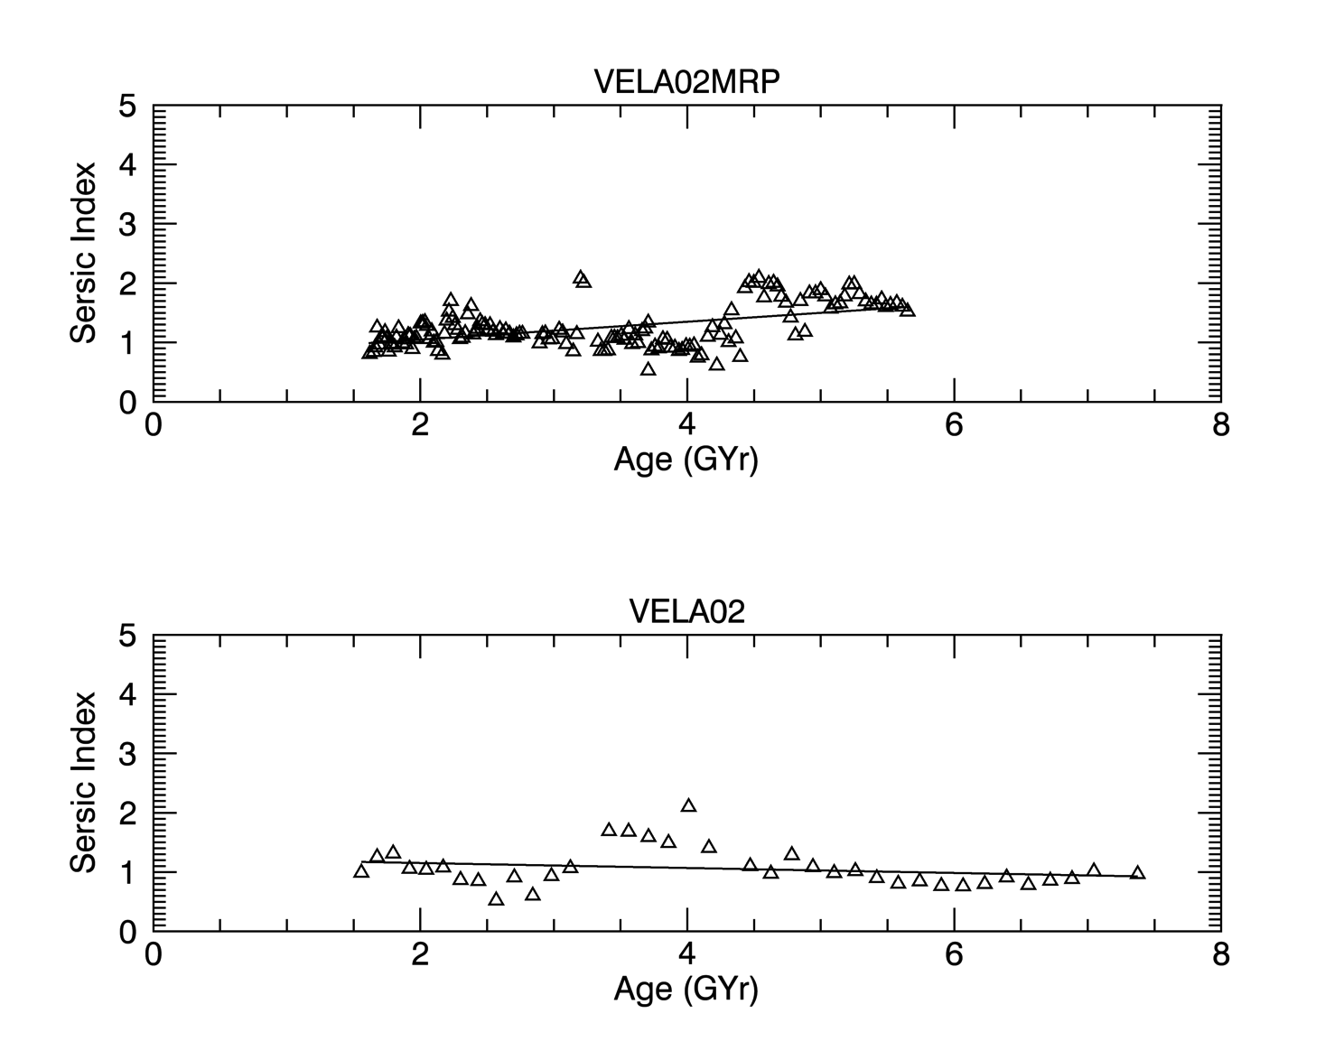
Automating the Analysis of Simulated Galaxies
Ian Tibbetts, Ariunjargal Bat-Erdene, Prof. Elizabeth McGrath
Department of Physics/Astronomy, Colby College, Waterville, ME
ABSTRACT
INTRODUCTION
CHALLENGES
We are automating the process of analyzing the morphology, or structure, of simulated galaxies, so that they can be compared to that of real galaxies as observed by the Hubble Space Telescope. Our goal is to evaluate the quality of the current generation of simulations, and to discover how they can be improved in the future. Achieving accurate simulations of galaxies would provide invaluable details to astronomers that are unattainable from observation alone. Additional data, like multiple viewing angles and accurate mass measurements, would improve our understanding of the physical mechanisms of galaxy formation and upgrade future observations.
Because of the colossal number of images, which consist of several hundred per galaxy, it is important to automate existing tools that are used interactively by astronomers and output their aggregate results. These tools are typically used manually on observed images, but we are running them without human supervision on simulated images to obtain a refined model of the galaxy’s structure. We used the Python programming language, taught at Colby, to accomplish that goal. The program runs on an arbitrary set of images and takes advantage of parallel computing to improve runtime.
The interdisciplinary nature of this project makes it unique, combining the fields of Computer Science and Physics/Astronomy. It also establishes Colby College as the center of a collaborative work that merges theoretical and observational approaches to understanding galaxy formation and evolution.
There are many aspects of our universe that are well understood, but there is a lot still to be discovered about how galaxies, and the stars within them, evolve over time. We are inspecting galaxy morphology using images produced from fully cosmological, mass based simulations. These simulations are an attempt by theorists in the field to get more information about galaxies as they evolve, and our goal is to measure how well the current simulations match the galaxies that we observe in our sky. This will allow us to inform future simulations, and eventually achieve a quality that can enhance our ability to understand observations made from the Earth. We have hundreds of pictures of each galaxy at various times in its simulated life, from different camera angle and using different filters. The sheer number of images means that we have to automate the modeling of the galaxies depicted and the collecting of results, which is the task of this summer research project.
Locating the galaxies in an image was initially a challenge, but replacing IRAF with Source-Extractor helped with that problem. We are still working on calibrating Source-Extractor’s configuration file so that it works well on all images, meaning that it finds only the existing galaxies. Another challenge is the runtime, which is multiple hours for a single galaxy, even when run in parallel on a cluster of 12 computers. The parallel algorithm could be improved, but most of the time is spent by GALFIT while fitting models to the galaxies in the image.
Original
Model
CONTINUED WORK
Residual
Figure 1. An example image of a simulated galaxy (left) followed by the elliptical model produced by our program running GALFIT (right) and finally the residual (bottom), which is the original with the model subtracted. The center galaxy may need a two component fit, which can be seen in the residual by the bright spot remaining in the middle that indicates its bulge wasn’t well fit.
The Source-Extractor configuration file needs to be modified to yield good results for a higher percentage of images, or possibly the program needs to define separate configuration files depending on galaxy age. Once refined, these guesses can be sent through GALFIT and the aggregate data can be used to inspect how well different simulations match observation.
METHODS
RESULTS
We are using the Source-Extractor and GALFIT astronomy tools to automatically fit elliptical models to the galaxies contained in an image produced by simulation. A Python program mediates user input and organizes the resulting files to enable batch fitting of many images. Source-Extractor locates the galaxies in an image and makes some initial guesses about its properties, which are written to a parameter file that is used to run GALFIT. The final output is a file containing the original image, followed by the refined GALFIT model of all the galaxies contained and finally the residual between the two. In the case where one galaxy needs a two component fit for its disk and bulge, the result of the first run is used to write a new parameter file and GALFIT has another opportunity to fit the image, now with the additional component. This and other behaviors are controlled by command line options, giving the user control over the programs behavior.
Our current Python program has a powerful and consistent interface with the user on the command line, enabling the user to control options like running it either in parallel or serially, fitting a bulge component, etc. It accepts an arbitrarily long list of simulation images and produces good models for most of them. We haven’t gotten to the point where we evaluate simulations against observations, but we have made progress towards that goal and produced a program as a strong foundation for future research.
CONCLUSIONS
Having simulations of galaxies over time that are shown to agree well with what we know from observation would be a powerful tool for astronomers. The simulations provide a level of detail that would be otherwise unachievable, but first these simulations need to be shown to match closely with reality. This internship has successfully laid a foundation for future research towards that end, and future generations of simulation may aid our understanding of galaxy formation and of our own cosmic origin.
ACKNOWLEDGMENTS
Prof. McGrath, our project supervisor
TODO: Grant, for their support
Colby College, for sharing their facilities
TODO: Santa Cruz Group, for providing the excellent simulations
Figure 2. VELA27, a simulated galaxy, from two different viewing angles.
Figure 3. A simulated galaxy’s Sersic index plotted over time, a typical result.

