Slide 1

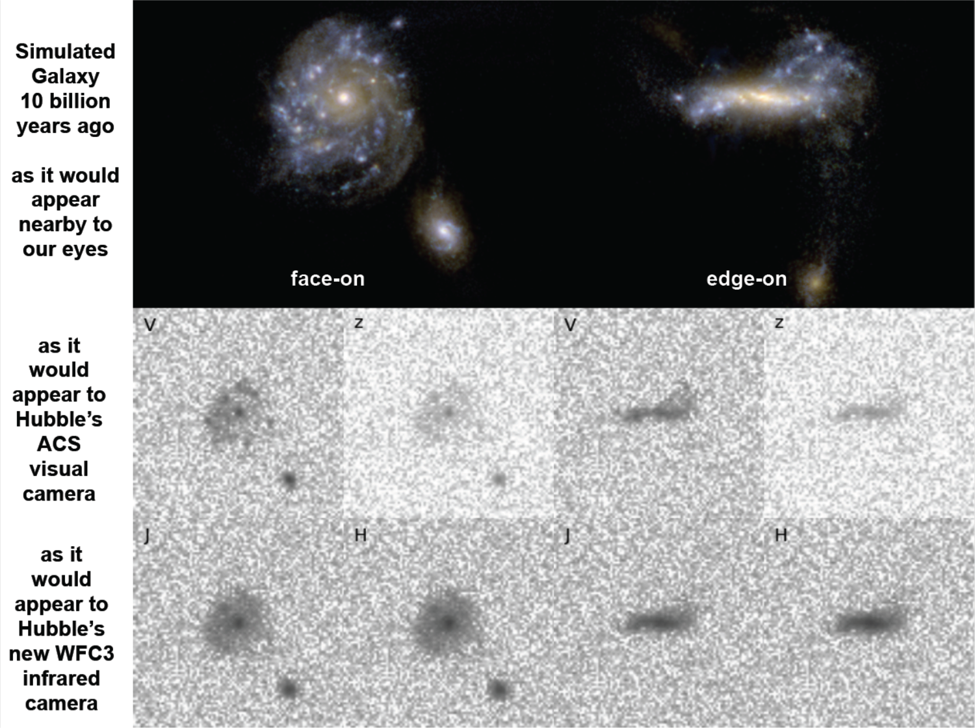
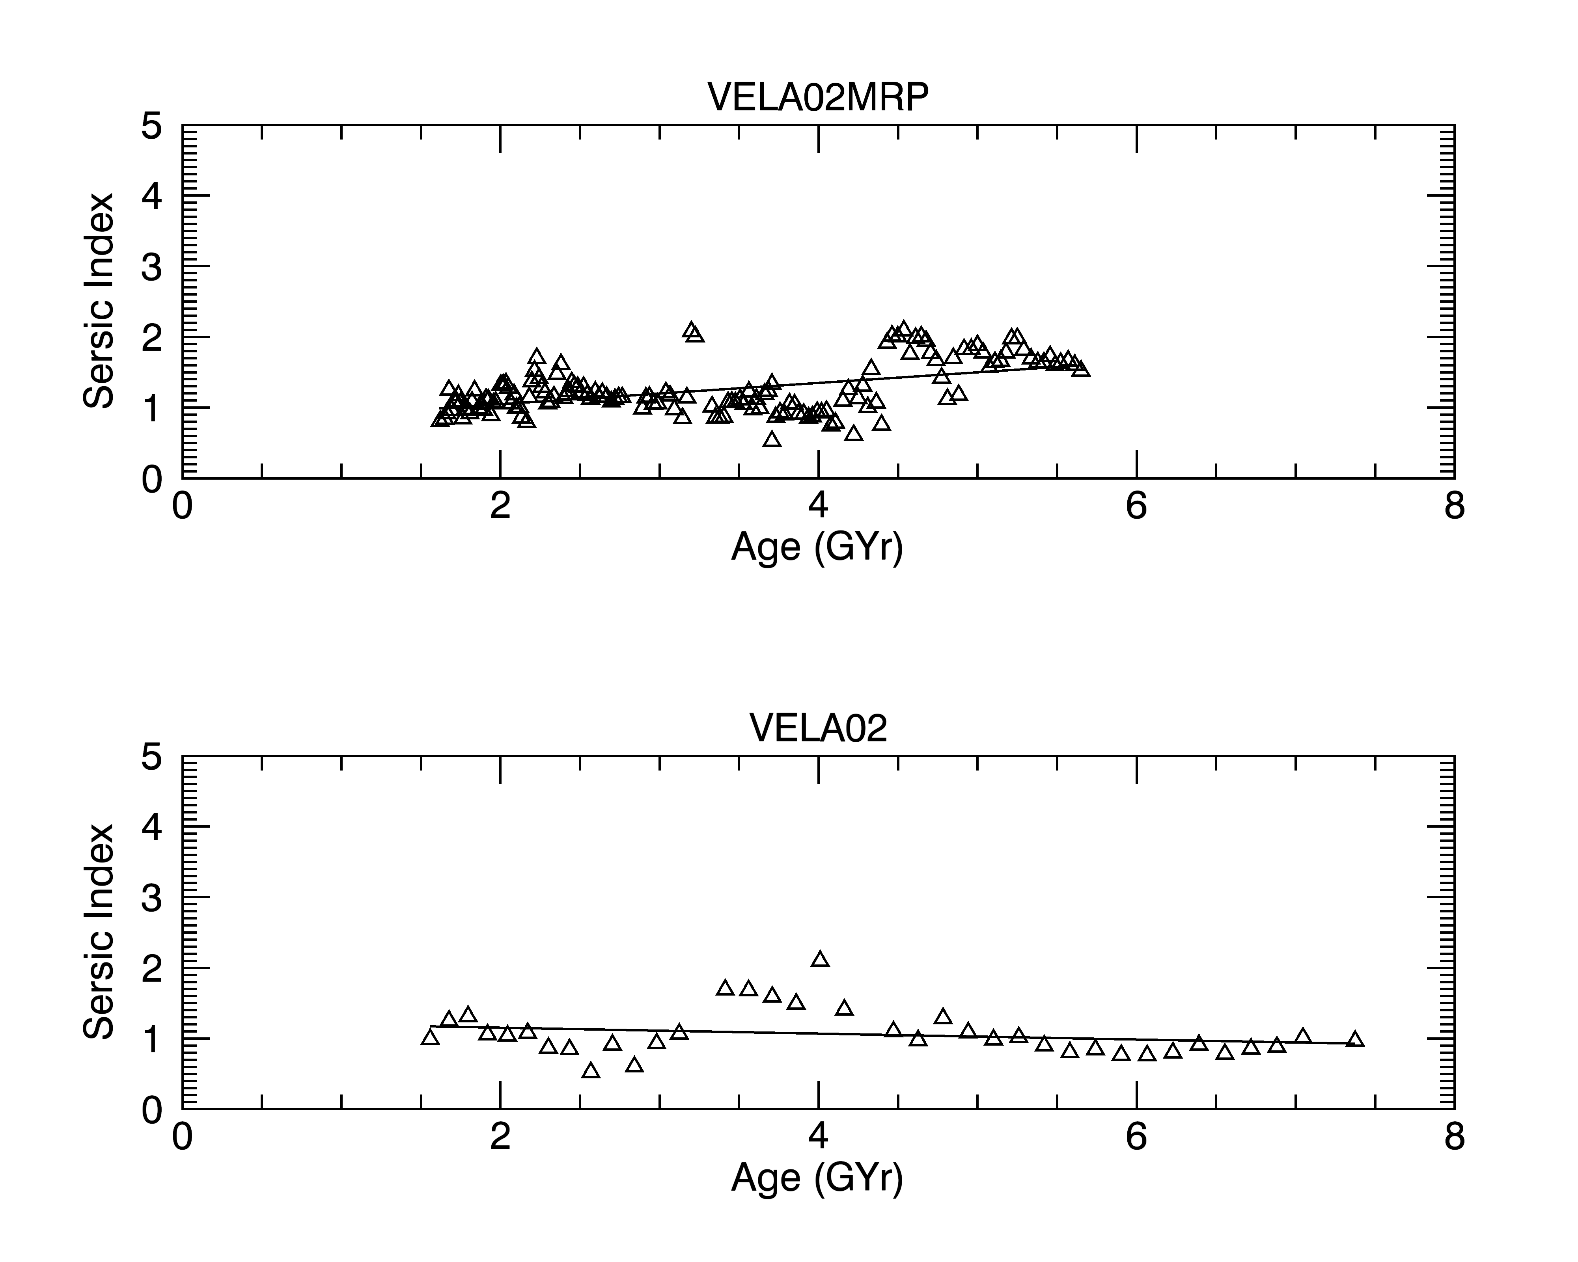
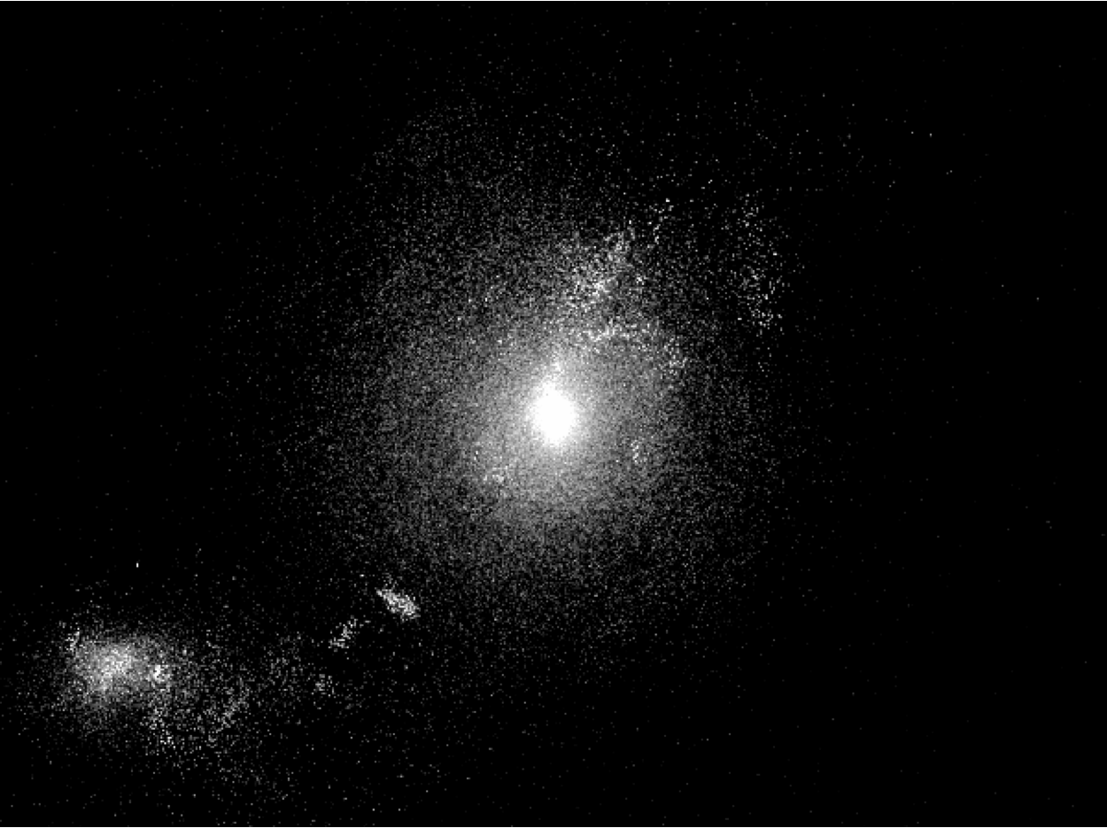
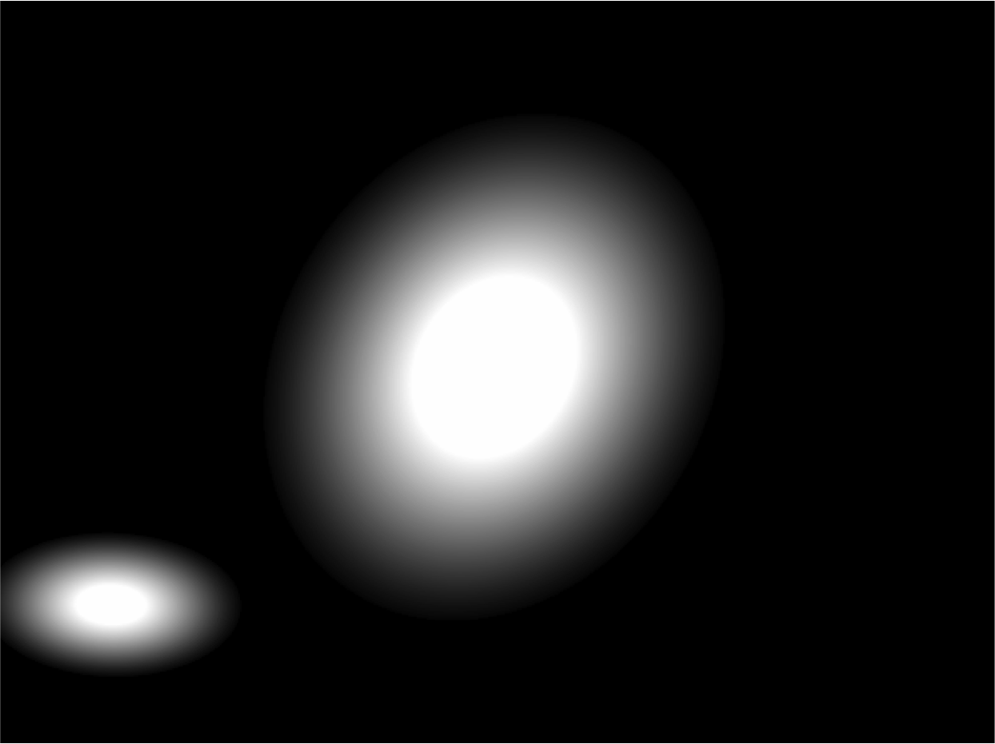
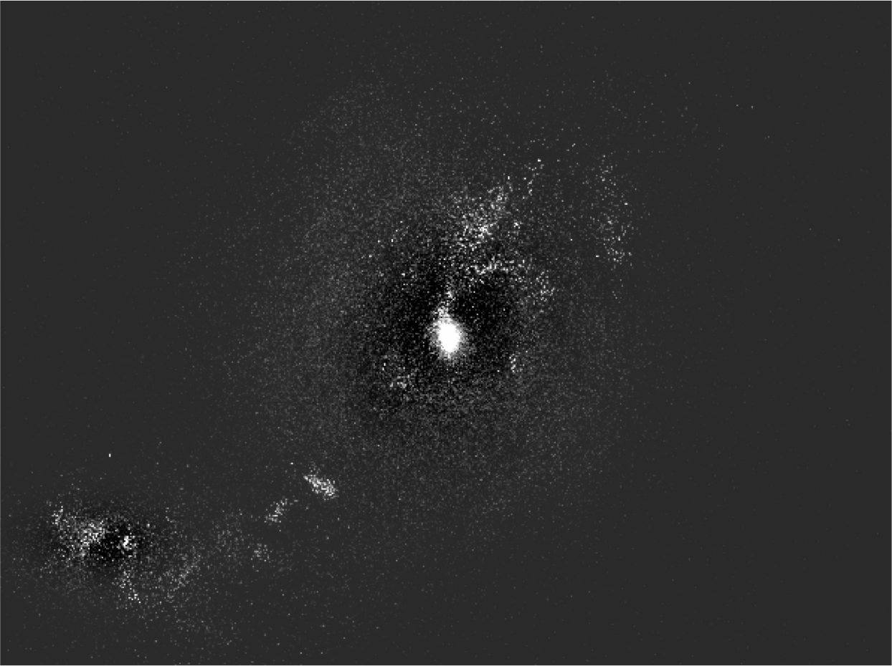
Automating the Analysis of Simulated Galaxies
Ian Tibbetts, Ariunjargal Bat-Erdene – Department of Physics/Astronomy
Abstract
Methods
Challenges
We are automating the process of analyzing the morphology, or structure, of simulated galaxies, so that they can be compared to that of real galaxies as observed by the Hubble Space Telescope. Our goal is to evaluate the quality of the current generation of simulations, and to discover how they can be improved in the future. Achieving accurate simulations of galaxies would provide invaluable details to astronomers that are unattainable from observation alone. Additional data, like multiple viewing angles and accurate mass measurements, would improve our understanding of the physical mechanisms of galaxy formation and upgrade future observations.
Because of the colossal number of images, which consist of several hundred per galaxy, it is important to automate existing tools that are used interactively by astronomers and output their aggregate results. These tools are typically used manually on observed images, but we are running them without human supervision on simulated images to obtain a refined model of the galaxy’s structure. We used the Python programming language, taught at Colby, to accomplish that goal. The program runs on an arbitrary set of images and takes advantage of parallel computing to improve runtime.
The interdisciplinary nature of this project makes it unique, combining the fields of Computer Science and Physics/Astronomy. It also establishes Colby College as the center of a collaborative work that merges theoretical and observational approaches to understanding galaxy formation and evolution.
We are using the Source-Extractor and GALFIT astronomy tools to automatically fit elliptical models to the galaxies contained in an image produced by simulation. A Python program mediates user input and organizes the resulting files to enable batch fitting of many images. Source-Extractor locates the galaxies in an image and makes some initial guesses about its properties, which are written to a parameter file that is used to run GALFIT. The final output is a file containing the original image, followed by the refined GALFIT model of all the galaxies contained and finally the residual between the two. In the case where one galaxy needs a two component fit for its disk and bulge, the result of the first run is used to write a new parameter file and GALFIT has another opportunity to fit the image, now with the additional component. This and other behaviors are controlled by command line options, giving the user control over the programs behavior.
Locating the galaxies in an image initially, but replacing IRAF with Source-Extractor helped with that problem. We are still struggling with calibrating Source-Extractor’s configuration file so that it works well on all images, finding only the existing galaxies. Another challenge is the runtime, which is multiple hours for a single galaxy, even when run in parallel on a cluster of 12 computers. The parallel algorithm could be improved, but most of the time is spent by GALFIT while fitting models to the galaxies in the image.
Results
The Python program has a powerful and consistent interface with the user on the command line, enabling the user to run it either in parallel or serially. It accepts an arbitrarily long list of simulation images and produces good models for most of them. The program is a strong foundation for continued work using GALFIT to fit either simulation or real images in bulk without human interaction.
Figure 1 – VELA27, a simulated galaxy, shown from two different angles. Notice the additional detail in the top images.
Figure 2 – IDL plot of a galaxy’s Sersic Index over time with (top) and without (bottom) radiation pressure.
Continued Work
Introduction
The Source-Extractor configuration file needs to be modified to yield good results for a higher percentage of images, or possibly the program needs to define separate configuration files depending on age. Once refined, these guesses can be sent through GALFIT and the aggregate data can be used to inspect how well different simulations match observation.
There are many aspects of our universe that are well understood, but there is a lot still to be discovered about how galaxies, and the stars within them, evolve over time. We are inspecting galaxy morphology using images produced from fully cosmological, mass based simulations. These simulations are an attempt by theorists in the field to get more information about galaxies as they evolve, and our goal is to measure how well the current simulations match the galaxies that we observe in our sky. This will allow us to inform future simulations, and eventually achieve a quality that can enhance our ability to understand observations made from the Earth. We have hundreds of pictures of each galaxy at various times in its simulated life, from different camera angle and using different filters. The sheer number of images means that we have to automate the modeling of the galaxies depicted and the collecting of results, which is the task of this summer research project.
Original
Model
Residual
Figure 3 – An example image of a simulated galaxy (left) followed by the elliptical model produced by our program running GALFIT (middle) and finally the residual (right), which is the original with the model subtracted. The center galaxy is a candidate for a two component fit, which can be seen in the residual by the bright spot remaining in the middle that indicates its bulge was not fit well.
Conclusion
This is my conclusion. This is my conclusion. This is my conclusion. This is my conclusion. This is my conclusion. This is my conclusion. This is my conclusion. This is my conclusion. This is my conclusion. This is my conclusion. This is my conclusion. This is my conclusion. This is my conclusion. This is my conclusion. This is my conclusion. This is my conclusion. This is my conclusion. This is my conclusion. This is my conclusion. This is my conclusion. This is my conclusion. This is my conclusion. This is my conclusion. This is my conclusion. This is my conclusion. This is my conclusion. This is my conclusion. This is my conclusion. This is my conclusion. This is my conclusion. This is my conclusion. This is my conclusion. This is my conclusion. This is my conclusion. This is my conclusion. This is my conclusion. This is my conclusion. This is my conclusion. This is my conclusion. This is my conclusion. This is my conclusion. This is my conclusion. This is my conclusion. This is my conclusion. This is my conclusion. This is my conclusion. This is my conclusion. This is my conclusion. This is my conclusion. This is my conclusion. This is my conclusion. This is my conclusion.

