Slide 1
R code structure
Case sensitive
MyData is not the same as mydata
Extra spaces don’t matter
col = 10 and col=10 are the same
Most names for things are available
Some function names are taken, such as max or e
You can add “my.” before such as my.max
Quotes are used for character strings
main = “My Title”: the words “My Title” are the title
vs. main = MyTitle: the words stored as MyTitle are the title

Slide 2
R code structure
Assign objects with <- or =
most people use <-
my.num<-12 or my.num=12
# blocks off code for comment or to prevent a line from running
Ctrl+r to run line(s) of code on Windows, Command+Enter on Mac
Highlight multiple lines to run at once
?function() pulls up the help page for the function

Slide 3
Create a script
You can type right into the console to run commands
Good for quick checks
Create/save a script to save your work
Ctrl+n or use the menu to create a new script.
Add a header using a comment (#) to remind you what the code is for without having to run it.

Slide 4
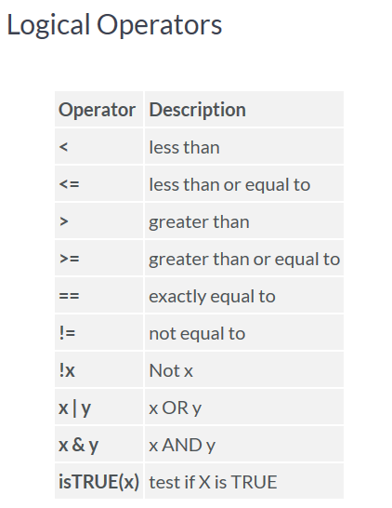
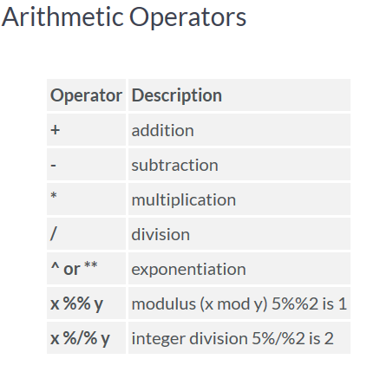
Basice Operators

Slide 5
Types of data
Mode()
Numeric (double)
Integer (whole number)
Character (text)
Factor (category, stored as a number)
E.g. “Temperate”, “Arid”, “Tropical” could look like text but be a factor stored as Temperate = 1, Arid = 2, Tropical = 3
Ordinal (ordered factor)
E.g. “Low”, “Med”, “High” where Low<Med<High
Class()
https://www.statmethods.net/input/datatypes.html

Slide 6
Making random numbers
Use sample() to get random integers
sample(1:20,5,replace=F): sample 5 times from 1 to 20 without replacement
Use runif () (Note: that’s random uniform not run if) for random numbers (not integers)
runif(5, min=0, max=10): 5 random numbers between 0 and 10
Use rnorm() for random numbers from the normal distribution
rnorm(5,mean=0,sd=1)

Slide 7
Reading in existing data

Slide 8
Setting working directory
Your working directory is where R looks for and saves data
Usually is a folder on your computer
Use setwd() to set the working directory
setwd(“D:/Documents/Teaching/IntroR”)
Notice R uses “/” not “\” like when you copy a file location from Windows

Slide 9
Reading in data
Commonly, data stored in Excel
From Excel, save as Comma Separated Values (.csv) file
In R, use read.csv() to read in the data
Make sure you assign it!
Use header=T if the first row has column names
My.trees <- read.csv(“treesR.csv”,header=T)
Use read.table for general table types, such as tab separated
Read.table(“treesR.csv”,header=T,sep=“,”)
sep=“,” for comma, “\t” for tab, etc.

Slide 10
View data
If it’s too big to see the whole thing at once, use head() or tail()
head(my.trees,n) pulls up the first n rows
tail(my.trees,n) pulls up the last n rows
As with matrices, use dim() to see the size
Use summary() to give info about the data
Use str() to give info about the data structure
Notice a lot of times text can get read in as factor
Use colnames() to get the column names of the dataset

Slide 11
Select part of the data
Use [rows,columns] after the object name
Leave either blank if you want both
My.trees[,”OAK”]: select my.trees column called “OAK”
My.trees[,4]: select my.trees, column 4
My.trees[4,5]: select my.trees, row 4, column 5
Use [n] after to get the nth element in that column
My.trees[,4][5]: select the 5th element in column 4 of my trees (same as my.trees[5,4])
Use $ in data frames that have column names
My.trees$MAPLE: selects the column called “MAPLE”

Slide 12
Save data
Use write.csv() or write.table() like reading in
Make sure you don’t overwrite an existing file
My.trees2<-my.trees$OAK
Write.csv(my.trees2,“treesR_new.csv”)

Slide 13
Data Exploration

Slide 14
Central Tendency
Mean- sum of all values divided by the number of values in the data set
mean(vector)
Median- middle value
median(vector)
Mode- most commonly occurring value

Slide 15
Variation
Range- lowest and highest values in a data set
range(vector)
Variance- average of the squared differences from the mean
var(vector)
Standard deviation- square root of the variance
sd(vector)
Standard error- standard deviation divided by the square root of the sample size

Slide 16
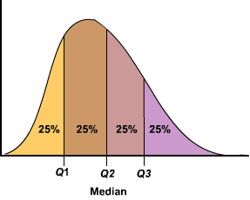
Quantiles
Cutpoints dividing a variable into equal intervals
quartiles (0.25, 0.5, 0.75)
quantile(vector, prob)

Slide 17
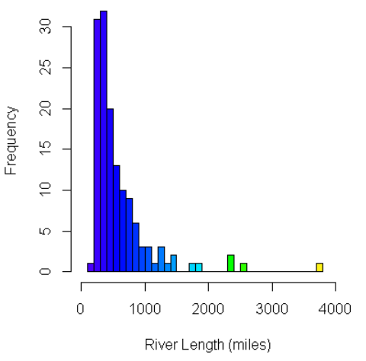
Histogram
Graphical representation of the distribution of numerical data
hist(vector, breaks)

Slide 18
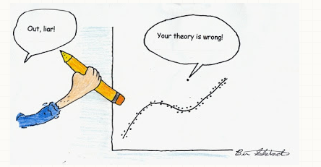
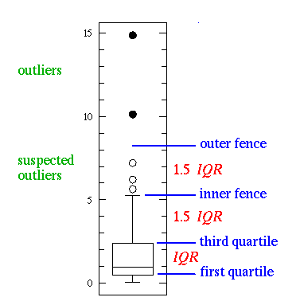
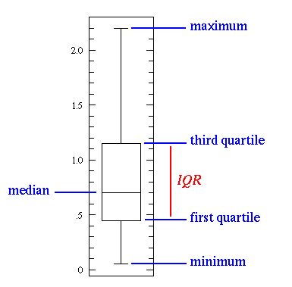
Box Plot
Box plot- a.k.a. box and whisker plot
boxplot(vector)

Slide 19
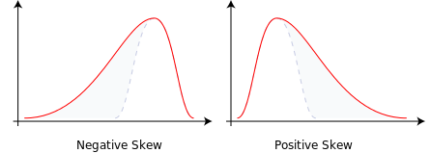
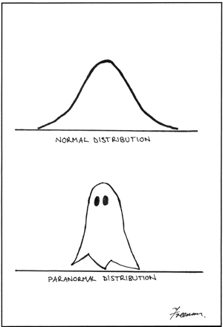
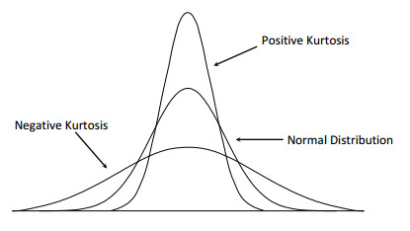
Normality
Skewness- measure of the assymetry of a distribution
normal=0
skewness(vector) #moments package
Kurtosis- measure of the shape of a distribution
normal = 3
kurtosis(vector)#moments package
Shapiro-Wilk test
shapiro.test(vector)

Slide 20
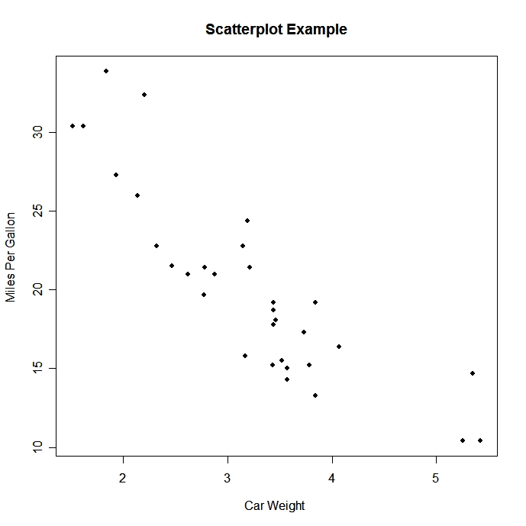
Scatter Plot
Shows relationship between two sets of data
plot(x,y )

Slide 21
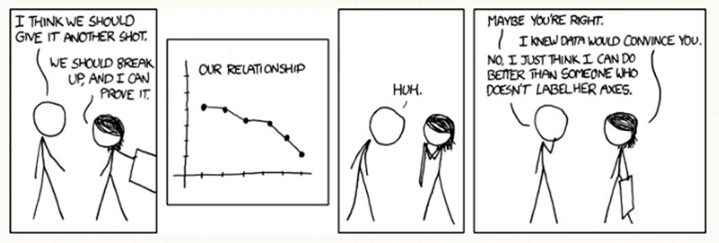
Standardization
Variable rescaled to have a mean of zero and standard deviation of one
a.k.a. z-score
For each value subtract the mean and divide by the standard deviation
scale(vector)

Slide 22
Data visualization

Slide 23
Scatter plot
plot(x, y)or plot(y~x)
x: explanatory variable
y: response variable
x and y should be continuous variable

Slide 24
Boxplot
boxplot(y~x)
y: continuous variable
x: group

Slide 25
Barplot
barplot(x)
x: height

Slide 26
Saving the graphics
pdf(“file location”, width=7, height=4) # Start new device
par(mfrow=c(1,2)) # panel figures
plot() # plot
dev.off() # Terminate the device

Slide 27
Statistics
Correlations
Linear regressions/ANOVA
Clustering techniques
“For” loops
Apply functions

Slide 28
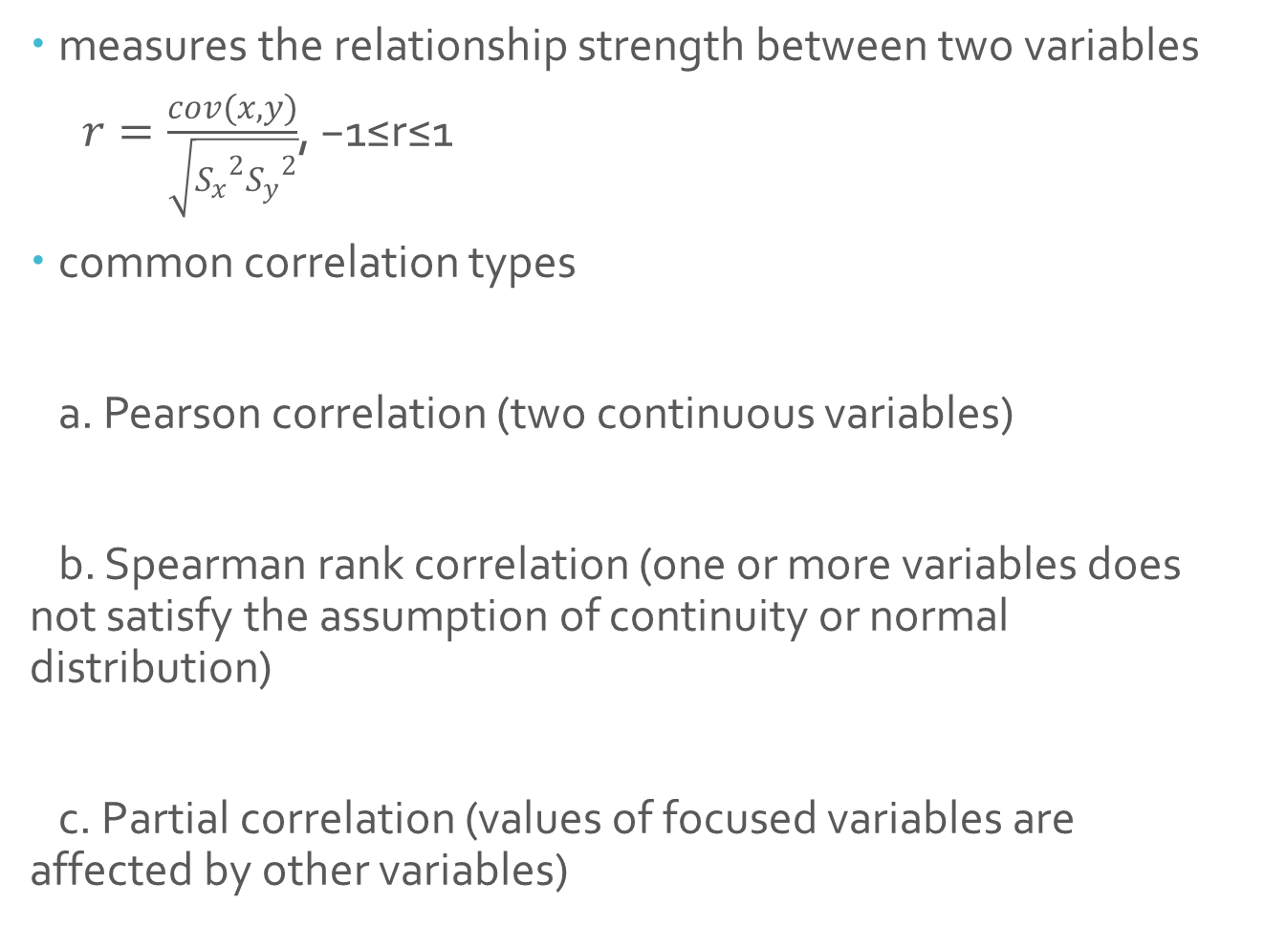
Correlations
measures the relationship strength between two variables
$r=\frac{cov(x,y)}{\sqrt{{S_{x}}^{2}{S_{y}}^{2}}}$, −1≤r≤1
common correlation types
a. Pearson correlation (two continuous variables)
b. Spearman rank correlation (one or more variables does not satisfy the assumption of continuity or normal distribution)
c. Partial correlation (values of focused variables are affected by other variables)

Slide 29
Correlations
Pearson correlation and Spearman rank correlation in R
Usage: cor(x, y = NULL, use = "everything",
method = c("pearson", "kendall", "spearman"))
Default: cor(x,y) ###pearson correlation
cor.test(x, y, alternative = c("two.sided", "less", "greater"),
method = c("pearson", "kendall", "spearman"),
exact = NULL, conf.level = 0.95, continuity = FALSE, …)

Slide 30
Regressions
Regression analysis is a statistical method for estimating the relationships between dependent (responsive) variable and independent (explanatory) variables. There could be more than one independent variables.
What you need to know before performing a regression analysis: data, variables, models.
Common regression analysis:
bivariate regression
multiple regression
linear regression
polynomial regression
piecewise regression
non-linear regression
…

Slide 31
Regressions
Linear regression and maximum likelihood estimates
y=ax+b (a: slope, b: intercept)
assumption: y residuals, which are the differences between measured and model predicted y values, are normally distributed.
The method of least squares gives the maximum likelihood estimates.
Usage: lm(formula, data, subset, weights, na.action, method = "qr", model = TRUE, x = FALSE, y = FALSE, qr = TRUE, singular.ok = TRUE, contrasts = NULL, offset, ...)
Default form: lm(y~x)
##### linear regression model of ozone level with temperature
data <- read.csv('ozone.csv', header=T)
x <- data [,5] ## temperature
y <- data [,2] ## ozone level
lm(y~x) ## linear model regression
summary(lm(y~x)) ## summarize all results of the linear model regression
plot(x,y, xlab=“temperature”, ylab=“ozone” ) ## plot the data
abline(lm(y~x)) ##include the regression line in the plot

Slide 32
Regressions
> summary(lm(y~x)) ## summarize all results of the linear model regression
Call:
lm(formula = y ~ x)
Residuals:
Min 1Q Median 3Q Max
-40.922 -17.459 -0.874 10.444 118.078
Coefficients:
Estimate Std. Error t value Pr(>|t|)
(Intercept) -147.6461 18.7553 -7.872 2.76e-12 ***
x 2.4391 0.2393 10.192 < 2e-16 ***
---
Signif. codes: 0 ‘***’ 0.001 ‘**’ 0.01 ‘*’ 0.05 ‘.’ 0.1 ‘ ’ 1
Residual standard error: 23.92 on 109 degrees of freedom
Multiple R-squared: 0.488, Adjusted R-squared: 0.4833
F-statistic: 103.9 on 1 and 109 DF, p-value: < 2.2e-16

Slide 33
ANOVA (Analysis of Variance)
Idea: compare two or more means through their variances
Explanatory variables are categorical
Each variable is a factor, which has two or more levels
A single factor ANOVA also called one-way ANOVA
Student t test can be viewed as a special form of ANOVA for a single factor of 2 levels
Usage: aov(formula, data = NULL, projections = FALSE, qr = TRUE, contrasts = NULL, …)
You can also use the R function anova ( )

Slide 34
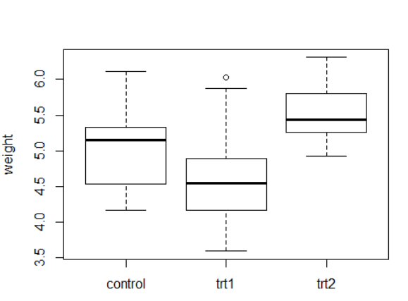
ANOVA (Analysis of Variance)
##### compare the impact of different treatments on plant growth
rm(list=ls(all=TRUE))
data<-read.csv('plant weight.csv', header=T)
y<-data[,3]
trt<-data[,2]
plot(trt,y,names=c("control","trt1","trt2"), ylab="weight")
summary(aov(y~trt))
> summary(aov(y~trt))
Df Sum Sq Mean Sq F value Pr(>F)
trt 2 3.766 1.8832 4.846 0.0159 *
Residuals 27 10.492 0.3886
---
Signif. codes: 0 ‘***’ 0.001 ‘**’ 0.01 ‘*’ 0.05 ‘.’ 0.1 ‘ ’ 1

Slide 35
Cluster analysis
one type of multivariate statistics without a responsive variable
instead, we look for structure in data
cluster analysis look for groups in data
three ways to allocate individuals to groups - partitioning, hierarchical, and discriminant analysis

Slide 36
Cluster analysis
Hierarchical cluster analysis
to show which of a set of samples are most similar to one another, and to group those similar samples in the same limb of a tree.
Usage: d <- dist(data, method=”euclidean”) # find distance matrix hc <- hclust(d, method=”complete”) # apply hirarchical clustering plot(hc) # plot the dendrogram

Slide 37
Cluster analysis
Example: use body weight and brain size to cluster animals
rm(list=ls(all=TRUE))
data<-read.csv('weight.csv', header=T, row.name=1)
d<-dist(data,method="euclidean")
hc<-hclust(d,method="complete")
plot(hc)

Slide 38
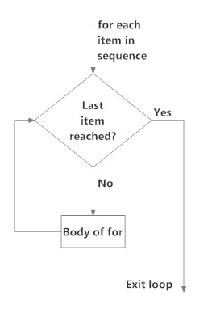
“For” loops
Description: Performs the same task a specific number of times using elements in a sequence.
Structure of “for” loops
for (element in sequence) {
task
}

Slide 39
Apply functions
apply
by
eapply
lapply
mapply
tapply
Apply Functions Over Array Margins
Apply a Function to a Data Frame Split by Factors
Apply a Function Over Values in an Environment
Apply a Function over a List or Vector
Apply a Function to Multiple List or Vector Arguments
Apply a Function Over a Ragged Array

Slide 40
apply()
Description: Returns a vector or array or list of values obtained by applying a function to margins of an array or matrix.
apply(matrix, margin, function)
1 (row) or 2 (column)
Name of matrix
Function

Slide 41
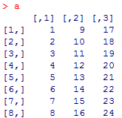
apply()
Example
Create matrix
a = matrix(c(1:24), nrow = 5 , ncol = 3)

Slide 42

apply()
Calculate means for rows
apply(a, 1, mean)
Calculate means for columns
apply(a, 2, mean)

Slide 43
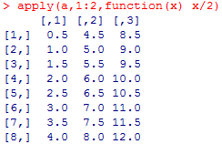
apply()
Divide all numbers by 2
apply(a, 1:2, function(x) x/2)

Slide 44
lapply()
Description: Returns a list of the same length as list X, each element of which is the result of applying a function to a list X.
lapply(list, function)
Function
Name of list

Slide 45
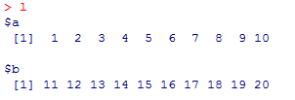
lapply()
Example
Create list
l = list(a= 1:10, b = 11:20)

Slide 46


lapply()
Calculate means of elements a and b of list l
lapply(l, mean)
Calculate sum of elements a and b of list l
lapply(l, sum)

Slide 47
tapply()
Description: Apply a function to a set of values grouped by a selected factor in a data frame.
A dataset that can be broken up into groups
You want to break it up into groups
Within each group, you want to apply a function
tapply(summary variable, grouping variable, function)
Variable used to group dataset
Variable onto which apply function
Function

Slide 48
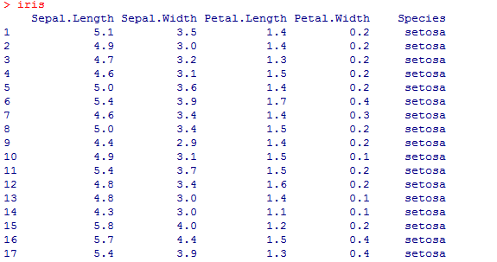
tapply()
Example
Download dataset
data(iris)
attach(iris)

Slide 49


tapply()
Obtain mean petal length for each species
tapply(Petal.Length, Species, mean)
Obtain maximum petal length for each species
tapply(Petal.Length, Species, max)

