Slide 1
The influence of change of temperature on flowering date
Zhikai Yang
08/18/2017
Data from Phenology

Slide 2
Why study this?

Slide 3
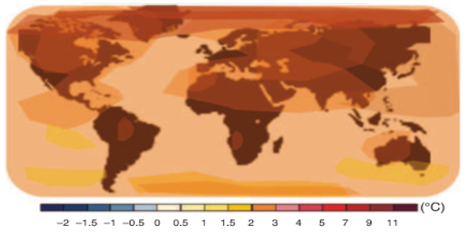
Temperature Change
Predicted average shift in surface temperature.
Color scales denotes the decrease or the increase in temperature (IPCC 2014).

Slide 4
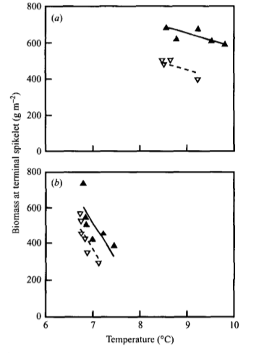
The result of rising temperature is shortened development stages and yield loss
The rising temperature induces early flowering and shortens the development stages. The biomass of spikelet of winter wheat is decreasing with temperature rising.(Wheeler et al.1996)

Slide 5
Is temperature really rising?

Slide 6
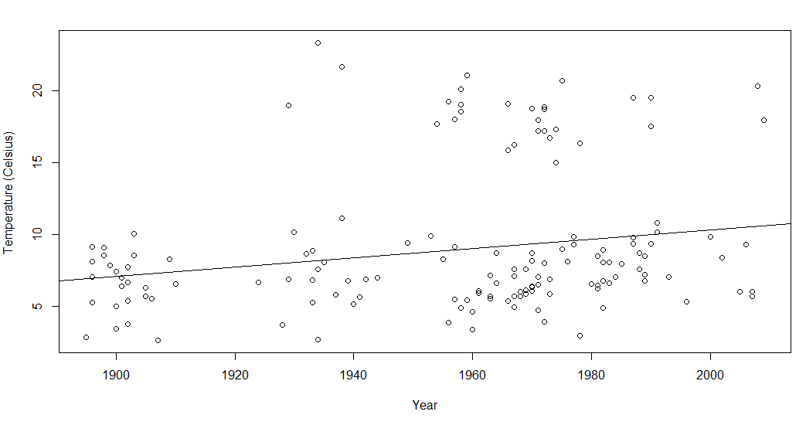
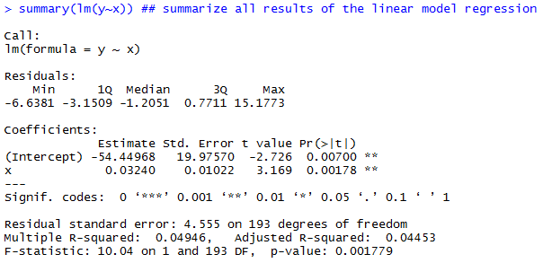
Yes

Slide 7
Interesting code
############regression between year and mean temperature for a year################
rm(list=ls(all=TRUE)) ##clean the memory
PS<-read.csv("PS.csv",header=T)
yearmean<-as.data.frame(tapply(PS$Temperature..Celsius.,PS$Year,mean))
yearmean$year<-rownames(yearmean)
colnames(yearmean)[1]<-"mean"
x <- as.numeric(yearmean$year) ## Year
y <- as.numeric(yearmean$mean) ## Temperature
lm(y~x) ## linear model regression
summary(lm(y~x)) ## summarize all results of the linear model regression
plot(x,y, xlab="Year", ylab="Temperature (Celsius) " ) ## plot the data
abline(lm(y~x)) ##include the regression line in the plot

Slide 8
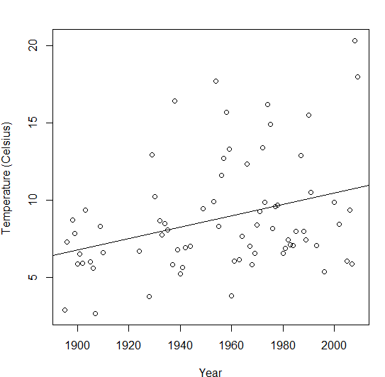
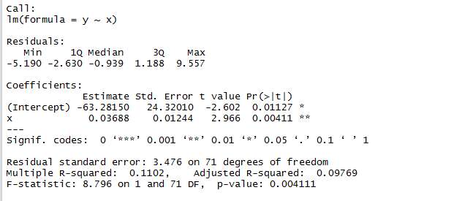
Regression between year and mean temperature for a year

Slide 9
Does rising temperature really induce early flowering?

Slide 10
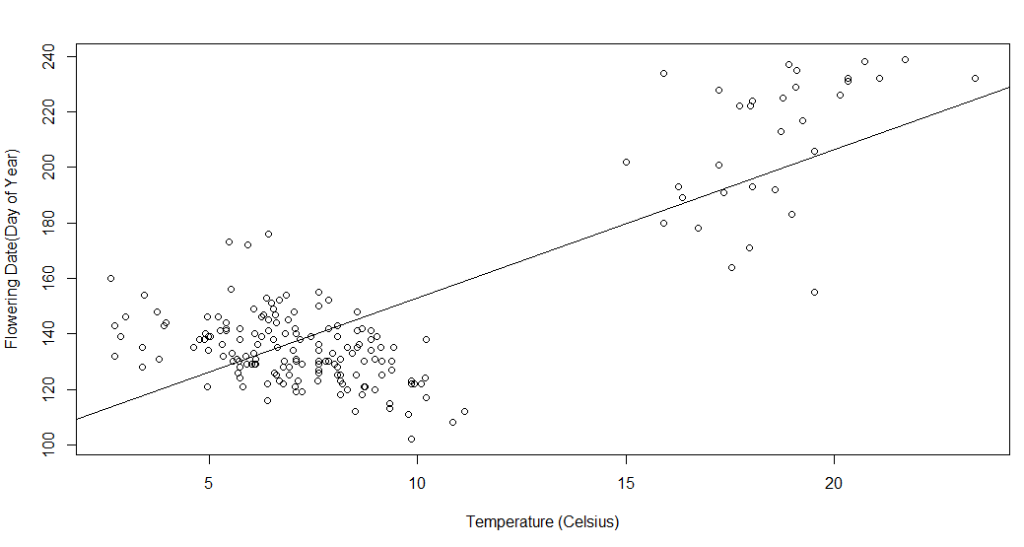
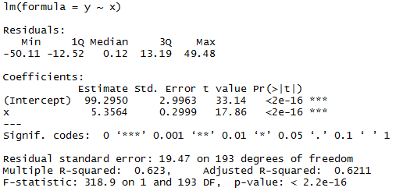
Oops, this is strange

Slide 11
There is clearly separation between data points, which denotes that plant responds differently to different temperature range.

Slide 12
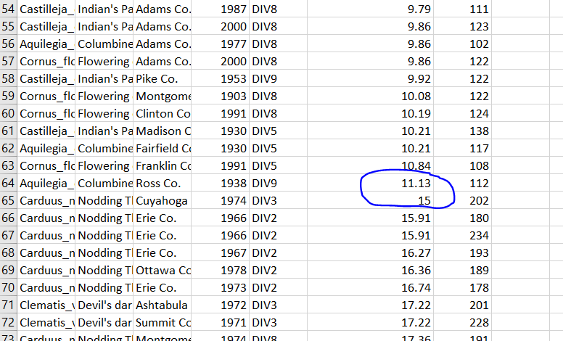
Use Excel to process data
So, I separate the data into low temperature range(<12.5) and high temperature range(>12.5), and create two files LT.csv and HT.csv

Slide 13
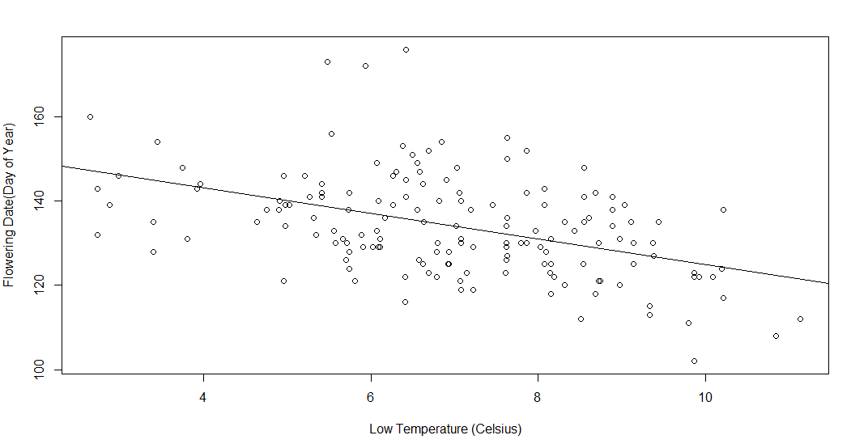
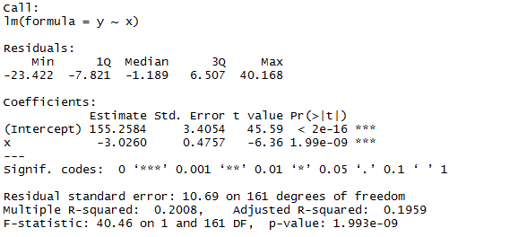
Rising temperature(LT) induces earlier flowering

Slide 14
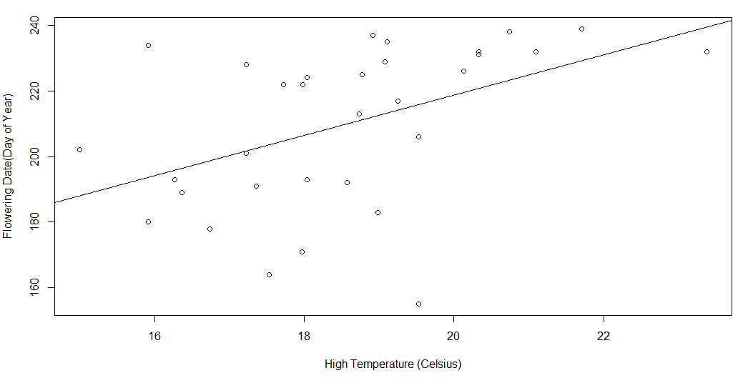
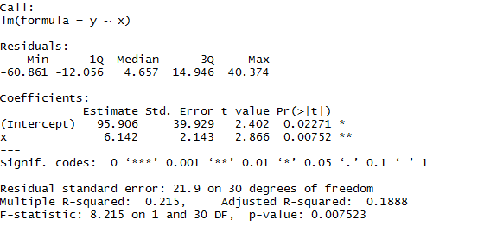
Rising temperature(HT) induces later flowering

Slide 15
Possible Reasons
Different temperature range induces different physiological reponses.
Different species have different flowering date response.

Slide 16
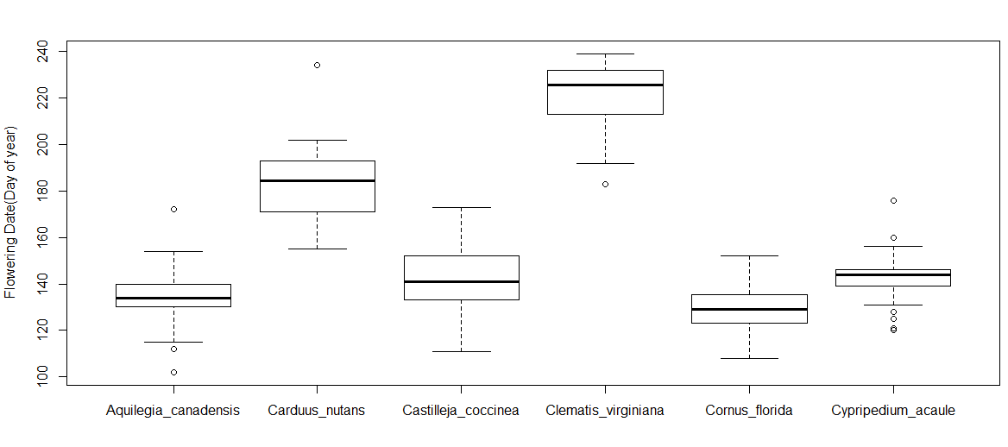

ANOVA of different species and flowering date

Slide 17
Conclusion
1.The temperature is increasing
2.Different temperature range has different impact on flowering date:
a.Rising temperature(low temperature range) induces earlier flowering;
b.Rising tempe.rature(high temperature range) induces later flowering.
3.Different species have different flowering date.

