Slide 1
R code structure
Case sensitive
MyData is not the same as mydata
Extra spaces don’t matter
col = 10 and col=10 are the same
Most names for things are available
Some function names are taken, such as max or e
You can add “my.” before such as my.max
Quotes are used for character strings
main = “My Title”: the words “My Title” are the title
vs. main = MyTitle: the words stored as MyTitle are the title

Slide 2
R code structure
Assign objects with <- or =
most people use <-
my.num<-12 or my.num=12
# blocks off code for comment or to prevent a line from running
Ctrl+r to run line(s) of code on Windows, Command+Enter on Mac
Highlight multiple lines to run at once
?function() pulls up the help page for the function

Slide 3
Create a script
You can type right into the console to run commands
Good for quick checks
Create/save a script to save your work
Ctrl+n or use the menu to create a new script.
Add a header using a comment (#) to remind you what the code is for without having to run it.

Slide 4
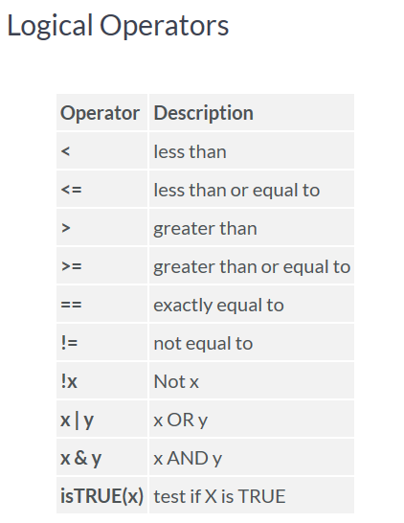
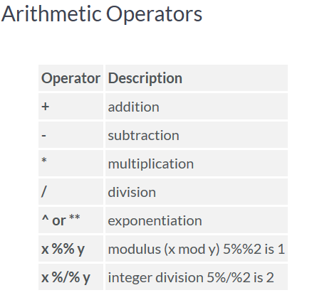
Basice Operators

Slide 5
Types of data
Mode()
Numeric (double)
Integer (whole number)
Character (text)
Factor (category, stored as a number)
E.g. “Temperate”, “Arid”, “Tropical” could look like text but be a factor stored as Temperate = 1, Arid = 2, Tropical = 3
Ordinal (ordered factor)
E.g. “Low”, “Med”, “High” where Low<Med<High
Class()
https://www.statmethods.net/input/datatypes.html

Slide 6
Making random numbers
Use sample() to get random integers
sample(1:20,5,replace=F): sample 5 times from 1 to 20 without replacement
Use runif () (Note: that’s random uniform not run if) for random numbers (not integers)
runif(5, min=0, max=10): 5 random numbers between 0 and 10
Use rnorm() for random numbers from the normal distribution
rnorm(5,mean=0,sd=1)

Slide 7
Reading in existing data

Slide 8
Setting working directory
Your working directory is where R looks for and saves data
Usually is a folder on your computer
Use setwd() to set the working directory
setwd(“D:/Documents/Teaching/IntroR”)
Notice R uses “/” not “\” like when you copy a file location from Windows

Slide 9
Reading in data
Commonly, data stored in Excel
From Excel, save as Comma Separated Values (.csv) file
In R, use read.csv() to read in the data
Make sure you assign it!
Use header=T if the first row has column names
My.trees <- read.csv(“treesR.csv”,header=T)
Use read.table for general table types, such as tab separated
Read.table(“treesR.csv”,header=T,sep=“,”)
sep=“,” for comma, “\t” for tab, etc.

Slide 10
View data
If it’s too big to see the whole thing at once, use head() or tail()
head(my.trees,n) pulls up the first n rows
tail(my.trees,n) pulls up the last n rows
As with matrices, use dim() to see the size
Use summary() to give info about the data
Use str() to give info about the data structure
Notice a lot of times text can get read in as factor
Use colnames() to get the column names of the dataset

Slide 11
Select part of the data
Use [rows,columns] after the object name
Leave either blank if you want both
My.trees[,”OAK”]: select my.trees column called “OAK”
My.trees[,4]: select my.trees, column 4
My.trees[4,5]: select my.trees, row 4, column 5
Use [n] after to get the nth element in that column
My.trees[,4][5]: select the 5th element in column 4 of my trees (same as my.trees[5,4])
Use $ in data frames that have column names
My.trees$MAPLE: selects the column called “MAPLE”

Slide 12
Save data
Use write.csv() or write.table() like reading in
Make sure you don’t overwrite an existing file
My.trees2<-my.trees$OAK
Write.csv(my.trees2,“treesR_new.csv”)

