Slide 1
Teledyne and UNL
Nov. 11, 2024

Slide 2
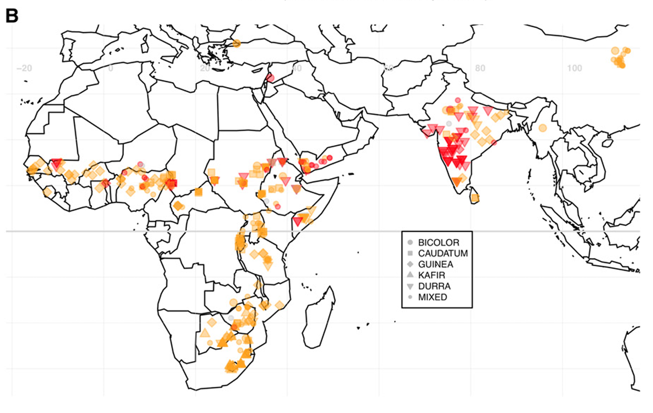
Longitudinal Adaptation of Sorghum
Sorghum was domesticated in East Sudan and spread across many tropical regions longitudinally.
We have n=400 lines with years of genotype, phenotype, and RNA-seq datasets
We can select a subset based on the longitude, i.e., n=10

Slide 3
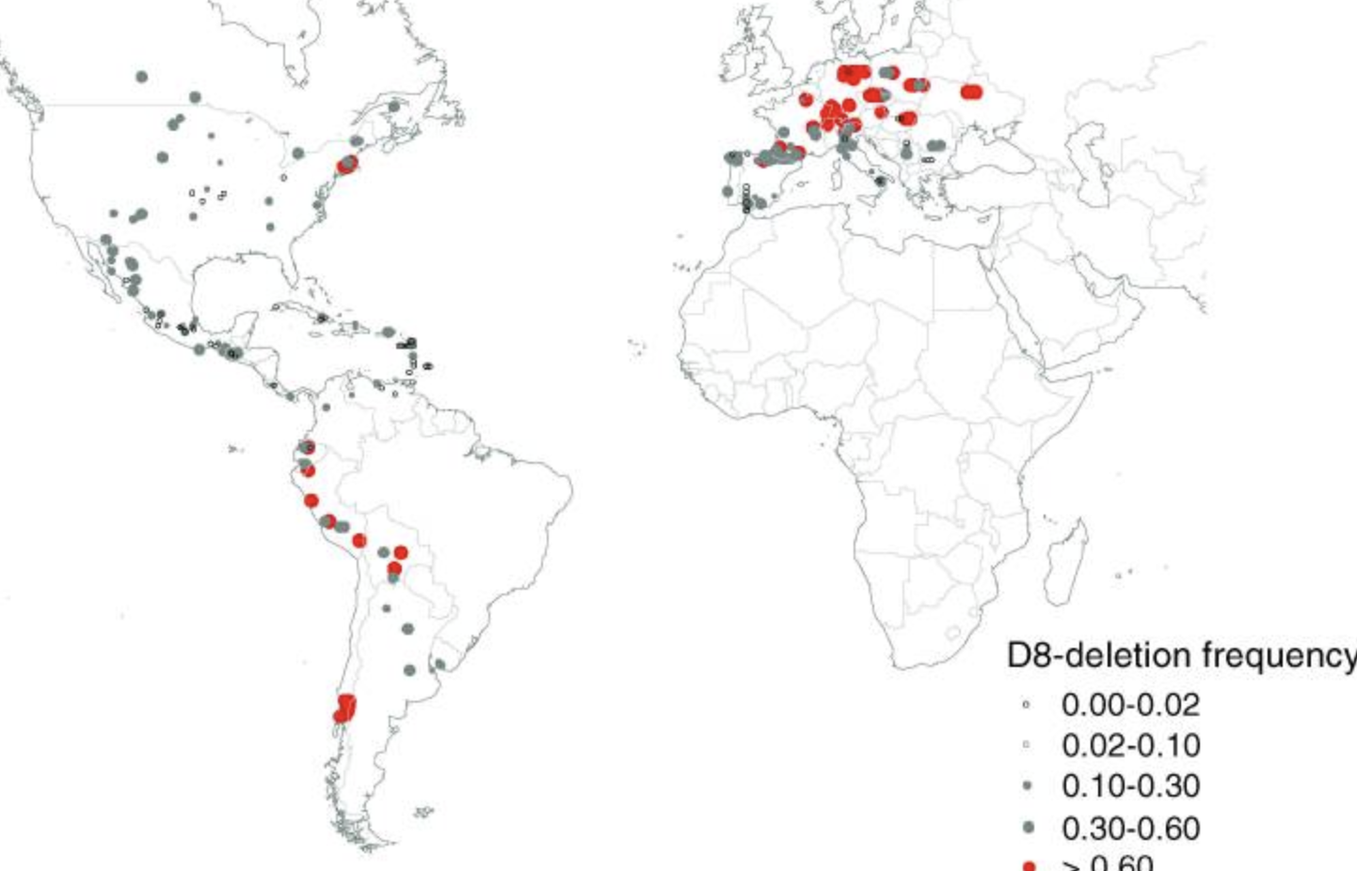


Latitudinal Adaptation of Maize
Maize was domesticated in Central Mexico, spread throughout the Americas, and later reached Europe after the Columbian exchange.
We have diverse lines can be selected for the test (i.e., n=10)
Camus-Kulandaivelu et al., 2006

Slide 4
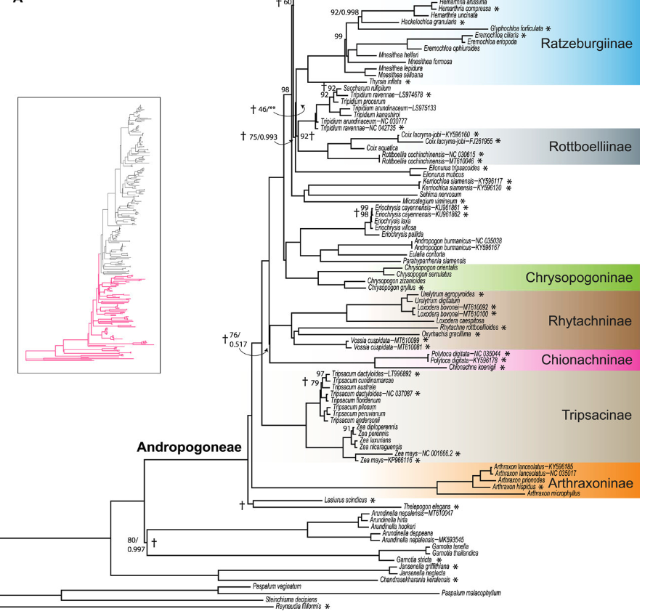
From warm season to cold season
Between maize and sorghum, there are over 1,000 other grasses in the Andropogoneae tribe
Some of them adapted to areas with an average annual temperature of 10–17 °C
The NSF-supported PanAnd project has sequenced several of these grasses that we can choose from.

Slide 5
NIC Greenhouse experiments
With these geographically widely distributed maize and sorghum genotypes, along with seasonally adapted grasses, we have a highly representative set of samples.
With selected chemical exposures, we can conduct greenhouse experiments to measure hyperspectral responses and analyze metabolites at early developmental stages.

