Slide 1
ITB paper figures

Slide 3
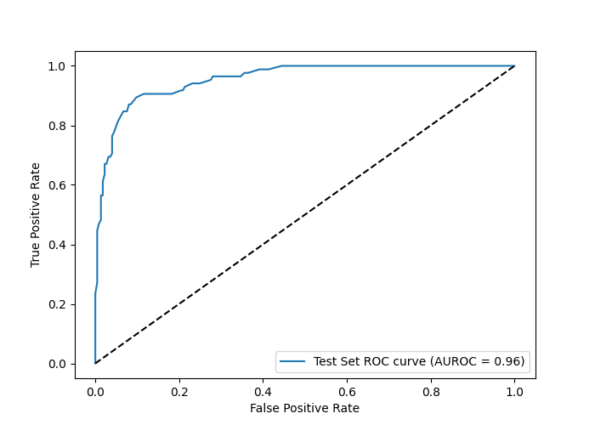
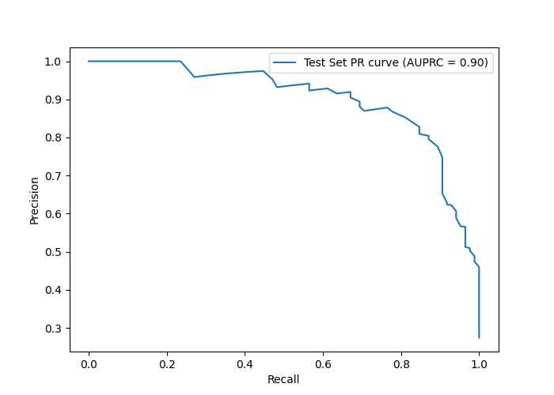
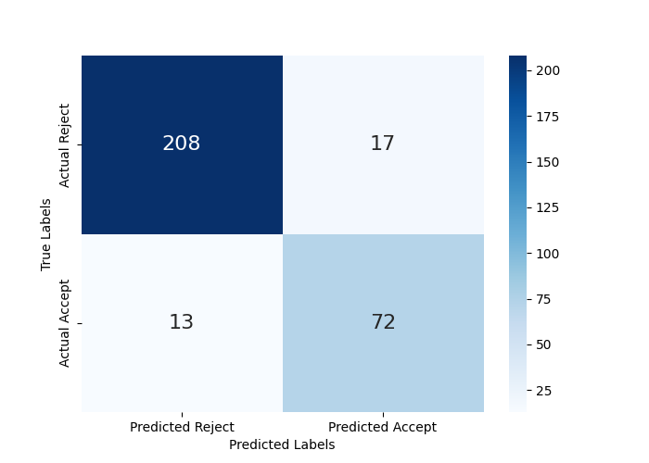
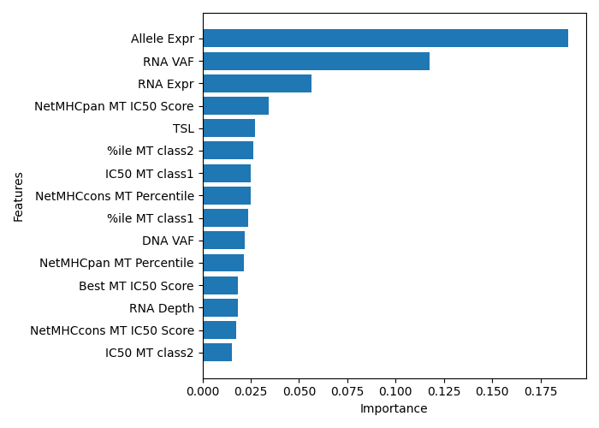
A
B
C
D
Notes:
Figure 2. Performance evaluation of the final model (Random Forest with down-sampling).
(A) Receiver Operating Characteristic (ROC) curve of the model on the held-out test set, demonstrating strong discriminatory ability with an Area Under the ROC (AUROC) of 0.96.
(B) Precision-Recall (PR) curve of the same model, with an Area Under the PR Curve (AUPRC) of 0.90, indicating robust performance in the presence of class imbalance.
(C) Confusion matrix showing classification outcomes on the test set. The model correctly classified 208 rejected and 72 accepted neoantigen candidates, with 17 false positives and 13 false negatives.
(D) Top 15 most important features ranked by Mean Decrease in Impurity (MDI, or Gini importance). Features related to RNA expression, allele-specific expression, and predicted MHC binding affinity were among the most influential in determining model predictions.

Slide 4
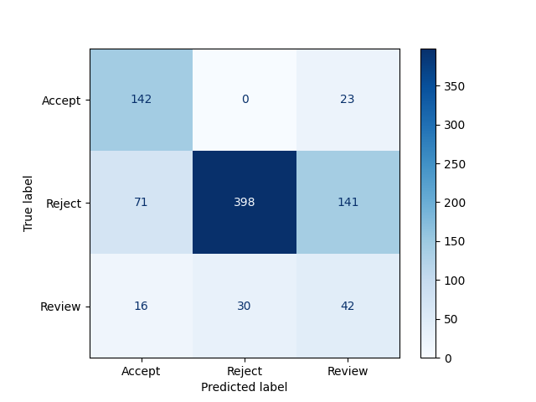
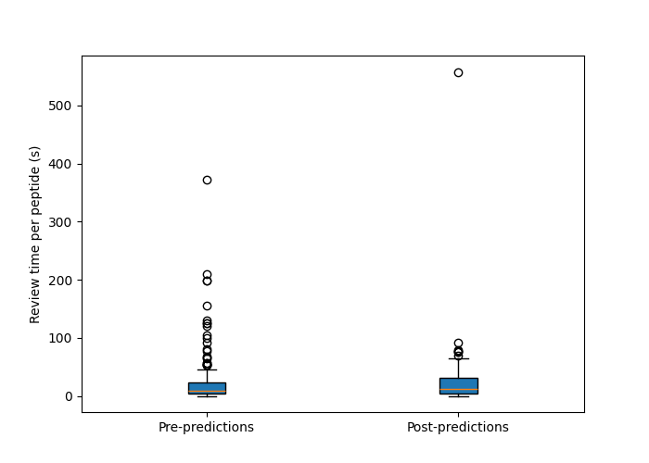
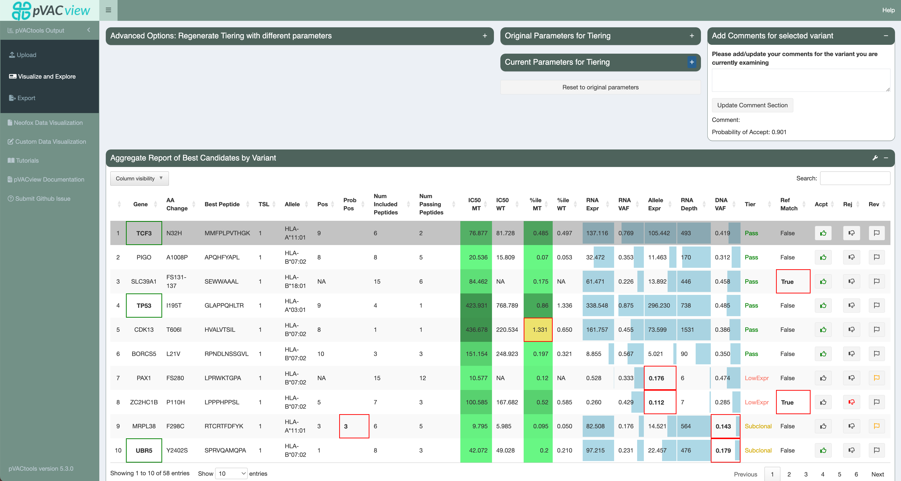
A
B
C
Notes:
Figure 3. Evaluation of model performance beyond the test set in a real-world review setting.
(A) Confusion matrix showing the classification results of the final model (Random Forest with down-sampling) applied to an external patient cohort. The model categorized neoantigen candidates into three groups: “Accept,” “Reject,” and “Review.”
(B) Boxplot comparing the review time per peptide by the Immunotherapy Tumor Board (ITB) before and after model predictions were revealed. Four patient cases were reviewed without model predictions, while three additional cases were evaluated after predictions were incorporated into the workflow. A decrease in review time per peptide was observed in the post-prediction group, suggesting that the model may streamline expert review.
(C) Screenshot of the pVACview interface integrated with model predictions. For each neoantigen candidate, the model’s predicted classification (Accept, Reject, or Review) and the associated probability score are displayed. This feature enables reviewers to incorporate model-derived prioritization alongside conventional selection criteria during manual evaluation.

