Slide 1
Inverse Mechanics
Introduction
Spring 2026

Slide 2
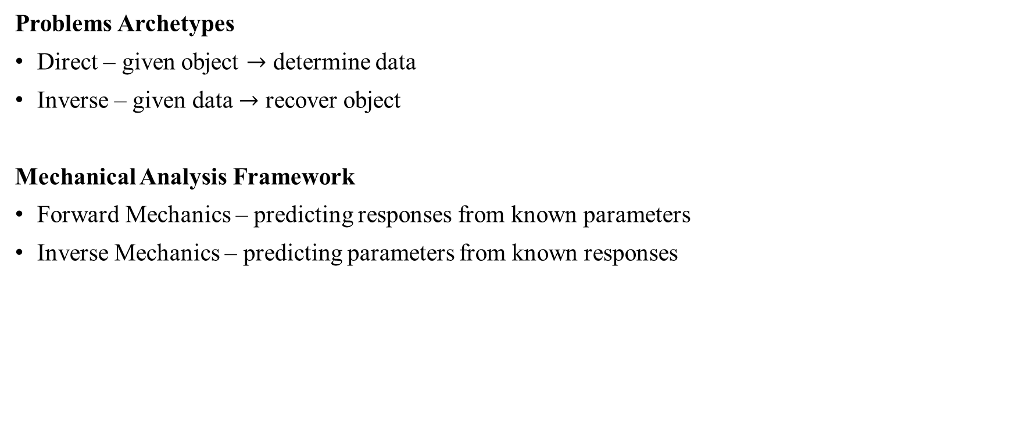
Definitions [1]
Problems Archetypes
Direct – given object $→$ determine data
Inverse – given data $→$ recover object
Mechanical Analysis Framework
Forward Mechanics – predicting responses from known parameters
Inverse Mechanics – predicting parameters from known responses
Direct Problem
Object
Data
Inverse Problem

Slide 3
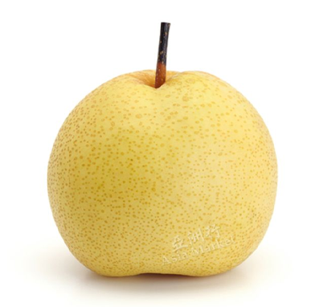

Example 1: Image Processing
Gaussian blur algorithm
Image sharpening algorithm
Object – Original Photo
Direct Problem
Data – Blurred photo
Object
Data
Inverse Problem

Slide 4
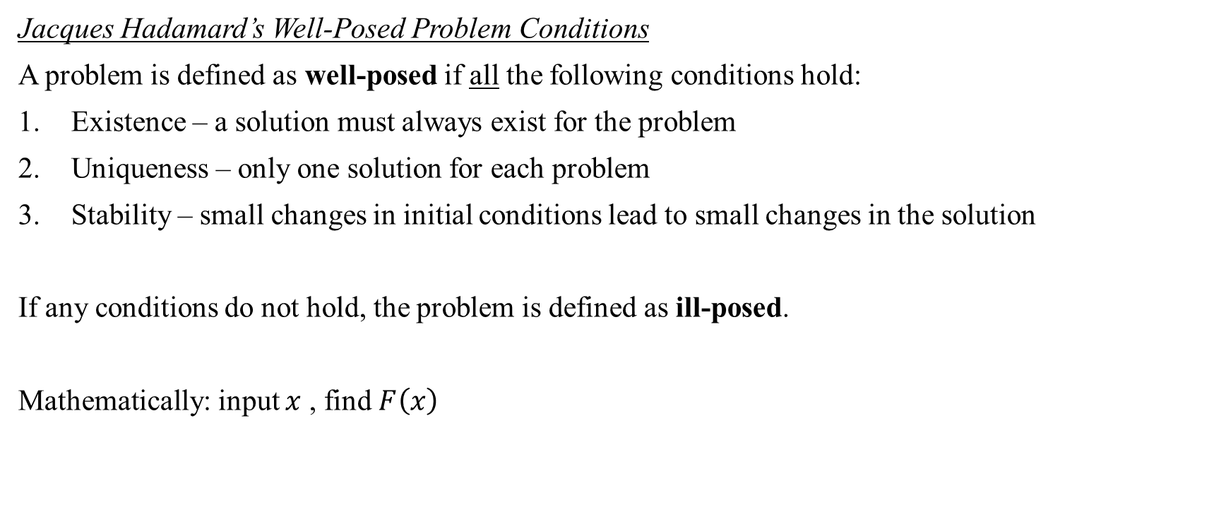
Definitions [2]
Jacques Hadamard’s Well-Posed Problem Conditions
A problem is defined as well-posed if all the following conditions hold:
Existence – a solution must always exist for the problem
Uniqueness – only one solution for each problem
Stability – small changes in initial conditions lead to small changes in the solution
If any conditions do not hold, the problem is defined as ill-posed.
Mathematically: input $x$ , find $F\left(x\right)$

Slide 5
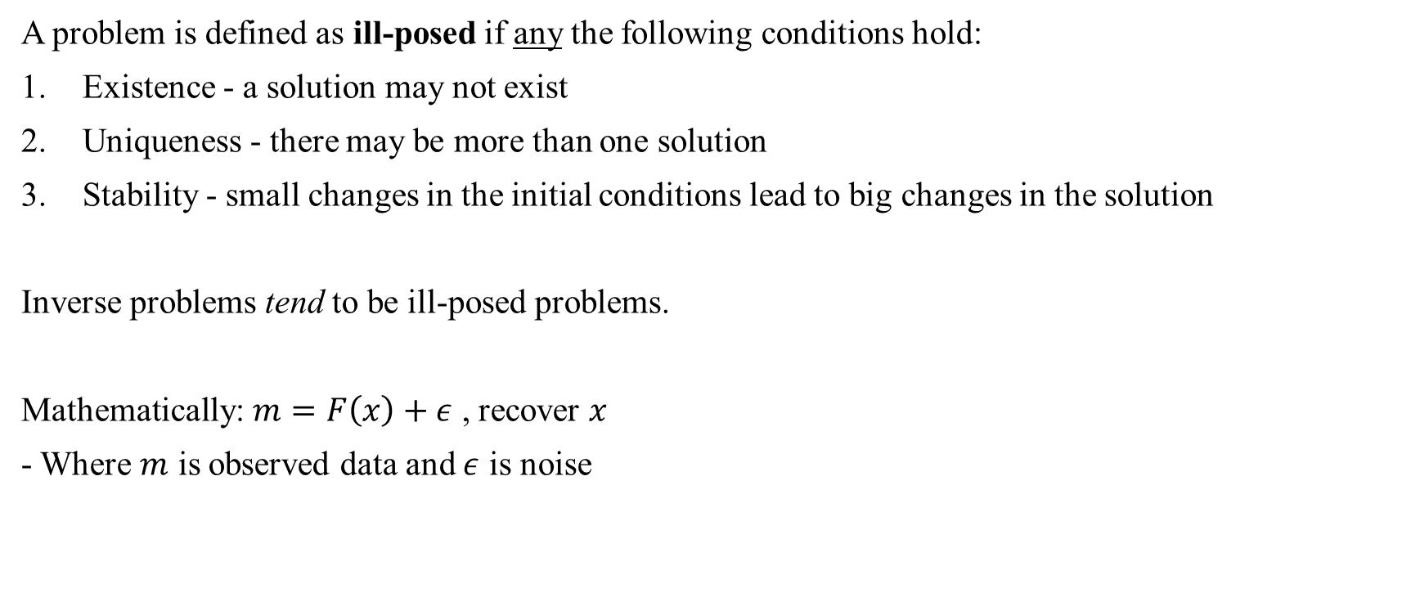
Definitions [3]
A problem is defined as ill-posed if any the following conditions hold:
Existence - a solution may not exist
Uniqueness - there may be more than one solution
Stability - small changes in the initial conditions lead to big changes in the solution
Inverse problems tend to be ill-posed problems.
Mathematically: $m=F\left(x\right)+ε$ , recover $x$
- Where $m$ is observed data and $ε$ is noise

Slide 6
Example 2: An Everyday Problem
Direct Problem: What year were you born?
1980
1990
2000
2003
A solution does exist, D: 2003. This solution is unique— I was not born in any other year but 2003. It is a conclusive answer.
Inverse Problem: It was in 2003.
When I was born
When Finding Nemo came out
When the US invaded Iraq
When Lebron James was drafted
There are many solutions to this problem. The solution is not unique as all four of these events occurred in 2003. It is an inconclusive answer that requires more information.

Slide 7

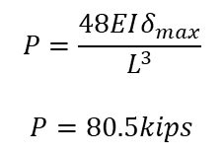
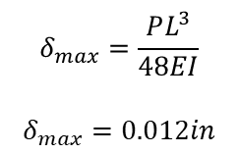



Example 3: Simple Beam
Direct Problem: Given P = 1kip $→$ find $δ_{max}$
Inverse Problem: Given $δ_{max}$ = 1in $→$ find P
P = 1kip
P = ?
E = 29,000 ksi
I = 100$in^{4}$
E = 29,000 ksi
I = 100$in^{4}$
$$δ_{max}=?$$
$$δ_{max}=1in$$
L = 10ft
L=10ft
$$δ_{max}=\frac{PL^{3}}{48EI}$$
$$δ_{max}=0.012in$$
$$P=\frac{48EIδ_{max}}{L^{3}}$$
$$P=80.5kips$$

Slide 8

Simple Beam Problem
The direct problem has known input parameters and a governing equation to compute the results.
The inverse problem has an observed output and some input parameters— the governing equation must be back-solved to find the missing input parameter.
Recall, Hadamard’s conditions:
Existence – a solution exists ✓
Uniqueness – only one solution per problem ✓
Stability – the inputs depends on the outputs, vice versa ✓
Therefore, this is a well-posed direct and inverse problem.
P
$$δ_{max}$$
L

Slide 9



Example: Simple Beam with Two Materials
Recall, Hadamard’s conditions:
Existence – a solution exists ✓
Uniqueness – only one solution per problem ✗
Stability – the inputs depends on the outputs, vice versa ✓
This is an ill-posed problem. This is also an inverse problem as you are finding an input (E) based on an output and given inputs.
P
$E_{1}$= ?
$E_{2}$= ?
$$δ_{max}$$
L

Slide 10


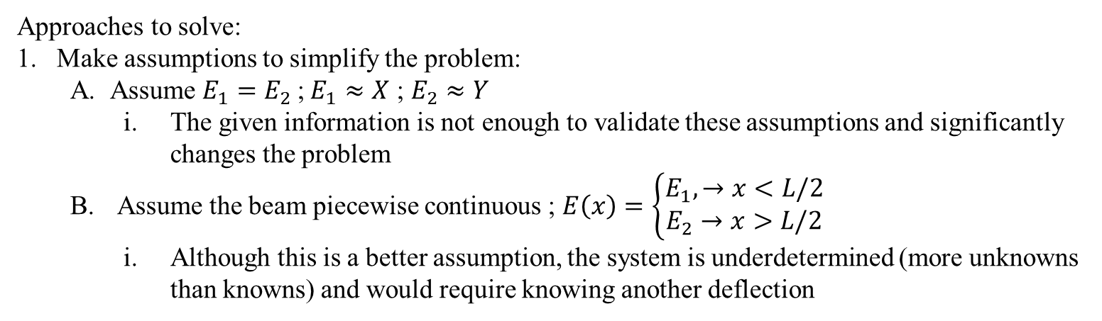
Example: Simple Beam with Two Materials
Approaches to solve:
Make assumptions to simplify the problem:
  Assume $E_{1}=E_{2}$;$E_{1}≈X$ ; $E_{2}≈Y$
    The given information is not enough to validate these assumptions and significantly changes the problem
  Assume the beam piecewise continuous ; $E\left(x\right)=\left\{\begin{aligned}E_{1},→x<L\text{/}2 \\ E_{2}→x>L\text{/}2\end{aligned}\right.$
    Although this is a better assumption, the system is underdetermined (more unknowns than knowns) and would require knowing another deflection
P
$E_{1}$= ?
$E_{2}$= ?
$$δ_{max}$$
L

Slide 11
Example: Simple Beam with Two Materials
Approaches to solve:
Optimization Solve
P
$E_{1}$= ?
$E_{2}$= ?
$$δ_{max}$$
L

