Slide 1
U. S. Department of Transportation (DOT) “HAZMAT Employee” Training for Nuclear Medicine Technologists
Presented by
Monty Ingram, RPh, BCNP
NuTech, Inc.
Copyright © 2017 NuTech, Inc.
Notes:
The name of presentation.
Who is doing it?
My presentation should be about 1 hour-1.5 hour. All your questions and comments are welcome.

Slide 2
Why does a
Nuclear Medicine
Technologist need
DOT “HAZMAT
Employee” training?

Slide 3
Mission of DOT
“Serve the United States by ensuring a fast, safe, efficient, accessible and convenient transportation system …”

Slide 4
“HAZMAT”
  – abbreviated form of “HAZardous MATerial”; also seen as “HM”
  Hazardous Material – defined by Secretary of DOT as “any substance or material that ……is capable of posing an unreasonable risk….when transported in commerce
  Radioactive materials are considered
  Hazardous Materials

Slide 5
“HAZMAT Employee”
– a person who in the course of employment
  directly affects hazardous materials transportation
  safety. (49 CFR 171)
Includes anyone who:
loads, unloads, or handles HM
prepares HM for transportation
is responsible for safety of transporting HM
operates a vehicle used to transport HM

Slide 6
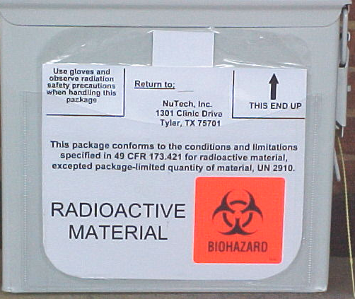
So, when you turn our “sideboards” around to show this side…
…you have just prepared HM for transport, which makes you a “HAZMAT Employee”.

Slide 7
and you are affirming
that ….
“This package conforms to the conditions and limitations specified in 49 CFR 173.421 for radioactive material, UN 2910.”
In order to affirm that, a Nuclear Medicine Technologist must know what those conditions and limitations are.

Slide 8
Who enforces
DOT Training Regs?
Texas Administrative Code (TAC)
TITLE 25 HEALTH SERVICES
PART 1 DEPT. OF STATE HEALTH SERVICES
CHAPTER 289 RADIATION CONTROL
SUBCHAPTER F LICENSE REGULATIONS
RULE 289.257 PACKAGING AND TRANSPORTATION OF RADIOACTIVE MATERIALS
        (e) Transportation of Radioactive Material
        (1) Each licensee … shall comply with…
        (F) 49 CFR Part 172: Subpart H.

Slide 9
HAZMAT Employee
Training Options
Other Programs
Audience: General, Anyone in Industry
Curriculum: Broad, for entire Industry
Duration: 6 to 10 hours
Cost: $215
Location: Major Metropolitan Areas
When: Their Convenience
Answer to Specific Questions: Variable
Bonus: ???
Our Program
Audience: Specific for Nuc Med Techs
Curriculum: Focused on Nuc Medicine
Duration: 2 hours
Cost: $0
Location: Your Location or Our Office
When: Your Convenience
Answer to Specific Questions: Probable
Bonus: Sometimes a Meal!
OR
“Paper compliance” – “here, just take this test”.

Slide 10
Range for Civil Penalties
(from 49 CRF 107)
Violation description
Failure to Train
Failure to maintain training records
Undeclared Shipment
No Shipping Paper
Failure to Label
Incorrect label category
No shipper certification signature
Incorrect label, activity, TI
Incorrect labeling as Limited Quantity
Fine
$400 and up
$500 and up
$15,000 and up
$3,000 to $6,000
$5,000
$5,000
$800
$2,000 to $4,000
$4,000

Slide 11
Outline
Goals of Program
Conditions and Requirements of Training specified in 49 CFR Part 172: Subpart H.
  Three Conditions
  Five Requirements = most of program
Testing required

Slide 12
Goals of Program
To satisfy the DOT training requirements for persons involved in the transport of HAZMAT
To train Nuclear Medicine Technologists to correctly & safely perform duties of a HAZMAT Employee

Slide 13
Conditions and Required Components of Training
Three Conditions –
completed within 90 days of employment
refreshed every 3 years
validated by testing

Slide 14
Conditions and Required Components of Training
Five Required Topics
General awareness/familiarization training
Function-specific training
Safety training
Security awareness training
Security plan training, when applicable

Slide 15
Conditions and Required Components of Training
Five Required Topics
General awareness/familiarization training
  Source of HAZMAT Regulations
  The Hazardous Materials Table
  Shipping Papers
  Marking and Labeling
  Packaging

Slide 16
General
Awareness/Familiarization
Training
Source of HAZMAT Regulations
  Also known as “the HMR”
  found in 49 CFR Parts 100 to 185

Slide 17
General
Awareness/Familiarization
Training
  Part 171 – General Information, Regulations, and Definitions
  Part 172 – Hazardous Materials Table … Emergency Response Information, and Training Requirements
  Part 173- Shippers – General Requirements for Shipments and Packaging

Slide 18
Conditions and Required Components of Training
Five Required Topics
General awareness/familiarization training
  Source of HAZMAT Regulations
  The Hazardous Materials Table

Slide 19
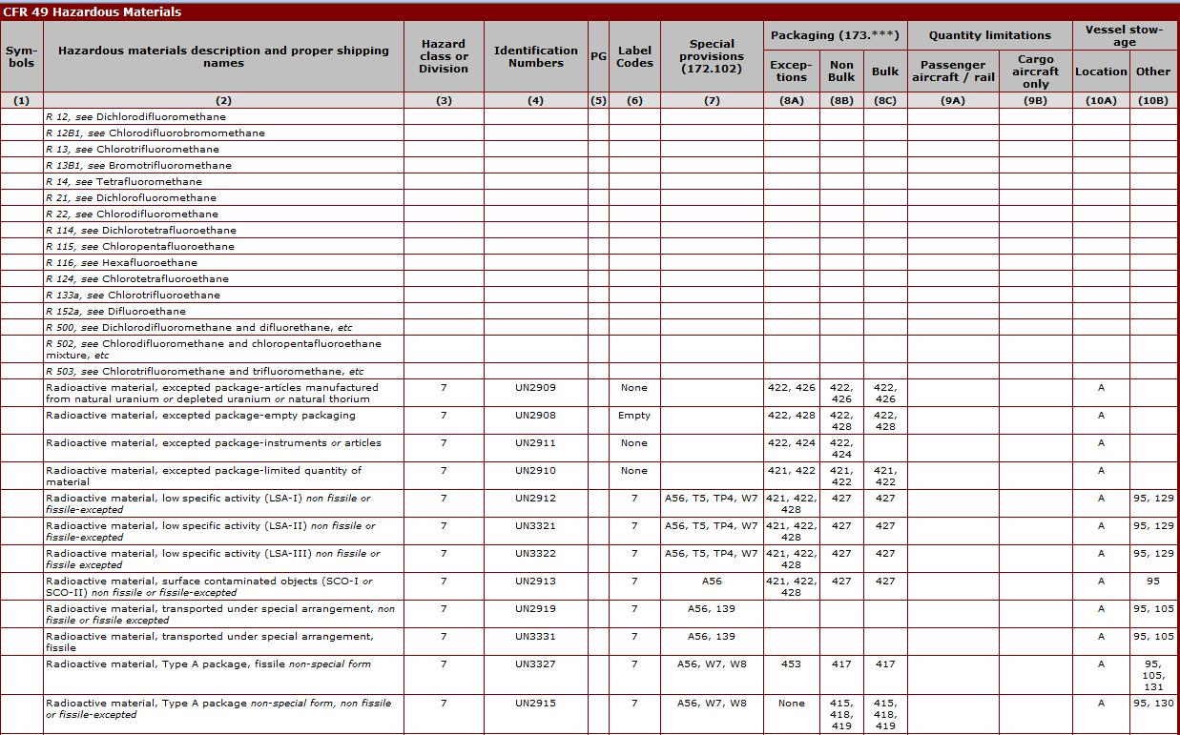
Hazardous Materials Table excerpt

Slide 20
The Hazardous Materials Table
  the foundation of all HM regulations
  used for:
    proper shipping names of the transported materials
    proper packaging, labeling and marking
    allowable quantities
    emergency procedures

Slide 21
The Hazardous Materials Table
  Arranged in Ten Columns
  Most important for us:
    Description and Proper Shipping Name (2)
    Hazard class or Division (3)
    Identification numbers (4)
    Packaging (8, especially 8A Exceptions)

Slide 22
The Hazardous Materials Table
  Column 2: Description and Proper Shipping Name
    Only two lines apply to us
      Radioactive Material, Type A package
      Radioactive Material, excepted package – limited quantity of material

Slide 23
The Hazardous Materials Table
Column 3: Hazard class or Division
    Nine hazard classes; twenty-two divisions
    All radioactive materials are Class 7

Slide 24
The Hazardous Materials Table
Column 4: Identification numbers
  Only two apply to us
    UN 2915
    UN 2910

Slide 25
The Hazardous Materials Table
Column 8: Packaging, specifically 8A and 8B
    8B - requirements regarding packaging integrity, labeling, and marking
    8A – exceptions to 8B - very significant

Slide 26
General
Awareness/Familiarization
Training
Source of HAZMAT Regulations
The Hazardous Materials Table
Shipping Papers

Slide 27
Shipping Papers
Accompanies and describes package
Must contain:
Proper shipping name
Hazard class or division identification
Identification number
Total quantity
Shipper certification
Emergency response telephone number
Carrier contact information

Slide 28
Shipping Papers
A shipping paper is ALWAYS required
for a White-I, Yellow-II, or Yellow-III
package.

Slide 29
Review of Label Categories
Radiation level at surface Label Category Shipping Paper?
Less than or equal to 0.5mR/h White-I Yes
Greater than 0.5mR/h but less Yellow-II Yes
than or equal to 50mR/h
Greater than 50mR/h but less Yellow-III Yes
Than 200mR/h

Slide 30
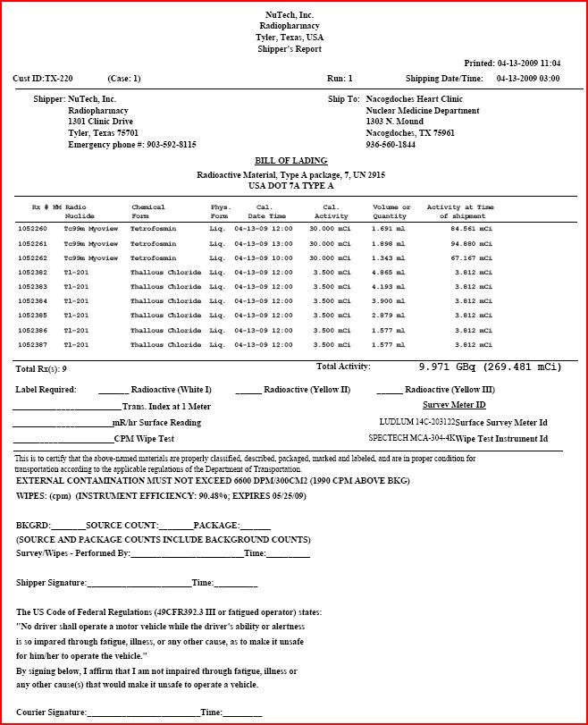
A NuTech shipping paper or bill of lading
Proper shipping name
Hazard class or division identification
Identification number
Total quantity
Shipper certification
Emergency response telephone number
Carrier contact information

Slide 31
General
Awareness/Familiarization
Training
Source of HAZMAT Regulations
The Hazardous Materials Table
Shipping Papers
Marking and Labeling

Slide 32
Marking and Labeling
“Labeling” refers to specific hazard warning labels required on the exterior of a package
  White-I
  Yellow-II
  Yellow-III
“Marking” refers to the proper shipping name, ID number, cautions, and instructions required on the exterior of a package.
We refer to marking and labeling as “sideboards”

Slide 33
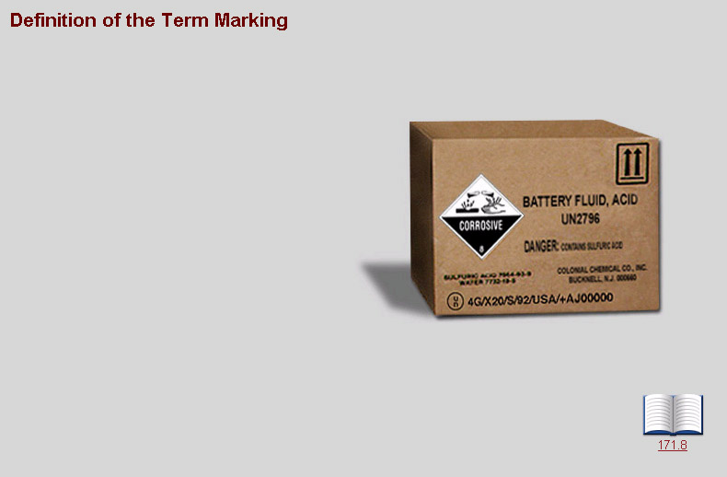
Marking and Labeling
On this box, the “Corrosive” sticker is an example of Labeling, and
“Battery Fluid, Acid”
“UN2796”,
“Danger”
and the ‘up’ arrows are examples of Marking.

Slide 34
General
Awareness/Familiarization
Training
Source of HAZMAT Regulations
The Hazardous Materials Table
Shipping Papers
Marking and Labeling
Packaging

Slide 35
Packaging
Addressed in columns 8A and 8B of HMT.
8B addresses “package integrity”
  Refers to the containers that hazardous materials are shipped in.
  Integrity requirements are specified in the HMR and are very stringent.
  Approved packaging must be tested and documented (unless exception applies).

Slide 36
Packaging
8A addresses exceptions to 8B package integrity and marking and labeling requirements
  Exempts packages from specific marking and labeling requirements under certain conditions and limitations
  Exceptions are extremely useful and important to us

Slide 37
General
Awareness/Familiarization
Training
End of
General Awareness/Familiarization
Training
Any Questions?

Slide 38
Conditions and Requirements of Training
Five Requirements –
General awareness/familiarization training
Function-specific training
Safety training
Security awareness training
Security plan training, when applicable

Slide 39
Function-specific Training
For Nuclear Medicine Technologists, function-specific training primarily consists of:
Preparing packages (“ammo boxes”) for return to provider.
Preparing spent sources for return.
Preparing unused I-131 doses for return to provider.
Preparing other packages containing radioactive materials for shipment via commercial carriers.

Slide 40
Column 8A exceptions have the effect of creating a fourth label category
that is critically important for
Nuclear Medicine Technologists to understand.

Slide 41
The 8A Exceptions allows a package meeting
5 specific limitations and conditions to be shipped without a shipping paper
This package is known as an
excepted package – limited quantity
or simply
“Limited Quantity”

Slide 42
Does this look familiar?
How would you like to have to prepare a shipping paper for every one of these you send back?
That’s how important the 8A exceptions are!

Slide 43
The conditions and limitations to ship as a Limited Quantity without a shipping paper are:
Activity must not exceed limit established for each nuclide.
Radiation level at any point on the external surface must not exceed 0.5mR/h.
Removable contamination must not exceed 10⁻⁵ uCi/cm² (22 dpm/cm²) [173.443 Table 11]
The outside of the package must bear the marking “Radioactive”.
The outside of the package must bear the marking “UN 2910”

Slide 44
Isotope | Max. Act.-Liquid Form (mCi) | Max Act.-Solid Form (mCi)
Tc-99m | 11
I-131 | 1.9 | 19
In-111 | 8.1
Ga-67 | 8.1
Tl-201 | 11
Co-57 |  | 270
Gd-153 | N/A | 240
Activity does not exceed limit established by regulation for each nuclide. Texas limits for Tc99m and Tl201 changed significantly in 2007.

Slide 45
Radiation level at any point on the external surface does not exceed 0.5mR/h.

Slide 46
Removable contamination does not exceed 10⁻⁵ uCi/cm² (22 dpm/cm²) [173.443 Table 11]
  In other words, a wipe test on the outgoing package. This is NOT a new condition; it has been in place all along.

Slide 47
The outside of the packaging bears the marking “Radioactive”.

Slide 48
The outside of the package must bear the marking “UN 2910”

Slide 49
Pearls:
  The current limit for the return of Tc99m without a shipping paper is 11 mCi per package.
  The practical effect is that most unused doses of Tc99m radiopharmaceuticals cannot be returned on the same day without a shipping paper.
  Allow all unused doses to decay for 18 hours from calibration time before packaging for return.

Slide 50
One more look
First three are limitations, last two are conditions:
Activity must not exceed limit established for each nuclide.
Radiation level at any point on the external surface must not exceed 0.5mR/h.
Removable contamination must not exceed 10⁻⁵ uCi/cm² (22 dpm/cm²) [173.443 Table 11]
____________________________________________
The outside of the package must bear the marking “Radioactive”.
The outside of the package must bear the marking “UN 2910”

Slide 51
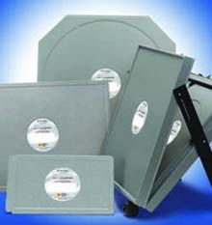
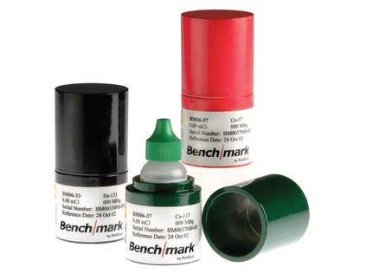
You also function as a HAZMAT Employee
when you prepare a source for shipment, whether it is to NuTech or directly to vendor.

Slide 52
Function-specific Training
Preparing spent sources for return
  Often requires a shipping paper because surface reading exceeds 0.5 mr/hr
  Determine whether source in shipping box meets first three limitations in sequence.
  If you get a “no”, package does NOT qualify as a Limited Quantity and must be accompanied by shipping paper.
  Helpful forms available on our website.

Slide 53
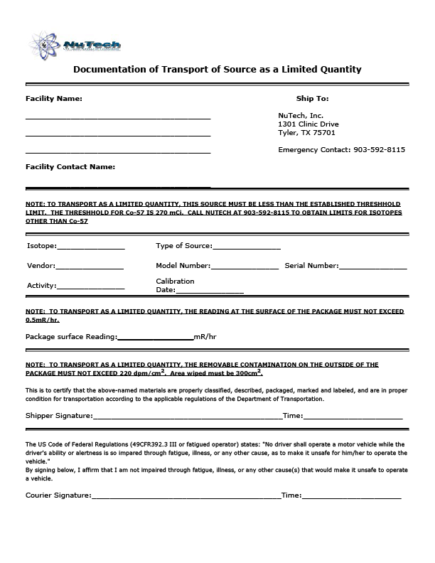
“Documentation of Transport of Source as a Limited Quantity” from our website.

Slide 54
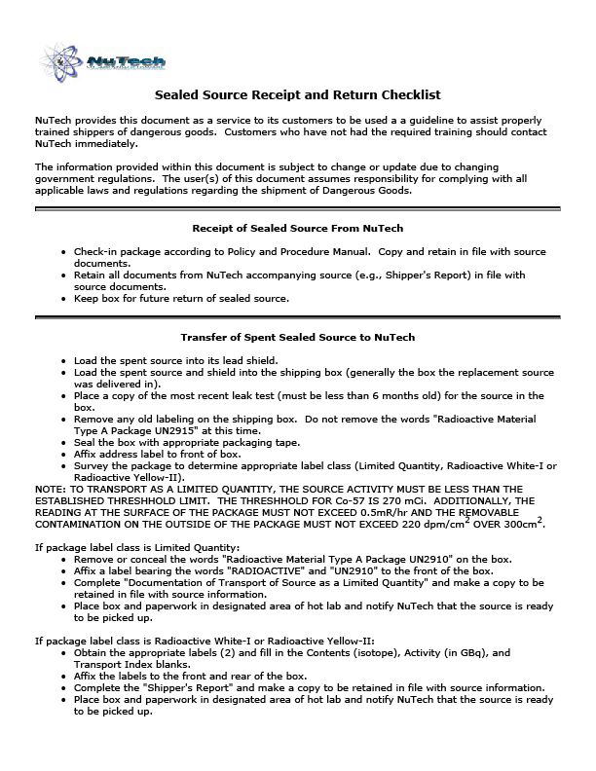
“Sealed Source Receipt and Return Checklist” from our website.

Slide 55
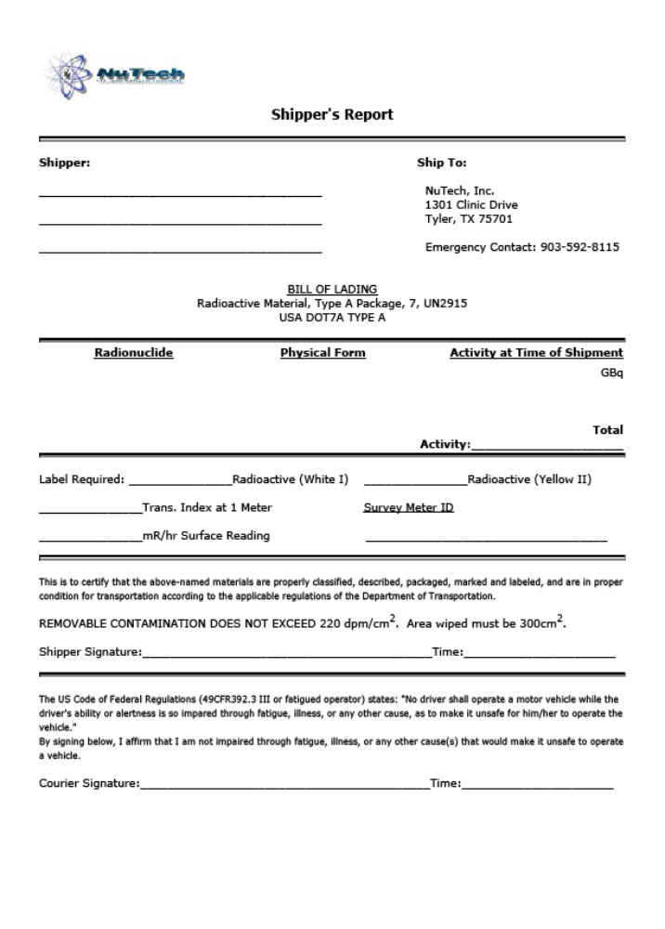
“Shipper’s Report” from our website.
Must be used if source exceeds any of first three limitations.

Slide 56
Foolproof method
  Determine whether source of radioactivity in shipping container meets first three limitations in sequence.
  As soon as you get a “no”, package does NOT qualify as a Limited Quantity and must be accompanied by shipping paper.
  Contact us for help if package cannot be shipped as limited quantity and requires a shipping paper!

Slide 57
Function-specific Training
Preparing unused I-131 doses for return to provider.
  Almost always requires a shipping paper
  Call us, and we will step you through the process.
  REMEMBER, in this case YOU will be the shipper, and YOU assume responsibility for preparing shipping paper correctly.

Slide 58
Function-specific Training
Preparing other packages containing radioactive materials for shipment via commercial carriers.
  Limited Quantity packages may be shipped UPS without a shipping paper following 5 limitations and conditions discussed.

Slide 59
Function-specific Training
Preparing other packages containing radioactive materials for shipment via commercial carriers.
  White-I or Yellow-II packages MUST be accompanied by a dangerous goods form and shipped by a commercial carrier. FedEx is extremely picky about accuracy of shipping paper –use online program.
  Yellow-II requires determination of a Transport Index (TI)

Slide 60
Definition of Transport Index (TI)
“the dimensionless number (rounded up to the next tenth) placed on the label of a package, to designate the degree of control to be exercised by the carrier during transportation.”
used to limit maximum amount of activity in a commercial carrier vehicle or vessel.

Slide 61
Determining a TI
Use survey meter to measure reading at surface of package. If greater than 0.5 mR/h, package is a Yellow-II, and a TI is required.
Move detector to distance 1 meter (approximately 3 feet) from package, and take reading.
Round reading up to next highest tenth.
Record result as TI.
TI has no units associated with it, and it can only contain whole numbers and tenths. Ex: 0.1 or 5.1 or 10.1 but not 0.01 or 0.09, or 5.01 or 5.09, or 10.01 or 10.09)

Slide 62
Only ONE digit to right of decimal on a Transport Index!
Package Reading at 1 meter | Transport Index
0.01 to 0.1 | 0.1
0.11 to 0.2 | 0.2
0.21 to 0.3 | 0.3
0.31 to 0.4 | 0.4
0.41 to 0.5 | 0.5
0.51 to 0.6 | 0.6
0.61 to 0.7 | 0.7
0.71 to 0.8 | 0.8
0.81 to 0.9 | 0.9
0.91 to 1.0 | 1.0
above 1.0 | cannot ship as Yellow-II

Slide 63
Function-specific Training
Preparing other packages containing radioactive materials for shipment via commercial carriers.
  If being shipped by air, shipper must be able to show documentation of training specifically for shipping by air; must repeat training every TWO years, not three.

Slide 64
Determination of Transport Index (TI)
Review of Label Categories
Radiation level at surface Label Category TI Required?
Less than or equal to 0.5mR/h White-I No
Greater than 0.5mR/h but less Yellow-II Yes
than or equal to 50mR/h
Greater than 50mR/h Yellow-III Cargo air only

Slide 65
Function-specific Training
End of
Function-specific
Training
Any Questions?

Slide 66
Conditions and Requirements of Training
Requirements - Training must include:
General awareness/familiarization training
Function-specific training
Safety training

Slide 67
Safety Training
HMRs allow for other pertinent training, such as annual Radiation Safety training and OSHA Hazard Communication updates to partially satisfy this requirement.
HMRs do require specific training on Emergency Response Information

Slide 68
Emergency Response Information
HMRs spells out specific emergency response information that must be provided with all shipments that require shipping papers.
Two major requirements:
  Emergency Contact (Telephone) Number monitored at all times.
  Access to information for first responders, including immediate risks to health, risks of fire or explosion, precautions to be taken, et al
Limited quantity shipments (UN 2910) exempt from these requirements, UN2915 is NOT.

Slide 69
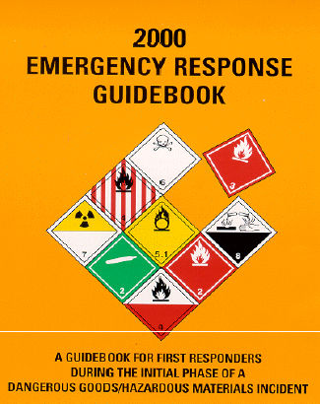
Safety Training
Best source of Emergency Response Information is current (2008) North American Emergency Response Guidebook. Cross referenced by UN number and technical name.

Slide 70
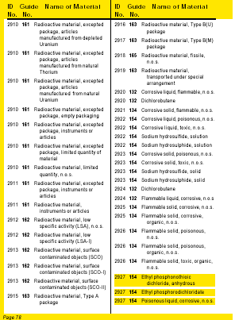
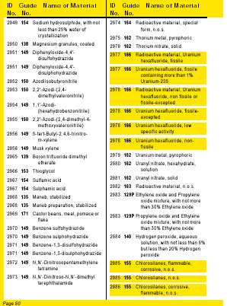

Slide 71
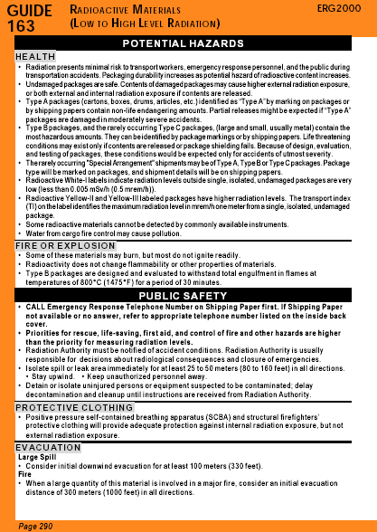
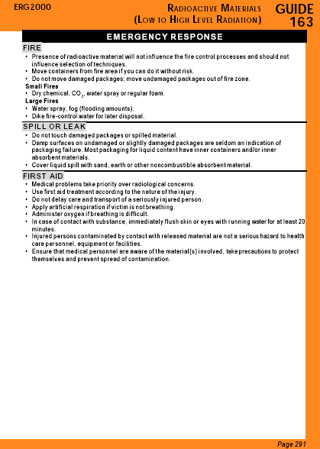

Slide 72
Safety Training
End of
Safety
Training
Any Questions?

Slide 73
Conditions and Requirements of Training
Requirements - Training must include:
General awareness/familiarization training
Function-specific training
Safety training
Security awareness training

Slide 74
Security Awareness Training
HAZMAT Transportation Industry
  Includes fuels, chemicals, radiation
  800,000 shipments per day
  95% of shipments via truck
  Essential to everyday life, but potentially problematic in wrong hands

Slide 75
Security Awareness Training
Most likely HM targets of diversion
Flammable liquids (jet fuel, gasoline)
Flammable gases
Toxic chemicals
Sources of radiation

Slide 76
Security Awareness Training
Potential Catastrophic Uses of HM
  Explosion, detonation, ignition of HM
  Contamination of food, water, air by HM
  Any misuse that causes panic, disruption

Slide 77
Security Awareness Training
Principal threats to HAZMAT security:
  External “Terrorists” threats
    Primary focus in past
    Includes not only physical acts of violence against individuals or property, but also acts intended to cause fear, panic, or hysteria, or disrupt normal life.
  Internal threats
    Disgruntled employee/former employee
    Political activists/extremists

Slide 78
Security Awareness Training
Handling of Radioactive Materials poses special burden because of public’s disproportionate fear of radioactivity.
Ex: Theft of truck in Mexico in Dec ‘13

Slide 79
Security Awareness Training
Enhancing the security of your handling of Radioactive Material:
  Develop and follow policies and procedures regarding access to your department, your hot lab, and your radiopharmaceuticals.
  Inform vendors of P&P in writing
  Be aware that what you handle routinely could be misused by those intent on doing so.
  Be aware that your sealed sources could be misused, also.

Slide 80
Conditions and Requirements of Training
Requirements - Training must include:
General awareness/familiarization training
Function-specific training
Safety training
Security awareness training
Security plan training, when applicable

Slide 81
Security Plan Training
The requirement for security plan training is applicable only to shippers who ship above a threshold amount of HM.
Neither radiopharmaceutical providers nor medical users ship amounts above the threshold amount for radioactivity, so this training is not required.
End of ALL Training – Any Questions?

Slide 82
Program Outline
Goals of Program
Conditions and Requirements of Training specified in 49 CFR Part 172: Subpart H.
Testing – required by regulations

Slide 83
Hazardous Materials Table excerpt

