Slide 1

ECE434 Pedestrian Crosswalk Recognition
Team Members: Jacob Yax, KJ Hobday, Tuan Nguyen

Slide 2
Risk Significance
“In 2021 alone pedestrian fatalities in the United States alone numbered 7,388 while over 600,000 were injured, a 13% increase from 2020”
-National Highway Transportation Safety Agency

Slide 3
Mitigations
What can an autonomous vehicle do?
Sense how far along a crosswalk the pedestrian is and control speed based on that
Fully stop at crosswalk check for pedestrians then move
Check a pedestrian light to see if red or green and move based off the status of that

Slide 4
Approach
Create a world in gazebo to simulate crosswalk environment
Utilize images from environment to train robot on what is a crosswalk
Create ROS nodes which tell robot when to stop and go as well as determine light
Evaluate model to confirm performance

Slide 5
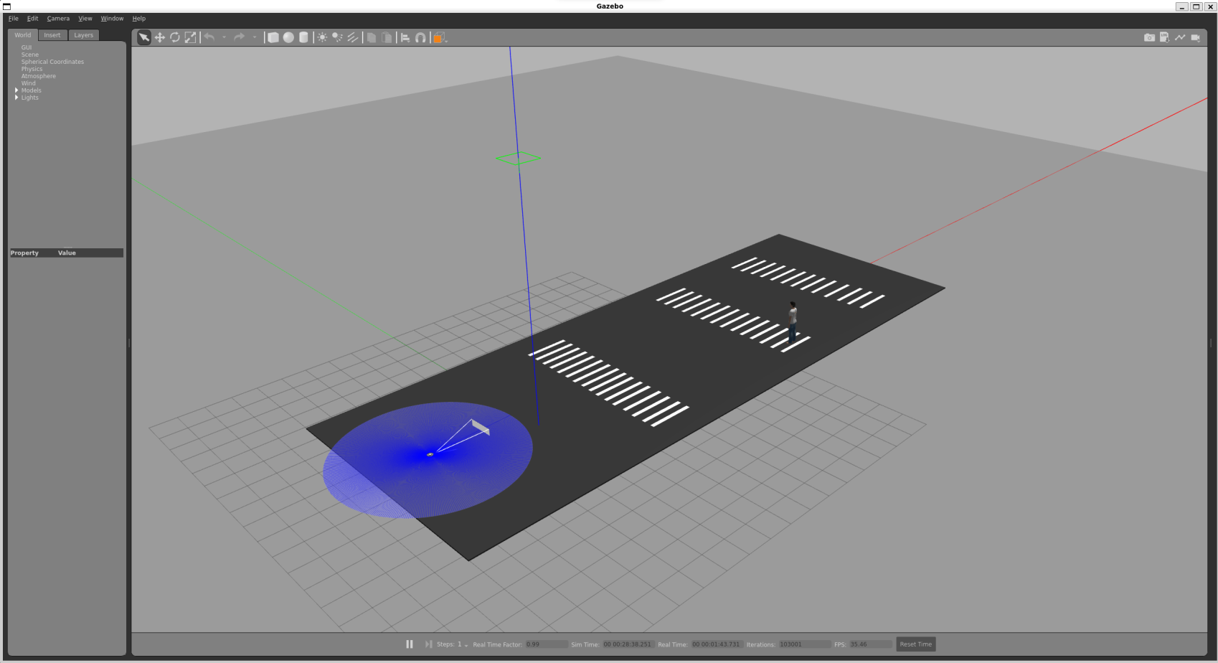
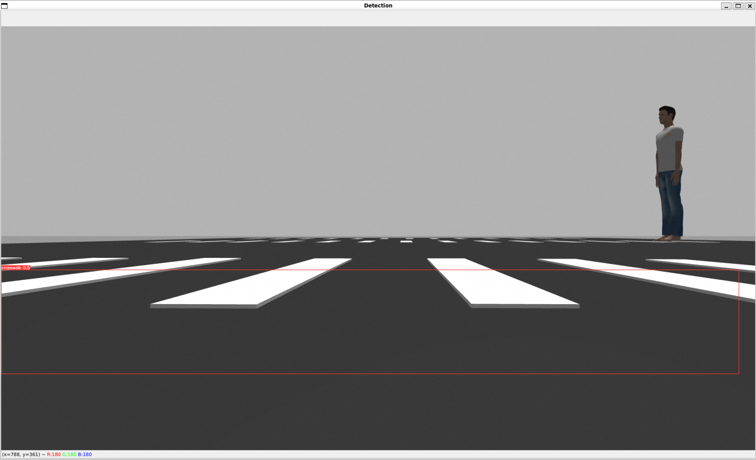
The World

Slide 6
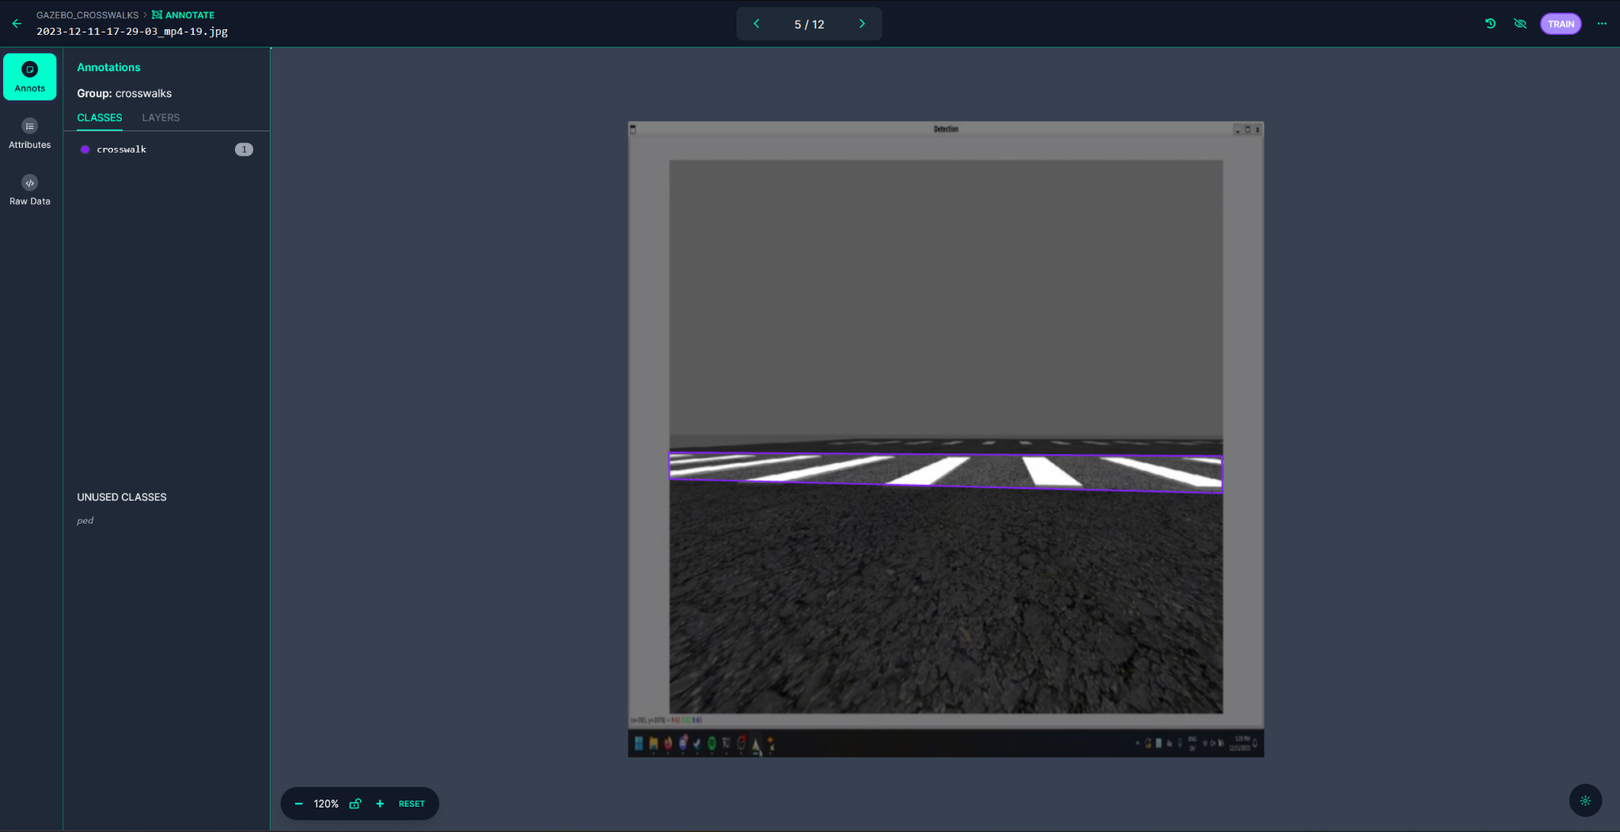
Annotating on Roboflow

Slide 7
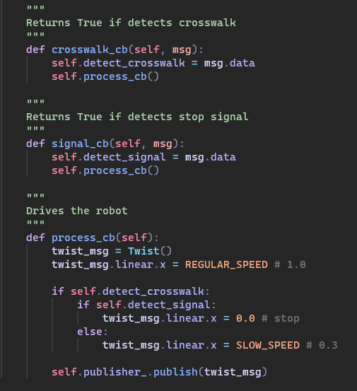
Robot Control Logic

Slide 8
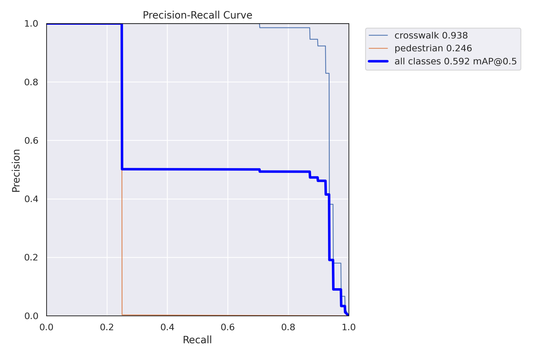
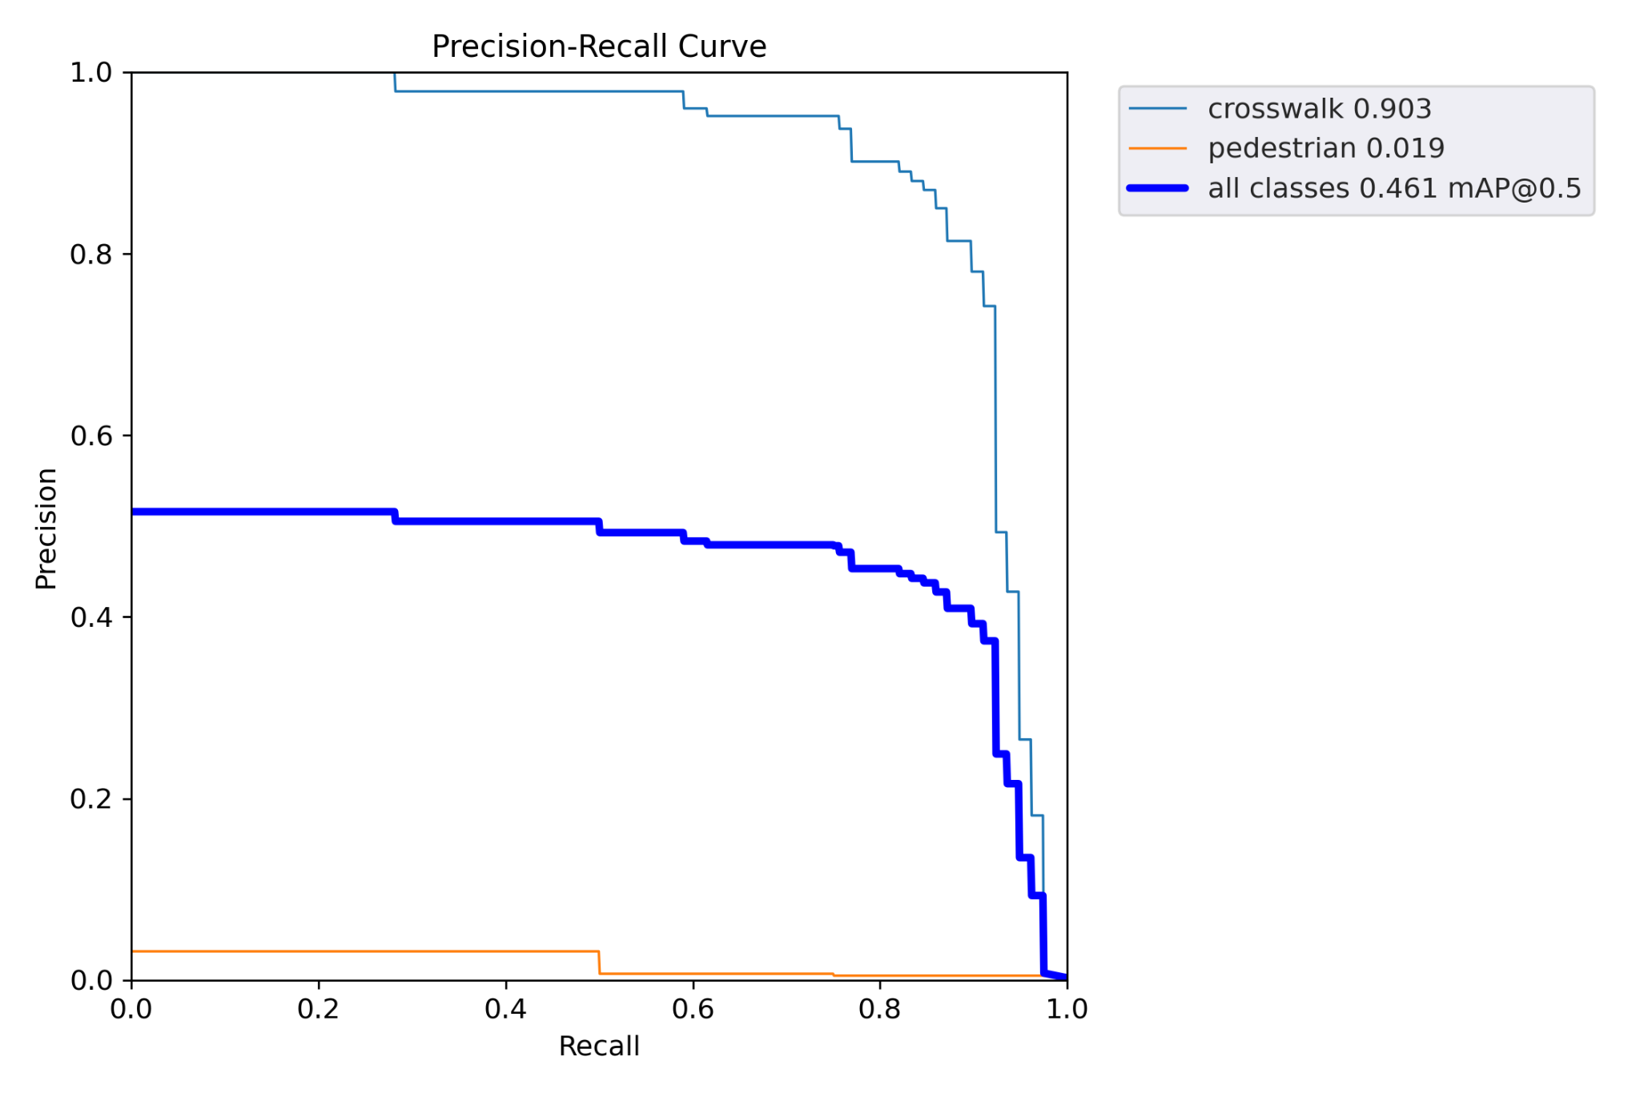
Training Sets
Real World
Virtual World

Slide 9

Results

Slide 10
Conclusion
In a world where safety remains the top concern with autonomous vehicles, this model offers a successful answer on handling pedestrian safety

