Slide 1
PROJECT UPDATE
6
IEEE 1687 / 1838 Tessent Integration Flow
CORE STEPS
CURRENT BASELINE
Third-party Tessent integrated into the existing RTL-to-gate design environment.
1
2
3
4
5
6
ENV
INSERT
RETARGET
RTL VERIFY
SYNTHESIS
GATE VERIFY
Current: access flow and generated patterns verified | Next: ATPG and regression | Bonus: Steps 10–11
IEEE 1687 / 1838 Automation Progress Review
01

Slide 2
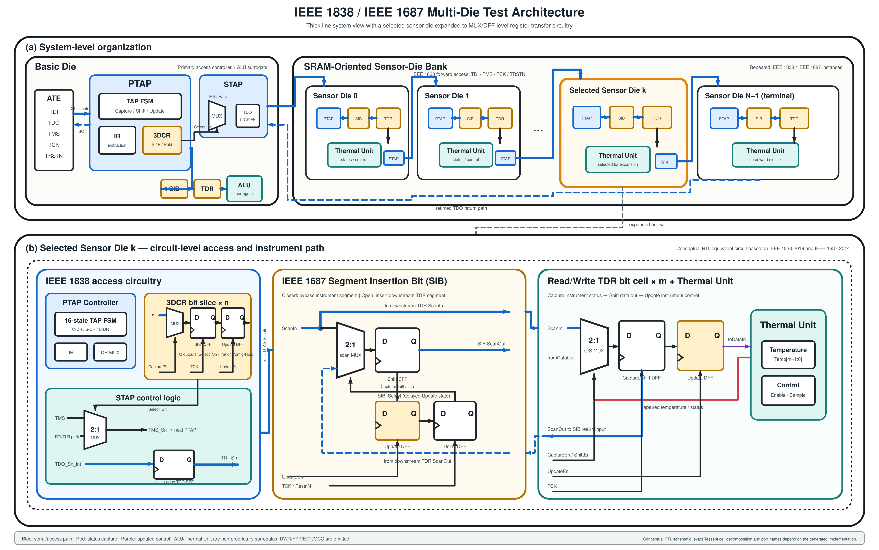
PROJECT CONTRIBUTIONS
Project Contributions
Tessent integration establishes a verified IEEE 1687 / 1838 flow
without replacing the existing RTL-to-gate environment.
01 INTEGRATE
Flow integration
Tessent + RTL-to-gate
02 VERIFY
Three access scopes
1687 · +1838 · stack_top
03 DELIVER
Working Tcl + evidence
scripts · compare · issue guide
CURRENT PROOF
Access and pattern delivery are proven; the ATPG environment is the next milestone.
Architecture based on the current prototype and IEEE 1687-2014 / IEEE 1838-2019
02

Slide 3
HOW TO READ THE DECK
Current Flow Produces Evidence and Documentation
1
2
3
CURRENT FLOW
AUTOMATE
EVIDENCE
Configure Each Case
Run + Check
Save Results
Working Tcl set; I/O, hierarchy, and checks remain case-specific
Run flow · DRC · path reachable · mismatch = 0
Logs · waveforms · reports · comparisons
DOCUMENTED
Tcl scripts + issue resolutions + verification evidence
Step 12 will consolidate scripts, design settings, folders, and rerun rules.
Validated: IEEE 1687 · IEEE 1687 + 1838 · stack_top | DWR = bonus
03

Slide 4
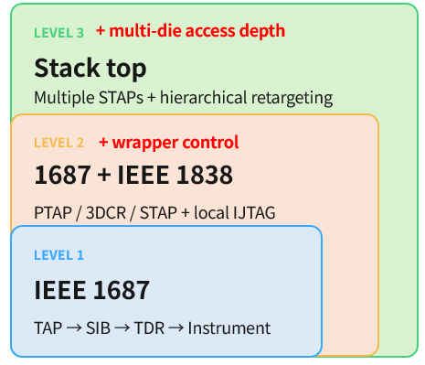
BASELINE
Six Core Steps Define the Current Baseline
01
02
03
04
05
06
Environment
RTL Insertion
ICL / PDL
RTL Verify
Synthesis
Gate Verify
scripts + inputs
1687 / 1838
package pattern
waveform + compare
preserve network
RTL = gate
Validated Access | Current Deliverables
FLOW INTEGRATION Tessent linked to existing RTL, simulation, and synthesis
WORKING TCL SET Executable scripts; design settings are still mixed in one folder
DOCUMENTATION Tcl usage, integration issues, fixes, and verification evidence
Current assets: working Tcl · ICL / PDL · simulation · synthesis Step 12: separate common flow, design config, runs, and reports
Validated: IEEE 1687 · IEEE 1687 + 1838 · stack_top | DWR = bonus
04

Slide 5
SCALE
One Framework Supports Three Access Scopes
+ multi-die access depth
LEVEL 3
Stack top
Multiple STAPs + hierarchical retargeting
+ wrapper control
LEVEL 2
1687 + IEEE 1838
PTAP / 3DCR / STAP + local IJTAG
LEVEL 1
IEEE 1687
TAP → SIB → TDR → Instrument
Current assets: working Tcl · ICL / PDL · simulation · synthesis Step 12: separate common flow, design config, runs, and reports
Validated: IEEE 1687 · IEEE 1687 + 1838 · stack_top | DWR = bonus
05

Slide 6
STAGE DETAIL
Step 1 Establishes a Working Run Environment
1 ENV
2 INSERT
3 RETARGET
4 RTL VERIFY
5 SYNTHESIS
6 GATE VERIFY
STAGE 1
Run Environment
TASK
CHECKPOINT
EVIDENCE
Build
Must Pass
Show
Organize RTL, libraries, and file lists
✓
RTL elaborates cleanly
Current run log
Executed script sequence + outputs
Run the existing Tcl scripts from one working folder
✓
Required Tcl sequence runs successfully
Working Tcl folder
Edit design I/O, hierarchy, and checks case by case
✓
Expected artifacts are generated
Scripts + design-specific edits together
Generated artifacts
RTL · ICL · patterns · reports
Validated: IEEE 1687 · IEEE 1687 + 1838 · stack_top | DWR = bonus
06

Slide 7
STAGE DETAIL
Step 2 Inserts Tessent Test Logic into Existing RTL
1 ENV
2 INSERT
3 RETARGET
4 RTL VERIFY
5 SYNTHESIS
6 GATE VERIFY
STAGE 2
RTL Insertion
Tessent Test Network
Checkpoint
Existing RTL
✓
Insertion DRC passes
RTL + libraries + instrument ports
TAP / PTAP
SIB
TDR
✓
All instruments are reachable
3DCR
STAP
✓
Hierarchy matches the architecture
Evidence
Insertion summary
Hierarchy report
Connectivity report
Insertion is complete only when reachability is proven.
Validated: IEEE 1687 · IEEE 1687 + 1838 · stack_top | DWR = bonus
07

Slide 8
STAGE DETAIL
Step 3 Retargets PDL to the Package Path
1 ENV
2 INSERT
3 RETARGET
4 RTL VERIFY
5 SYNTHESIS
6 GATE VERIFY
STAGE 3
PDL Retargeting
Instrument PDL
Post-insertion ICL
Retargeting
Top-level Pattern
write · run · read
network hierarchy
resolve path
package pattern
Checkpoint
Why it matters
✓
ICL checks pass
Tessent resolves the access hierarchy; design-specific Tcl maps each design's ports and instruments.
✓
No unresolved paths
✓
Scan length matches the network
Validated: IEEE 1687 · IEEE 1687 + 1838 · stack_top | DWR = bonus
08

Slide 9
STAGE DETAIL
Step 4 Verifies the Full Access Sequence
1 ENV
2 INSERT
3 RETARGET
4 RTL VERIFY
5 SYNTHESIS
6 GATE VERIFY
STAGE 4
RTL Access Verification
TMS / TCK
TAP / PTAP
IR decode
Capture / Shift / Update
SIB / 3DCR / STAP
TDR / shadow
drive state
change state
select path
apply controls
open network
write & read
PASS criteria
Evidence
✓
All care bits match
Waveform with event markers
✓
Instrument response is correct
PASS summary · mismatch = 0
✓
Unselected instruments stay unchanged
Reset · SIB / STAP close
Validated: IEEE 1687 · IEEE 1687 + 1838 · stack_top | DWR = bonus
09

Slide 10
RTL RESULTS
One Pattern Flow Covers All Three Levels
1 ENV
2 INSERT
3 RETARGET
4 RTL VERIFY
5 SYNTHESIS
6 GATE VERIFY
01
IEEE 1687
Local access confirmed
✓
TAP → SIB → TDR → Instrument
02
1687 + IEEE 1838
Wrapper controls confirmed
✓
PTAP → local SIB → TDR
03
stack_top
Stack path + return confirmed
✓
Package → Basic STAP → Sensor STAP → SIB → TDR
Access depth grows; pattern authoring stays simple.
Validated: IEEE 1687 · IEEE 1687 + 1838 · stack_top | DWR = bonus
10

Slide 11
WAVEFORM EVIDENCE
Event Markers Make Stack Traces Debuggable
1 ENV
2 INSERT
3 RETARGET
4 RTL VERIFY
5 SYNTHESIS
6 GATE VERIFY
M0
M2
M4
M7
M9
Reset
Sensor0 3DCR
TDR Update
Valid
Compare
M1
M3
M5
M8
M10
Basic 3DCR
Sensor1 SIB
Start
Capture
Pass
Markers localize failures to 1838 access, 1687 selection, or instrument response.
Validated: IEEE 1687 · IEEE 1687 + 1838 · stack_top | DWR = bonus
11

Slide 12
STAGE DETAIL
Step 5 Preserves the Test Network Through Synthesis
1 ENV
2 INSERT
3 RETARGET
4 RTL VERIFY
5 SYNTHESIS
6 GATE VERIFY
STAGE 5
Synthesis
Tessent RTL
Compile test block
dont_touch + SDC
Top synthesis
Gate netlist
test logic
separate block
preserve + constrain
full design
GLS ready
Checkpoint
Evidence
✓
Test network survives optimization
Pre/post hierarchy comparison
✓
Test clocks, resets, and constraints are applied
Log · constraints · gate netlist
Validated: IEEE 1687 · IEEE 1687 + 1838 · stack_top | DWR = bonus
12

Slide 13
STAGE DETAIL
Step 6 Verifies RTL–Gate Response Matching
1 ENV
2 INSERT
3 RETARGET
4 RTL VERIFY
5 SYNTHESIS
6 GATE VERIFY
STAGE 6
Gate Verification
RTL lane
Inserted RTL
Same pattern
Expected response
COMPARE
care-bit mismatch = 0
Gate lane
Gate netlist + libs
Same pattern
Observed response
Netlist compiles • pattern completes • care-bit mismatch = 0
Validated: IEEE 1687 · IEEE 1687 + 1838 · stack_top | DWR = bonus
13

Slide 14
FLOW VALIDATION
The Current Six-Step Baseline Is Verified at All Levels
Columns = access levels · rows = accepted deliverables
DWR bonus
Verification item | 1687 | 1687 + 1838 | stack_top
Automated RTL insertion | ✓ | ✓ | ✓
ICL generation / check | ✓ | ✓ | ✓
PDL retargeting | ✓ | ✓ | ✓
RTL pattern simulation | ✓ | ✓ | ✓
Synthesis integration | ✓ | ✓ | ✓
Gate-level pattern simulation | ✓ | ✓ | ✓
Hierarchical access | N/A | Local die | Multi-die
Auto-generated patterns are verified across the current access scopes.
Validated: IEEE 1687 · IEEE 1687 + 1838 · stack_top | DWR = bonus
14

Slide 15
ENGINEERING VALUE
The Baseline Is Integrated, Verified, and Documented
01
02
03
INTEGRATED
VERIFIED
DOCUMENTED
Tessent works inside the existing RTL-to-gate environment
Generated patterns pass through local, wrapper, and stack access
Capture scripts, issues, fixes, checkpoints, and evidence
Packaged Deliverables
Integration flow
Working Tcl + document
Tessent + simulation + synthesis handoff
scripts + issue / solution guide + evidence
Step 12 will organize the working Tcl set into a maintainable handoff environment.
Validated: IEEE 1687 · IEEE 1687 + 1838 · stack_top | DWR = bonus
15

Slide 16
ROADMAP
Pattern Verification Leads to ATPG and Flow Consolidation
VERIFIED ACCESS BASELINE
01
✓
02
✓
03
✓
04
✓
05
✓
06
✓
Environment
RTL Insertion
ICL / PDL
RTL Verify
Synthesis
Gate Verify
scripts ready
network inserted
paths retargeted
mismatch = 0
network preserved
RTL = gate
STEP 12 · FLOW CONSOLIDATION
NEXT TARGET · ATPG FLOW
12
11
10
09
08
07
Flow Cleanup
DWR Test
Sensor Scan
Regression
ATPG Flow
Pattern Verify
Tcl + folders
additional bonus
additional bonus
coverage + PASS/FAIL
generate + grade
generated · verified
13
GUI / VISUAL REPORT
Run Tcl · track status · export PASS/FAIL, coverage, mismatch, and runtime
Next: build the ATPG environment; Steps 10–11 are bonus; Step 12 organizes the execution flow.
16

Slide 17
NEXT TARGET
Next Milestone: Build a Verifiable ATPG Environment
7 PATTERN VERIFY
8 ATPG FLOW
9 REGRESSION
10 SENSOR SCAN
11 DWR TEST
12 ENV CLEANUP
NEXT TARGET
ATPG Generation, Fault Grading & Regression
Auto Patterns
ATPG Generation
Fault Grading
Regression
generated + verified
representative faults
fault simulation + coverage
coverage + PASS / FAIL
Checkpoint
Why it matters
✓
Auto-generated patterns pass access and compare
The next milestone connects ATPG generation, fault grading, coverage, and regression in one environment.
○
ATPG patterns and fault coverage reported
○
Fault grading and regression return PASS / FAIL
Scope: die-level ATPG generation and grading; stack-level hierarchical pattern delivery
17

Slide 18
ADDITIONAL BONUS
Steps 10–11 Extend Sensor and Die-Link Testing
7 PATTERN VERIFY
8 ATPG FLOW
9 REGRESSION
10 SENSOR SCAN
11 DWR TEST
12 ENV CLEANUP
ADDITIONAL BONUS
Sensor Scan & DWR Interconnect Test
DFT Extensions
Checkpoint
Sensor + Die Links
✓
Sensor structural coverage reported
sensor logic + die links
Sensor Scan
DWR
Stuck-at
✓
DWR tests die-to-die faults
Transition
Die-link Test
✓
Run only if schedule and die-link ports permit
Evidence
Scan + ATPG report
DWR coverage
Die-link simulation
Additional bonus does not block the main ATPG environment deliverable.
Additional bonus: sensor structural ATPG and DWR interconnect testing
18

Slide 19
FLOW CONSOLIDATION
Step 12 Consolidates the Tcl and Run Environment
1 INVENTORY
2 COMMON FLOW
3 DESIGN CONFIG
4 RUN FOLDERS
5 CHECKS
6 HANDOFF
STEP 12
Environment Consolidation
Target Structure
Checkpoint
Current State
✓
Separate common flow from design-specific settings
all Tcl scripts in one working folder
common/
designs/
runs/
✓
Define one documented run order and entry point
docs/
reports/
✓
Reproduce key results from a clean output folder
Evidence
Folder tree
Config + entry script
Clean-run checklist
Step 12 turns working scripts into a maintainable, transferable environment.
GUI can follow after outputs, folders, and PASS / FAIL rules stabilize.
19

Slide 20
CURRENT STATUS
Next Milestone: A Verifiable ATPG Environment
✓
✓
✓
✓
✓
✓
ENV
INSERT
RETARGET
RTL VERIFY
SYNTHESIS
GATE VERIFY
VERIFIED BASELINE
NEXT TARGET
✓
Tessent integrated into the existing design environment
Generate ATPG patterns and perform fault grading
✓
Six-step access baseline verified at three levels
Report fault simulation, coverage, and regression
✓
Auto-generated patterns verified through the current access flow
Step 12: consolidate Tcl, configs, folders, and rerun rules
Next: ATPG generation, grading, coverage, and regression. Bonus: Steps 10–11 sensor scan and DWR.
Scope: die-level fault detection and stack-level pattern delivery within one ATPG environment.
20

