Slide 1
PROGRESS REVIEW
6
IEEE 1687 / 1838
Automated Insertion & Verification
STAGES
3 validation levels
A repeatable flow linking Tessent RTL insertion, ICL/PDL retargeting, synthesis, and gate-level verification.
1
2
3
4
5
6
ENV
INSERT
RETARGET
RTL VERIFY
SYNTHESIS
GATE VERIFY
Scope: 1687 only → 1687 + 1838 → stack_top | DWR excluded
IEEE 1687 / 1838 Automation Progress Review
01

Slide 2
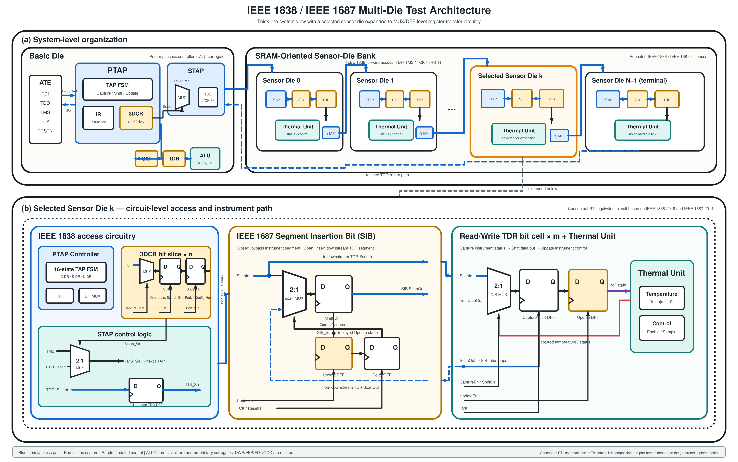
CORE MESSAGE
One Reusable Engineering Flow, Not Three Isolated Cases
The same insertion, retargeting, simulation, and synthesis methods scale across deeper access hierarchies.
LEVEL 1
IEEE 1687
Local instrument access
LEVEL 2
1687 + IEEE 1838
Die-level access
LEVEL 3
stack_top
Multi-die hierarchical access
KEY TAKEAWAY
The flow is repeatable, extensible, and backed by clear acceptance evidence at every stage.
Architecture based on the current prototype and IEEE 1687-2014 / IEEE 1838-2019
02

Slide 3
PRESENTATION LOGIC
Task and Checkpoint Can Share a Slide—Evidence Must Close the Loop
1
2
3
TASK
CHECKPOINT
EVIDENCE
Action Taken
Acceptance Criteria
Proof to Show
Example: insert SIB/TDR, generate ICL, and run retargeting
Example: DRC passes, path is reachable, and care-bit mismatches = 0
log summary
hierarchy
waveform / compare report
Definition of Done
Task completed + Checkpoint met + Evidence reproducible
Every stage uses this structure, so acceptance criteria never have to be hunted across slides.
Current scope: IEEE 1687 + IEEE 1838; DWR excluded
03

Slide 4
MASTER FLOW
Six Stages Form a Repeatable End-to-End Automation Flow
01
02
03
04
05
06
Environment
RTL Insertion
ICL / PDL
RTL Verify
Synthesis
Gate Verify
script / file list
1687 / 1838 structures
retargeted patterns
causal waveform trace
dont_touch + SDC
same-pattern compare
One Flow, Three Levels
IEEE 1687
✓
Local instrument access
1687 + IEEE 1838
✓
Die wrapper + local IJTAG
stack_top
✓
Package-to-die hierarchical access
Current scope: IEEE 1687 + IEEE 1838; DWR excluded
04

Slide 5
VALIDATION STRATEGY
Validation Depth Increases While the Core Flow Stays the Same
+ multi-die access depth
LEVEL 3
stack_top
+ wrapper control
Multiple STAPs + hierarchical retargeting
LEVEL 2
1687 + IEEE 1838
PTAP / 3DCR / STAP + local IJTAG
LEVEL 1
IEEE 1687
TAP → SIB → TDR → Instrument
Shared core: one Tcl / ICL / PDL / simulation / synthesis flow
Current scope: IEEE 1687 + IEEE 1838; DWR excluded
05

Slide 6
STAGE DETAIL
Convert One-Off Commands into a Repeatable Environment
1 ENV
2 INSERT
3 RETARGET
4 RTL VERIFY
5 SYNTHESIS
6 GATE VERIFY
STAGE 1
Environment & Script Setup
TASK
CHECKPOINT
EVIDENCE
Actions
Pass Conditions
Artifacts
Organize RTL, libraries, and file lists
✓
All RTL reads and elaborates successfully
Clean-run log
Fixed entry point and output structure
Create one entry point for insertion, pattern generation, simulation, and synthesis
✓
A clean directory reproduces the full run
Config diff
Switch among 1687, 1838, and stack_top through configuration
✓
Changing configurations requires no major manual script edits
Only parameters change across the three architectures
Generated artifacts
RTL / ICL / pattern / reports
Current scope: IEEE 1687 + IEEE 1838; DWR excluded
06

Slide 7
STAGE DETAIL
Automated Insertion Must First Prove Reachability and RTL Integrity
1 ENV
2 INSERT
3 RETARGET
4 RTL VERIFY
5 SYNTHESIS
6 GATE VERIFY
STAGE 2
Automated RTL Insertion
Tessent-inserted RTL
Checkpoint
Functional RTL
✓
Insertion DRC passes
original design
+ instrument ports
TAP / PTAP
SIB
TDR
✓
Every instrument is reachable through the network
3DCR
STAP
✓
Generated hierarchy and connectivity match the intended architecture
Evidence
successful insertion summary
generated hierarchy / instance count
compile / connectivity report
This stage proves correct insertion; the next stage proves correct operation.
Current scope: IEEE 1687 + IEEE 1838; DWR excluded
07

Slide 8
STAGE DETAIL
ICL/PDL Retargets Instrument Operations to Top-Level Patterns
1 ENV
2 INSERT
3 RETARGET
4 RTL VERIFY
5 SYNTHESIS
6 GATE VERIFY
STAGE 3
ICL / PDL & Pattern Retargeting
Instrument PDL
Post-insertion ICL
Retargeting
Top-level Pattern
write / run / read
SIB + die hierarchy
resolve access path
package TDI/TDO sequence
Checkpoint
Why it matters
✓
ICL rule and syntax checks pass
Users describe only instrument-level operations; the tool handles SIBs, STAPs, and multi-die paths automatically.
✓
Retargeting completes with no unresolved paths
✓
Scan length matches the active network
Current scope: IEEE 1687 + IEEE 1838; DWR excluded
08

Slide 9
STAGE DETAIL
RTL Verification Traces the Full Causal Chain—not Just Simulation Completion
1 ENV
2 INSERT
3 RETARGET
4 RTL VERIFY
5 SYNTHESIS
6 GATE VERIFY
STAGE 4
RTL Pattern Verification
TMS / TCK
TAP / PTAP
IR decode
Capture / Shift / Update
SIB / 3DCR / STAP
TDR / shadow
drive state
FSM transition
select network
enable registers
open path
write & read
PASS criteria
Evidence
✓
All care-bit comparisons pass
Representative waveform with markers
✓
Instrument response matches expectations
pattern pass summary / mismatch = 0
✓
Unselected instruments remain unchanged
reset、SIB / STAP close behavior
Current scope: IEEE 1687 + IEEE 1838; DWR excluded
09

Slide 10
RTL VERIFICATION EVIDENCE
One Pattern Flow Now Covers Three Access Depths
1 ENV
2 INSERT
3 RETARGET
4 RTL VERIFY
5 SYNTHESIS
6 GATE VERIFY
01
IEEE 1687
Proves local instrument access
✓
TAP → SIB → TDR → Instrument
02
1687 + IEEE 1838
Proves wrapper, 3DCR, and STAP control
✓
PTAP → local SIB → TDR
03
stack_top
Proves multi-die retargeting and return path
✓
Package → Basic STAP → Sensor STAP → SIB → TDR
Access hierarchy grows; manual pattern complexity does not.
Current scope: IEEE 1687 + IEEE 1838; DWR excluded
10

Slide 11
RTL VERIFICATION EVIDENCE
Event Markers Make Complex Stack Traces Verifiable
1 ENV
2 INSERT
3 RETARGET
4 RTL VERIFY
5 SYNTHESIS
6 GATE VERIFY
M0
M2
M4
M7
M9
Reset
Sensor0 3DCR
TDR Update
Valid
Compare
M1
M3
M5
M8
M10
Basic 3DCR
Sensor1 SIB
Start
Capture
Pass
Each marker binds the expected state, control, and data signals, localizing errors to IEEE 1838 access, IEEE 1687 selection, or instrument behavior.
Current scope: IEEE 1687 + IEEE 1838; DWR excluded
11

Slide 12
STAGE DETAIL
Synthesis Must Preserve the Test Network—not Merely Produce a Netlist
1 ENV
2 INSERT
3 RETARGET
4 RTL VERIFY
5 SYNTHESIS
6 GATE VERIFY
STAGE 5
Synthesis Integration
Tessent RTL
Compile test block
dont_touch + SDC
Top synthesis
Gate netlist
generated test logic
independent boundary
preserve structure / timing
functional + test logic
ready for GLS
Checkpoint
Evidence
✓
Tessent network survives optimization intact
pre/post-synthesis hierarchy & instance comparison
✓
Test clocks, resets, and generated constraints are applied correctly
synthesis log / constraint report / gate netlist
Current scope: IEEE 1687 + IEEE 1838; DWR excluded
12

Slide 13
STAGE DETAIL
Gate-Level Reuse Proves Synthesis Preserved the Access Path
1 ENV
2 INSERT
3 RETARGET
4 RTL VERIFY
5 SYNTHESIS
6 GATE VERIFY
STAGE 6
Gate-Level Verification
RTL lane
Inserted RTL
Same retargeted pattern
Expected response
COMPARE
care bits
mismatch = 0
Gate lane
Gate netlist + libs
Same retargeted pattern
Observed response
Gate netlist compiles • pattern completes • RTL/gate readback matches • no unexpected X affects comparison
Current scope: IEEE 1687 + IEEE 1838; DWR excluded
13

Slide 14
COVERAGE SUMMARY
Regression Matrix Shows Completed Coverage at a Glance
Each column represents an access depth; each row is an accepted end-to-end deliverable.
DWR excluded
Verification item | 1687 | 1687 + 1838 | stack_top
Automated RTL insertion | ✓ | ✓ | ✓
ICL generation / check | ✓ | ✓ | ✓
PDL retargeting | ✓ | ✓ | ✓
RTL pattern simulation | ✓ | ✓ | ✓
Synthesis integration | ✓ | ✓ | ✓
Gate-level pattern simulation | ✓ | ✓ | ✓
Hierarchical access | N/A | Local die | Multi-die
Conclusion: the complete flow now spans local to multi-die access, with closed-loop verification at both RTL and gate levels.
Current scope: IEEE 1687 + IEEE 1838; DWR excluded
14

Slide 15
WHAT WAS BUILT
The Engineering Value Is Repeatability, Scalability, and Traceability
01
02
03
REPEATABLE
SCALABLE
TRACEABLE
Rerun insertion, retargeting, simulation, and synthesis from a clean environment
Scale the same flow from 1687 to 1838 and then to a multi-die stack
Attach a checkpoint plus a log, waveform, or compare result to every stage
Integration Issues Resolved
Test logic
Retargeting
independent compile + dont_touch + Tessent SDC
instrument-level PDL → package-level pattern
The result is not a one-time PASS, but a reusable baseline for future designs.
Current scope: IEEE 1687 + IEEE 1838; DWR excluded
15

Slide 16
CURRENT STATUS
End-to-End Baseline Complete; Regression Hardening Is Next
✓
✓
✓
✓
✓
✓
ENV
INSERT
RETARGET
RTL VERIFY
SYNTHESIS
GATE VERIFY
COMPLETED
NEXT
✓
1687 / 1838 automated insertion
Curate representative logs, waveforms, and compare reports
✓
ICL / PDL retargeting + RTL verification
Build one-command regression with assertion-based checks
✓
synthesis integration + gate-level verification
Confirm project integration order; evaluate DWR in a later phase
Core message: the flow works end to end; next, improve automation maturity and evidence reproducibility.
Decision point: regression hardening first; DWR remains out of current scope
16

