Slide 1
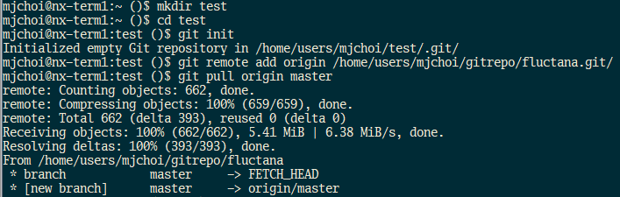
How to get ‘fluctana’
Login iKSTAR server
Make a directory (repository) for fluctana
Make the directory as a git repository and pull the code from the remote fluctana repository (/home/users/mjchoi/gitrepo/fluctana.git/)

Slide 2
A guideline to play with ‘fluctana’
I suggest you to make the folder named ‘analysis’ under ‘fluctana’
Any changes in ‘analysis’ will be ignored from Git, and so you can make your own analysis codes freely
Copy some codes from ‘examples’ folder
[Caution] During the campaign, the ECEI storage server is busy archiving the data for about ~3 minutes after the shot finished. PLEASE DO NOT access the ECEI data using ‘fluctana’ during the data archiving period.

Slide 3
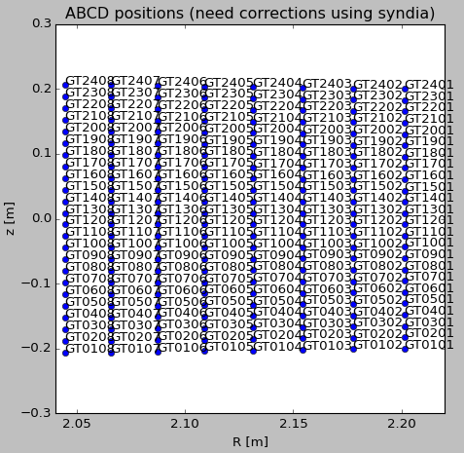
Check ECEI positions using check_ecei_pos.py
Names of the KSTAR ECEI system
Since 2018 : GT, GR, HT (two systems at G-port and one system at H-port)
Before 2018 : L, H, G (two systems (L, H) at H-port and one system at G-port)
shot
name

Slide 4
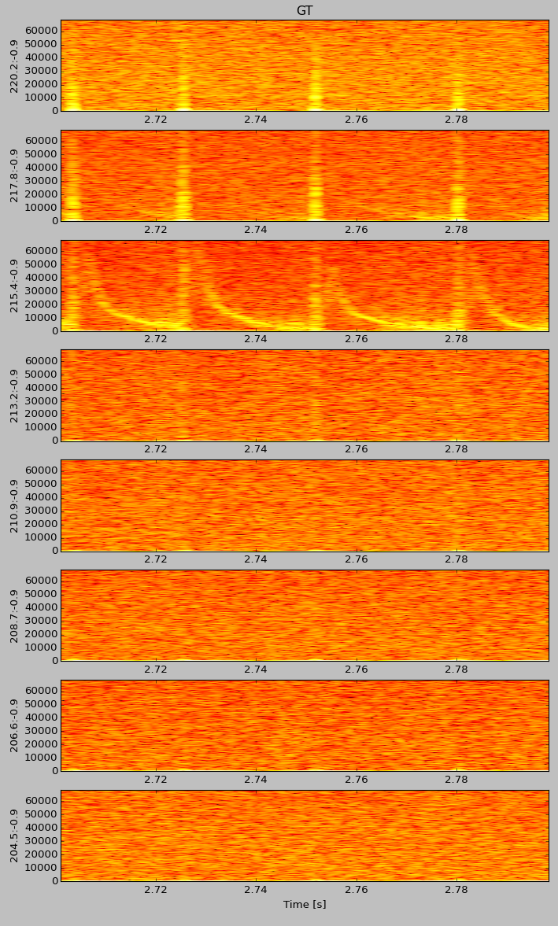
Check ECEI spectrum using check_ecei_data.py
Check the spectrum to determine the mode frequency
shot
name
time range
ELM

Slide 5
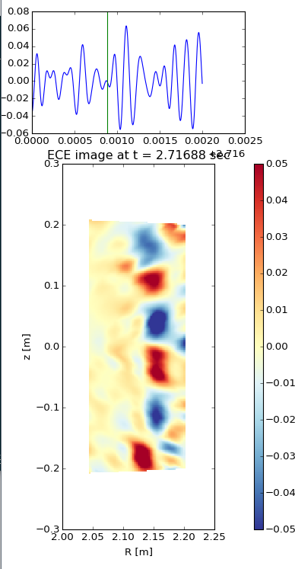


Check ECE images using check_ecei_image.py
I suggest to work on ipython
It is faster to plot the image
Command history is preserved
Import check_ecei_image
Play the image
You can choose ‘automatic’ or ‘manual’ mode by enterning 0 or 1
‘automatic’ mode : You can select time step [frame index unit]
‘manual’ mode : You can select the time point to plot the image in the top axes until you click the point beyond the available range
FIR band-pass range [kHz]
name
Color scale
time range

Slide 6
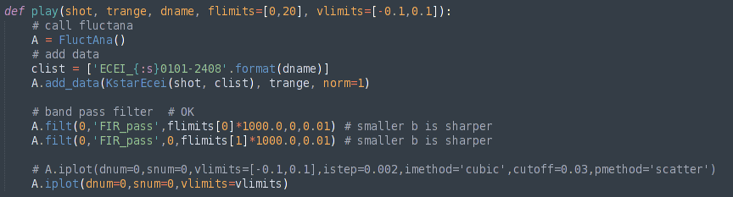
Note on check_ecei_image.py
You may use this code to check the MHD instability between shots during your KSTAR experiment. But, PLEASE DO NOT during the data archiving period (~ 3 minutes after the shot finish).
More options for a better image
You can also apply the svd filter after the FIR filter.
Please refer to ‘check_filter.py’ in ‘examples’
You can try to change interpolation methods or plot type
by changing ‘istep’, ‘imethod’ [‘linear’,’nearest’,’cubic’], ‘cutoff’, ‘pmethod’ [‘scatter’,’contourf’]

