Slide 1
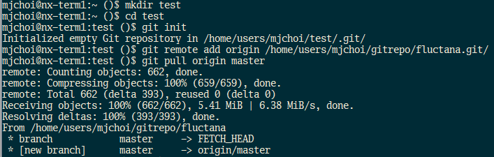
Get the code
Login iKSTAR server
Make a directory (repository) for fluctana and
Make the directory as a git repository and pull the code from the remote fluctana repository (/home/users/mjchoi/gitrepo/fluctana.git/)
Move to examples/ to run example codes

Slide 2
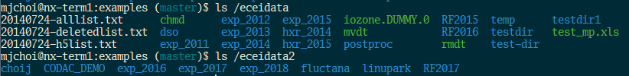
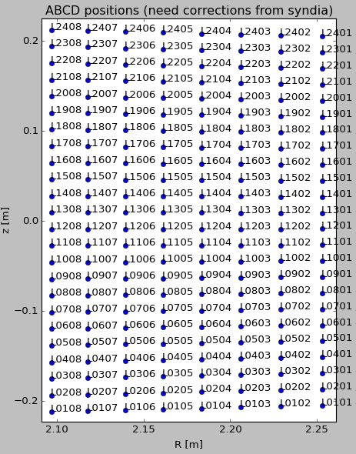
Check ECEI data and positions (need corrections)
Check ECEI data
Before 2018, three ECEI systems called L,H,G; each has 24(v)x8(r) channels
Since 2018, three ECEI systems called GT,GR,HT; each has 24(v)x8(r) channels
Channel naming : ECEI_Lvvrr or ECEI_GTvvrr
vv = vertical channel number
rr = radial channel number
Check ECEI positions
shot number = 10186
channels = ECEI_L0101-2408 (meaning channels from 0101 to 2408 (all))
shot number = 21328
channels = ECEI_GT0101-2408

Slide 3
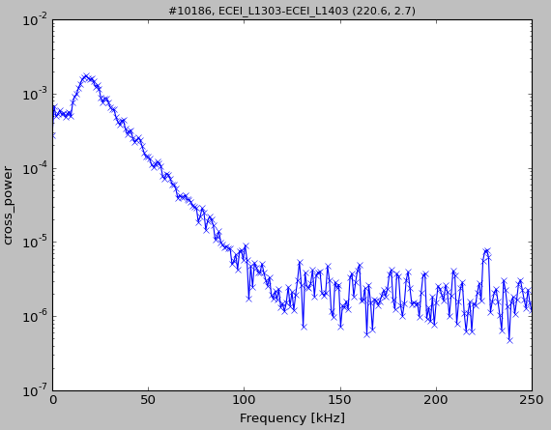
Examples) frequency spectrum (cross power)
Read ‘check_cross_power.py’ and run the following command
shot = 10186
time range = [15.9,16] s
channels in data set #0 = ECEI_L1303
channels in data set #1 = ECEI_L1403
Cross power using ECEI_L1303
and ECEI_L1403

Slide 4
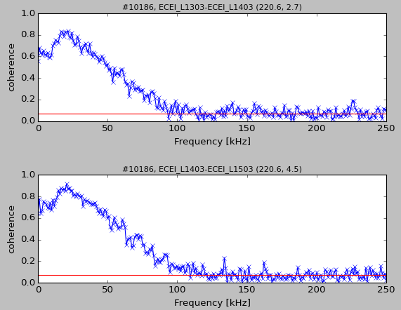
Examples) coherence
Read ‘check_coherence.py’ and run the following command
shot = 10186
time range = [15.9,16] s
channels in data set #0 = ECEI_L1303, ECEI_L1403
channels in data set #1 = ECEI_L1403, ECEI_L1503
coherence using ECEI_L1303
and ECEI_L1403
coherence using ECEI_L1403
and ECEI_L1503

Slide 5
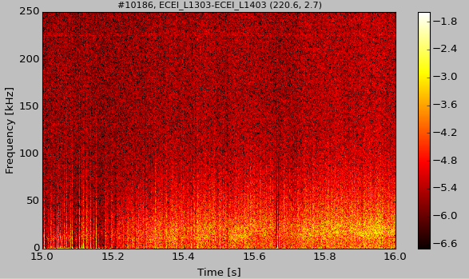
Examples) cross power spectrogram
Read ‘check_xspec.py’ and run the following command
shot = 10186
time range = [15,16] s
channels in data set #0 = ECEI_L1303
channels in data set #1 = ECEI_L1403
Cross power spectrogram using ECEI_L1303 and ECEI_L1403

Slide 6
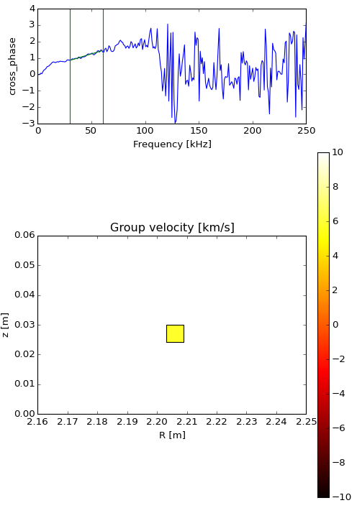
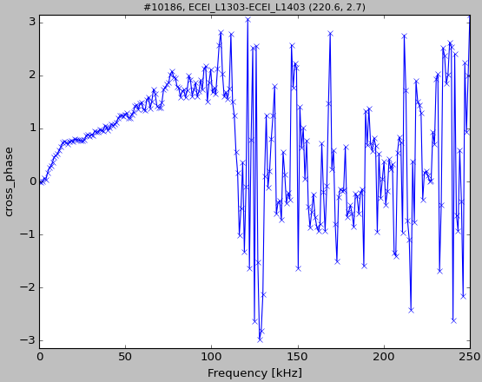
Examples) cross phase
Read ‘check_cross_phase.py’ and run the following command
shot = 10186
time range = [15.9,16] s
channels in data set #0 = ECEI_L1303 channels in data set #1 = ECEI_L1403
Group velocity of fluctuations in [30,60] kHz range
Direction (sign)
+ : from ECEI_L1303 to L1403
- : from ECEI_L1403 to L1303
cross phase using ECEI_L1303
and ECEI_L1403

Slide 7
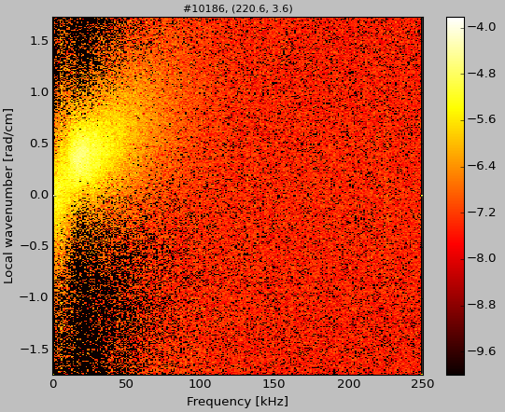
Examples) local S(K,w) spectrum
Read ‘check_SKw.py’ and run the following command
shot = 10186
time range = [15.9,16] s
channels in data set #0 = ECEI_L1203,L1303,L1403,L1503 channels in data set #1 = ECEI_L1303,L1403,L1503,L1603
Local S(K,w) spectrum using 4 pairs of L1203 & L1303, L1303 & L1403, L1403 & L1503, L1503 & L1603

Slide 8
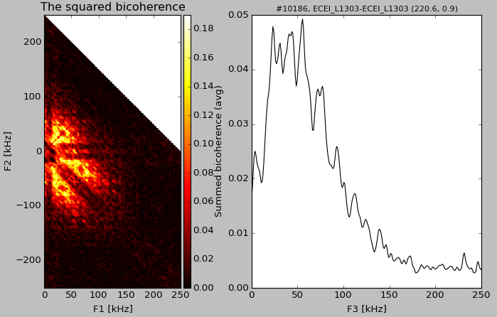
Examples) auto bicoherence
Read ‘check_bicoherence.py’ and run the following command
shot = 10186
time range = [15.9,16] s
channels in data set #0 = ECEI_L1303 channels in data set #1 = ECEI_L1303
Auto squared bicoherence using ECEI_L1303

Slide 9
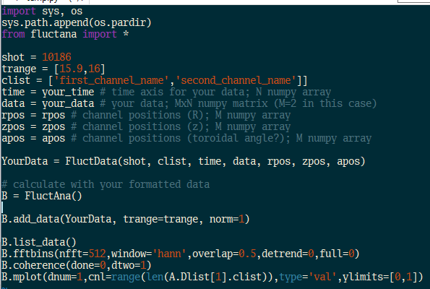
To use ‘fluctana’ with other diagnostics data
The KSTAR MDSplus data and the MIR diagnostics data are supported via ‘kstarmds.py’ and ‘kstarmir.py’ modules
Replace “KstarEcei(shot=shot, clist=clist)” with “KstarMds(shot=20896, clist=[‘MC1T06’])” or “KstarMir(shot=20896, clist=[‘MIR_vvrr’])” in the example codes
MDSplus node name
MIR channel naming = MIR_vvrr where vv = vertical channels (01~16) rr = radial channels (01~04)
You can also use your own data after transforming them into FluctData format as shown right

