Slide 1
基于图覆盖的测试设计
陈梓楠
edisonchan@szu.edu.cn
深圳大学致腾楼618-3

Slide 2
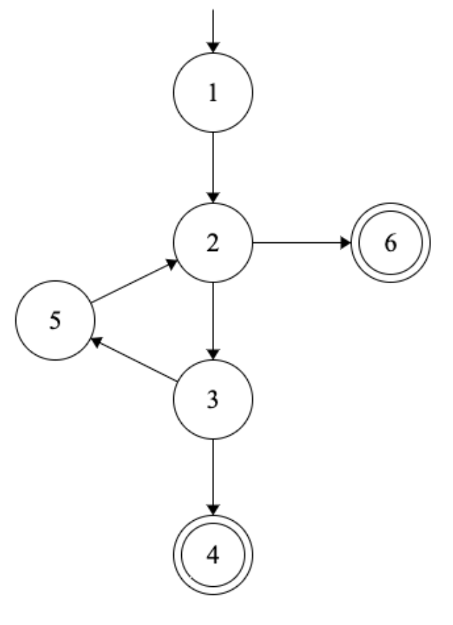
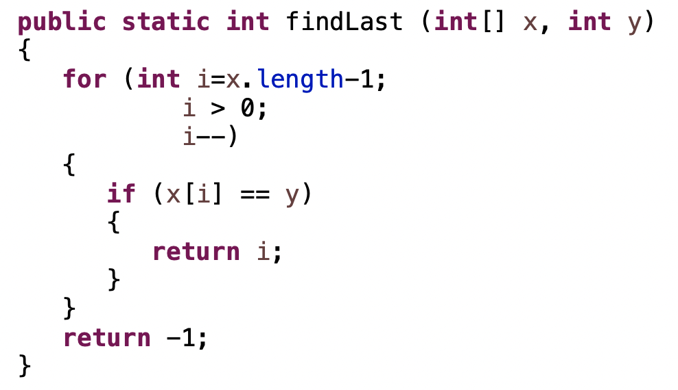
结构化覆盖：控制流程图
findLast:控制流程图
i <= 0
i > 0
x[i] != y
x[i] == y

Slide 3
生成测试需求
测试需求表
序号 | 准则 | 需求列表 | 备注
TR1 | NC | [1], [2], [3], [4], [5], [6]
TR2 | EC | [1, 2], [2, 3], [2, 6], [3, 4], [3, 5], [5, 2]
TR3 | EPC | [1, 2, 3], [1, 2, 6], [5, 2, 3], [5, 2, 6], [2, 3, 4], [2, 3, 5], [3, 5, 2]
TR4 | PPC | [5, 2, 3, 5], [5, 2, 3, 4], [3, 5, 2, 6], [3, 5, 2, 3], [2, 3, 5, 2], [1, 2, 3, 5], [1, 2, 3, 4], [1, 2, 6]

Slide 4
生成测试路径
测试路径表
序号 | 测试路径 | 覆盖 | 顺路
TP1 | [1, 2, 3, 4] | NC: [1], [2], [3], [4] EC: [1, 2], [2, 3], [3, 4] PPC: [1, 2, 3, 4] | 【可选】
TP2 | [1, 2, 3, 5, 2, 6] | NC: [1], [2], [3], [5], [6] EC: [1, 2], [2, 3], [2, 6], [3, 5], [5, 2] EPC: [1, 2, 3], [5, 2, 6], [2, 3, 5], [3, 5, 2]
TP3 | [1, 2, 6] | EPC: [1, 2, 6] PPC: [1, 2, 6]
TP4 | [1, 2, 3, 5, 2, 3, 4] | EPC: (1), (3), (5), (6), (7) PPC: (2), (4), (5), (6)
TP5 | [1, 2, 3, 5, 2, 3, 5, 2, 6] | PPC: (1), (3), (4), (5), (6)
可用上表对应序号表示
Notes:
NC
[1, 2, 3, 4] : [[1], [2], [3], [4]]
[1, 2, 3, 5, 2, 6] : [[1], [2], [3], [5], [6]]
EC
[1, 2, 3, 4] : [[1, 2], [2, 3], [3, 4]]
[1, 2, 3, 5, 2, 6] : [[1, 2], [2, 3], [2, 6], [3, 5], [5, 2]]
EPC
[1, 2, 6] : [[1, 2, 6]]
[1, 2, 3, 5, 2, 6] : [[1, 2, 3], [5, 2, 6], [2, 3, 5], [3, 5, 2]]
[1, 2, 3, 5, 2, 3, 4] : [[1, 2, 3], [5, 2, 3], [2, 3, 4], [2, 3, 5], [3, 5, 2]]
PPC
[1, 2, 6] : [[1, 2, 6]]
[1, 2, 3, 4] : [[1, 2, 3, 4]]
[1, 2, 3, 5, 2, 3, 5, 2, 6] : [[5, 2, 3, 5], [3, 5, 2, 6], [3, 5, 2, 3], [2, 3, 5, 2], [1, 2, 3, 5]]
[1, 2, 3, 5, 2, 3, 4] : [[5, 2, 3, 4], [3, 5, 2, 3], [2, 3, 5, 2], [1, 2, 3, 5]]

Slide 5
分析测试路径
测试路径分析表
序号 | 测试路径 | 来源 | 约束列表 | 备注
TP1 | [1, 2, 3, 4] | NC, EC, PPC | x.length - 1 > 0 x[x.length - 1] == y | TC1
TP2 | [1, 2, 3, 5, 2, 6] | NC, EC, EPC | x.length - 1 > 0 x[x.length - 1] != y x. length - 2 <= 0 | TC2
TP3 | [1, 2, 6] | EPC, PPC | x.length - 1 <= 0 | TC3
TP4 | [1, 2, 3, 5, 2, 3, 4] | EPC, PPC | x.length - 1 > 0 x[x.length - 1] != y x.length - 2 > 0 x[x.length - 2] == y | TC4
TP5 | [1, 2, 3, 5, 2, 3, 5, 2, 6] | PPC | x.length - 1 > 0 x[x.length - 1] != y x.length - 2 > 0 x[x.length - 2] != y x.length - 3 <= 0 | TC5

Slide 6
设计测试用例
测试用例表
序号 | 测试用例 | 预期输出 | 实际输出 | 通过？
TC1 | x = [1, 2], y = 2 | 1
TC2 | x = [1, 2], y = 3 | -1
TC3 | x = [1], y = 2 | -1
TC4 | x = [1, 2, 3], y = 2 | 1
TC5 | x = [1, 2, 3], y = 1 | 0

Slide 7
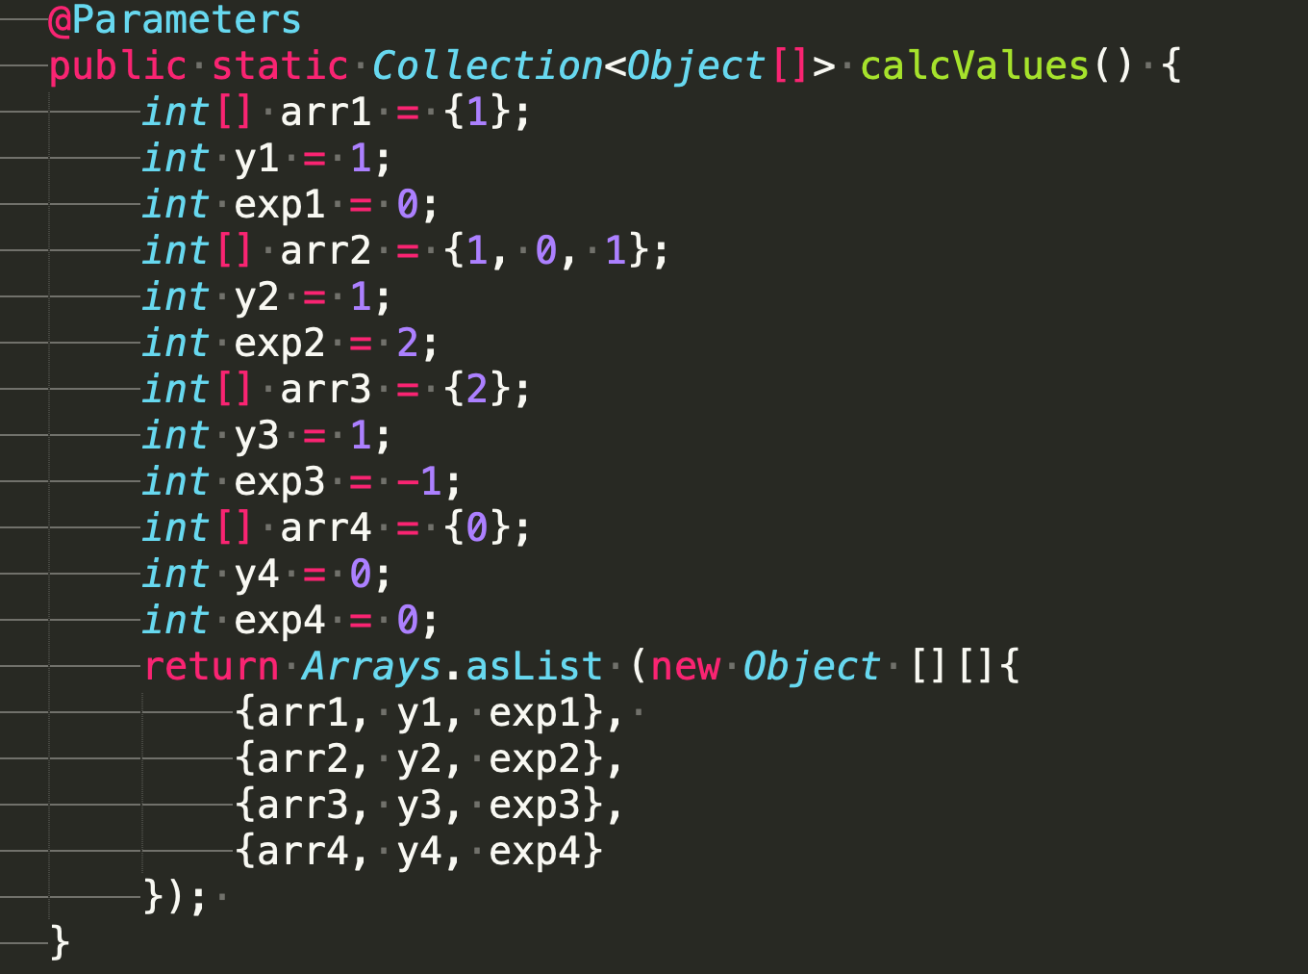

自动化脚本：JUnit

Slide 8
数据流覆盖
findLast:控制流程图的装饰
def i
use x
use i
use i
def i
use i
use x, y, i
use x, y, i
use i

Slide 9
生成测试需求
定义使用路径表
变量 | DU对 | DU路径集 | 变量 | DU对 | DU路径集
i | (1, (2, 3)) | { [1, 2, 3] } | i | (5, (2, 3)) | { [5, 2, 3] }
 | (1, (2, 6)) | { [1, 2, 6] } |  | (5, (2, 6)) | { [5, 2, 6] }
 | (1, (3, 4)) | { [1, 2, 3, 4] } |  | (5, (3, 4)) | { [5, 2, 3, 4] }
 | (1, (3, 5)) | { [1, 2, 3, 5] } |  | (5, (3, 5)) | { [5, 2, 3, 5] }
 | (1, 4) | { [1, 2, 3, 4] } |  | (5, 4) | { [5, 2, 3, 4] }
 | (1, 5) | { [1, 2, 3, 5] } |  | (5, 5) | { [5, 2, 3, 5] }
测试需求表
序号 | 准则 | 需求列表 | 备注
TR5 | ADUPC | [1, 2, 3], [1, 2, 6], [1, 2, 3, 4], [1, 2, 3, 5], [5, 2, 3], [5, 2, 6], [5, 2, 3, 4], [5, 2, 3, 5]
Notes:
def(i) ={1, 5}
use(i) ={(2,3), (2,6), (3,4), (3,5), 4, 5}

Slide 10
生成测试路径
测试路径表（可与前表合并）
序号 | 测试路径 | 覆盖 | 顺路
TP1 | [1, 2, 3, 4] | NC: [1], [2], [3], [4] EC: [1, 2], [2, 3], [3, 4] PPC: [1, 2, 3, 4] ADUPC: [1, 2, 3], [1, 2, 3, 4] | 【可选】
TP2 | [1, 2, 3, 5, 2, 6] | NC: [1], [2], [3], [5], [6] EC: [1, 2], [2, 3], [2, 6], [3, 5], [5, 2] EPC: [1, 2, 3], [5, 2, 6], [2, 3, 5], [3, 5, 2]
TP3 | [1, 2, 6] | EPC: [1, 2, 6] PPC: [1, 2, 6] ADUPC: [1, 2, 6]
TP4 | [1, 2, 3, 5, 2, 3, 4] | EPC: (1), (3), (5), (6), (7) PPC: (2), (4), (5), (6) ADUPC: (1), (4), (5), (7)
TP5 | [1, 2, 3, 5, 2, 3, 5, 2, 6] | PPC: (1), (3), (4), (5), (6) ADUPC: (1), (4), (5), (6), (8)
可用上表对应序号表示
Notes:
[1, 2, 6] : [[1, 2, 6]]
[1, 2, 3, 4] : [[1, 2, 3], [1, 2, 3, 4]]
[1, 2, 3, 5, 2, 3, 4] : [[1, 2, 3], [1, 2, 3, 5], [5, 2, 3], [5, 2, 3, 4]]
[1, 2, 3, 5, 2, 3, 5, 2, 6] : [[1, 2, 3], [1, 2, 3, 5], [5, 2, 3], [5, 2, 6], [5, 2, 3, 5]]

Slide 11
分析测试路径
测试路径分析表（可与前表合并）
序号 | 测试路径 | 来源 | 约束列表 | 备注
TP1 | [1, 2, 3, 4] | NC, EC, PPC, ADUPC | x.length - 1 > 0 x[x.length - 1] == y | TC1
TP2 | [1, 2, 3, 5, 2, 6] | NC, EC, EPC | x.length - 1 > 0 x[x.length - 1] != y x. length - 2 <= 0 | TC2
TP3 | [1, 2, 6] | EPC, PPC, ADUPC | x.length - 1 <= 0 | TC3
TP4 | [1, 2, 3, 5, 2, 3, 4] | EPC, PPC, ADUPC | x.length - 1 > 0 x[x.length - 1] != y x.length - 2 > 0 x[x.length - 2] == y | TC4
TP5 | [1, 2, 3, 5, 2, 3, 5, 2, 6] | PPC, ADUPC | x.length - 1 > 0 x[x.length - 1] != y x.length - 2 > 0 x[x.length - 2] != y x.length - 3 <= 0 | TC5

Slide 12
测试用例设计
测试路径分析表
序号 | 测试用例 | 预期输出 | 实际输出 | 通过？
TC1 | x = [1, 2], y = 2 | 1
TC2 | x = [1, 2], y = 3 | -1
TC3 | x = [1], y = 2 | -1
TC4 | x = [1, 2, 3], y = 2 | 1
TC5 | x = [1, 2, 3], y = 1 | 0

