Slide 2
Definition of Audit, Legal and Professional Consideration

Slide 3
What is assurance?
An assurance engagement is: 'An engagement in which a practitioner expresses a conclusion designed to enhance the degree of confidence of the intended users other than the responsible party about the outcome of the evaluation or measurement of a subject matter against criteria.'

Slide 4
International Audit and Assurance Standards Board(IAASB)
Giving assurance means: offering an opinion about specific information so the users of that information are able to make confident decisions knowing that the risk of the information being 'incorrect' is reduced.

Slide 5
Elements of an Assurance Engagement
• A three party relationship involving a practitioner, a responsible party, and intended users
• An appropriate subject matter
• Suitable criteria
• Sufficient appropriate evidence
•A written assurance report in the form appropriate

Slide 6
Three Party Relationship
• Practitioner: for example an auditor. Responsible for determining the nature, timing and extent of procedures and must pursue doubts and queries
• A responsible party: the person responsible for the information and assertions
• The intended users: the person(s) for whom the practitioner prepares the assurance report. The responsible party can be one of the intended users.

Slide 7
Subject matter
Many types:
• Financial performance
• Non-financial performance e.g. the key indicators of efficiency and effectiveness.
• Physical characteristics e.g. capacity of a facility.
• Systems and processes e.g. an entity’s internal control or IT system
• Behaviour e.g.- corporate governance, compliance with regulation

Slide 8
Suitable Criteria
Criteria are the benchmarks used to evaluate or
measure the subject matter. Without the frame of reference provided by suitable criteria, any conclusion is open to individual interpretation and misunderstanding.
Examples:
• Financial Statements: IFRS
• Internal Control: an internal control framework.
• Compliance: the applicable law, regulation or contract.
They must be available to intended users

Slide 9
Sufficient appropriate evidence
• Professional scepticism
• Sufficient, appropriate evidence
Sufficiency = quantity of evidence.
Appropriateness = quality of evidence (relevance and its reliability)

Slide 10
Assurance Report
A written report containing a conclusion is provided to the intended users.

Slide 11
Types of assurance engagement
The IAASB International Framework for Assurance Engagements permits two types of assurance engagement:
• Reasonable assurance engagement (Audit)
• Limited assurance engagement (Review Engagement)

Slide 12
Reasonable assurance engagements
In a reasonable assurance engagement, the practitioner:
• Gathers sufficient appropriate evidence to be able to draw reasonable conclusions.
• Concludes that the subject matter conforms in all material respects with identified suitable criteria.
• Gives a positively worded assurance opinion.
Positive form (reasonable assurance engagement): “In our opinion internal control is effective, in all material respects, based on XYZ criteria.”

Slide 13
Limited assurance engagement
In a limited assurance assignment, the practitioner:
• Gathers sufficient appropriate evidence to be able to draw limited conclusions.
• Concludes that the subject matter, with respect to identified suitable criteria, is plausible in the circumstances.
• Gives a negatively worded assurance opinion.
Negative form (limited assurance engagement): “Based on our work described in this report, nothing has come to our attention that causes us to believe that internal control is not effective, in all material respects, based on XYZ criteria.”

Slide 14
Audit Defined
An audit is still a key example of and assurance service in Bangladesh, where all registered companies are required to have audits by law.
An audit is an official examination of the accounts (or accounting systems) of an entity (by an auditor).

Slide 15
The main objective of an audit is to enable an auditor to convey an opinion as to whether or not the financial statements of an entity are prepared according to an applicable financial framework.

Slide 16
Definition of Audit
The word 'audit' comes from the Latin audire meaning to hear.
An auditor is defined in Chamber dictionary as: a hearer: one who audits accounts.
The auditors were deputed to hear suspected cases of irregularities, corruption, fraud and other serious offences in medieval times.

Slide 17
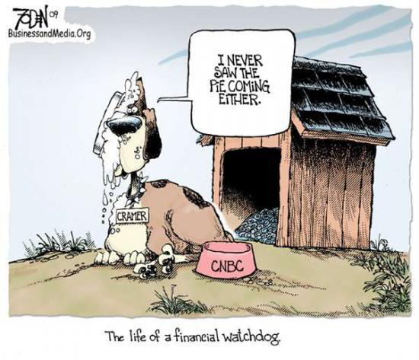
Auditor-Financial Watchdog

Slide 18
Why audit is needed?
Agency Theory:
Share Holders
Audit
Director
Accountability
Employee

Slide 19
Benefits of an audit:
• An audit improves the quality and reliability of information,
Giving investors faith in and improving the reputation in the market.
• Independent scrutiny and verification may be valuable to management.
• An audit may reduce the risk of management bias, fraud and error by
acting as a deterrent.

Slide 20
• An audit enhances the credibility of the financial statements, e.g. for tax authorities/lenders.
• Deficiencies in the internal control system may be highlighted by the
auditor.
Auditors recommending improvements in company systems.

Slide 21
Purpose and Objectives of Audit
The purpose of an audit is to enhance the degree of confidence of the intended users in the financial statements.
The objective of an external audit engagement is to enable the auditor to express an opinion on whether the financial statements:
• give a true and fair view (or present fairly in all material respects).
• are prepared, in all material respects, in accordance with an applicable financial reporting framework.

Slide 22
Review Engagement
It is possible for small companies, who are not legally required to have a full audit, to have a review of their financial statements to enable them to present their accounts (for example) to potential lenders.
A review engagement is an example of a limited assurance engagement.

Slide 23
The objective of a review of financial statements is to enable an auditor to state whether, on the basis of procedures which do not provide all the evidence required in an audit, anything has come to the auditor’s attention that causes the auditor to believe that the financial statements are not prepared in accordance with the applicable financial reporting framework (i.e. negative/limited assurance).

Slide 24
Expectations gap
Some users incorrectly believe that an audit provides absolute assurance; that the audit opinion is a guarantee the financial statements are 'correct'. This and other misconceptions about the role of an auditor are referred to as the 'expectations gap'.

Slide 25
Level of assurance engagement/ Limitation of Audit
The greatest level of assurance auditors can provide is reasonable. They cannot provide absolute assurance (i.e. 100% validation) for the following reasons:
The financial statements contain estimates and judgments;
Auditors have to test on a sample basis;
Fraud may be disguised; and

Slide 26
Much of the evidence obtained will be persuasive rather than conclusive.
do not review 100% of the transaction.
Other examples of the expectations gap include:
a belief that auditors test all transactions and balances; they test on a sample basis.
• a belief that auditors are required to detect fraud;
• a belief that auditors are responsible for preparing the financial statements; this is the responsibility of management.

Slide 27

Thank You

