Slide 1
Attack MNIST Recognition
7
Adversarial attacks on a trained CNN: FGSM, PGD, and Momentum I-FGSM
MNIST · PyTorch · CNN · ASR
3
8
Zhongling Ye
Notes:
- Today I will present my adversarial attack experiment on MNIST recognition. - The goal is to start with a high accuracy model and then test how easily it can be fooled.

Slide 2
Assignment objective
Train on MNIST train set, test on MNIST test set, then measure robustness under attacks.
Required metrics
Algorithms implemented
Recognition rate before attacks
Attack Success Rate (ASR) after attacks
Compare attacks across epsilon values
FGSM: one gradient-sign step
PGD / I-FGSM: iterative update
Momentum I-FGSM: iterative update with accumulated gradient
MNIST Train
Simple CNN
Clean Test
Adversarial Test
ASR
Notes:
- The assignment asks for training and testing on the official MNIST split. - Then I evaluate both clean recognition rate and attack success rate.

Slide 3
Model and data setup
The target model is a small CNN trained on MNIST handwritten digits.
2
60k
10k
99.28%
5
training images
test images
clean test accuracy
training epochs
CNN architecture
Training detail
Conv2d 1→32, ReLU, MaxPool
Conv2d 32→64, ReLU, MaxPool
Flatten → FC(128) → Dropout(0.25)
FC(10) outputs logits for digits 0–9
Optimizer: Adam, learning rate 0.001
Loss: CrossEntropyLoss
Batch size: 64 for training, 1000 for testing
Train augmentation: RandomAffine + normalization
5
Notes:
- The clean CNN is strong on normal MNIST images. - That high starting accuracy gives a good baseline for measuring how much attacks reduce reliability.

Slide 4
What is an adversarial attack?
A small, carefully chosen perturbation can change the model prediction while the image still looks similar to a human.
7
7
+ gradient-based noise
Model predicts
wrong digit
Key idea
Instead of random noise, adversarial attacks use the gradient of the loss to choose a direction that increases classification error.
Notes:
- The perturbation is not random. - It is calculated from the model gradient, so it pushes the input in the direction that increases the loss.

Slide 5
Attack algorithms
All three methods use gradients, but they differ in how many update steps they take.
FGSM
PGD / I-FGSM
Momentum I-FGSM
One-step attack:
adv = x + ε · sign(∇x loss)
Multiple small steps; each step is projected back into the ε-ball.
Like iterative FGSM, but accumulates gradient direction with momentum.
Fastest, weakest
Stronger, more stable
Strong and direction-aware
1 step
10 steps
10 steps
Notes:
- FGSM is simple and fast because it only uses one gradient step. - PGD and Momentum I-FGSM repeat the update, which usually creates stronger adversarial examples.

Slide 6
Evaluation design
ASR is measured only on images the clean model originally classified correctly.
Epsilon values
Implementation details
Pixel values are normalized using MNIST mean/std
Epsilon and alpha are adjusted to normalized scale
PGD and MI-FGSM use alpha = epsilon / 10 and 10 steps
Perturbations are clamped to valid image range
0.05
0.10
0.20
0.30
ASR = fooled originally-correct test images / originally-correct test images
Notes:
- ASR is computed in a strict way. - The denominator is the examples the clean model got correct, because those are the examples that can be meaningfully fooled.

Slide 7
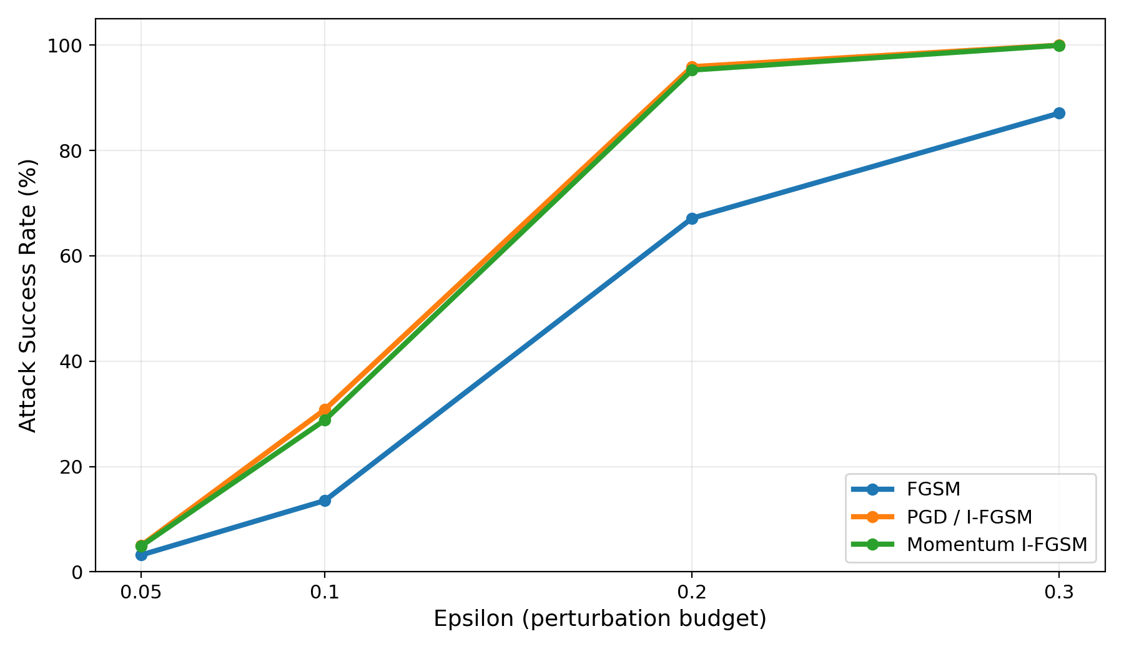
Attack success rate increases with epsilon
Larger allowed perturbations make the attacks much more effective.
Main observations
At ε = 0.05, all attacks are weak.
At ε = 0.20, PGD and MI-FGSM already fool about 95%.
At ε = 0.30, PGD and MI-FGSM almost completely fool the CNN.
Notes:
- The trend is very clear: increasing epsilon increases ASR. - The iterative methods have a much sharper increase than FGSM.

Slide 8
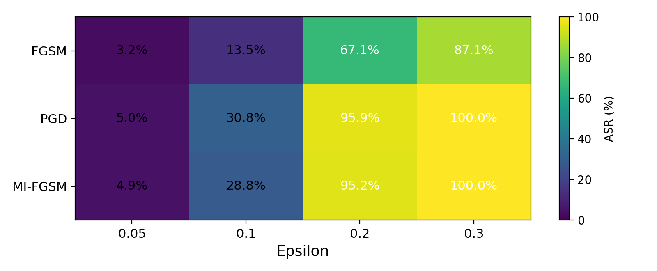
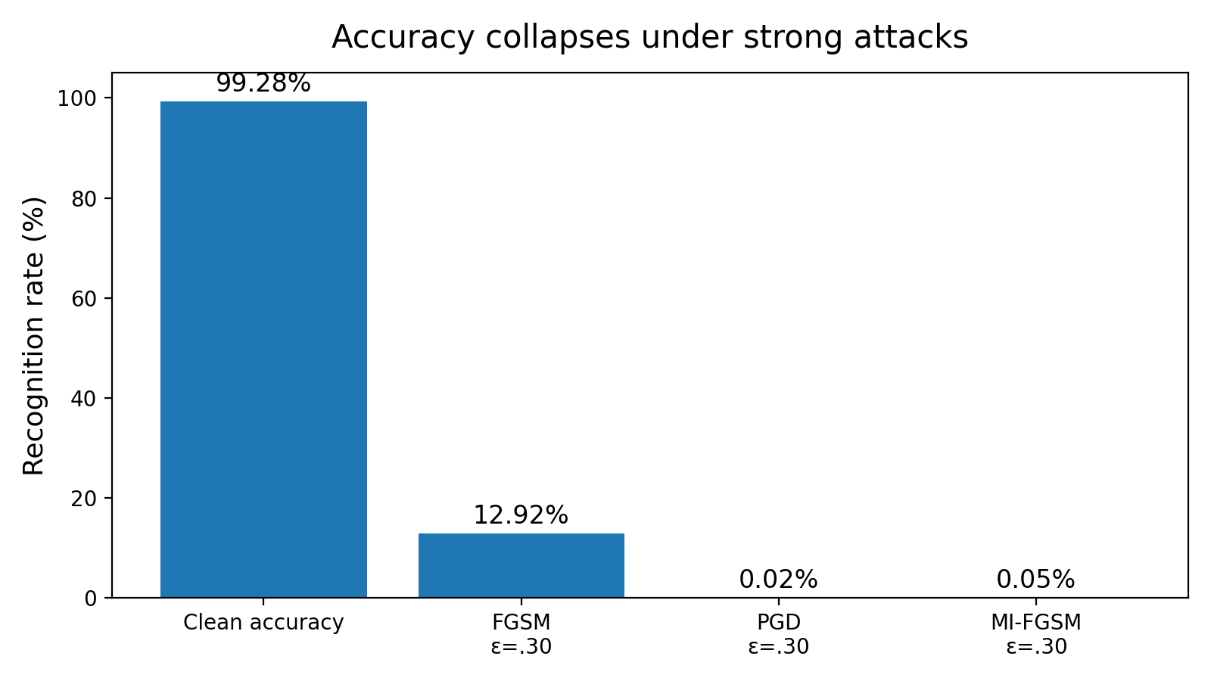
Numerical results
The clean recognition rate is high, but robustness is low under stronger attacks.
Results summary
ε
FGSM
PGD
MI-FGSM
0.05
3.21%
5.04%
4.92%
0.10
13.54%
30.81%
28.82%
0.20
67.14%
95.90%
95.25%
0.30
87.08%
99.98%
99.95%
Clean test accuracy: 99.28%. At ε = 0.30, the best attacks reduce reliable recognition to almost zero.
Notes:
- This slide shows both the table and the practical meaning. - The model is excellent on clean images but nearly fails under high-epsilon iterative attacks.

Slide 9
Why iterative attacks are stronger
PGD and Momentum I-FGSM refine the adversarial image instead of making only one jump.
Start image
FGSM
one jump
PGD
10 small steps
Decision boundary
crossed
Interpretation
FGSM is fast but may under-shoot or move in a less optimal direction.
PGD repeatedly recalculates gradients and stays inside the allowed perturbation budget.
Momentum smooths the direction by accumulating gradients, which can make the attack more consistent.
Notes:
- PGD is stronger because each step adapts based on the current adversarial image. - Momentum I-FGSM adds accumulated gradient direction to avoid unstable updates.

Slide 10
Conclusion
Clean accuracy alone is not enough to judge model reliability.
99.28%
99.98%
Next step
clean accuracy
PGD ASR at ε = 0.30
adversarial training / defense
Takeaway: The CNN learned MNIST very well, but gradient-based adversarial attacks can exploit its sensitivity. Robustness should be evaluated separately from normal test accuracy.
Repository: github.com/jye110/ai-hw-spring-2026-aa
Notes:
- My main takeaway is that a model can be accurate but not robust. - For future work, I would try adversarial training and compare defended and undefended models.

