Slide 1
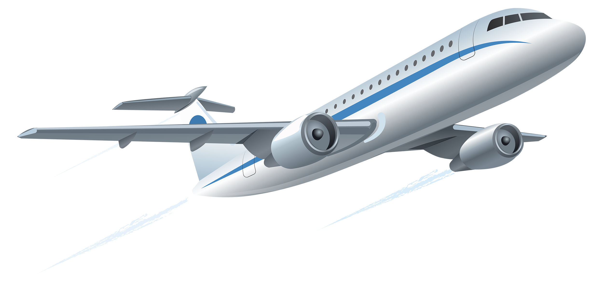

Airline Satisfaction
Chaitali Nautiyal, James Eakins,
Rupesh Ghosh,
Sanket Deepak Vichare

Slide 2
Business Questions
Which Airlines have the highest/lowest average customer satisfaction?
Which attributes impact customer satisfactions on those two airlines?
How can the lowest satisfaction Airline improve based on the highest satisfaction Airline?
What are the cities that have the most delays and what you can recommend to change it?
Does the age of the customer affect the customer rating?
Notes:
Trello board - bring the questions!

Slide 3
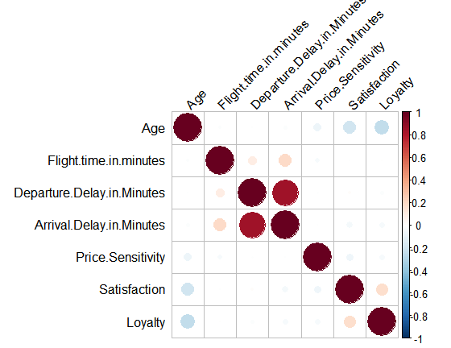
Correlation Matrix - Survey Data

Slide 4
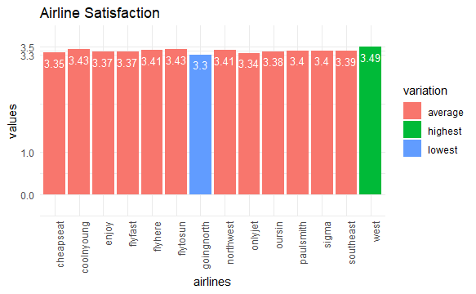
Overview
Airline Satisfaction is a key component for a successful business. Higher the satisfaction, more customers will use the airline to have better flight experience during the travel.
West Airways Inc. has the highest satisfaction and GoingNorth Airlines Inc. has the lowest customer satisfaction.
We will focus on how to improve GoingNorth Airlines Inc. satisfaction by comparing the attributes of West Airways inc.

Slide 5
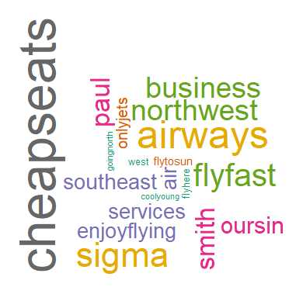

Slide 6
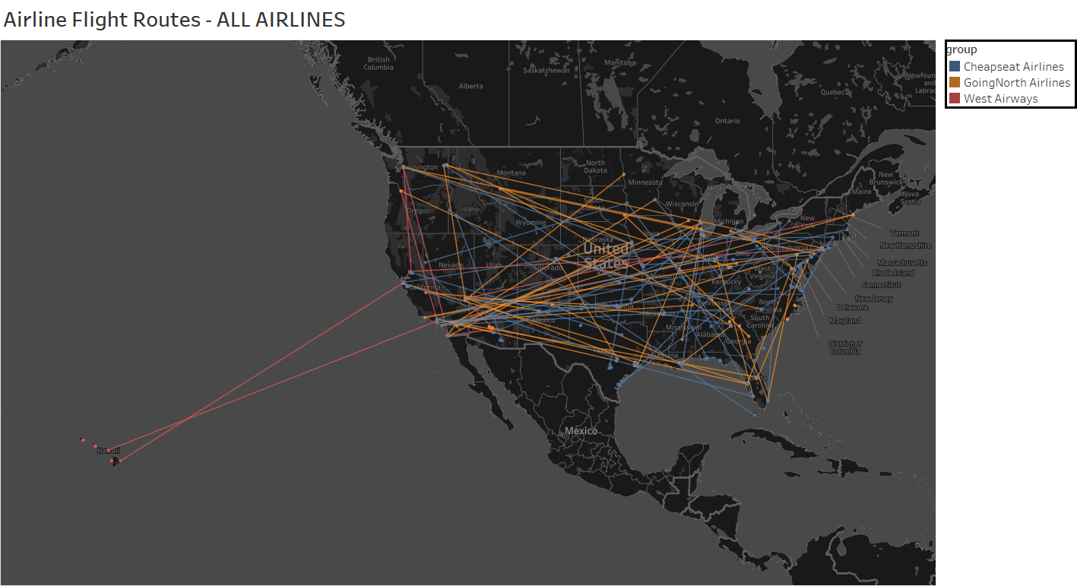
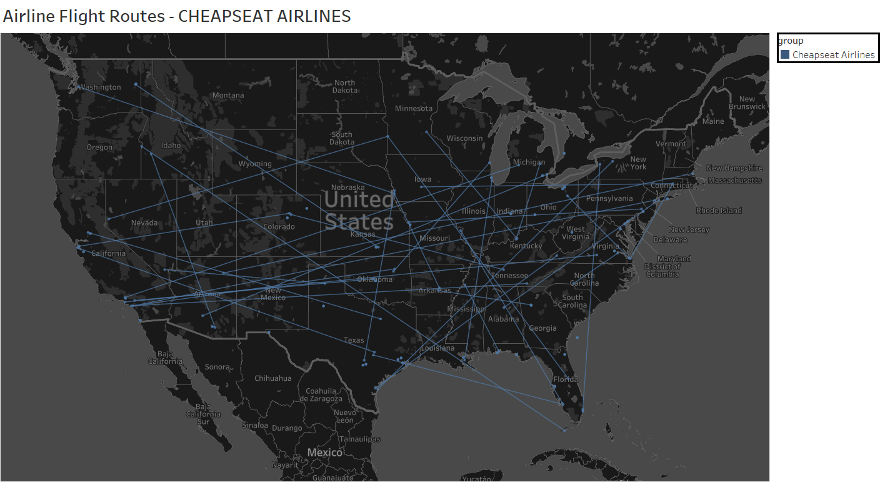
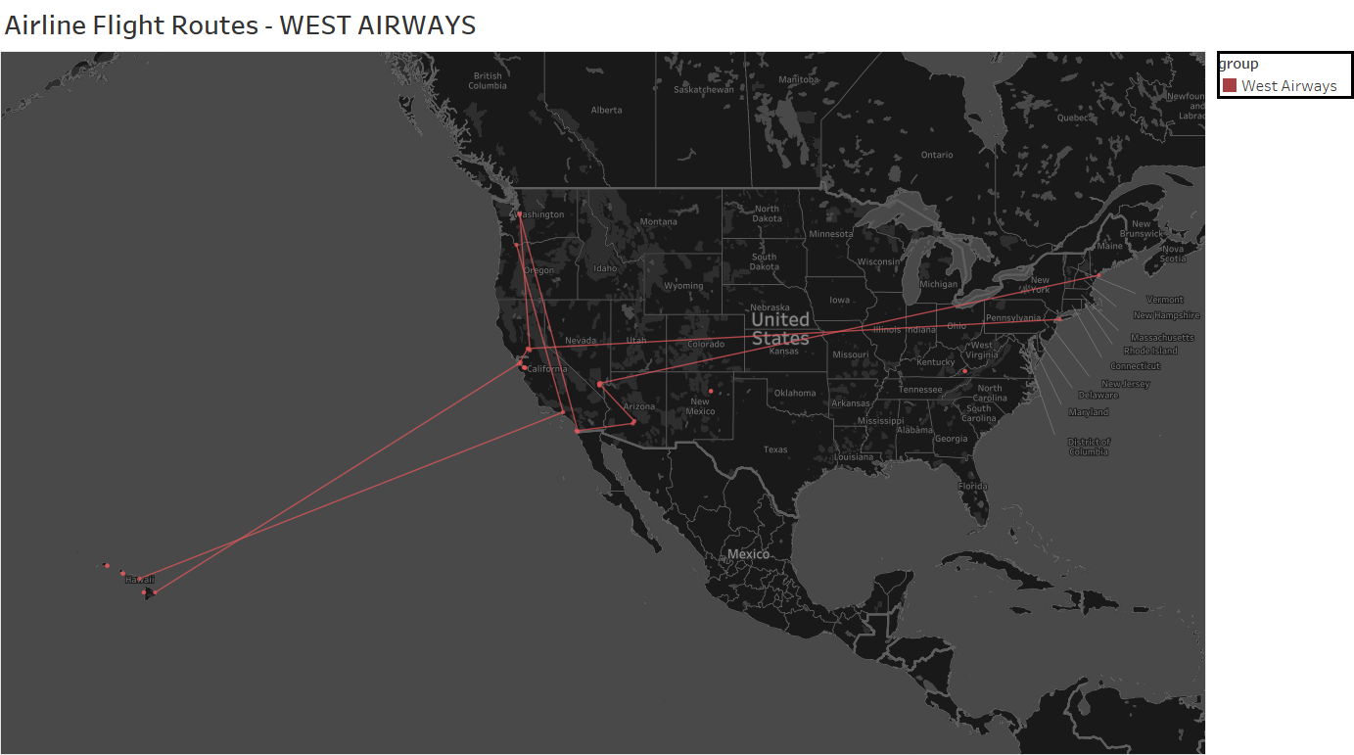
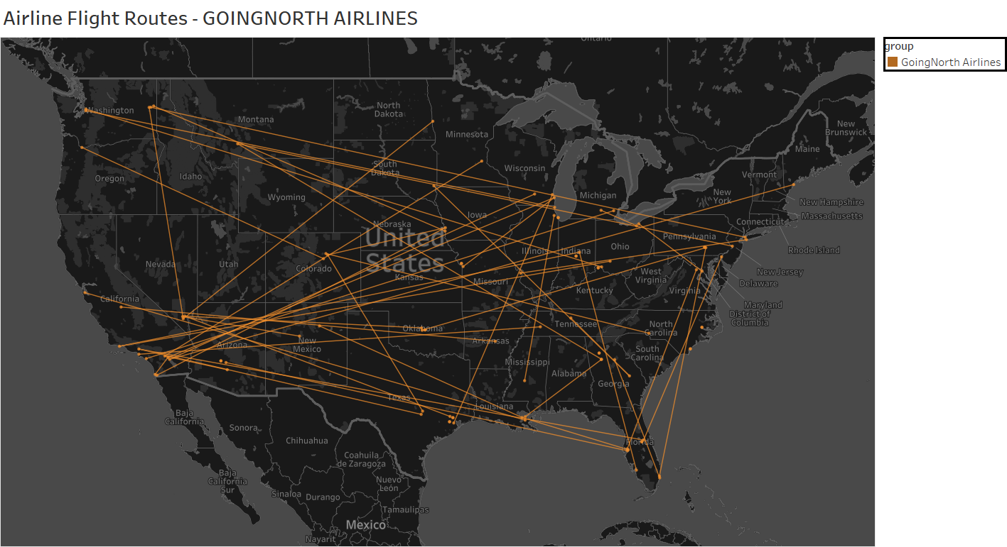

Slide 7
Understanding the Airlines
West Airways
GoingNorth Airlines
Cheapseat Airlines
Highest Satisfaction overall.
Low quantity Dataset
Need investigate what impacts their satisfaction average
Lowest Satisfaction overall
Operate on diverse regions
Need to investigate what impacts their satisfaction average
Highest quantity dataset
Operate on diverse regions
Mid-low satisfaction average but most demanded airline by customers overall

Slide 8
Project objective:
What makes the difference?

Slide 9
Understanding the Satisfaction
Of
Airlines

Slide 10
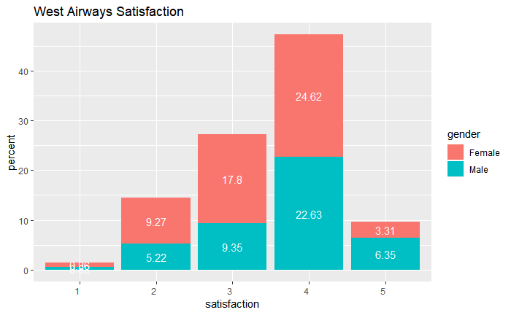
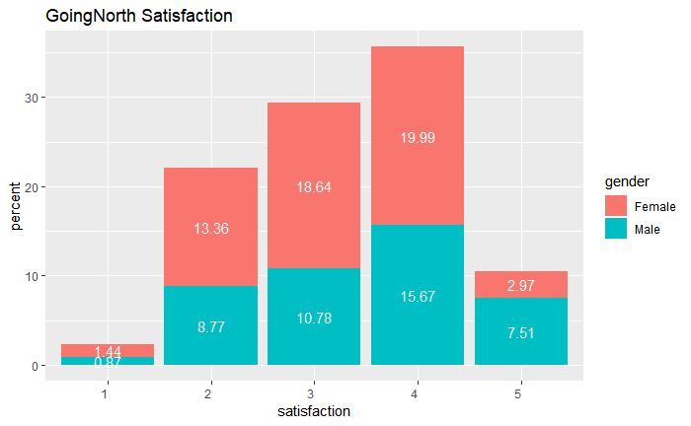
West Airways VS GoingNorth (Gender Satisfaction)

Slide 11
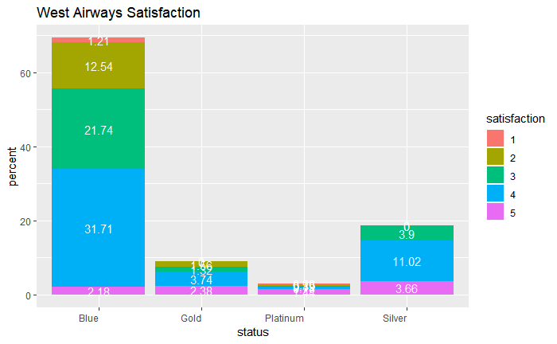
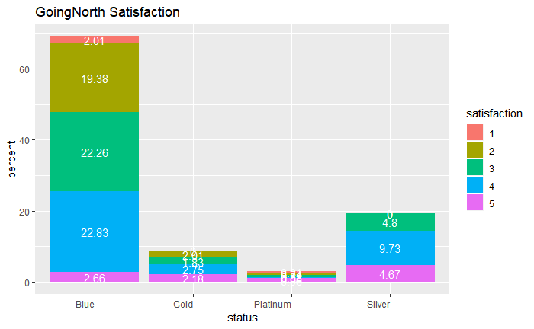
West Airways VS GoingNorth (AirlineStatus Sat.)

Slide 12
What else could impact satisfaction?

Slide 13
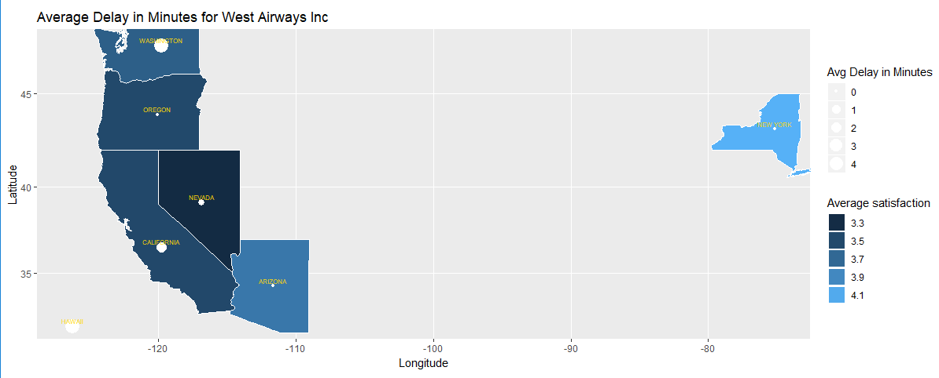
West Airways Inc Average Delay in Minutes
Notes:
West Airways didn’t have any cancelled flight!

Slide 14
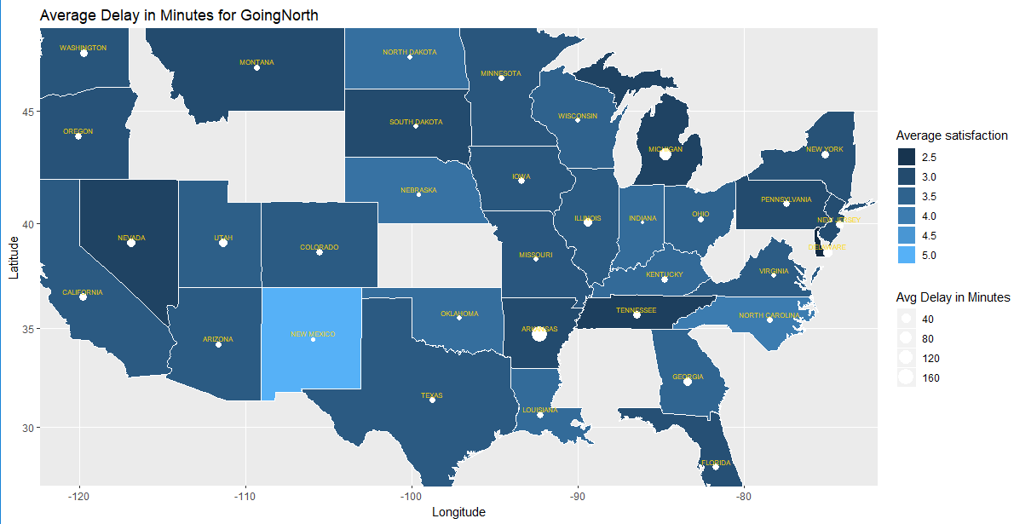
GoingNorth Airlines Inc Average Delay in Minutes

Slide 15
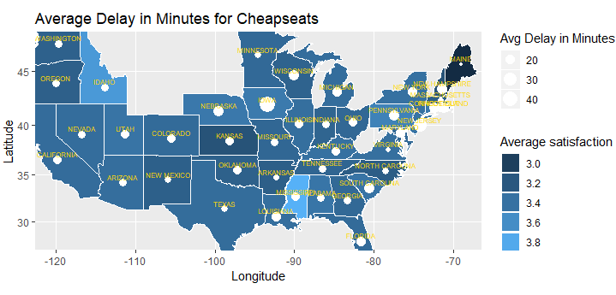
CheapSeats Airlines Inc Average Delay in Minutes

Slide 16
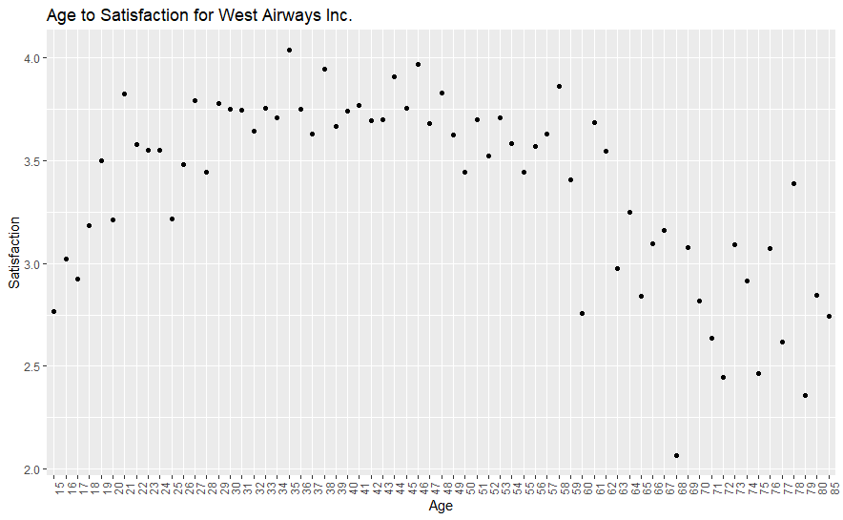
West Airways - Age to Satisfaction
Age Group:
High = Above 60
Average = 40-60
Low = Below 40
Average High Low
1 0.66% 0.31% 0.47%
2 3.89% 5.75% 4.94%
3 9.10% 9.14% 8.94%
4 19.25% 4.39% 23.52%
5 5.44% 0.70% 3.50%

Slide 17
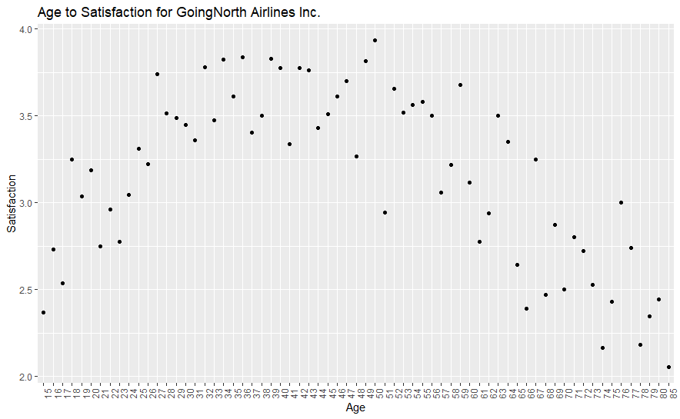
GoingNorth Airlines - Age to Satisfaction
Age Group:
High = Above 60
Average = 40-60
Low = Below 40
Average High Low
1 0.91% 0.78% 0.61%
2 6.04% 10.21% 5.91%
3 9.64% 6.65% 13.12%
4 16.94% 3.87% 14.9%
5 6.26% 0.78% 3.39%

Slide 18
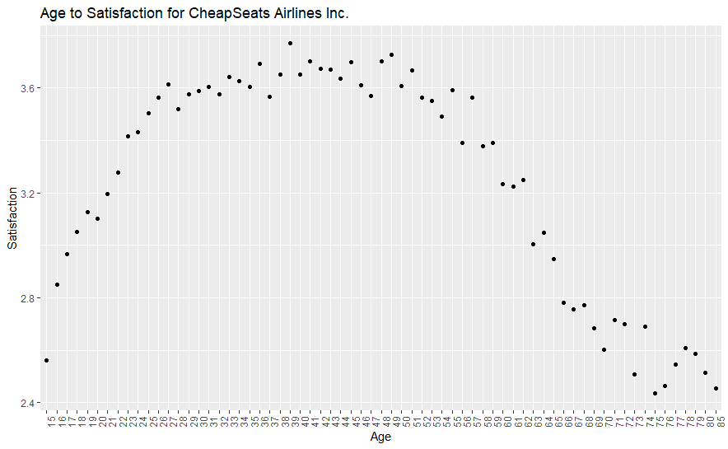
CheapSeats Airlines - Age to Satisfaction
Age Group:
High = Above 60
Average = 40-60
Low = Below 40
Average High Low
1 0.87% 0.92% 0.62%
2 5.12% 8.82% 5.27%
3 8.81% 8.13% 11.53%
4 18.52% 3.99% 18.00%
5 5.70% 0.52% 3.17%

Slide 19
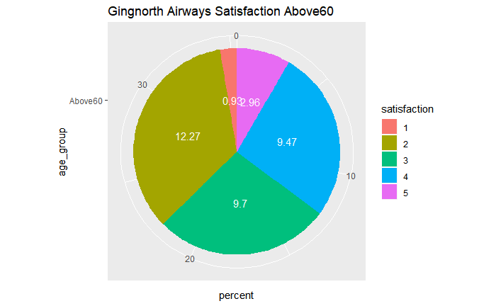
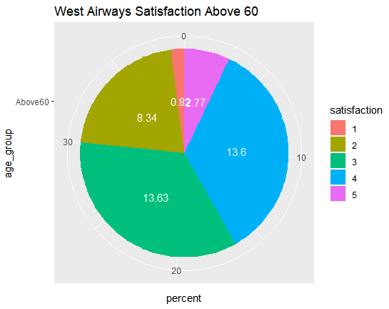
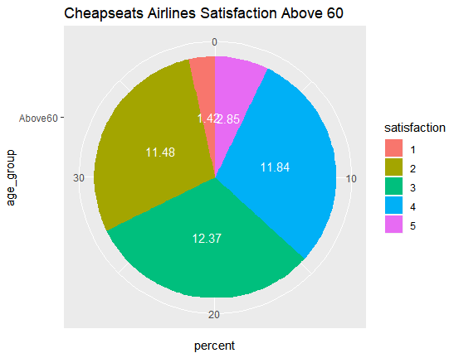
Satisfaction by Age Group Above 60

Slide 20
Modeling Techniques
Linear Model
It was not useful for our analysis
Not used for analysis - Results were showing some significance but too Low R-squared Values to use.
Apriori Rules
Created Age Group Bucket to proceed the analysis
Showed significant analysis result
SVM
Useful to determine the differences in Satisfaction between Airlines
Visualized in map to show the result

Slide 21
Timeline
Jan | Feb | Mar | Apr | May
Understanding & Cleaning Data
Analysis & Visualization
Tools Used:
Trello
Whatsapp
RStudio
Google
Lecture Notes
Homework
Team Meetings
Presentation Slides
Final Report

Slide 22

Actionable Insight

Slide 23


What should you do?
Aim to make the delay time less than 5 minutes
Offer better price & services to Blue Status Customers
Collect Female suggestions to improve services that target female customers
Give special assistance like wheelchair assistance, seats with greater leg space and comfort to the elderly as they are giving lower ratings

Slide 24


