Slide 1

CSE 583
Version Control I
David Beck^{1,2,3}, Joseph Hellerstein^{1,3}, Bernease Herman¹, Daniel Jones³
¹eScience Institute
²Chemical Engineering
³Computer Science
October 2, 2019

Slide 2
Survey the room
Raise your hand if…
You’ve never used source / version control
You’ve used source control, but not Git
Beginner in Git as an individual (git add, git commit)
Moderate/Advanced in Git as an individual (git rebase)
Beginner in Git as collaborative team (git push, git pull)
Moderate/Advanced in Git as collaborative team (pull requests, hooks)
Notes:
Dave had a very clever analogy for version control in his lecture from spring, so I’ll replicate (and

Slide 3
Agenda
Confirm sign-in to GitHub, fill in the spreadsheet
Version Control, Git, and GitHub
Hands on practice with Git & GitHub for individuals
Turning in homework
Notes:
Submitting homework on a separate video capture so you can refer back to it.

Slide 4
Questions from last lecture on
Procedural Python?

Slide 5
Why use version control?
Compare writing software with writing a manuscript.
Use undo to revert to a previous state
Use track changes when sharing document with advisor
Still, word processors can still be frustrating.
Intelligently combine changes made concurrently
Record reasoning (why? for code, what?) for changes
Efficient use of file storage
Modern version control systems can address all of these.
Notes:
Dave had a very clever analogy for version control in his lecture from spring, so I’ll replicate (and extend) it.

Slide 6
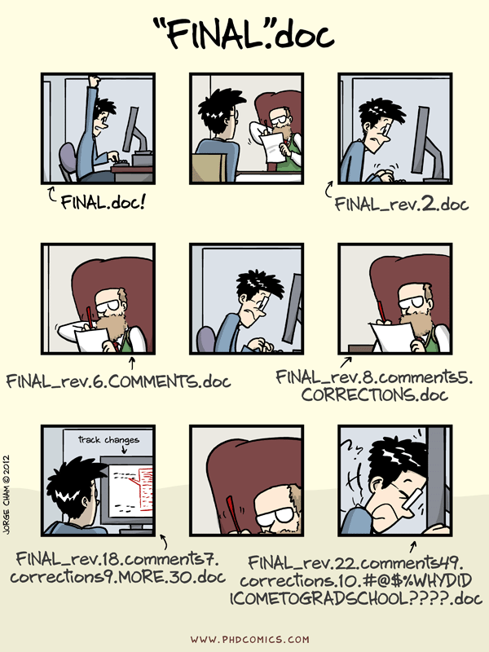
Tracking versions and efficient storage
http://phdcomics.com/comics/archive_print.php?comicid=1531
Notes:
I’m pretty sure that this comic is required for every “Why Version Control” presentation, so I won’t disappoint.

Slide 7
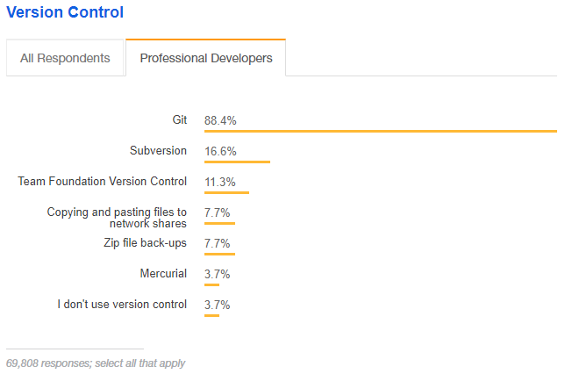
Stack Overflow Developer Survey 2018
Notes:
All of the cool kids do it. And at 88%, some of the uncool kids use it too.
Just short of 74 thousand developers represented.
My partner, for example, is a part of the 11% that has used Team Foundation Version Control throughout his career. We’ll talk more about why.

Slide 8
Git is a de facto standard for VCS
Benefits (+++++)
Performance: operations in Git are optimized and fast
Flexibility: doesn’t require use of a particular workflow
Security: protection against untraceable changes
Popularity: employment, available on many platforms
Distributed: can be used offline, no need for server
Downsides (-)
Distributed: not ideal for large files, merging changes
Notes:
At 88%, Git is the de facto standard for version control by software developers.
Git was originally developed in 2005 by Linus Torvalds, the famous creator of the Linux operating system kernel. So it’s not surprising that Git has strong flexibility, performance, and security measures compared to other VCS.
We’ll learn workflows later.

Slide 9
Version control in the cloud, GitHub
A working copy of your repository stored on GitHub’s servers connected and accessible via the internet
Others can download and use your code
Online repository is suitable as central repository
Social features, i.e. issue tracker, comments, notifications, wiki, etc.
Alternatives: Atlassian’s BitBucket, GitLab, SourceForge

Slide 10
Hands on Git / GitHub I

Slide 11
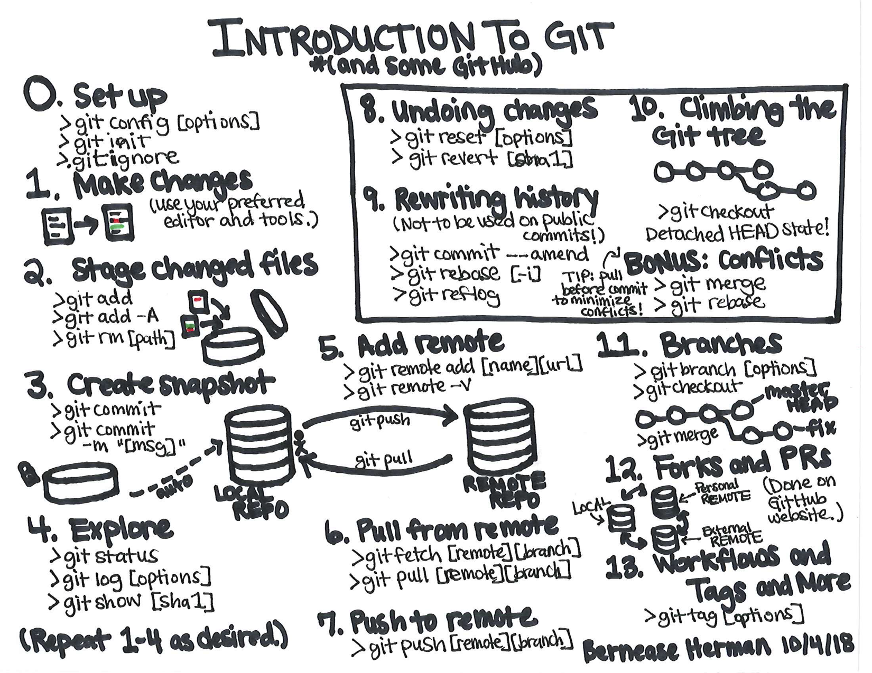

Slide 23
Questions on version control?
(Note that some topics will be covered in later VCS sessions)

Slide 24
DATA 583
Submitting Homework
via GitHub Classroom
Joseph Hellerstein^{1,3}, Bernease Herman¹, David Beck^{1,2,3}, Daniel Jones³
¹eScience Institute
²Chemical Engineering
³Computer Science
April 2, 2019

Slide 25
We’ll need your GitHub login.
(Please fill in the google doc so we can link your github ID to your UW Net ID.)

Slide 26
https://classroom.github.com/a/f0MI2yf6
Notes:
https://classroom.github.com/classrooms/49201890-uwseds-sp19-classroom

