Slide 1
Session 3: More Practices in R
IND E 321
Yan Jin (yanjin@uw.edu)
Dr. Shuai Huang (shuaih@uw.edu)

Slide 2
Outline for whole sessions by TA
Introduction to R
Basic statistics and ggplot2
More practice
Homework solution I
Minitab session
Homework solution II
R for quality control

Slide 3

Challenge 1
Problem: Create a vector of the values of $e^{x}\cos\left(x\right)$ at $x=3,3.1,3.2,…,6$

Slide 4
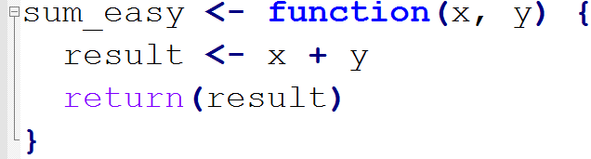
Challenge 1: Function in R
An example of a self-defined function in R

Slide 5

Challenge 1: Function in R
Redo this problem with defining function： Create a vector of the values of $e^{x}\cos\left(x\right)$ at $x=3,3.1,3.2,…,6$

Slide 6
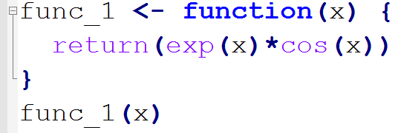
Challenge 1: Function in R
Redo this problem with defining function

Slide 7
Challenge 2: create function what_is_mode()
When to use mean, median, mode in the following cases
Type of variable | Mean, median, mode?
Continuous
Categorical
Ordinal

Slide 8
Challenge 2: create function what_is_mode()
When to use mean, median, mode in the following cases
Type of variable | Example | Mean, median, mode?
Continuous | 1,2,3,… | Mean, median, mode
Categorical | Male, female | Mode
Ordinal | Hot, warm, cold,… | Median, mode

Slide 9


Challenge 2: create function what_is_mode()
Problem: given the following vector, compute its mode.
Can we call the function mode()?

Slide 10
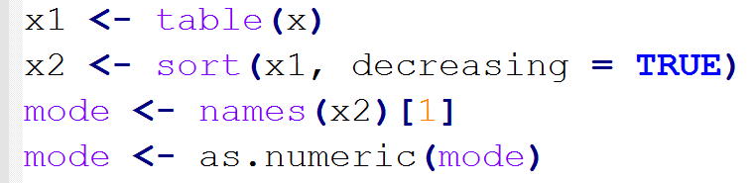
Challenge 2: create function what_is_mode()
How to compute the mode?

Slide 11
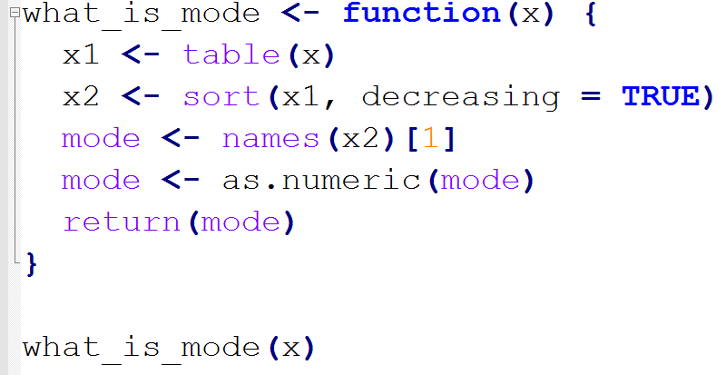
Challenge 2: create function what_is_mode()
Create function what_is_mode()

Slide 12
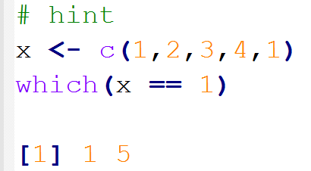
Exercise
In the dataset mtcars, what is the mode of transmission types (variable am) of the cars whose cylinder amount (variable cyl) is equal to the mode of the cylinder.
Find subset of cars whose cyl is at the mode of cyl
Compute the mode of am in the subset.

Slide 13
Challenge 3: Pairwise Correlation
Problem: Correlation between variable mpg and variable hp in mtcars

Slide 14
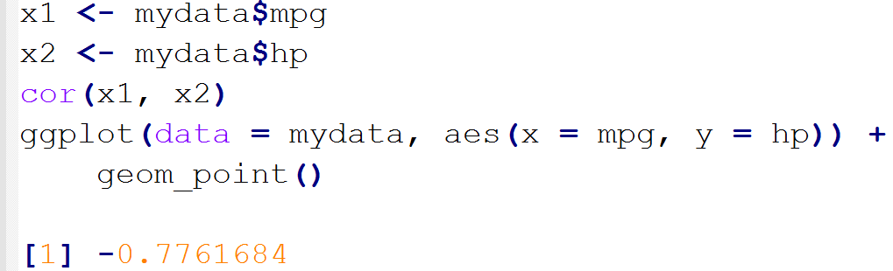
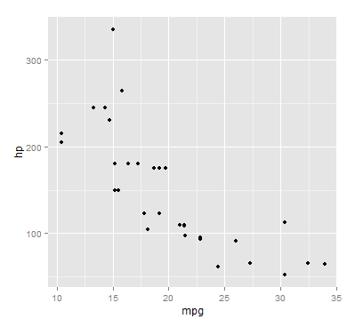
Challenge 3: Pairwise Correlation
Problem: Correlation between variable mpg and variable hp in mtcars

Slide 15
Challenge 3: Pairwise Correlation
What if the number of variables > 2? We might be interested in the pairwise correlation. How to do it in R?

Slide 16

Challenge 3: Pairwise Correlation
What if the number of variables > 2? We might be interested in the pairwise correlation. How to do it in R?
Visualization?

Slide 17

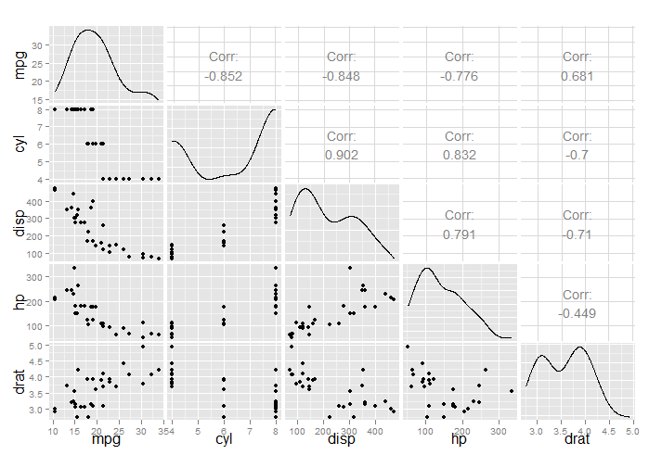
Challenge 3: Pairwise Correlation
Visualization for pairwise correlation?

Slide 18
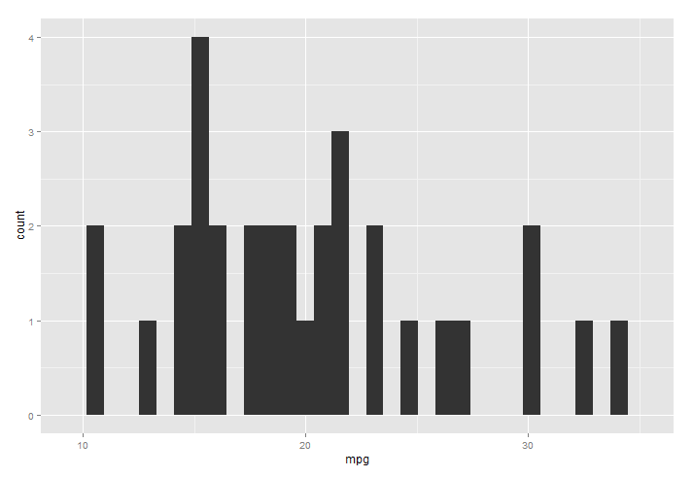
Challenge 4: Histogram
Change the bin size in the histogram
Increase the number of ticks in x axis

Slide 19
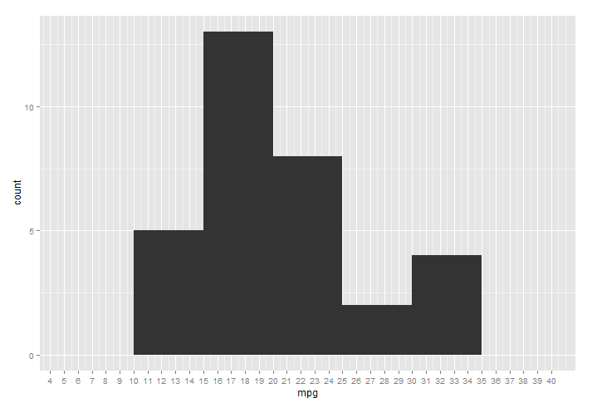
Challenge 4: Histogram
Change the bin size in the histogram
Increase the number of ticks in x axis

Slide 20
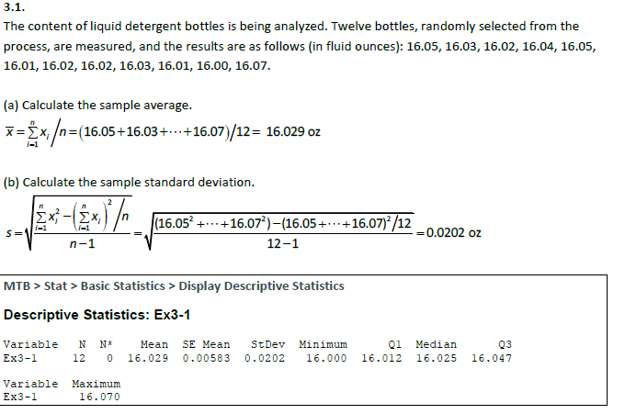
Exercise from your homework

Slide 21
Thank you.

