Slide 1
Session 2: Continued Session after 1st: statistics & ggplot2
IND E 321
Yan Jin (yanjin@uw.edu)
Dr. Shuai Huang (shuaih@uw.edu)

Slide 2
Outline for whole sessions by TA
Introduction to R
R for data analysis I
Homework solution I
Minitab session
Homework solution II
R for quality control

Slide 3
Outline for today’s session
Overview of R
Setting up R and basic operations
Preparing summary statistics
Basic plotting function

Slide 4
Outline for today’s session
Overview of R
Setting up R and basic operations
Preparing summary statistics
Basic plotting function

Slide 5
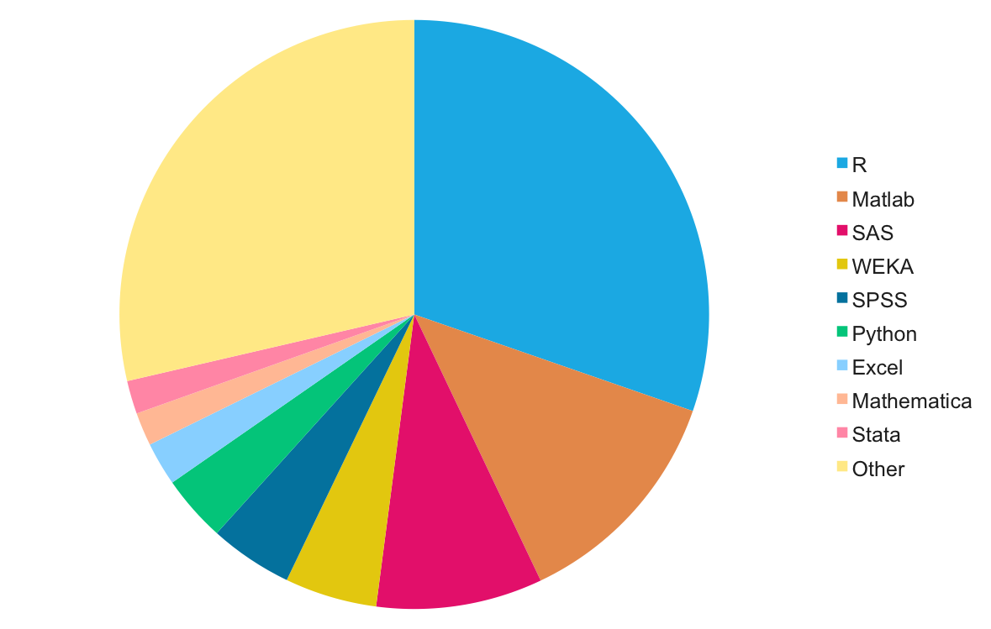
What is R?
Based on S language, written by Robert Gentleman and Ross Ihaka (R&R)
Programming language for statistical computing & graphics
Open source
From http://machinelearningmastery.com/best-programming-language-for-machine-learning/

Slide 6
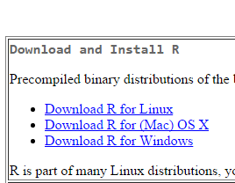


R is free!
R environment is free.
http://cran.r-project.org/
R IDE: rstudio is free.
http://www.rstudio.com/
R packages are free!
Get from

Slide 7
Outline for today’s session
Overview of R
Setting up R and basic operations
Preparing summary statistics
Basic plotting function

Slide 8
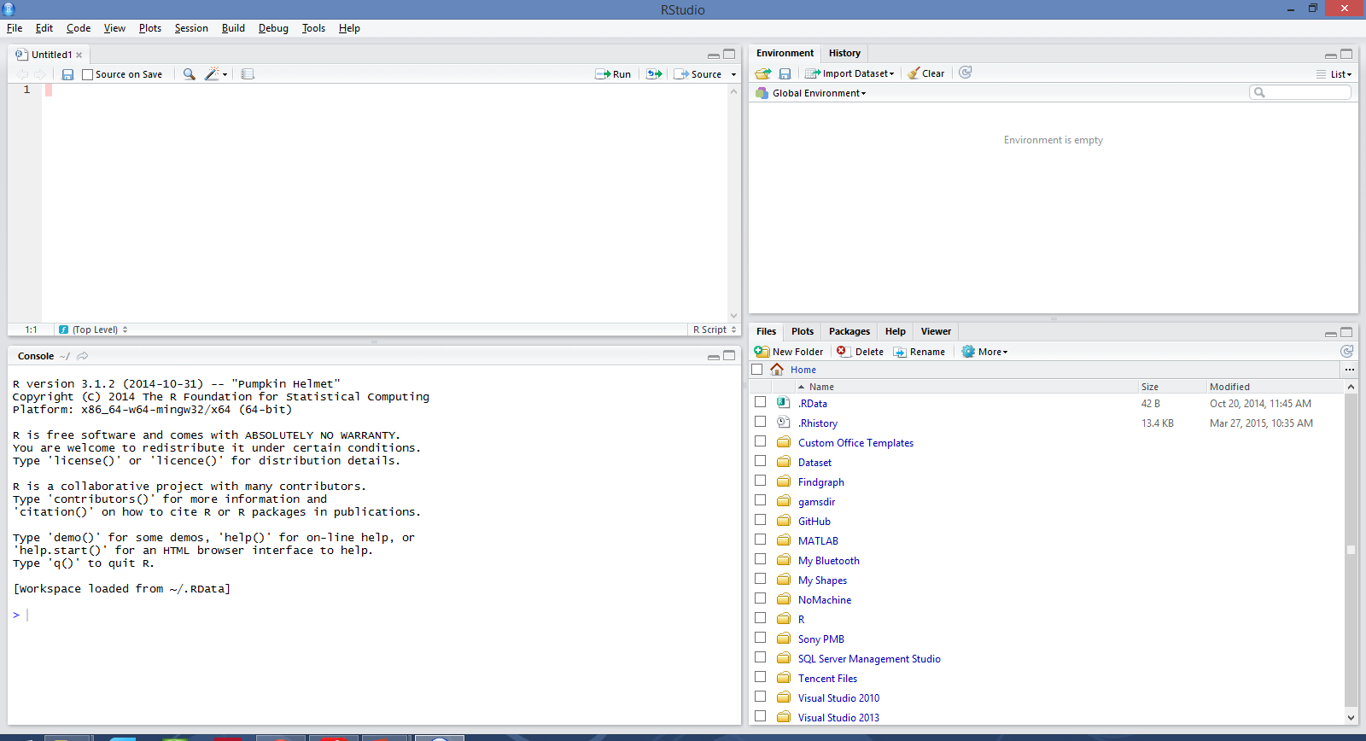
Set up RStudio

Slide 9
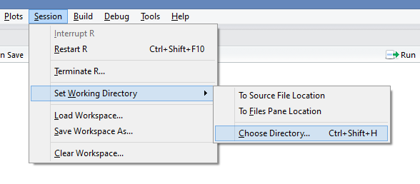
Set working directory
This is where you want to save all work.
In Rstudio, ‘session’ -> ‘Set Work Directory’ -> ‘Choose Directory …’
Manually specify in R code
In windows,
In mac or linux,
Check current working directory,

Slide 10
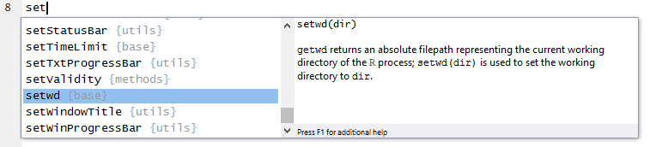
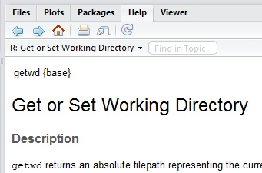

Some useful tricks
Comment, #
Code autocomplete, [tab]
Check help document, ?name, or help(name)
e.g.

Slide 11
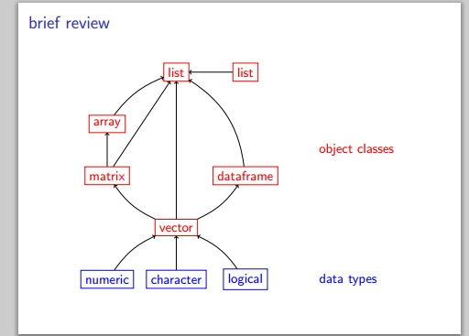
R data structures

Slide 12
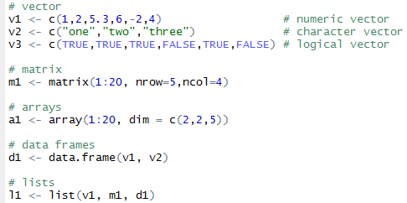

R data structures
Vector: one dimension with same type data
Matrix: two dimensions with same type data
Array: more dimensions with same type data
Data.frame: two dimensions with various type data
List: can be any format
To check data type of
a variable

Slide 13


Import data files
Use R package build-in dataset, e.g.
Import data from your files
csv (.csv), dat (.dat), txt (.txt)
Excel (.xls)
Minitab (.mtp)

Slide 14
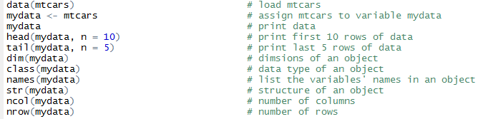
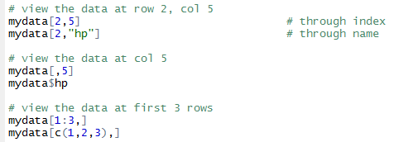
Viewing data
Use mtcars data as example

Slide 15
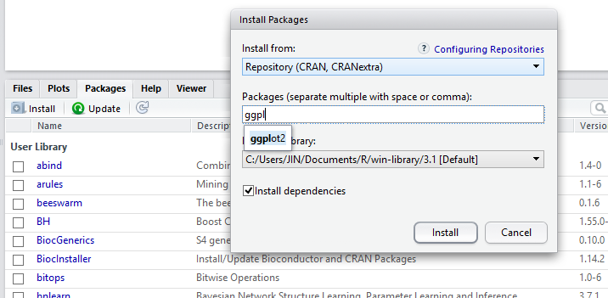
Install R packages
R is a lightweight statistical programming language, which is different from matlab, SAS and SPSS. It means it comes out with a few basic packages, and you have to install R packages if you want to do more.
e.g. R package ggplot2 is a beautiful plot tool.

Slide 16
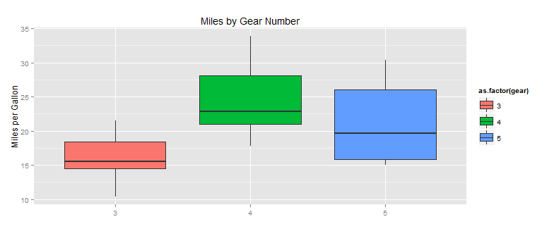
Use R packages
Two steps to use R packages after installation.
Load the R package
Call function implemented in the R package

Slide 17
Exercise
Install R package ‘qcc’
Load ‘qcc’
Check the help document of built-in dataset, ‘pistonrings’
Load data pistonrings
Show the data type of pistonrings
Show the dimension of pistonrings
Show the variable names of pistonrings
Show the first 8 rows of pistonrings
What is the value of row 5, col 2 in pistonrings
Challenge: what is the mean value of diameter in pistonrings

Slide 18
Outline for today’s session
Overview of R
Setting up R and basic operations
Preparing summary statistics
Basic plotting function

Slide 19
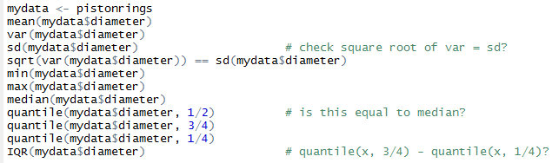
Basic statistical results
Mean
Variance
Standard deviation (how to validate sd with variance)
Minimum, maximum
Median
Quantile

Slide 20

Function ‘summary()’
Gives a collection of basic statistics
Can be used with many functions include model fitting functions (ANOVA, regression model, cluster analysis)

Slide 21


Function ‘table()’
You can generate frequency tables using the table( ) function

Slide 22
Outline for today’s session
Overview of R
Setting up R and basic operations
Preparing summary statistics
Basic plotting function

Slide 23
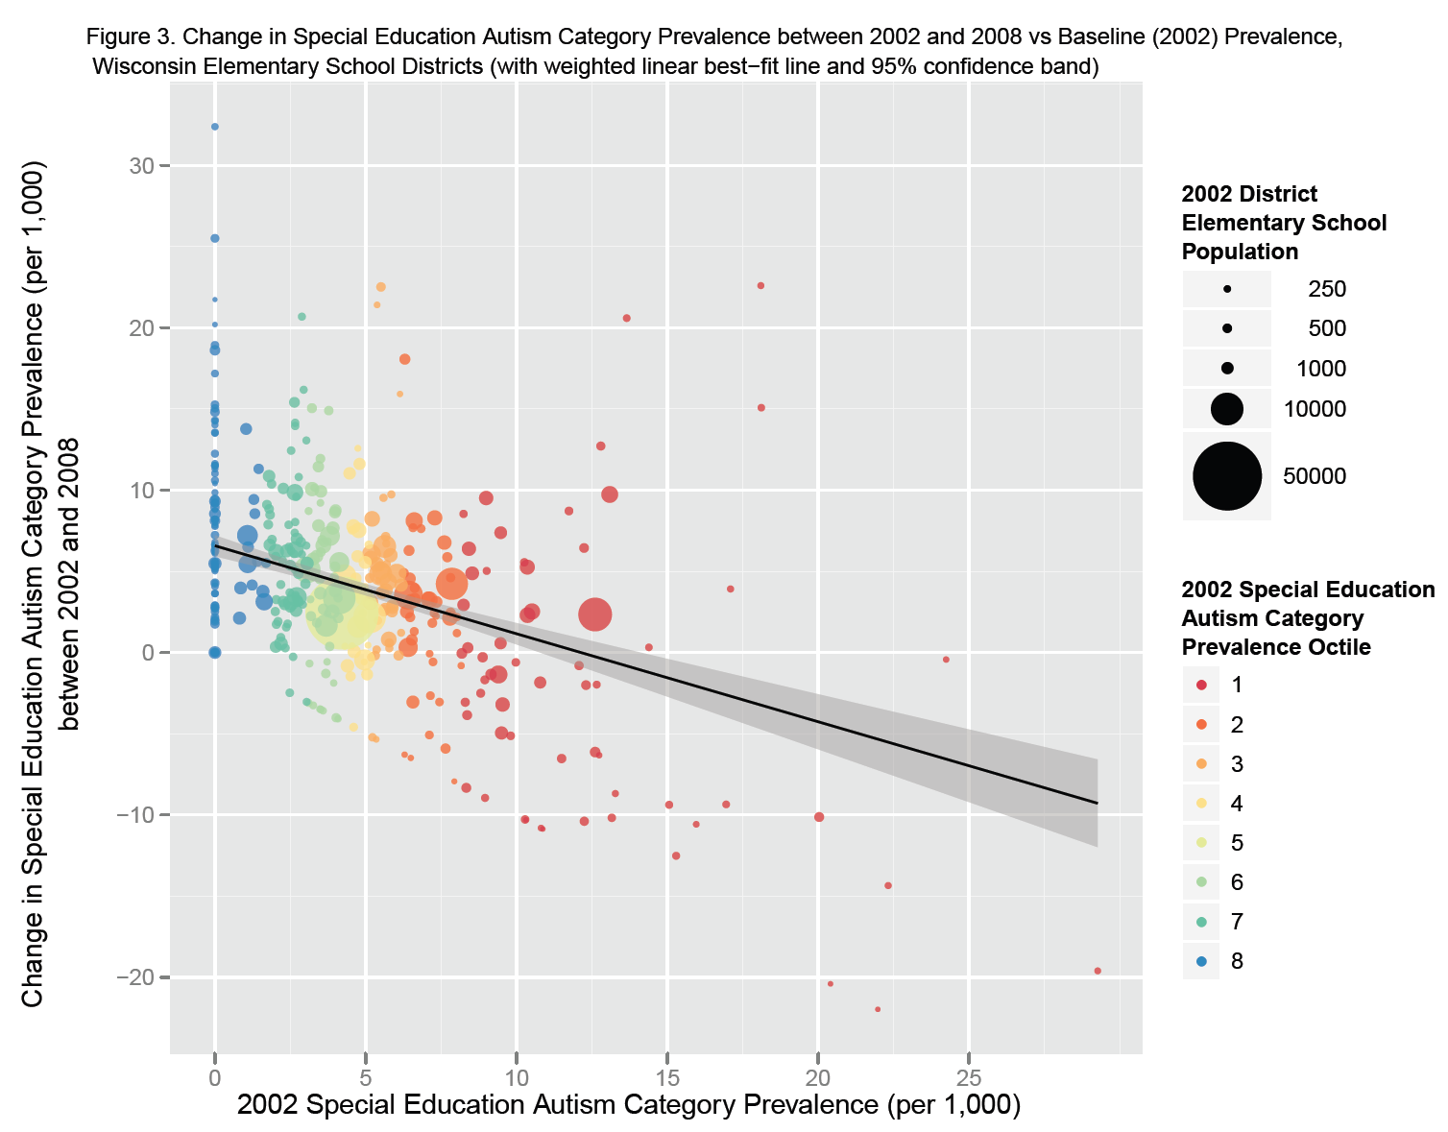
Introduce R package ggplot2
ggplot2 is an elegant plotting system for R.
http://ggplot2.org/
ggtitle()
ylim()
ylab()
geom_point()
guide_legend()
geom_line ()
xlim()
xlab()

Slide 24
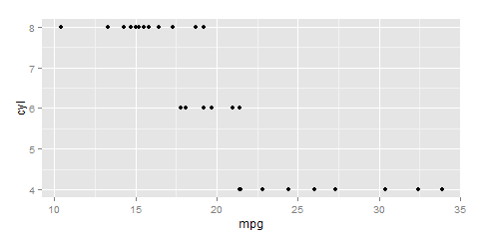
Basics in ggplot2
data: in data.frame form
aesthetic: map variables into properties people can perceive visually, e.g., position, color, line type
geom: types of plots, e.g., boxplot, histogram, scatter plot
scale: map data values into “computer” values
stat: summarization or transformation of data

Slide 25
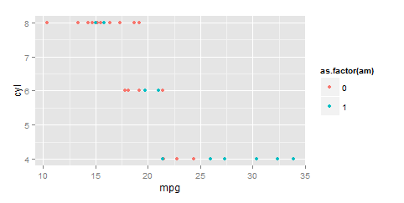
Map data to aesthetics in plots
mpg | cyl | am
21.0 | 6 | 1
21.0 | 6 | 1
22.8 | 4 | 0
mapping
x | y | color
21.0 | 6 | 1
21.0 | 6 | 1
22.8 | 4 | 0
x | y | color
21.0 | 6 | Blue
21.0 | 6 | Blue
22.8 | 4 | Red
scales

Slide 26

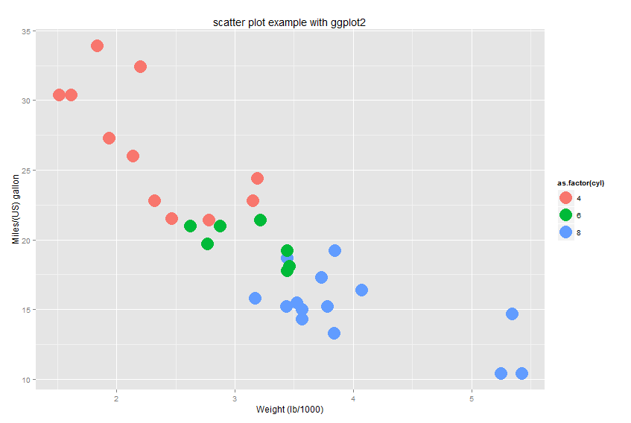
Scatter plot
aes(x variable, y variable, others)
Call ggplot(data_name, …)
as.factor() convert to discrete var
geom_XXX, layout, e.g.
geom_scatter()
geom_line()
geom_boxplot()
… …
xlab: x axis title
ylab: y axis title
ggtitle: main title

Slide 27

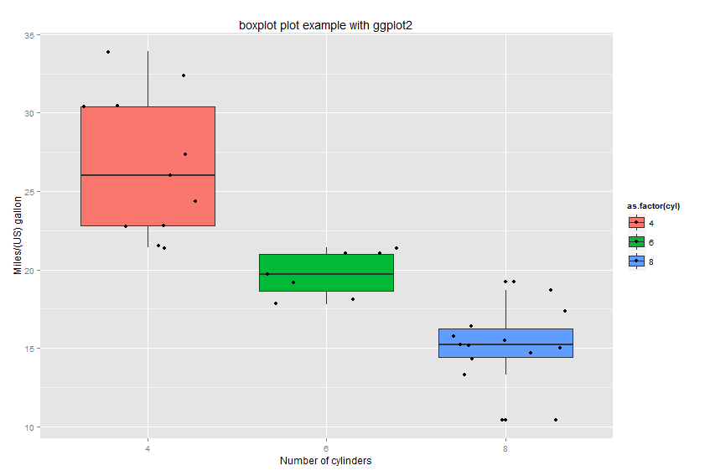
Boxplot plot
Second layout, geom_jitter(), plot points

Slide 28

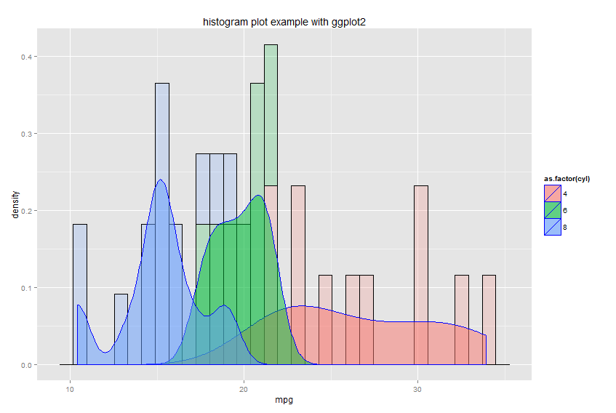
Histogram plot

Slide 29
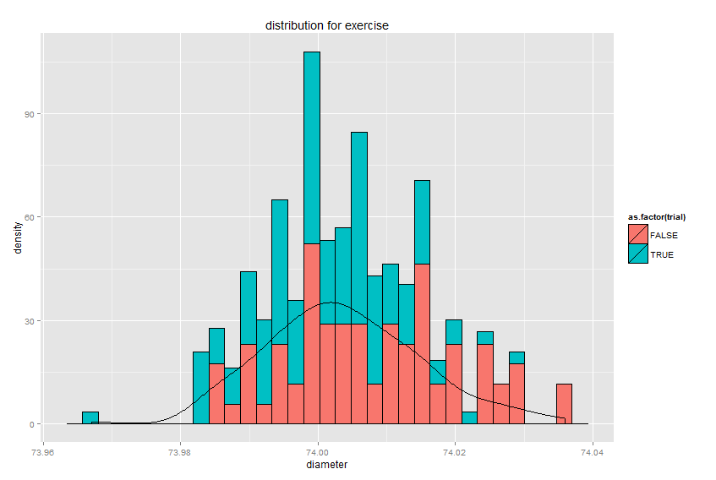
Exercise
Plot the histogram and density for variable ‘diameter’ in dataset ‘pistonrings’ in R package ‘qcc’
Add variable ‘trial’ to show the difference between two groups
Add main title
More …

Slide 30
Thank you!
See you next TA session.

