Slide 1
Session 4: R for data analysis
IND E 321
Yan Jin (yanjin@uw.edu)
Dr. Shuai Huang (shuaih@uw.edu)

Slide 2
Outline for whole sessions by TA
Introduction to R
Plotting system: ggplot2
Practice in R
Homework solution
R for data analysis
R for quality control

Slide 3
Outline for today’s session
Missing Data
Hypothesis testing

Slide 4
Outline for today’s session
Missing Data
Hypothesis testing

Slide 5
Missing Data
The impact of missing data is a subject that most of us want to avoid.
In the real world, missing data are ubiquitous.
Statistical packages offer automatic handling of missing data using methods that may not be optimal.
Data can be missing for many reasons.
Fail to complete a long questionnaire
Sometimes even be planned, e.g. to increase survey efficiency
Unfortunately, most statistical methods in R assume that you’re working with complete matrices, vectors, and data frames.

Slide 6
Sources and Impact of Missing Data
What percentage of the data is missing?
Is it concentrated in a few variables, or widely distributed?
Does it appear to be random?
Does the covariation of missing data with each other or with observed data suggest a possible mechanism that is producing the missing values?

Slide 7
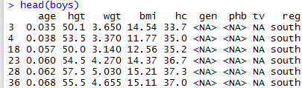
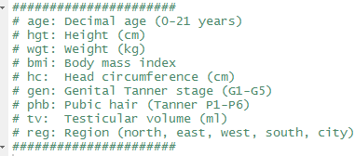
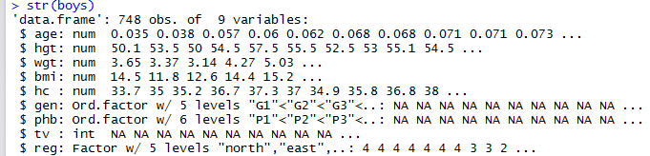
Example Dataset: boys
Boys is a built-in dataset with missing values in R package “mice”.
Height, weight, head circumference and puberty of 748 Dutch boys.

Slide 8
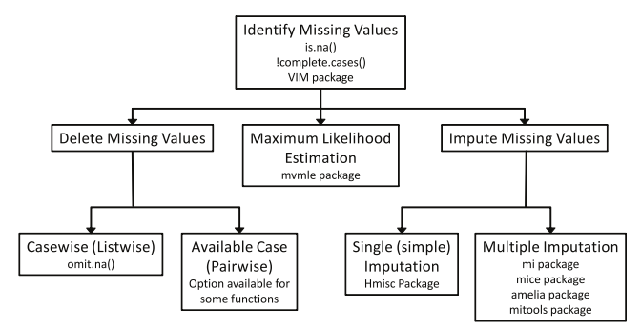
Methods for Handling Missing Data

Slide 9
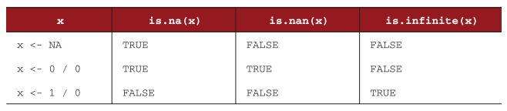
Identify Missing Data
NA (not available) = missing value
NaN (not a number) = impossible value
Inf / -Inf = positive infinity / negative infinity
NA and NaN are treated as missing data, while Inf/-Inf are valid data.

Slide 10

Identify Missing Data
Check missing value
List the complete dataset
Statistics of missing values

Slide 11
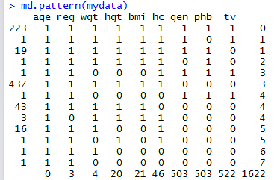
Explore Missing Values Patterns
Tabulating missing values

Slide 12
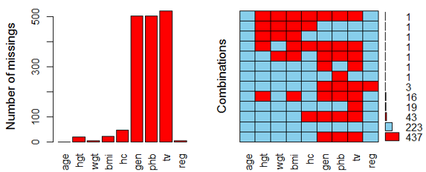
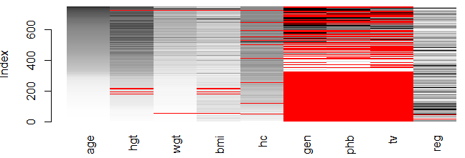
Explore Missing Values Patterns
Visualization

Slide 13
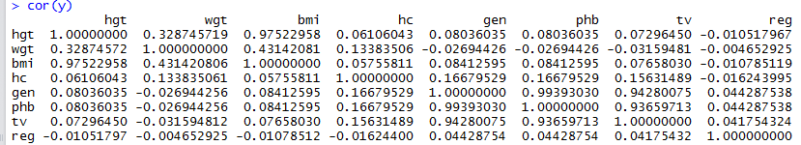
Explore Missing Values Patterns
Pairwise correlation of missing data
Construct shadow matrix through coding 1 for missing and 0 for present
Do pairwise correlation

Slide 14
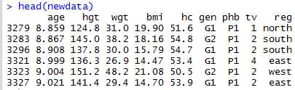
Dealing with Incomplete Data
Listwise deletion (complete case analysis)
Option 1:
Option 2:
This is the most common method, but it lose many information in some cases.

Slide 15

Dealing with Incomplete Data
Simple Imputation: the missing values in a variable are replaced with a single value, such as mean, median and mode
If there are moderate to large amounts of missing data, simple imputation is likely to underestimate standard errors, distort correlations among variables, and produce incorrect p-values in statistical tests.

Slide 16
Outline for today’s session
Missing Data
Hypothesis testing

Slide 17
Hypothesis Testing
One sample t test
Two samples t-test
Paired t-test

Slide 18
One sample t test
An outbreak of Salmonella-related illness was attributed to ice cream produced at a certain factory. Scientists measured the level of Salmonella in 9 randomly sampled batches of ice cream.
The levels (in MPN/g) were
0.593, 0.142, 0.329, 0.691, 0.231, 0.793, 0.519, 0.392, 0.418
Is there evidence that the mean level of Salmonella in the ice cream is greater than 0.3 MPN/g?

Slide 19

Contd..
Let mu be the mean level of Salmonella in all batches of ice cream. Here are hypothesis of interest can be expressed as (one side hypothesis)
H0: mu = 0.3
H1: mu > 0.3
Procedure
Critical value based on significance level
Compute t statistics

Slide 20
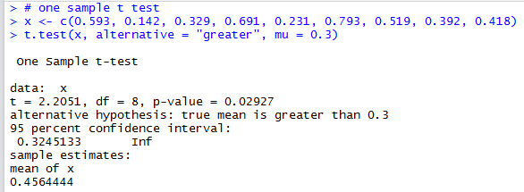
One sample t test In R
P-value = 0.02927. Hence, there is moderately strong evidence that the mean Salmonella level in the ice cream is above 0.3 MPN/g.
The t.test function prints out a confidence interval as well.

Slide 21
Two sample t tests
Subjects were given a drug (treatment group) and an additional 6 subjects a placebo (control group). Their reaction time to a stimulus was measured (in ms). We want to perform a two sample t-test for comparing the means of the treatment and control groups.

Slide 22
Contd..
Let mu1 be the mean of the population taking medicine and mu2 the mean of the untreated population. Here the hypothesis of interest can be expressed as:
H0: mu1 – mu2 = 0
H1: mu1 – mu2 < 0
Hence we will need to include the data for the treatment group in x and the data for the control group in y.
Finally, we need to decide whether or not the standard deviations are the same in both groups.

Slide 23
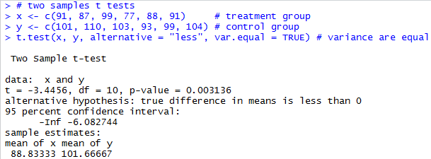
Two samples t tests in R

Slide 24
Paired t tests
There are many experimental settings where each subject in the study is in both the treatment and control group. For example, in a matched pairs design, subjects are matched in pairs and different treatments are given to each subject in the pair. The outcomes are thereafter compared pair-wise. Alternatively, one can measure each subject twice, before and after a treatment. In either of these situations we cannot use two sample t tests since the independence assumption is not valid. Instead we need to use a paired t-test. This can be done using the option paired=TRUE.

Slide 25
Contd..
A study was performed to test whether cars get better mileage on premium gas than on regular gas. Each of 10 cars was first filled with either regular or premium gas, decided by a coin toss, and the mileage for that tank was recorded. The mileage was recorded again for the same cars using the other kind of gasoline. We use a paired t-test to determine whether cars get significantly better mileage with premium gas.

Slide 26
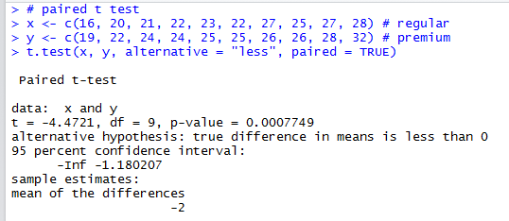
Paired t test in R

Slide 27
Thank you

