Slide 1
Session 5: Quality Control in R
IND E 321
Yan Jin (yanjin@uw.edu)
Dr. Shuai Huang (shuaih@uw.edu)

Slide 2
Outline for whole sessions by TA
Introduction to R
Plotting system: ggplot2
Practice in R
Homework solution
R for data analysis
R for quality control

Slide 3
R packages
qcc: http://cran.r-project.org/web/packages/qcc/qcc.pdf
graphicsQC: http://cran.r-project.org/web/packages/graphicsQC/graphicsQC.pdf
IQCC: http://cran.r-project.org/web/packages/IQCC/IQCC.pdf
qualityTools: http://cran.r-project.org/web/packages/qualityTools/qualityTools.pdf
SixSigma: http://cran.r-project.org/web/packages/SixSigma/SixSigma.pdf

Slide 4
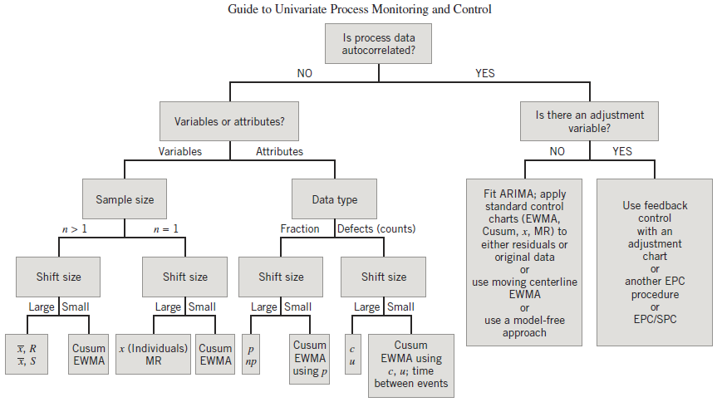

Slide 5

QCC Examples
$\overline{X}$ chart
R chart
P chart
U chart
CUSUM chart
EWMA chart

Slide 6

QCC Examples
$\overline{X}$ chart
R chart
P chart
U chart
CUSUM chart
EWMA chart

Slide 7
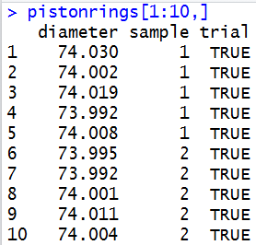
pistonrings

Slide 8
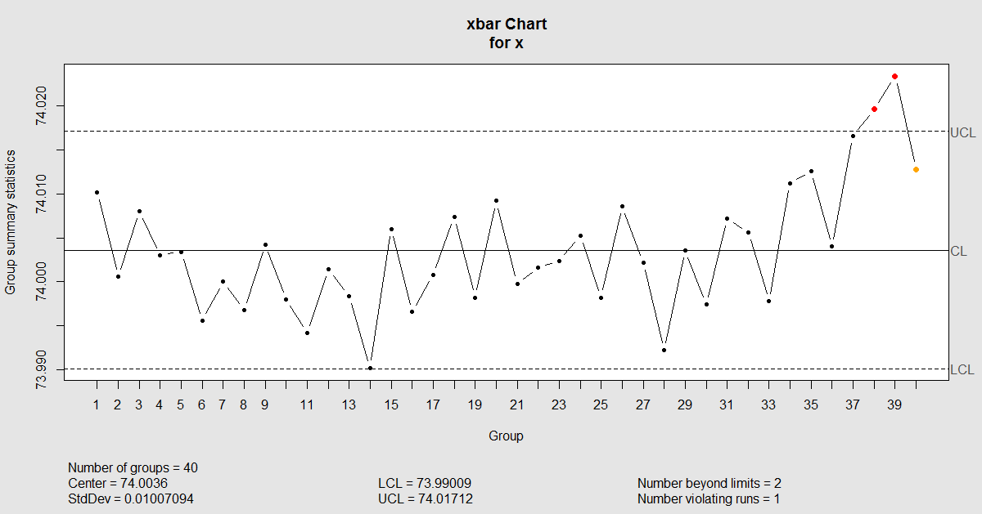

Slide 9
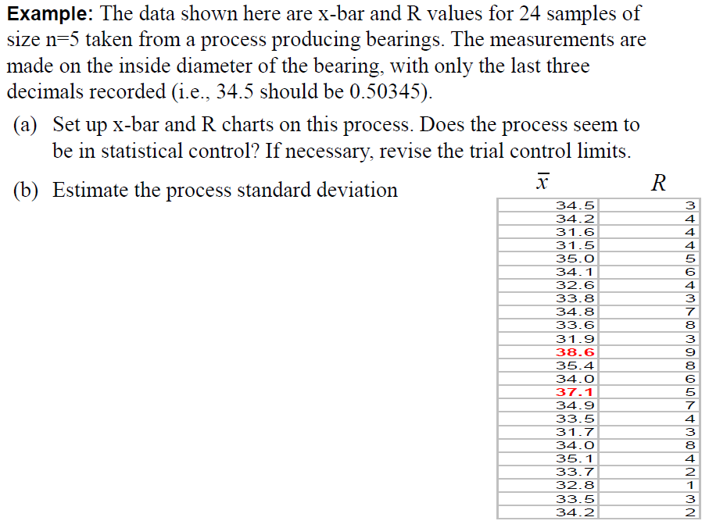
Page 259 in Slides

Slide 10
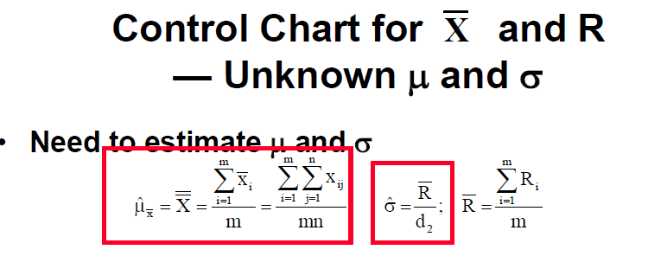
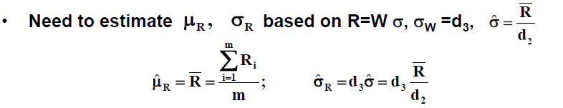

Slide 11
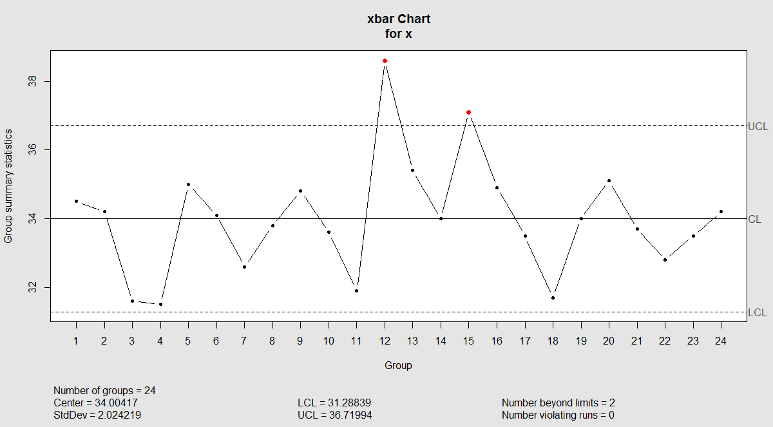

Slide 12
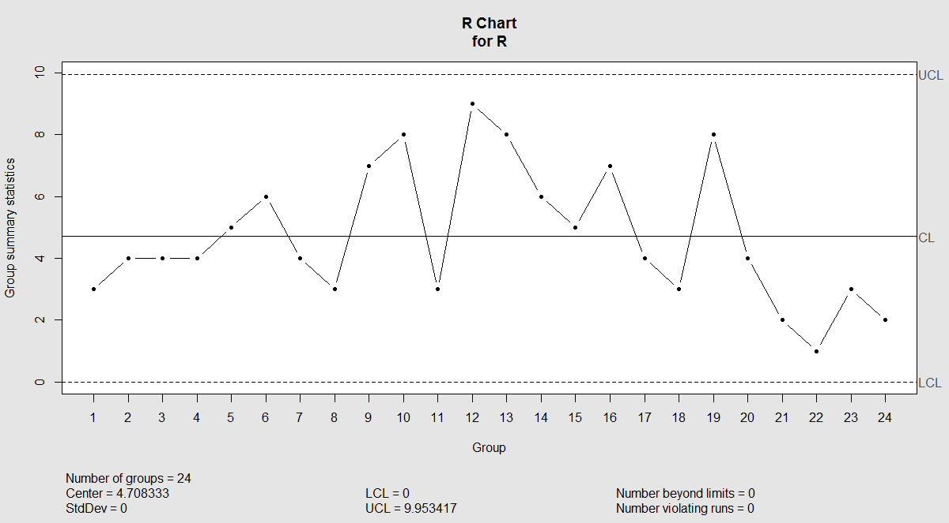

Slide 13

QCC Examples
$\overline{X}$ chart
R chart
P chart
U chart
CUSUM chart
EWMA chart

Slide 14
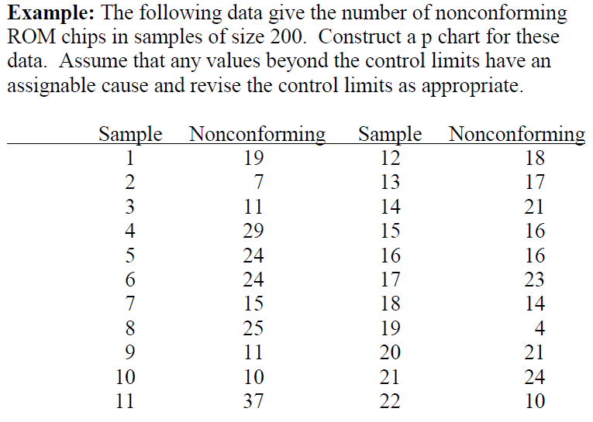

Slide 15
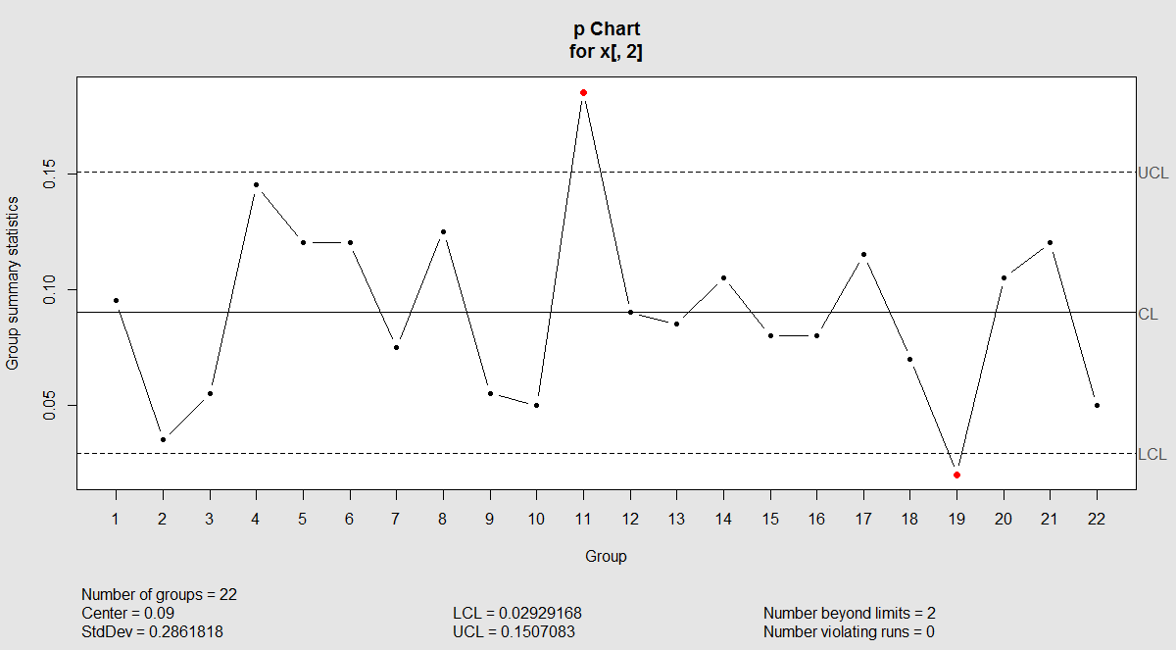

Slide 16
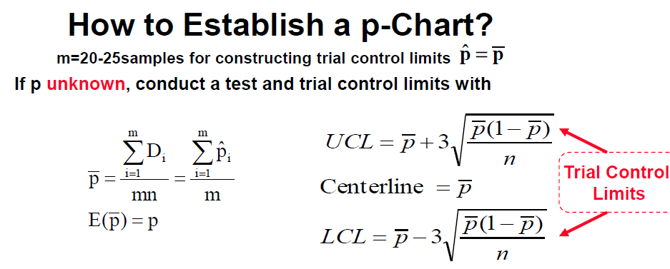

Slide 17
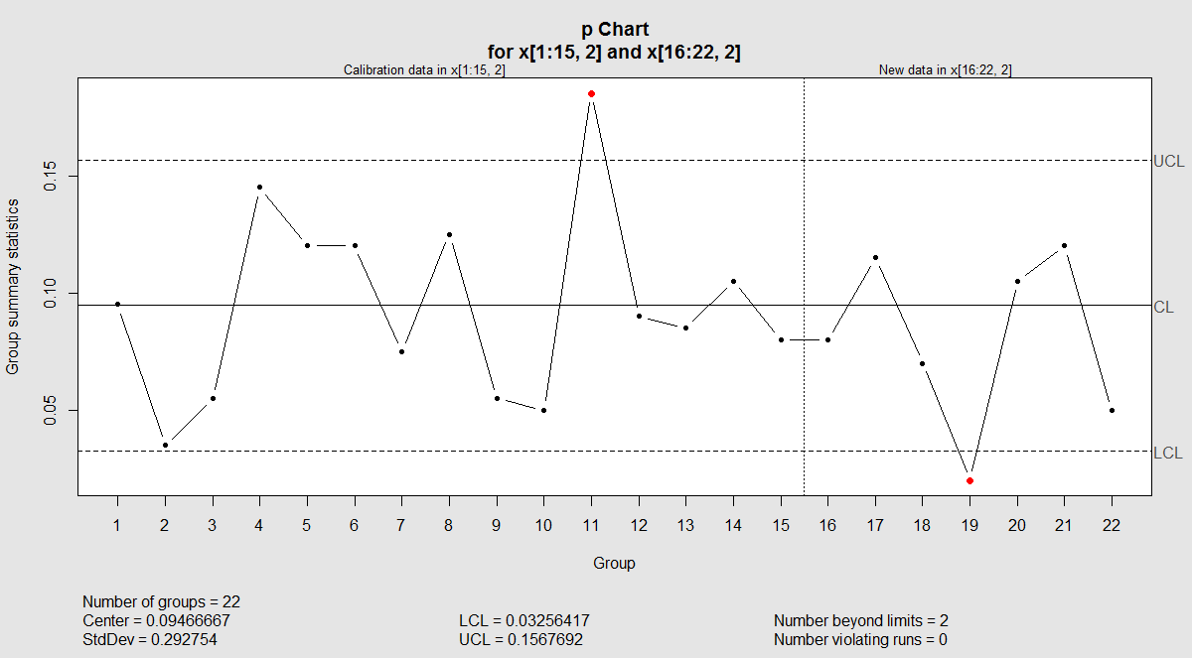
Monitor new samples

Slide 18

Practice in class
$\overline{X}$ chart
R chart
P chart
U chart
CUSUM chart
EWMA chart

Slide 19
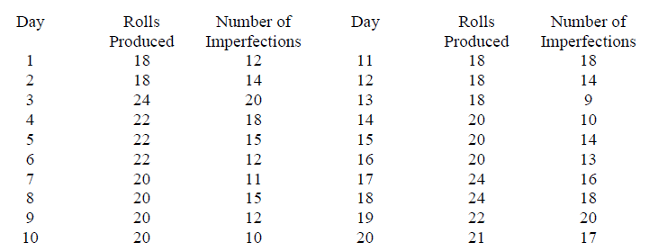
Set up a chart for the following data set. Use first 15 samples as calibration data, and remaining 5 as new samples to monitor. Page 329

Slide 20

QCC Examples
$\overline{X}$ chart
R chart
P chart
U chart
CUSUM chart
EWMA chart

Slide 21
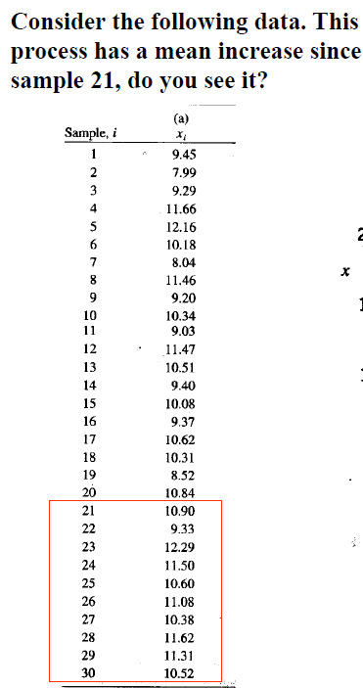
Page 335

Slide 22
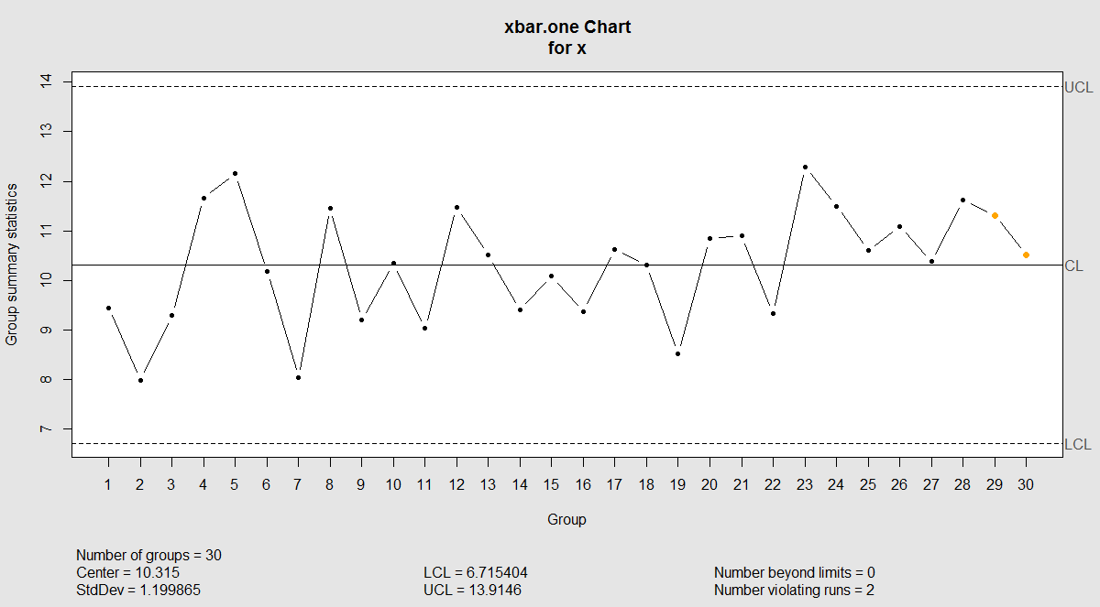
X bar chart

Slide 23
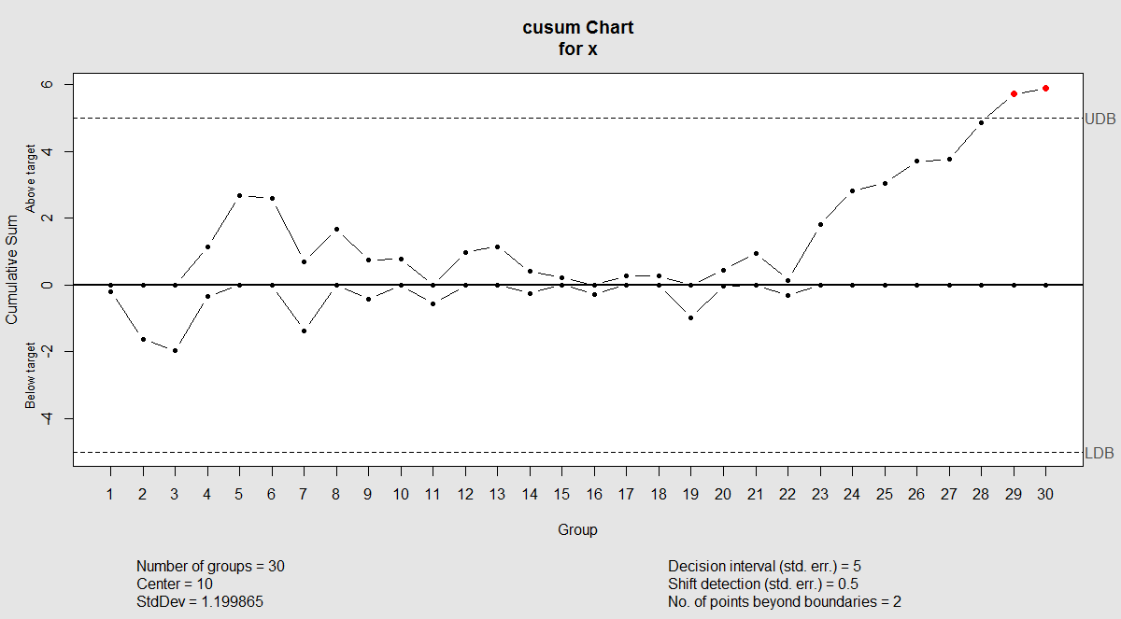
CUSUM Chart

Slide 24
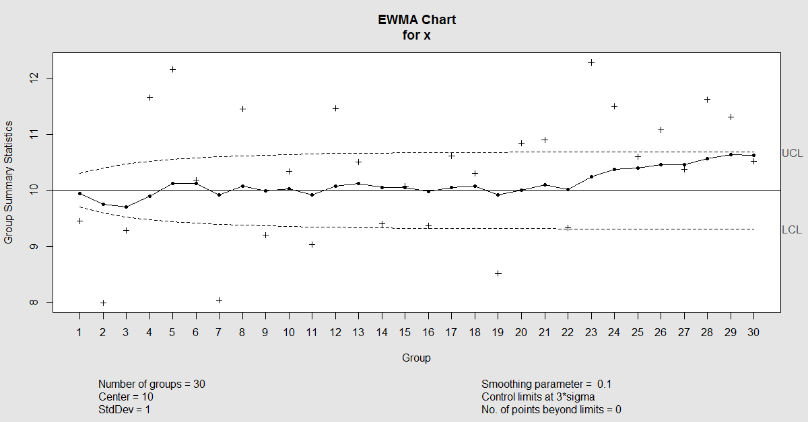
EWMA Chart

Slide 25
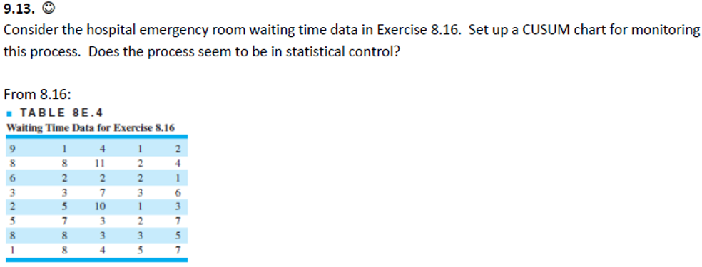

Homework Question 9.13
$$μ_{0}=4.5 \\ σ=2.79 \\ k=0.25 \\ h=8.01$$

Slide 26
Good luck in your finals

