Slide 1
Speech Enhancement using a Kalman Filter
Jia Ying Goh
26 June 2017
Project Supervisor: D. M. Brookes

Slide 2
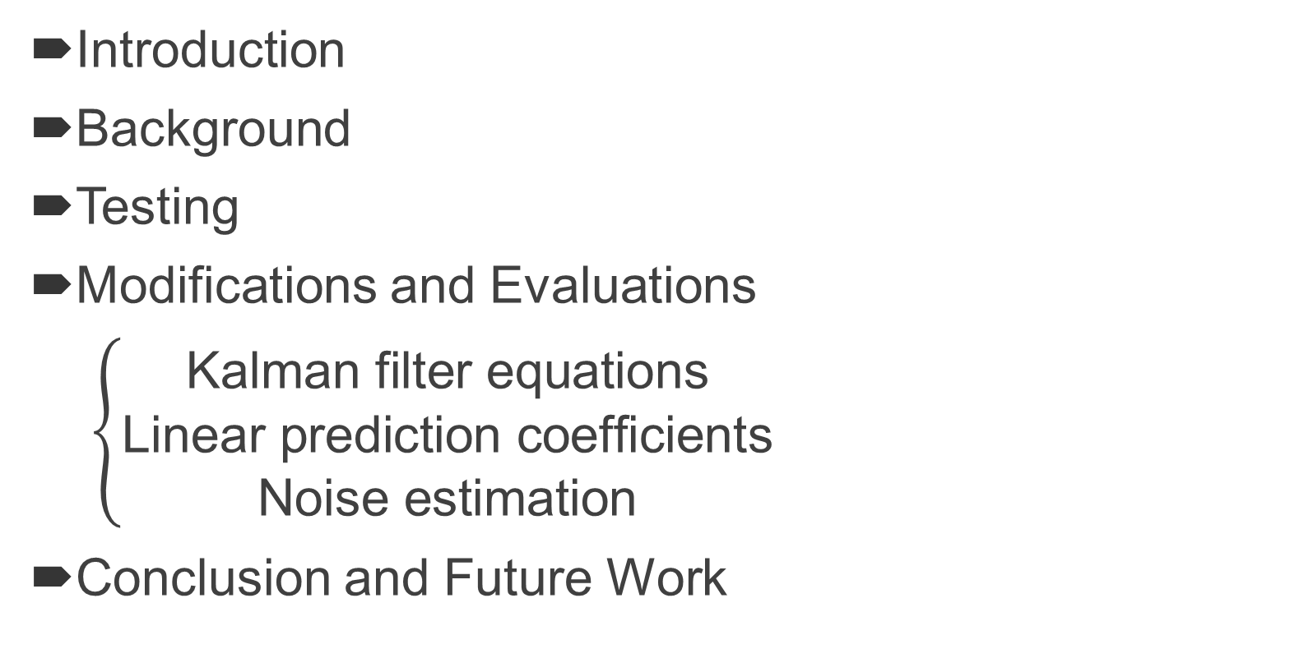
Contents
Introduction
Background
Testing
Modifications and Evaluations
$\left\{\begin{aligned}\text{Kalman} \text{filter} \text{equations} \\ \text{Linear} \text{prediction} \text{coefficients} \\ \text{Noise} \text{estimation}\end{aligned}\right.$
Conclusion and Future Work

Slide 3
Introduction
Speech Enhancement
Project Objectives
Modify Kalman filter with binary mask

Slide 4
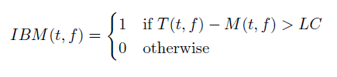
Background
Ideal Binary Mask (IBM)

Slide 5
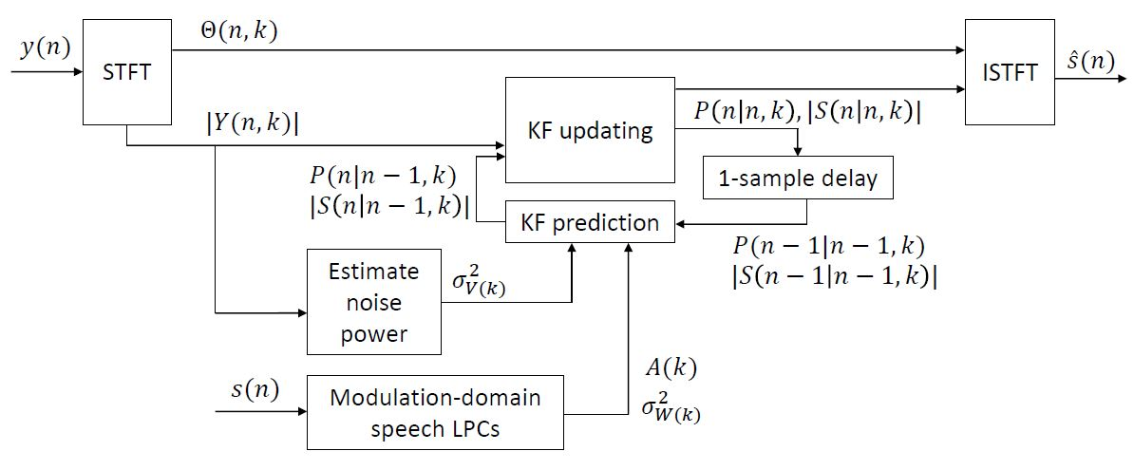
Background
Modulation-Domain Kalman Filter (MDKF)

Slide 6
Testing
Performance Assessment
Speech Quality
PESQ
Speech Intelligibility
STOI

Slide 7
Kalman Filter Equations
Apply IBM to training set
Decoupling MDKF equations
Updated state from measurement, prediction, mask

Slide 8
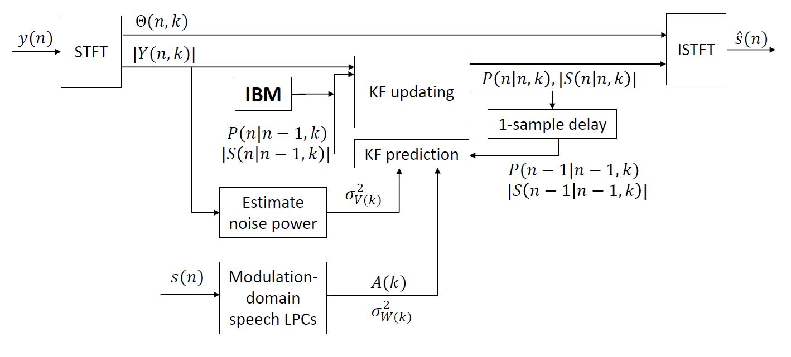
Kalman Filter Equations
BMMDKF

Slide 9
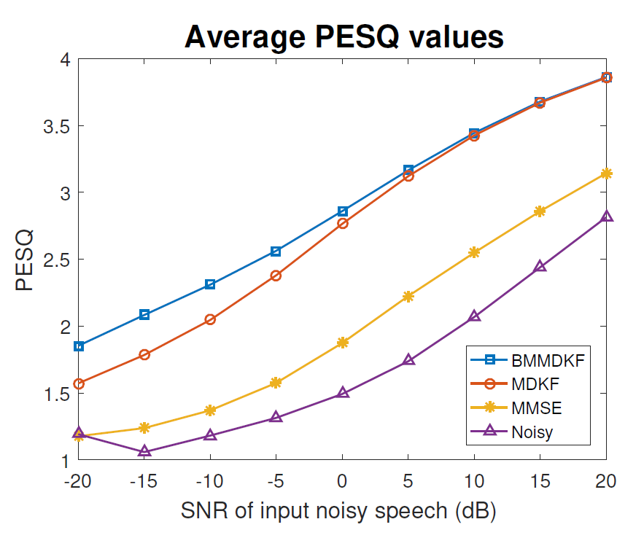
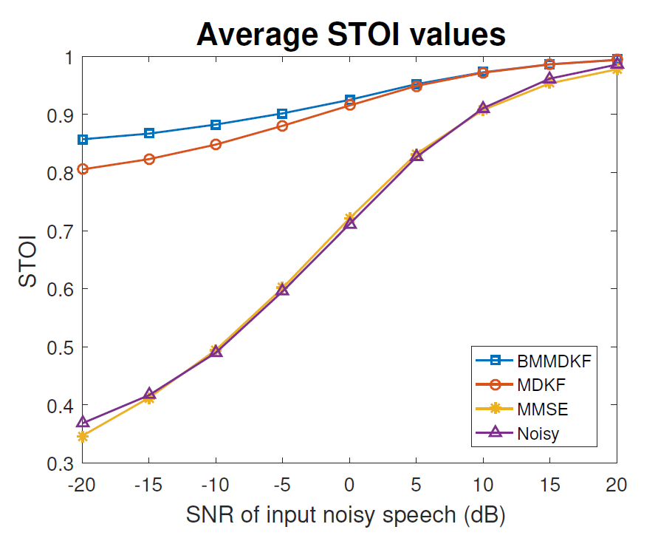
Kalman Filter Equations

Slide 10
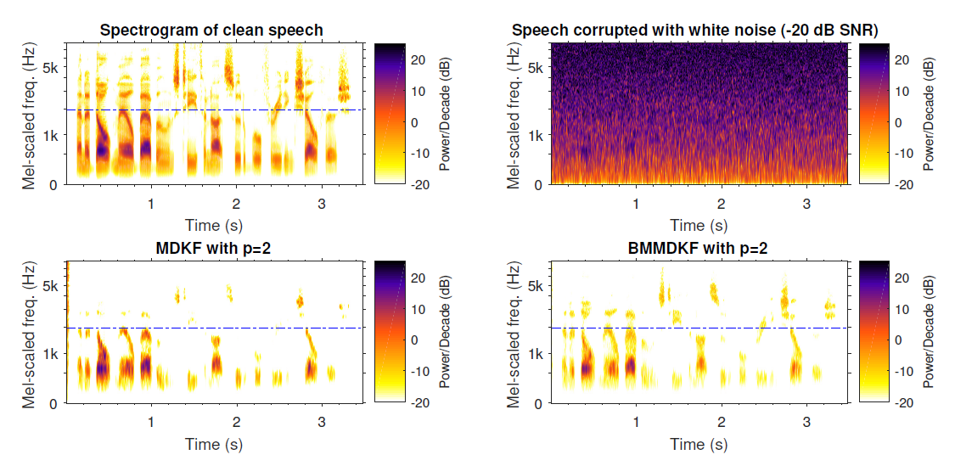
Kalman Filter Equations

Slide 11
Kalman Filter Equations
Evaluation
BMMDKF performs better overall
Greater improvement for noisier input

Slide 12
Weighted LPCs
Apply IBM to input
Modify linear prediction coefficients (LPCs)

Slide 13
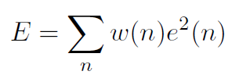
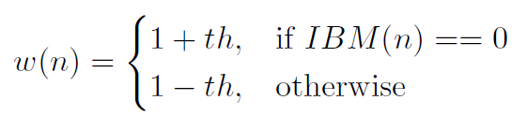
Weighted LPCs
Minimise weighted sum of errors

Slide 14
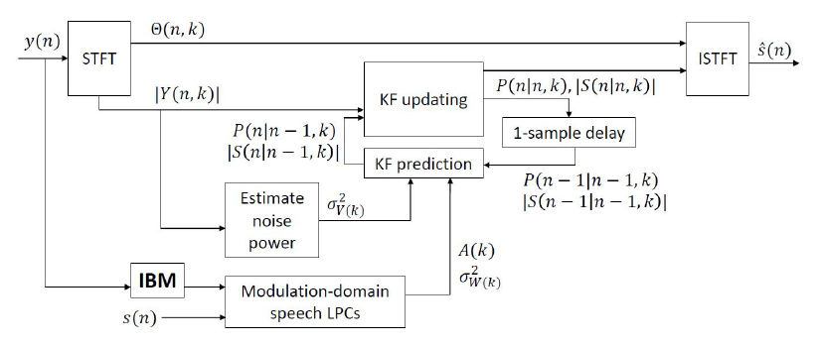
Weighted LPCs
LMDKF

Slide 15
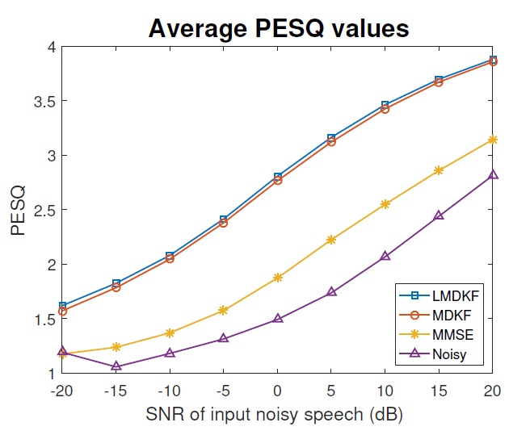
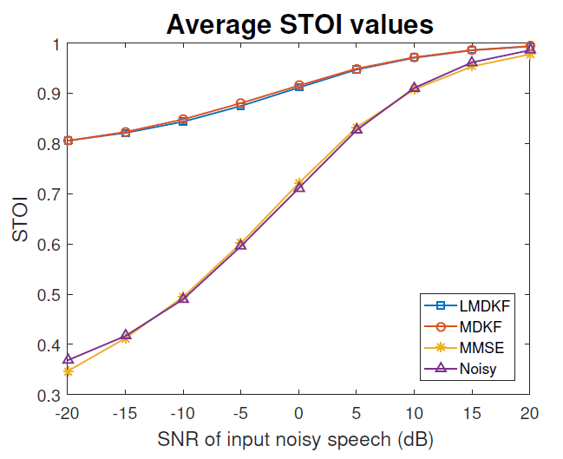
Weighted LPCs

Slide 16
Weighted LPCs
Evaluation
LMDKF slightly favoured
LPCs estimated using clean speech

Slide 17
Noise Estimation
Apply IBM to input
Modify noise estimation

Slide 18

Noise Estimation
Noise periodogram
Noisy observation
a priori SNR
Spectral noise power
a posteriori SPP (Speech Presence Probability)

Slide 19
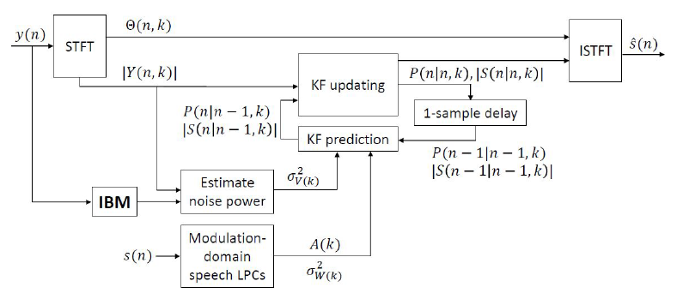
Noise Estimation
NMDKF

Slide 20
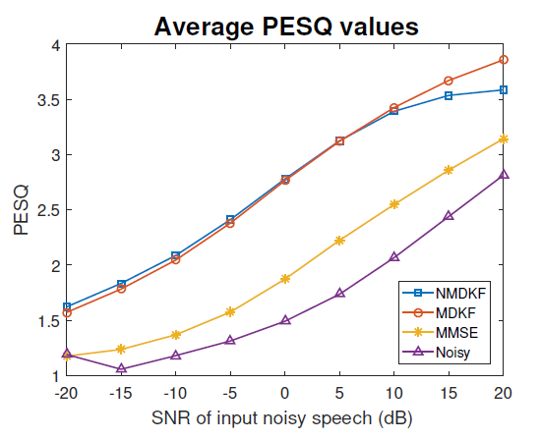
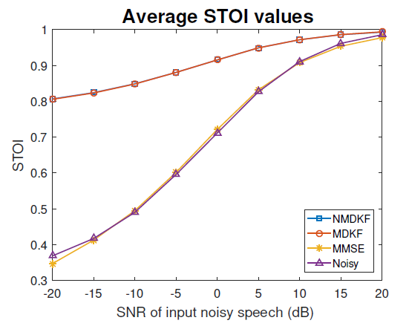
Noise Estimation

Slide 21
Noise Estimation
Evaluation
Local adjustments affecting overall score
High scores at high input SNR

Slide 22
Conclusion
Modifying MDKF using IBM
IBM-modified MDKF equations (BMMDKF)
IBM-weighted LPCs (LMDKF)
Noise estimation adjustment (NMDKF)

Slide 23
Future Work
Practical LPC estimation
BMMDKF probability distribution
Human listening tests

Slide 24
That’s all folks!

