Slide 1
Speech Enhancement using a Kalman Filter
Jia Ying Goh
Final Year Project Presentation
26 June 2017

Slide 2
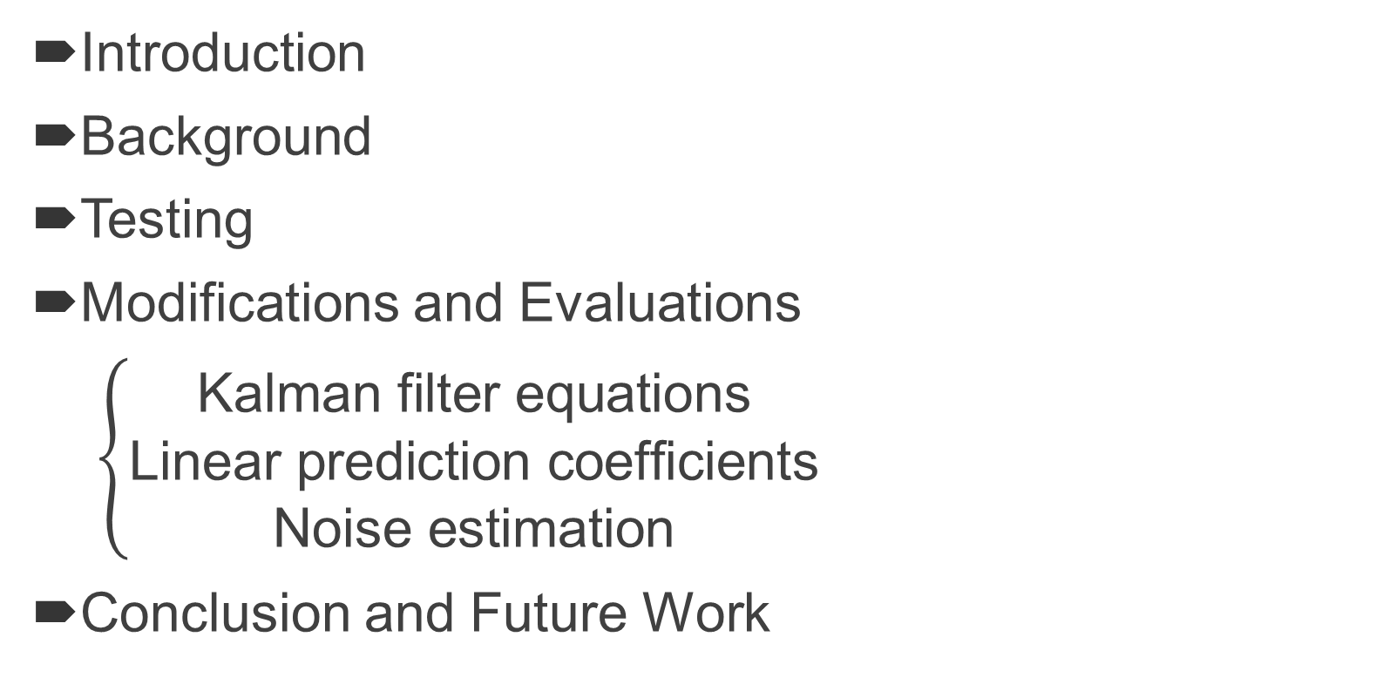
Contents
Introduction
Background
Testing
Modifications and Evaluations
$\left\{\begin{aligned}\text{Kalman} \text{filter} \text{equations} \\ \text{Linear} \text{prediction} \text{coefficients} \\ \text{Noise} \text{estimation}\end{aligned}\right.$
Conclusion and Future Work

Slide 3
Introduction
Speech Enhancement
Project Objectives
Scope

Slide 4
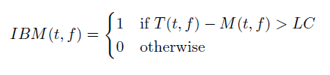
Background
Ideal Binary Mask (IBM)

Slide 5
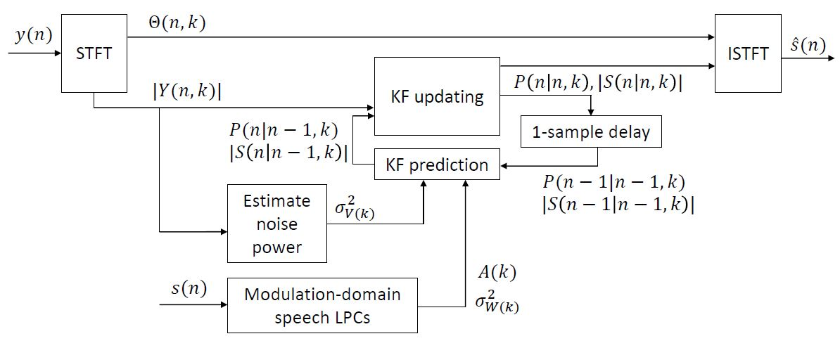
Background
Kalman Filter
Modulation-Domain Kalman Filter (MDKF)

Slide 6
Background
Performance Measures
Quality Assessment
SNR
PESQ
Intelligibility Assessment
STOI

Slide 7
Testing
Base framework: MDKF with clean speech LPCs

Slide 8
Testing
Performance Assessment
Speech Quality
segSNR
PESQ
Speech Intelligibility
STOI

Slide 9
Kalman Filter Equations
Apply IBM to training set
Decoupling MDKF equations
Incorporating IBM statistics

Slide 10
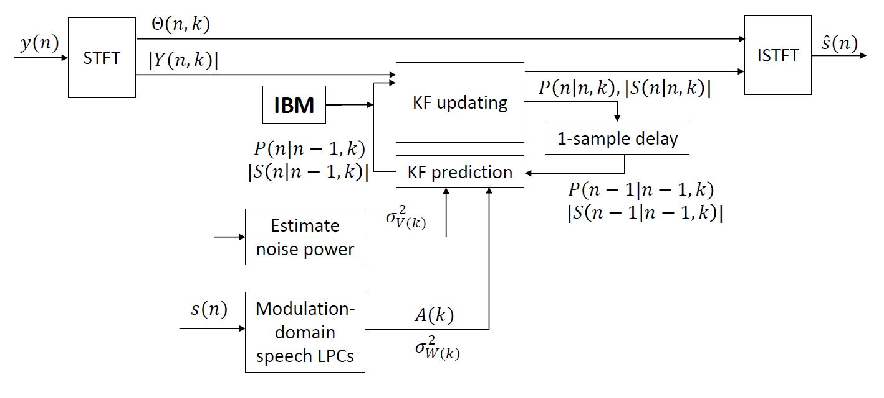
Kalman Filter Equations
BMMDKF

Slide 11
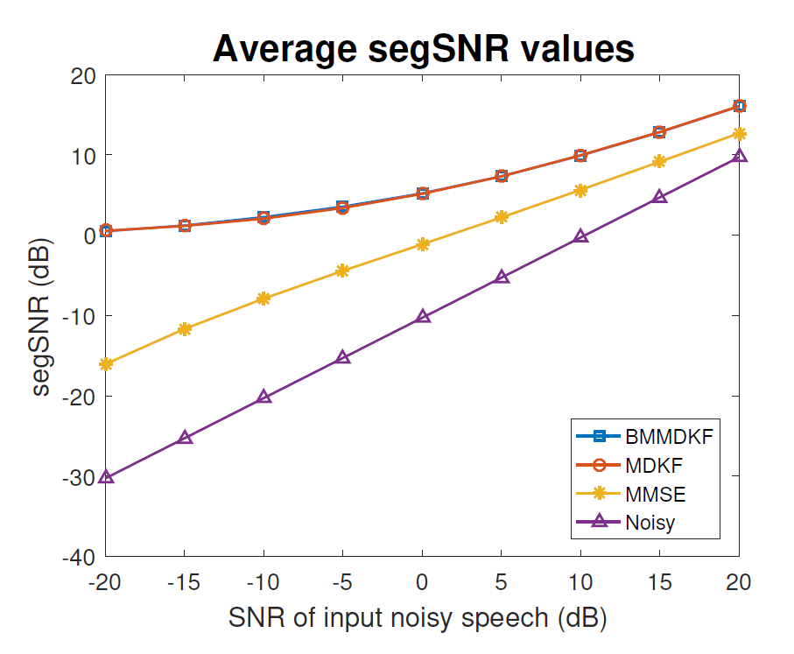
Kalman Filter Equations

Slide 12
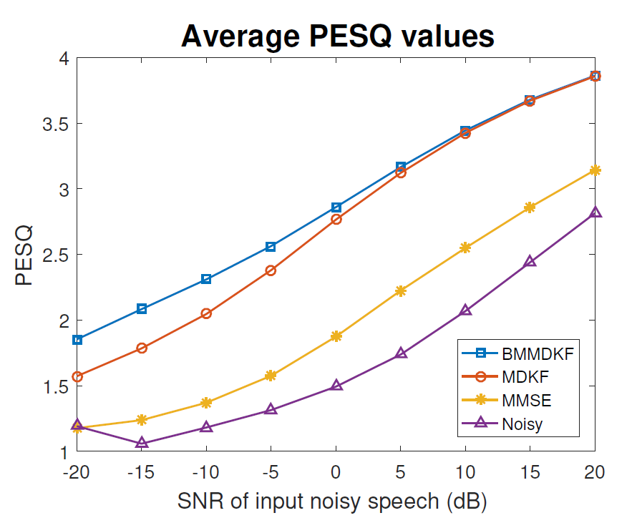
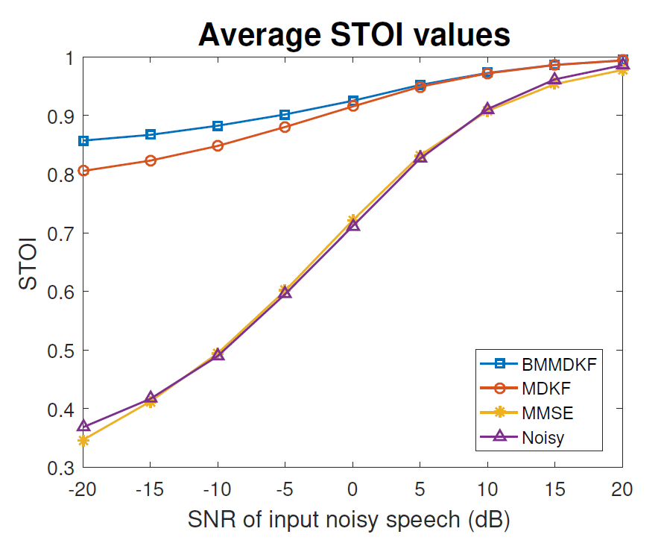
Kalman Filter Equations

Slide 13
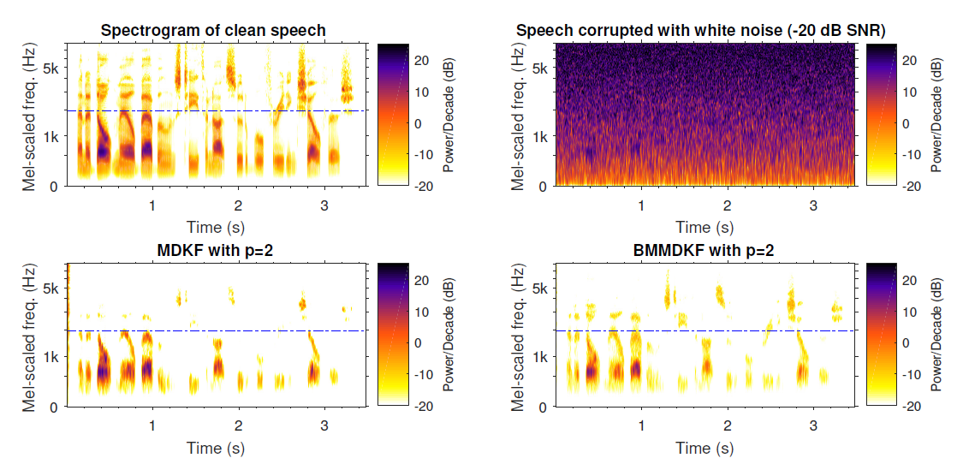
Kalman Filter Equations

Slide 14
Kalman Filter Equations
Evaluation
BMMDKF performs better overall
Greater improvement for noisier input

Slide 15
Weighted LPCs
Apply IBM to input
Modify linear prediction coefficients (LPCs)

Slide 16
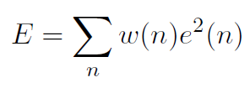
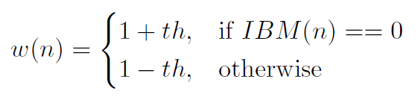
Weighted LPCs
Minimise weighted sum of errors

Slide 17
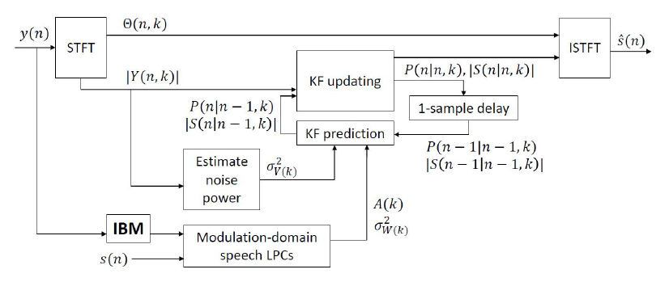
Weighted LPCs
LMDKF

Slide 18
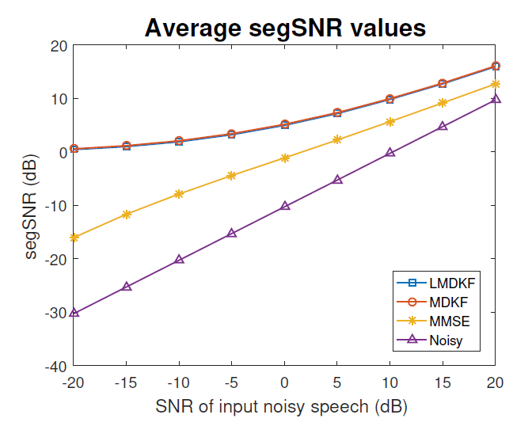
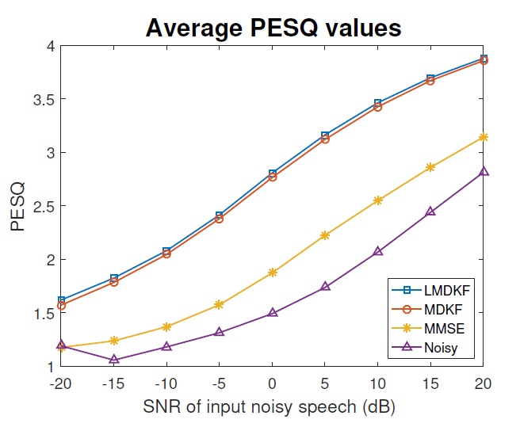
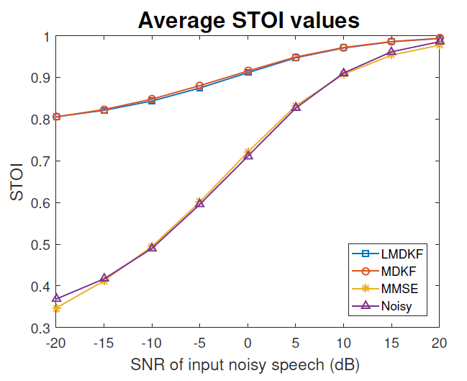
Weighted LPCs

Slide 19
Weighted LPCs
Evaluation
LMDKF slightly favoured
LPCs estimated using clean speech

Slide 20
Noise Estimation
Apply IBM to input
Modify MMSE noise estimation

Slide 21
Noise Estimation
MMSE Noise Estimation
Assumptions
a priori Signal-to-Noise Ratio (SNR)
a priori speech presence/absence probabilities

Slide 22


Noise Estimation
Modifications
a priori Signal-to-Noise Ratio (SNR)
a posteriori Speech Presence Probability (SPP)

Slide 23
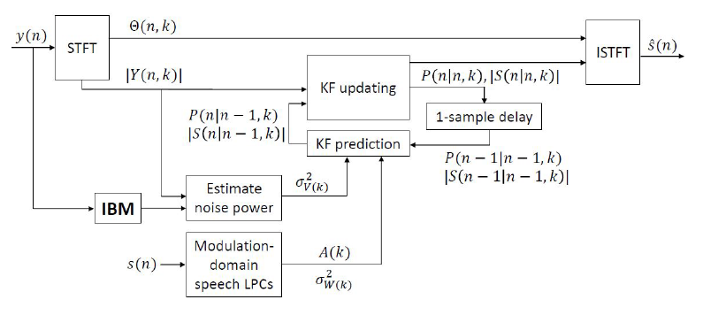
Noise Estimation
NMDKF

Slide 24
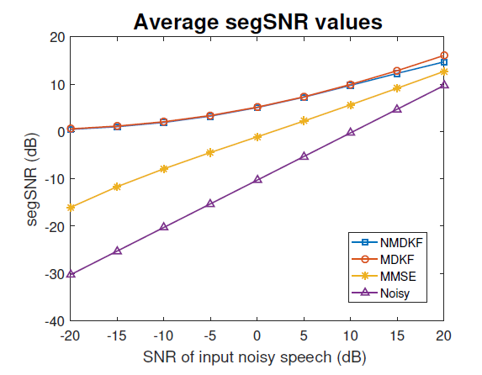
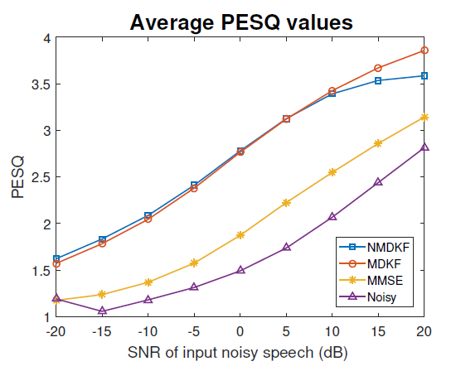
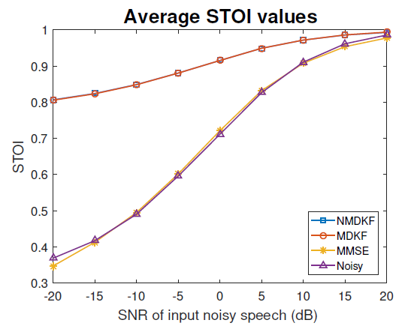
Noise Estimation

Slide 25
Noise Estimation
Evaluation
Local adjustments affecting overall score
High scores at high input SNR
Adaptive algorithm

Slide 26
Conclusion
Modifying MDKF using IBM
IBM-modified MDKF equations
BMMDKF
IBM-weighted LPCs
LMDKF
Noise estimation adjustment
NMDKF

Slide 27
Future Work
Practical LPC estimation
BMMDKF probability distribution
Combining modifications
Human listening tests

Slide 28
That’s all folks!

