Slide 1
用Fiddler进行系统调试和运营分析 System debugging and operational analysis with Fiddler
wapuboy @ 2018
Notes:
Fiddler 是什么，同类技术还有哪些
Fiddler的应用场景与局限
Fiddler的常用功能解释
Fiddler的脚本开发功能
Fiddler的系统调试开发实例
Fiddler的运营分析实例

Slide 2

工作原理
Principle
同类软件
Similar
安装说明
Installation
常规用法
Usage
二次开发
Development
数据分析
Analysis
Notes:
working principle
Similar software
Installation Notes
General usage
Secondary development
data analysis

Slide 3
工作原理
Principle
同类软件
Similar
安装说明
Installation
常规用法
Usage
二次开发
Development
数据分析
Analysis
Notes:
working principle
Similar software
Installation Notes
General usage
Secondary development
data analysis

Slide 4
WEB代理
WEB Proxy
浏览器
Browser
Web服务器
http request 1
http request
http request 1’
http response 1
http response
http response 1’

Slide 5
信息安全
Information security
机构
Institution
VERSIGN
Microsoft
协议
Protocol
HTTPS
SSL
算法
Algorithm
加密
Encryption
摘要
Summary
BASE64
MD5
SHA
混淆
Confusion
对称
Symmetry
非对称
Asymmetric
DES
AES
RSA
DSA
政府
Government
公司
Company
CFCA

Slide 6
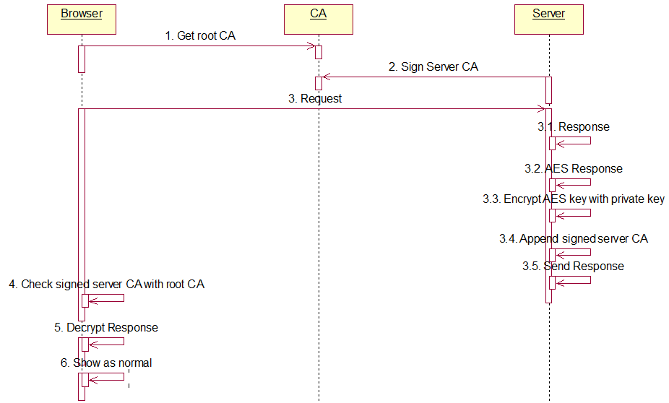

Slide 7
WEB代理
WEB Proxy
http connect
Get private root CA
浏览器
Browser
Web服务器
https request 1
https request
https request 1’
https response 1
https response
https response 1’

Slide 8
工作原理
Principle
同类软件
Similar
安装说明
Installation
常规用法
Usage
二次开发
Development
数据分析
Analysis
Notes:
working principle
Similar software
Installation Notes
General usage
Secondary development
data analysis

Slide 10
工作原理
Principle
同类软件
Similar
安装说明
Installation
常规用法
Usage
二次开发
Development
数据分析
Analysis
Notes:
working principle
Similar software
Installation Notes
General usage
Secondary development
data analysis

Slide 11
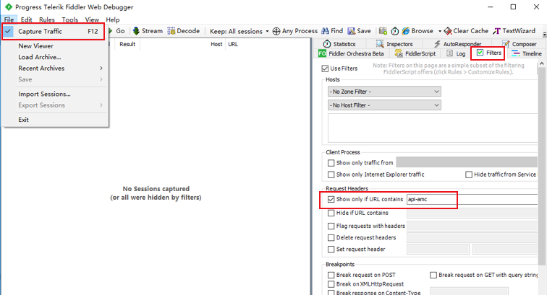
Notes:
Httpwatch
firebug,
Wireshark
fiddler

Slide 12
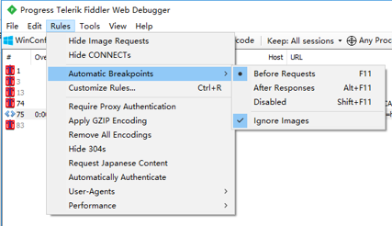
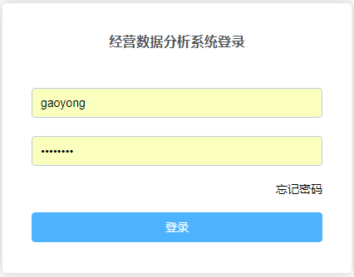
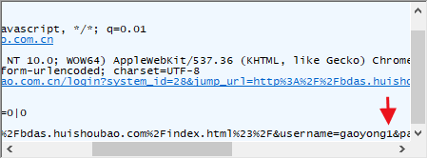
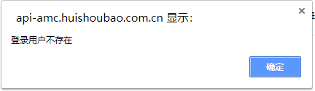
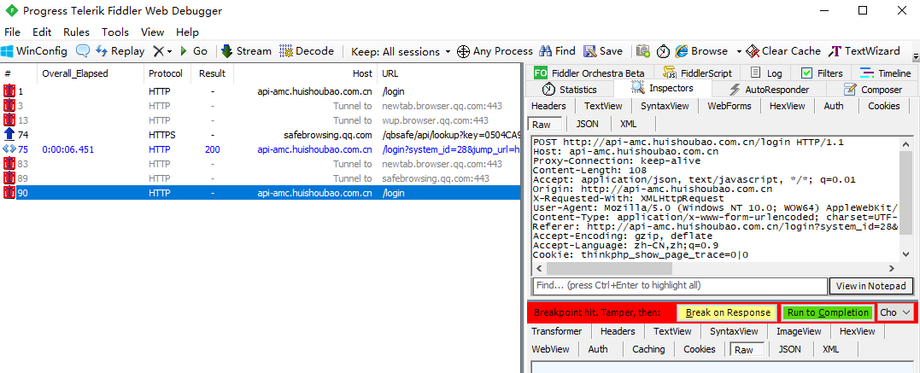
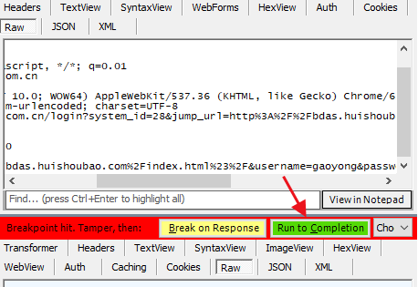
1
2
4
3
5

Slide 13
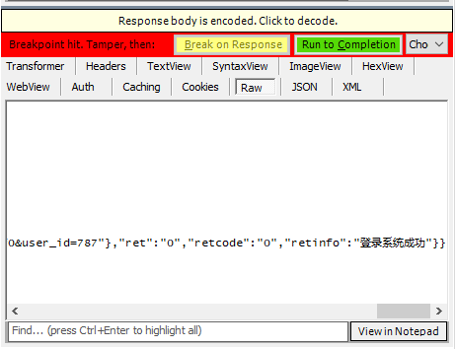
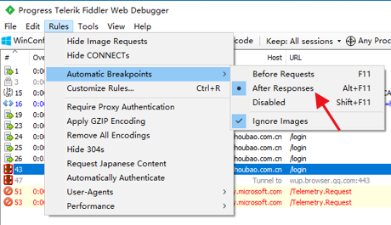
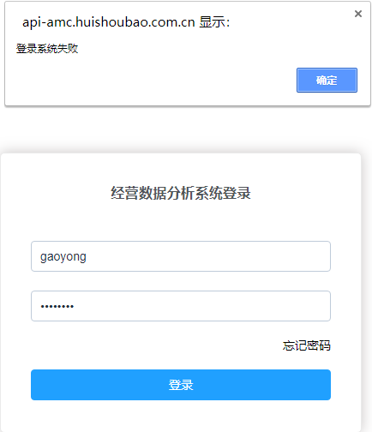
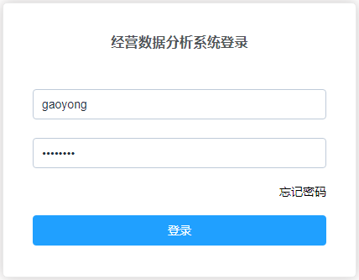
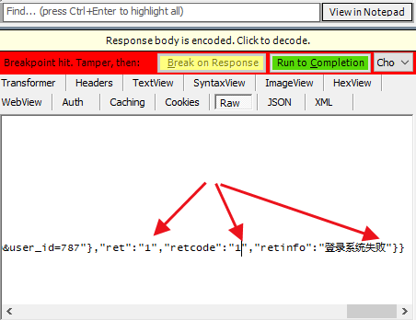
2
1
3

Slide 14
工作原理
Principle
同类软件
Similar
安装说明
Installation
常规用法
Usage
二次开发
Development
数据分析
Analysis
Notes:
working principle
Similar software
Installation Notes
General usage
Secondary development
data analysis

Slide 15

微信号|WeChat ID : wapuboy
wapuboy@gmail.com
https://github.com/wapuboy

