Slide 1
用Fiddler进行系统调试和运营分析 System debugging and operational analysis with Fiddler
wapuboy @ 2018
Notes:
Fiddler 是什么，同类技术还有哪些
Fiddler的应用场景与局限
Fiddler的常用功能解释
Fiddler的脚本开发功能
Fiddler的系统调试开发实例
Fiddler的运营分析实例

Slide 2

工作原理
Principle
同类软件
Similar
安装说明
Installation
常规用法
Usage
二次开发
Development
数据分析
Analysis
Notes:
working principle
Similar software
Installation Notes
General usage
Secondary development
data analysis

Slide 3
工作原理
Principle
同类软件
Similar
安装说明
Installation
常规用法
Usage
二次开发
Development
数据分析
Analysis
Notes:
working principle
Similar software
Installation Notes
General usage
Secondary development
data analysis

Slide 4
WEB代理
WEB Proxy
浏览器
Browser
Web服务器
http request 1
http request
http request 1’
http response 1
http response
http response 1’

Slide 5
信息安全
Information security
机构
Institution
VERSIGN
Microsoft
协议
Protocol
HTTPS
SSL
算法
Algorithm
加密
Encryption
摘要
Summary
BASE64
MD5
SHA
混淆
Confusion
对称
Symmetry
非对称
Asymmetric
DES
AES
RSA
DSA
政府
Government
公司
Company
CFCA

Slide 6
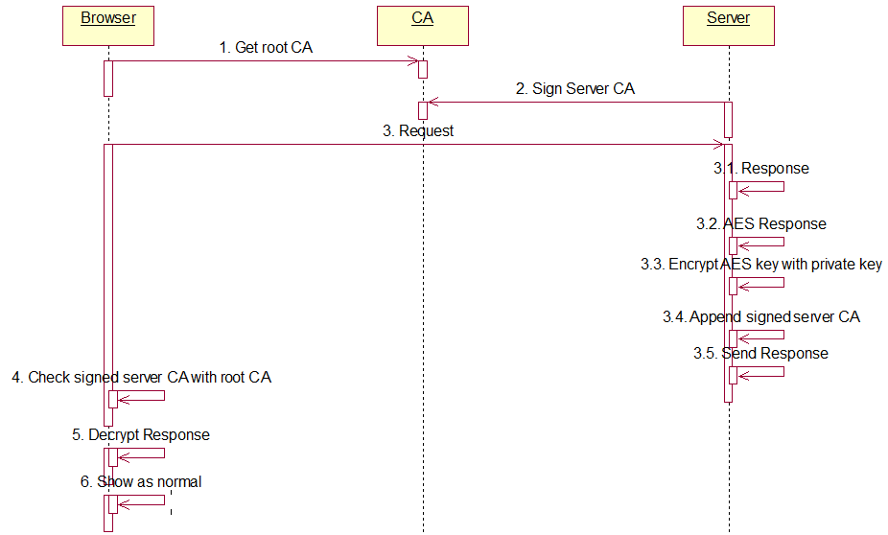

Slide 7
WEB代理
WEB Proxy
http connect
Get private root CA
浏览器
Browser
Web服务器
https request 1
https request
https request 1’
https response 1
https response
https response 1’

Slide 8
工作原理
Principle
同类软件
Similar
安装说明
Installation
常规用法
Usage
二次开发
Development
数据分析
Analysis
Notes:
working principle
Similar software
Installation Notes
General usage
Secondary development
data analysis

Slide 9
Charles
wireshark
ettercap
Ethereal
此处略去……
Splunk
winpcap
tcpdump

Slide 10
工作原理
Principle
同类软件
Similar
安装说明
Installation
常规用法
Usage
二次开发
Development
数据分析
Analysis
Notes:
working principle
Similar software
Installation Notes
General usage
Secondary development
data analysis

Slide 11
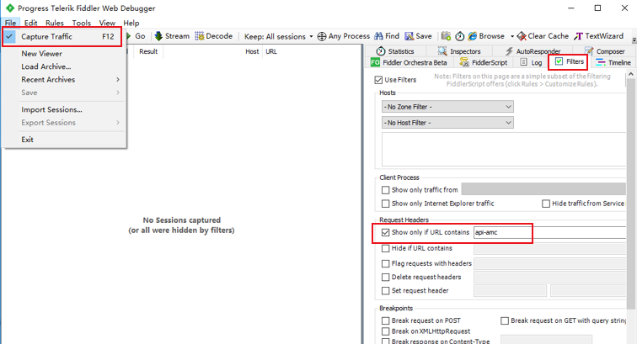
Notes:
Httpwatch
firebug,
Wireshark
fiddler

Slide 12
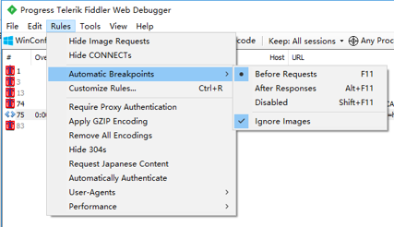
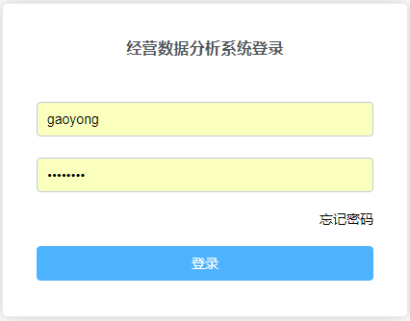
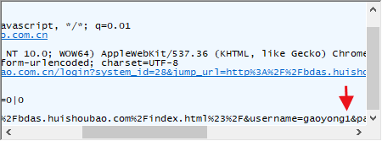
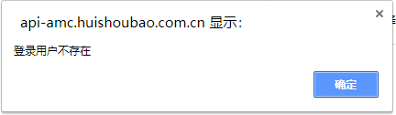
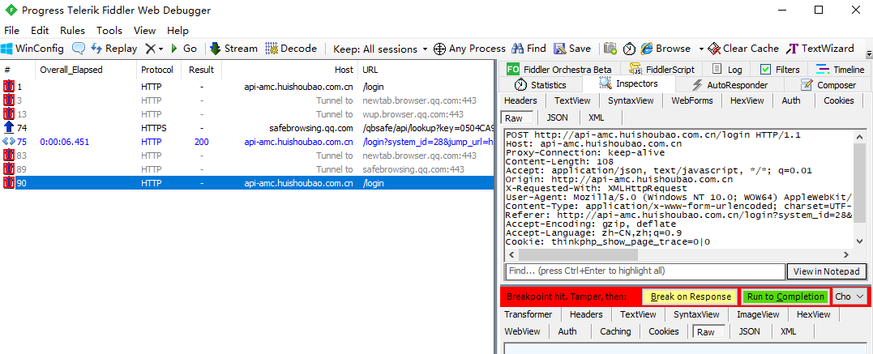
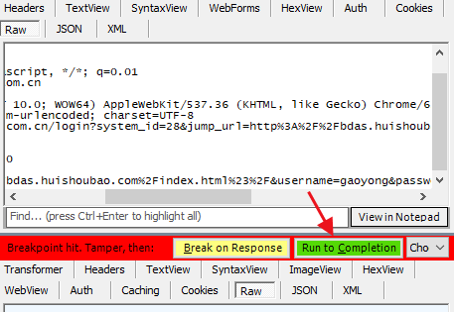
1
2
4
3
5

Slide 13
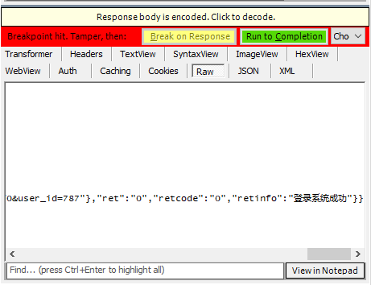
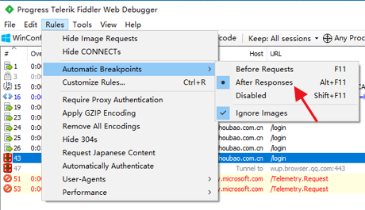
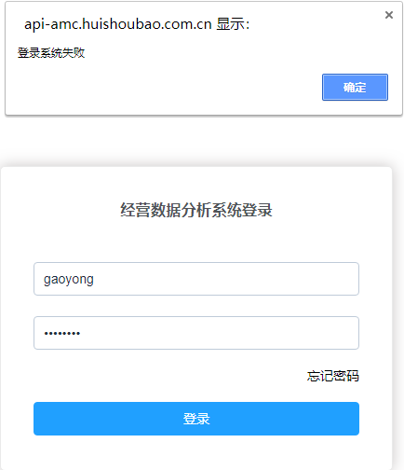
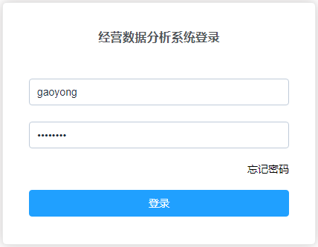
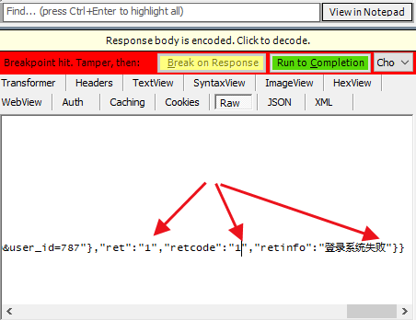
2
1
3

Slide 14
工作原理
Principle
同类软件
Similar
安装说明
Installation
常规用法
Usage
二次开发
Development
数据分析
Analysis
Notes:
working principle
Similar software
Installation Notes
General usage
Secondary development
data analysis

Slide 15
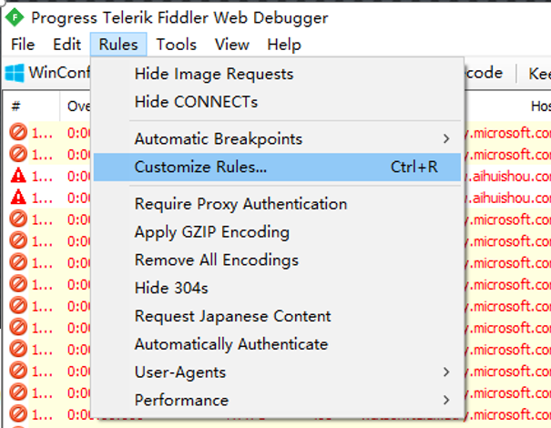

Slide 16
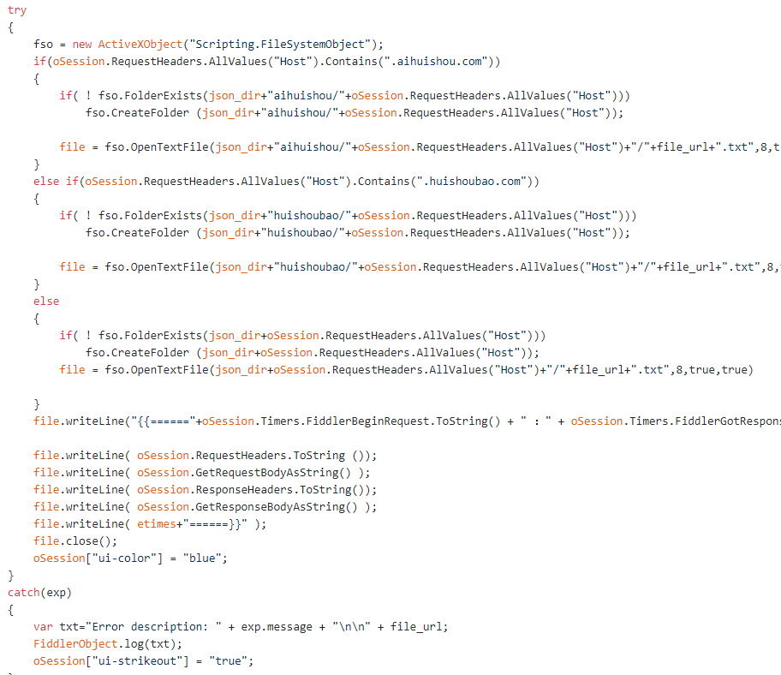

Slide 17
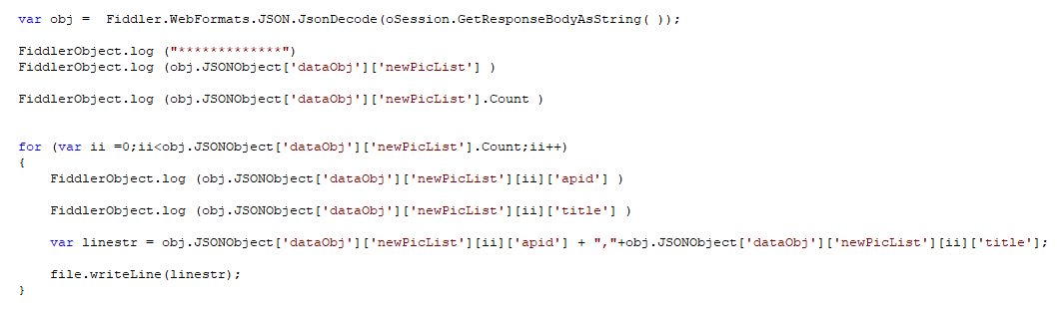

Slide 18
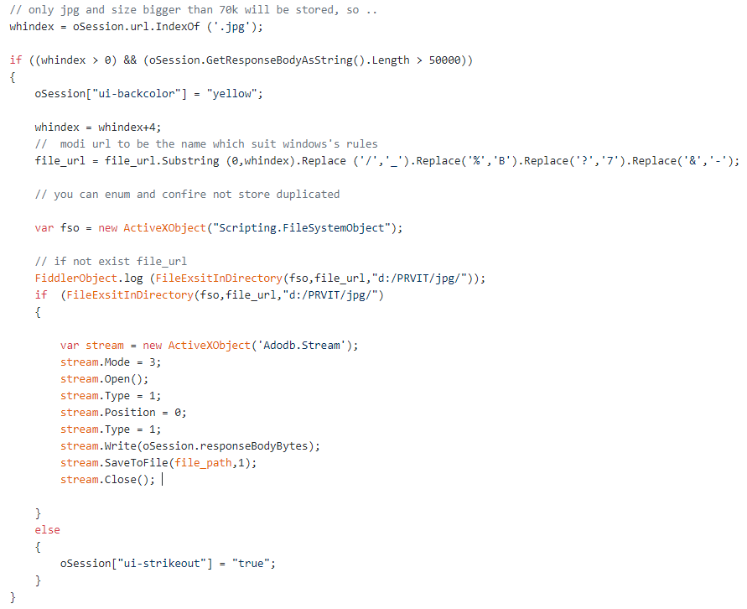

Slide 19
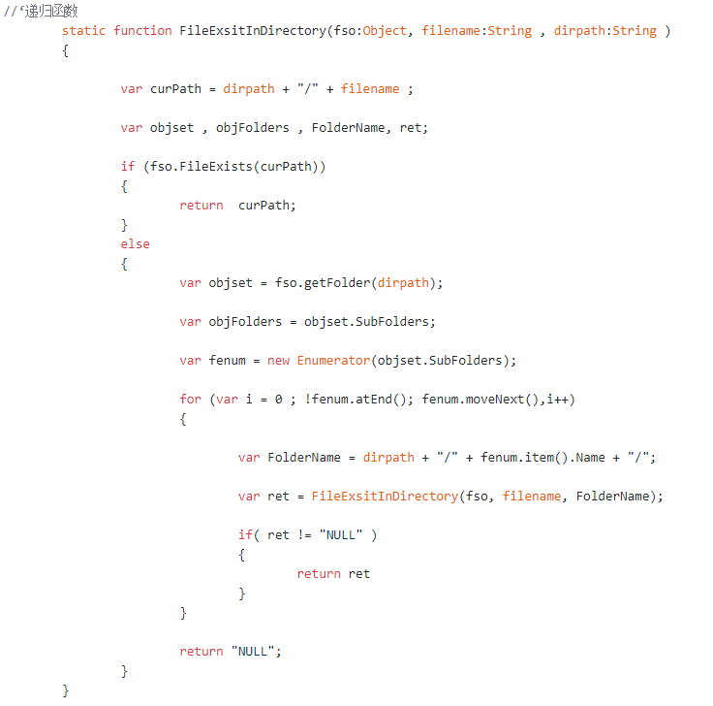

Slide 20
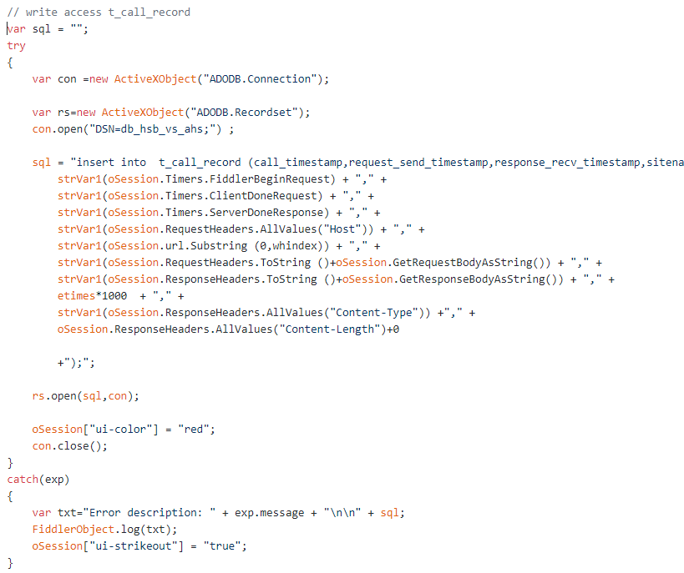

Slide 21
https://github.com/wapuboy/fiddler_capture_storage

Slide 22
工作原理
Principle
同类软件
Similar
安装说明
Installation
常规用法
Usage
二次开发
Development
数据分析
Analysis
Notes:
working principle
Similar software
Installation Notes
General usage
Secondary development
data analysis

Slide 23
采集
分析
呈现
Scrapy
PySpider
Nutch
WebMagic
Node-crawler
Webster
Phpspider
Beanbun
open-source-search-engine
PhantomJS
SlimerJS
外部动态部署
统一数据接口
数据逻辑识别
统一业务格式
异动通知服务
综合报表呈现
Luncene
Elasticsearch
Decision Tree
kafuka
MySQL
Habase
Hadoop
Redis
Navicat
Radash
JasperReports
Seal-Report
Supperset
cubes
grafana

Slide 24
Fiddler
Ethereal
Jd-gui
APKTool
PhantomJS
Telnet
Fiddler
PlantomJS
Scrapy
Sqlite
Mysql
kafuka
模拟
嗅探
采集

Slide 25

微信号|WeChat ID : wapuboy
wapuboy@gmail.com
https://github.com/wapuboy

