Slide 1
RPi 2/3 GPIO + Web(Flask)
jyheo0@gmail.com

Slide 2
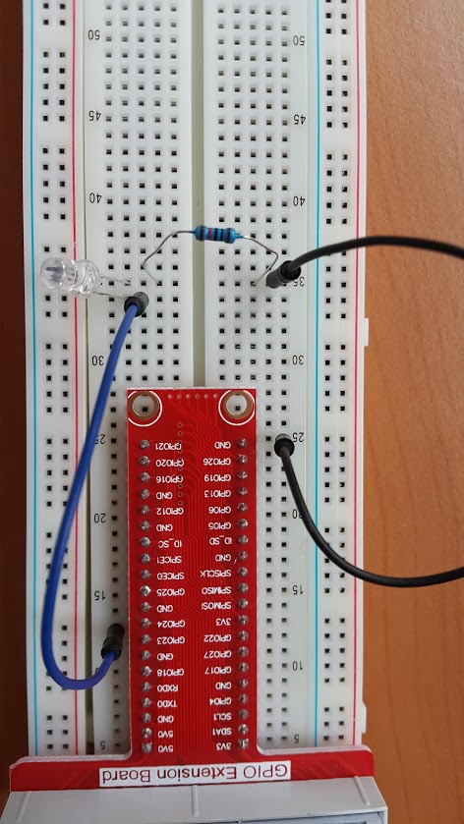
GPIO - LED
Be Carefull while Wiring!
LED: longer leg must be connected to + (GPIO24).

Slide 3
GPIO - LED
import RPi.GPIO as GPIO
import time
GPIO.setmode(GPIO.BCM)
GPIO.setwarnings(False)
led=24 # GPIO channel number
GPIO.setup(led, GPIO.OUT)
GPIO.output(led, 1)
time.sleep(2)
GPIO.output(led, 0)
$ nano gpio-led.py
$ python3 gpio-led.py
https://github.com/jyheo/rpi2/blob/master/gpio-led.py

Slide 4
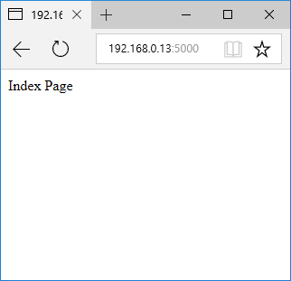
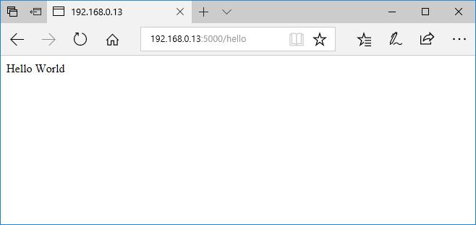
Flask
from flask import Flask
app = Flask(__name__)
@app.route(‘/’)
def index():
return ‘Index Page’
@app.route(‘/hello’)
def hello():
return 'Hello World'
if __name__ == ‘__main__’:
app.run(host=‘0.0.0.0’)

Slide 5
GPIO-LED + Flask
import RPi.GPIO as GPIO
from flask import Flask
GPIO.setmode(GPIO.BCM)
GPIO.setwarnings(False)
led=24 # GPIO channel number
GPIO.setup(led, GPIO.OUT)
app = Flask(__name__)
@app.route(‘/ledon’)
def ledon():
GPIO.output(led, 1)
return ‘LED ON’
@app.route(‘/ledoff’)
def ledoff():
GPIO.output(led, 0)
return ‘LED OFF’
if __name__ == ‘__main__’:
app.run(host=‘0.0.0.0’)
$ wget http://192.168.0.13:5000/on
$ wget http://192.168.0.13:5000/off
https://github.com/jyheo/rpi2/blob/master/iot.py

Slide 6
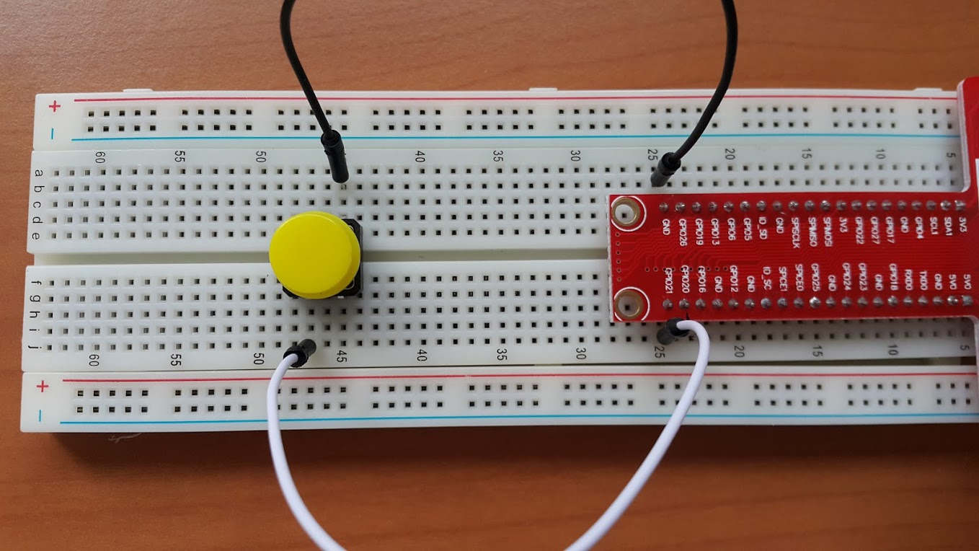
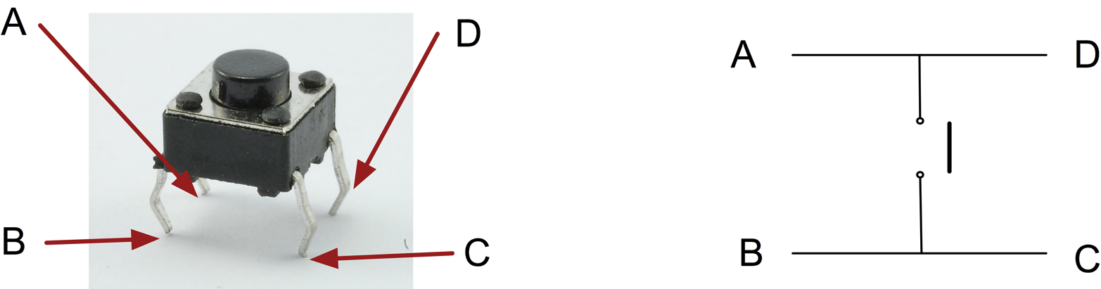
GPIO-Button
Be Carefull while Wiring!
GPIO21
Source: http://razzpisampler.oreilly.com/ch07.html

Slide 7
GPIO-Button
import RPi.GPIO as GPIO
import time
GPIO.setmode(GPIO.BCM)
GPIO.setwarnings(False)
button = 21
GPIO.setup(button, GPIO.IN, GPIO.PUD_UP)
while True:
if GPIO.input(button) == False:
print(‘Button pressed.’)
break
$ nano gpio_button.py
$ python3 gpio_button.py
https://github.com/jyheo/rpi2/blob/master/gpio_button.py

Slide 8
GPIO-Button + Flask
import RPi.GPIO as GPIO
from flask import Flask
GPIO.setmode(GPIO.BCM)
GPIO.setwarnings(False)
btn=21 # GPIO channel number
GPIO.setup(btn, GPIO.IN, GPIO.PUD_UP)
app = Flask(__name__)
@app.route(‘/button’)
def button():
btn_status = GPIO.input(btn)
return ‘Button:’ + str(btn_status)
if __name__ == ‘__main__’:
app.run(host=‘0.0.0.0’)
$ wget http://192.168.0.13:5000/button
Button:1
Button:0
https://github.com/jyheo/rpi2/blob/master/iot.py

Slide 9

Exercise
Write a web service
LED on/off
Get the status of the Button attached Raspberry Pi
Hint: iot.py
@app.route('/')
def index():
return render_template('iot.html')
@app.route('/ledon')
def ledon():
GPIO.output(led, 1)
return 'LED ON'

Slide 10
Exercise
templates/iot.html
<html>
<button type="button" onclick="ledon()">LED ON</button>
<p id="result">result</p>
<script>
function ledon() {
var xhttp = new XMLHttpRequest();
xhttp.onreadystatechange = function() {
if (this.readyState == 4 && this.status == 200) {
document.getElementById("result").innerHTML = this.responseText;
}
};
xhttp.open("GET", "/ledon", true);
xhttp.send();
}
</script>
</html>
https://github.com/jyheo/rpi2/blob/master/templates/iot.html

