Slide 1
RPi 2/3, I2C, Analog Sensor
jyheo0@gmail.com

Slide 2
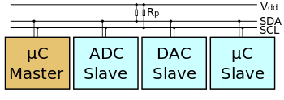
I²C (I-squared-C)
Serial computer bus invented by Philips Semiconductor
Typically used for attaching lower-speed peripheral ICs to processors and microcontrollers
A sample schematic with one master (a microcontroller), three slave nodes (an ADC, a DAC, and a microcontroller), and pull-up resistors Rp
https://en.wikipedia.org/wiki/I%C2%B2C

Slide 3
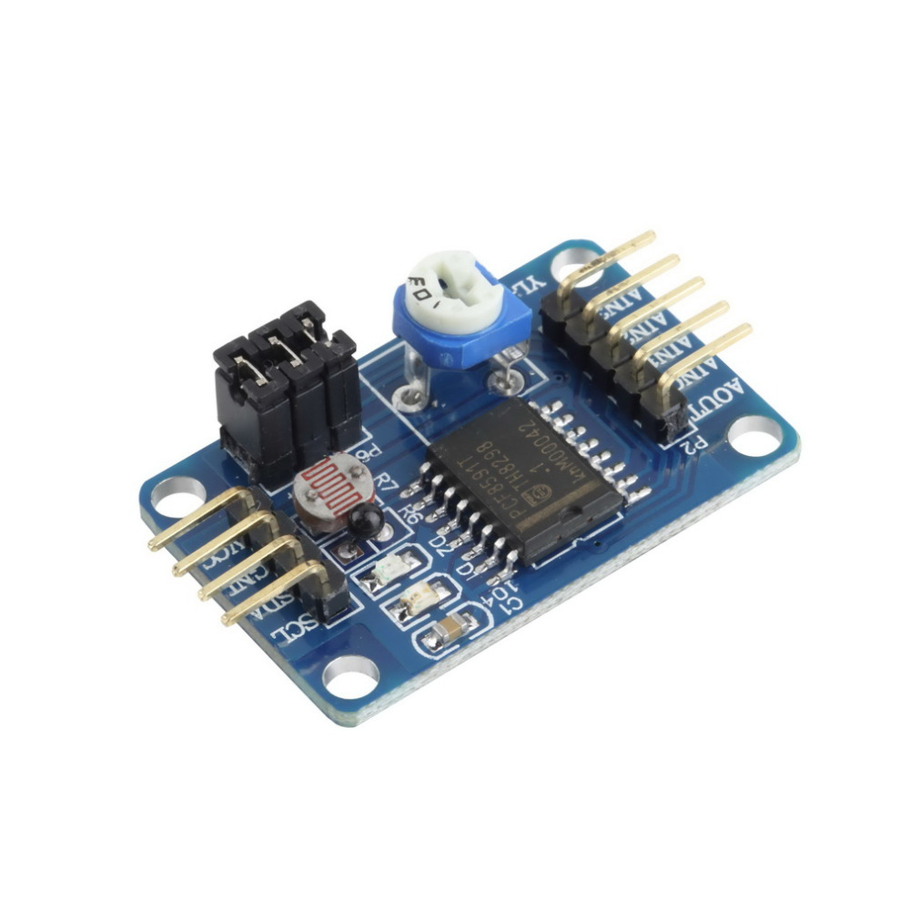
ADC, DAC
ADC - Analog to Digital Converter
DAC - Digital to Analog Converter
PCF8591t
3 ADC, 1 DAC
value range: 0~255
YL-40 board with PCF8591t
P4
P5
P6
AOUT
AIN0
AIN1
AIN2
AIN3
Jumper P4 for AIN1: R6 thermister
Jumper P5 to AIN0: R7 photocell
Jumper P6 to AIN3: The single turn 10K ohm resistance
Removing a jumper allows an input channel to be fed from one of the external pins, labelled accordingly.
SCL
SDA
GND
VCC

Slide 4
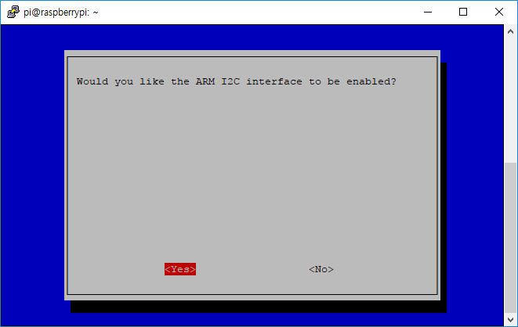
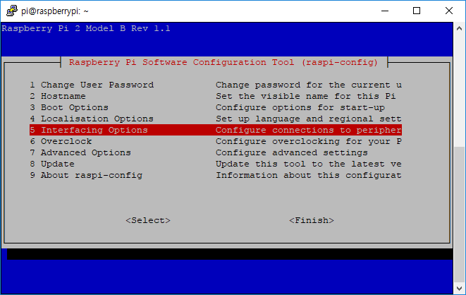
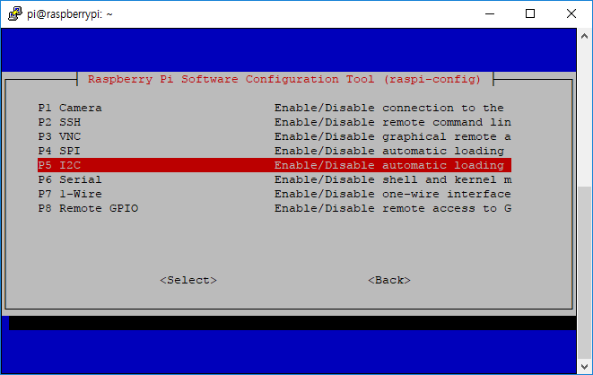
Enable I2C in RPi
Enable I2C in raspi-config and reboot
$ sudo raspi-config
Interfacing Options 선택 > I2C 선택

Slide 5
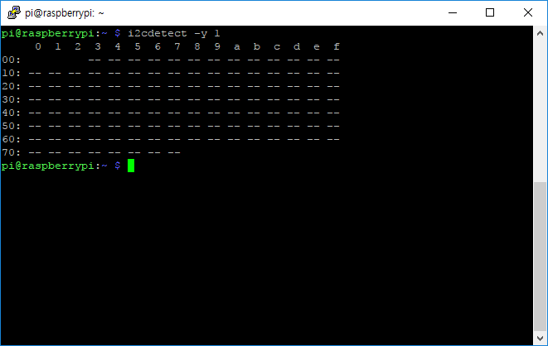
Enable I2C in RPi
Enable I2C in raspi-config and reboot
Check if the I2C kernel module is loaded
$ lsmod
i2c-dev, i2c-bcm???? must be listed!
Test
$ i2cdetect -y 1

Slide 6
Wiring RPi and YL-40
YL-40 | RPi
SCL | SCL1
SDA | SDA1
GND | GND
VCC | 3V3

Slide 7
Photocell on YL-40
import smbus
import time
import sys
bus = smbus.SMBus(1)
address = 0x48
if len(sys.argv) == 2:
i = int(sys.argv[1])
input_addr = 0x40 + i
else:
input_addr = 0x40
while True:
bus.write_byte(address, input_addr)
bus.read_byte(address)
aread = bus.read_byte(address)
print(aread)
time.sleep(0.2)
$ python3 yl40.py 0
# AIN0 0x40: photocell
# AIN1 0x41: thermister
# AIN3 0x43: registance
https://github.com/jyheo/rpi2/blob/master/yl40.py

Slide 8
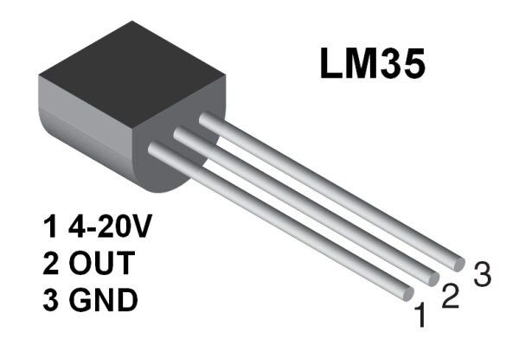
Temperature Sensor - LM35
Wiring
LM35 1 to RPi 3V3
OUT to YL-40 AIN2
GND to RPi GND
$ python3 yl40.py 2
https://github.com/jyheo/rpi2/blob/master/yl40.py

Slide 9
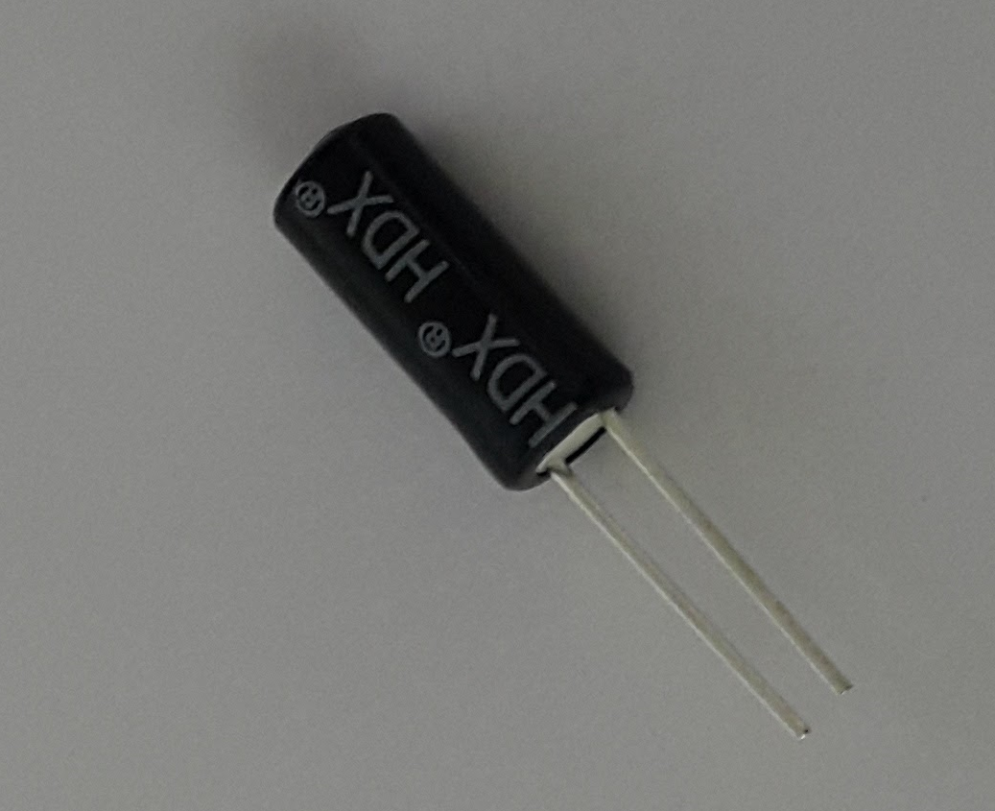
Vibration Sensor
Wiring
One leg of Vibration Sensor to RPi 3V3
The other leg to YL-40 AIN2
$ python3 yl40.py 2
https://github.com/jyheo/rpi2/blob/master/yl40.py

Slide 10
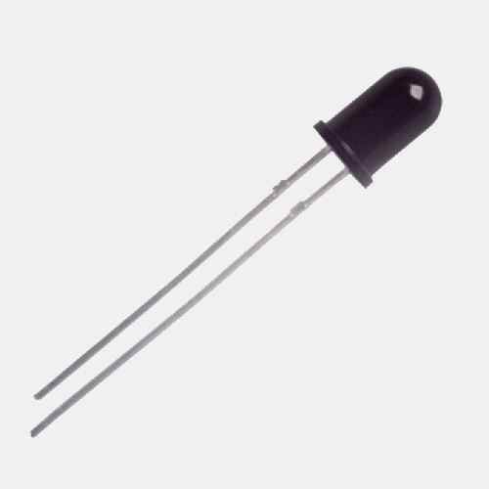
IR Receiver
Wiring
Longer leg of Vibration Sensor to RPi 3V3
The other leg to YL-40 AIN2
$ python3 yl40.py 2
IR Receiver can be used to detect motion
https://github.com/jyheo/rpi2/blob/master/yl40.py

Slide 11
Analog OUT
import smbus
import time
import sys
bus = smbus.SMBus(1)
address = 0x48
if len(sys.argv) == 2:
v = int(sys.argv[1])
bus.write_byte_data(address, 0x40, v)
else:
print(‘sudo python yl40w.py 0~255’)
$ python3 yl40w.py 255
Turn on green LED of YL-40
$ python3 yl40w.py 0
Turn off the LED
https://github.com/jyheo/rpi2/blob/master/yl40w.py

Slide 12
Exercise
Write a python program
To display temperature and light
Motion detection LED
Detect motion using IR receiver
Once detecting motion, keep turning LED on for 3 seconds

