Slide 1
Flask
Web Frameworks for Python
jyheo@hansung.ac.kr

Slide 2
Web Frameworks for Python
A Web framework is a collection of packages or modules
to write Web applications or services
without having to handle such low-level details as protocols, sockets or process/thread management.
Popular frameworks (https://wiki.python.org/moin/WebFrameworks/)
Django
web2py
Flask
Bottle
CherryPy
Raspbian includes Flask, don’t need to install it.

Slide 3
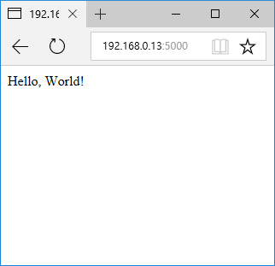
Flask - Minimal Application
pi@raspberrypi:~ $ cat hello.py
from flask import Flask
app = Flask(__name__)
@app.route('/')
def hello_world():
return 'Hello, World!'
if __name__ == '__main__':
app.run(host='0.0.0.0’)
pi@raspberrypi:~ $ python3 hello.py
* Running on http://0.0.0.0:5000/ (Press CTRL+C to quit)
192.168.0.129 - - [02/Nov/2017 10:52:38] "GET / HTTP/1.1" 200 -
192.168.0.129 - - [02/Nov/2017 10:52:38] "GET /favicon.ico HTTP/1.1" 404 -

Slide 4
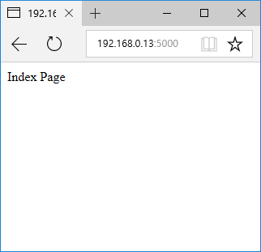
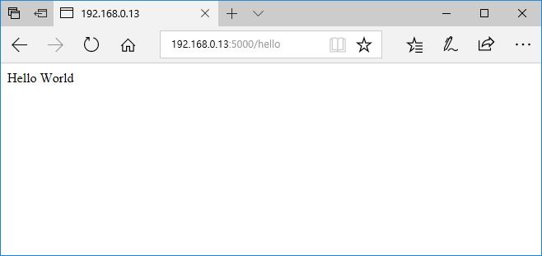
Route() Decorator
route() decorator is used to bind a function to a URL
from flask import Flask
app = Flask(__name__)
@app.route('/')
def index():
return 'Index Page'
@app.route('/hello')
def hello():
return 'Hello World'
if __name__ == '__main__':
app.run(host='0.0.0.0')

Slide 5
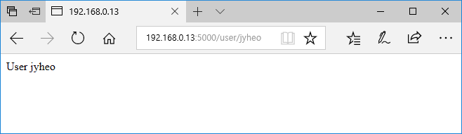
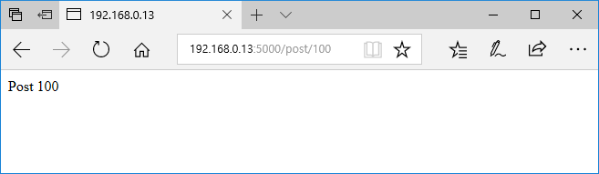
Variable to URL
from flask import Flask
app = Flask(__name__)
@app.route('/user/<username>')
def show_user_profile(username):
# show the user profile for that user
return 'User %s' % username
@app.route('/post/<int:post_id>')
def show_post(post_id):
# show the post with the given id, the id is an integer
return 'Post %d' % post_id
if __name__ == '__main__':
app.run(host='0.0.0.0')

Slide 6
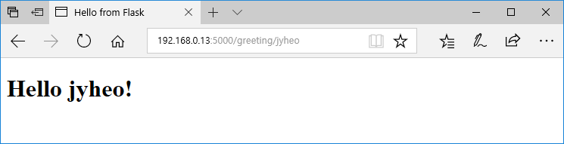
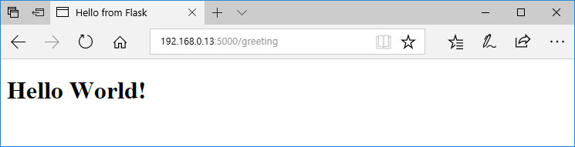
Templates
from flask import Flask
from flask import render_template
app = Flask(__name__)
@app.route('/greeting')
@app.route('/greeting/<name>')
def hello(name=None):
return render_template('greeting.html', name=name)
if __name__ == '__main__':
app.run(host='0.0.0.0')

Slide 7
Templates
render_template('greeting.html', name=name)
greenting.html must be stored in templates/
$ cat templates/greeting.html
<!doctype html>
<title>Hello from Flask</title>
{% if name %}
<h1>Hello {{ name }}!</h1>
{% else %}
<h1>Hello World!</h1>
{% endif %}

Slide 8
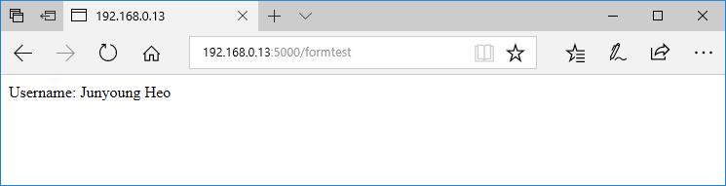
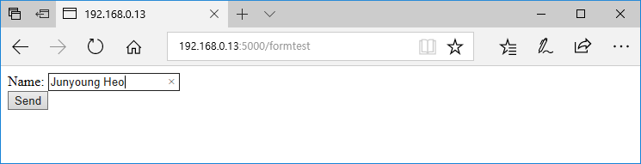
Form & Request Object
from flask import Flask, request
@app.route('/formtest', methods=['POST', 'GET'])
def form_test():
if request.method == 'POST':
return 'Username: %s' % (request.form['username'])
else:
return ''' <form action="/formtest" method="post">
Name: <input name="username" type="text" /> <br/>
<input value="Send" type="submit" />
</form> '''

Slide 9
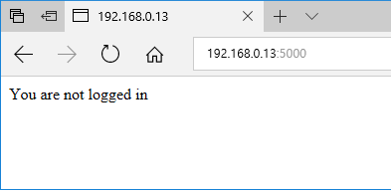
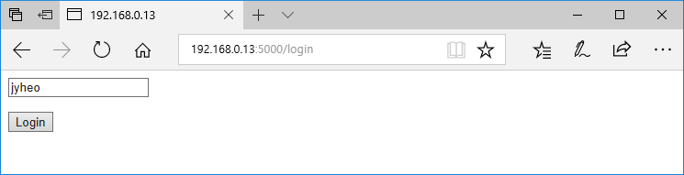
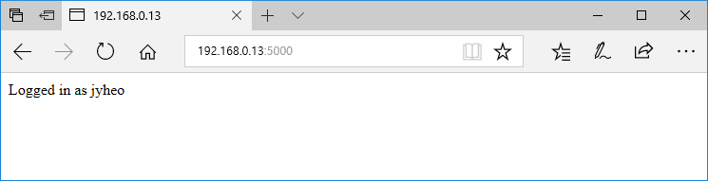
Session
https://gist.github.com/jyheo/b53dd1f868a4ef25a282
http://127.0.0.1:5000/logout

Slide 10
Tutorial
http://flask.pocoo.org/docs/0.12/tutorial/

Slide 11
Exercise
@app.route('/list')
def list():
retstr = ""
with open('list.txt') as f:
for l in f.readlines():
retstr += l + '<br/>'
return retstr
@app.route('/write', methods=['POST', 'GET'])
def write_article():
if request.method == 'POST':
article = request.form['article']
with open('list.txt', 'a') as f:
f.write(article)
return 'Write Successful'
return 'Write Error'
else:
return ''' <form action="/write" method="post">
Article: <input name="article" type="text" /> <br/>
<input value="Write" type="submit" />
</form> '''
Write an BBS web service based on these example code.
Use templates!
Hint: ‘for’ can be used in a template!

