Slide 1
Raspberry Pi GPIO PWM
Servo Motor
jyheo0@gmail.com

Slide 2
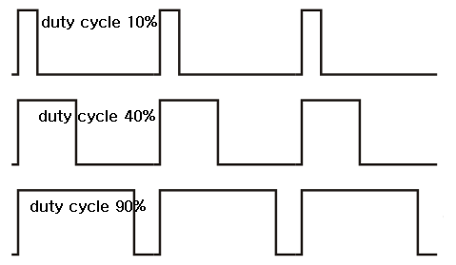
PWM(Pulse Width Modulation)?
Modulation technique used to encode a message into a pulsing signal.
Control of the power supplied to electrical devices, especially to inertial loads such as motors.
https://en.wikipedia.org/wiki/Pulse-width_modulation

Slide 3
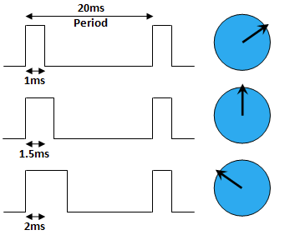
PWM + Servo Motor(SG90)
0도
45도
90도
http://www.piccircuit.com/shop/picture/motor/servo_operation.png

Slide 4
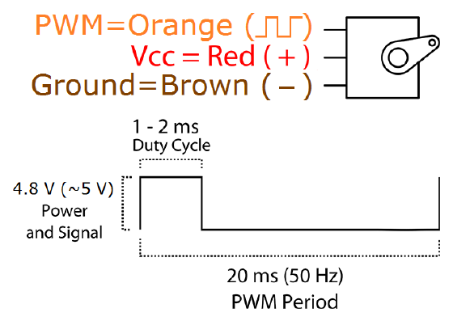
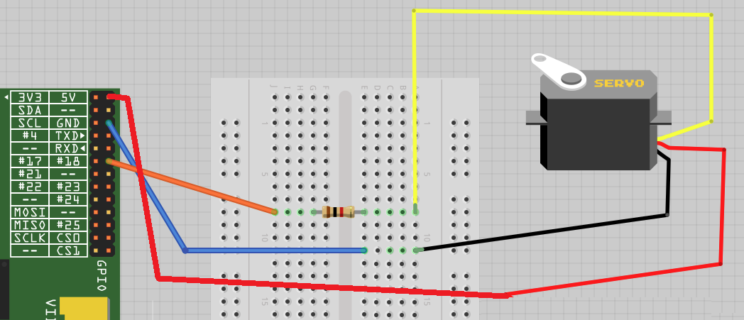
Wiring
RPi GPIO18 - PWM
RPi 5V - Vcc
RPi GND - Ground

Slide 5
Python code
import RPi.GPIO as GPIO
import time
import sys
GPIO.setwarnings(False)
GPIO.setmode(GPIO.BCM)
GPIO.setup(18, GPIO.OUT)
pwm = GPIO.PWM(18, 50) # 50Hz
pwm.start(1)
if len(sys.argv) != 2:
print('python servo.py 1~3’)
else:
ms = float(sys.argv[1])
dcycle = ms / 20.0 * 100 # percent
pwm.ChangeDutyCycle(dcycle)
time.sleep(2) # wait until the device receiving
pwm.stop()
GPIO.cleanup()
$ python3 servo.py 1
$ python3 servo.py 1.5
$ python3 servo.py 2

Slide 6
Exercise
버튼을 3개 연결하고
각 버튼을 누르면 서로 다른 위치로 서보 모터를 동작 시킨다.
서보 모터 대신 LED를 GPIO에 연결해서 결과를 본다.

