Slide 1

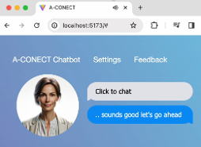




I-CONECT Clinical Trial
(1) Optimizing AI for Protocol Compliance
Clinical Protocol
Prompted LLM
Trained LLM
(3) Safety Monitoring
Instruct
Train
Trained Interviewers
Reward
Real-time Voice Interface
Emotion Responsive Robot
Reminiscence
Engagement
MCI/NC Older Users
Virtual User
Fine-Tuned
LLM
Vocabulary
MCI/NC Older Users
(2) Simulate Human Feedback
(4) Device and Interface

Slide 2

I-CONECT Clinical Trial
(1) Optimizing AI for Protocol Compliance
Social Isolation Risks
Clinical Protocol
Low Emotion
Study Staff
Prompted LLM
Train
Trained LLM
Alert
Instruct
Suicidal Tendence
Reward
Harmful Content
Trained Interviewers
Reminiscence
Engagement
(3) Safety Monitoring
(5) Check-in Call
Vocabulary
MCI/NC Older Users
Virtual Users
Fine-Tuned
LLM
Real-time Voice Interface
MCI/NC Older Users
Emotion Responsive Robot
(2) Simulate Human Conversation
(6) Final Survey
(4) Device and Interface
(7) Adherence Rate

Slide 3
I-CONECT Clinical Trial
(1) Optimizing AI for Protocol Compliance
Negative Emotion
Alert
Study Staff
Clinical Protocol
Suicidal Tendence
Instruct
LLM
Harmful Content
(3) Safety Monitoring
(5) Check-in Call
Trained Interviewers
Train
Reminiscence
Real-time Voice Interface
MCI/NC Older Users
Engagement
MCI/NC Older Users
Virtual Users
Fine-Tuned
LLM
Vocabulary
Emotion Responsive Robot
Satisfactory Survey
Adherence Rate
(2) Simulate Human Conversation
(4) Device and Interface
(6) Feasibility Study
Notes:
V3: Simplified some components

Slide 4
I-CONECT Clinical Trial
RLHF for Protocol Compliance
Clinical Protocol
Prompt
LLM
Trained Interviewers
Train
Reminiscence
Engagement
MCI/NC Older Users
Virtual Users
Fine-Tuned
LLM
Vocabulary
Safety
Conversation Simulation
Notes:
V4: Add training for 3D generation. Remove study part.

Slide 5
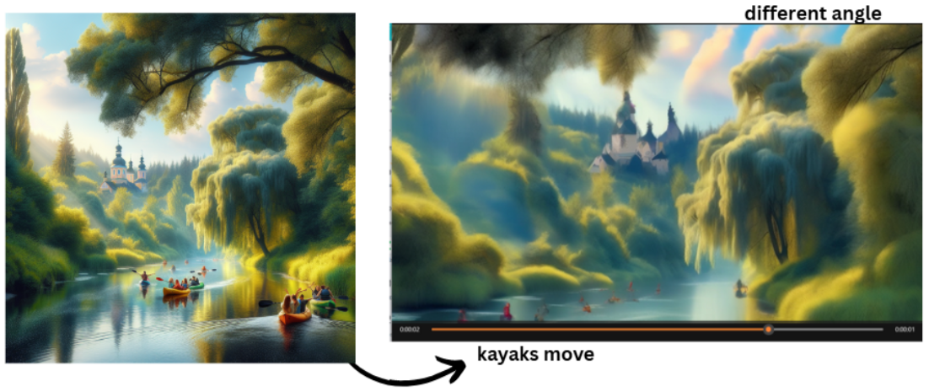
Negative Emotion
Trained Chat
LLM
Harmful Content
Alert
Study Staff
Safety Monitoring
Multimodal Interface
Real-time Voice Interface
Check-in Call
User’s Editing Instruction
Emotionally Responsive Robot
MCI/NC Older Users
Memory Image Generation
3D Memory Scene
Interact:
Move left/right
Notes:
Architecture design

Slide 6
Describe image
MCI/NC Older Users
LLM Chat
Follow-up questions
Describe image
MCI/NC Older Users
LLM Chat
Ask memory
Describe memory
Generate 3D Scene.
Ask details
Reminiscence & Vocab enhancement
Describe details
Edit 3D Scene.

Slide 7
Options and their difference to Roybal
Roybal:
  Chatbot + I-CONECT Protocol (image, semi-structured, engagement optimization)
AI-CONECT v1 R21
  Chatbot + I-CONECT Protocol
  Optimization method: digital twin simulation
  Safety guardrail
  (Interactive) Social Robot to provide emotion feedback (Avatar Face)
AI-CONECT v2 R21
  (everything in v1)
  3D scene generation and interactive design.
    Addressed challenge: Engagement.
    Tech: Interactivity
Title: AI-Interactive-CONECT → AI^2-CONECT

Slide 8
Multimodality Interactions
Conversation:
  Language interactions LLM
Multi-modality:
  Audio
  Image
  Video
Interaction
  Conversational instruction
  Explorable memory space

Slide 9

I-CONECT Clinical Trial
Virtual Evaluation
AI-CONECT Chatbot
Reminiscence Stimulation
“Conversations were created to stimulate cognitive function by using reminiscence of old events in their lives”.
Clinical Protocol
Prompt Design
LLM +
Engaging Participants
“We aim to keep word counts by the conversational staff at or below 30% of the total word counts to provide ample opportunities for participants to talk.”
Trained Interviewers
Reminiscence
Auto Evaluation
Engagement
User-friendly Device
Vocabulary
User-friendly Device
“To avoid confounding effects of cognitive stimulation from learning how to use videochats, the user-friendly simple chat device was created.”
MCI/NC Older Users
Virtual User
Fine-Tuned
LLM
Virtual Conversation

Slide 10
I-CONECT Clinical Trial
To validate the effectiveness of the conversational
engagement for dementia prevention
AI-CONECT Virtual Benchmark
To validate the language compliance of LLMs in
implementing the conversational engagement
AI-CONECT Chatbot
To examine the potential of AI-based design choices
Reminiscence Stimulation
“Conversations were created to stimulate cognitive function by using reminiscence of old events in their lives”.
Clinical Protocols
Prompt Design
LLM +
Engaging Participants
“We aim to keep word counts by the conversational staff at or below 30% of the total word counts to provide ample opportunities for participants to talk.”
Trained Interviewers
Reminiscence Ratio
Auto Evaluation
User Word Ratio
Voice Interface
User-friendly Interface
“To avoid confounding effects of cognitive stimulation from learning how to use videochats, the user-friendly simple chat device was created.”
MCI/NC Older Users
Virtual User
Fine-Tuned
LLM
Virtual Conversation
Claim: A-CONECT framework transform clinical protocol into a scalable benchmark to drive the design of AI Chatbot.

Slide 11





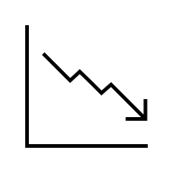

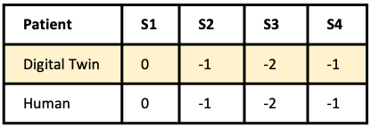

Development Pipeline
Human as Interviewer
Digital Twin
Chatbot
Chatbot as Interviewer
Recruit
(1) Data Curation
(3) Designing Chatbot
Chat
Train interviewer
Record, transcribe, remove PIIs, filtering…
Design choices: Prompt, behavior guide, finetuning etc.
Interviewer: Any fun to share?
Patient: I went to <LOCATION> <DATE>.
Chat
MCI Symptom
(2) Creating Digital-Twin
(4) Simulation
Patient
Conversation simulation
MCI Symptom
Fine-tune LLM
Chatbot: Hello, how are you today?
Digital-Twin: Not bad. How are you
Chatbot: Good. Would you like to talk about history today?
(5) Symptom Validation
(6) Chatbot Evaluation
Fluency: Good
Memory recall: Not often

