Slide 1
Tabnet: Attentive Interpretable Tabular Learning
算法分享

Slide 2
表格学习
论文尝试解决的问题: 深度学习在表格数据领域的应用
表格数据特点
特征关联度高，少部分特征做主要贡献
缺失情况严重
类别不平衡情况严重

Slide 3
背景
论文尝试解决的问题: 深度学习在表格数据领域的应用
决策树模型（传统优势）：
(1)表示效果好: 决策流型近似于超平面，适用表格数据分布
(2)可解释
(3)训练快
深度学习（潜在优势）：
处理大数据量
end-to-end：处理图像，减少特征工程工作，在线学习，表示学习场景（半监督学习等）
传统DNN（现存问题）：
堆叠网络层导致过参数化(overparametrized)，影响模型性能
TabNET：
可学习的稀疏mask，用在特征上

Slide 4
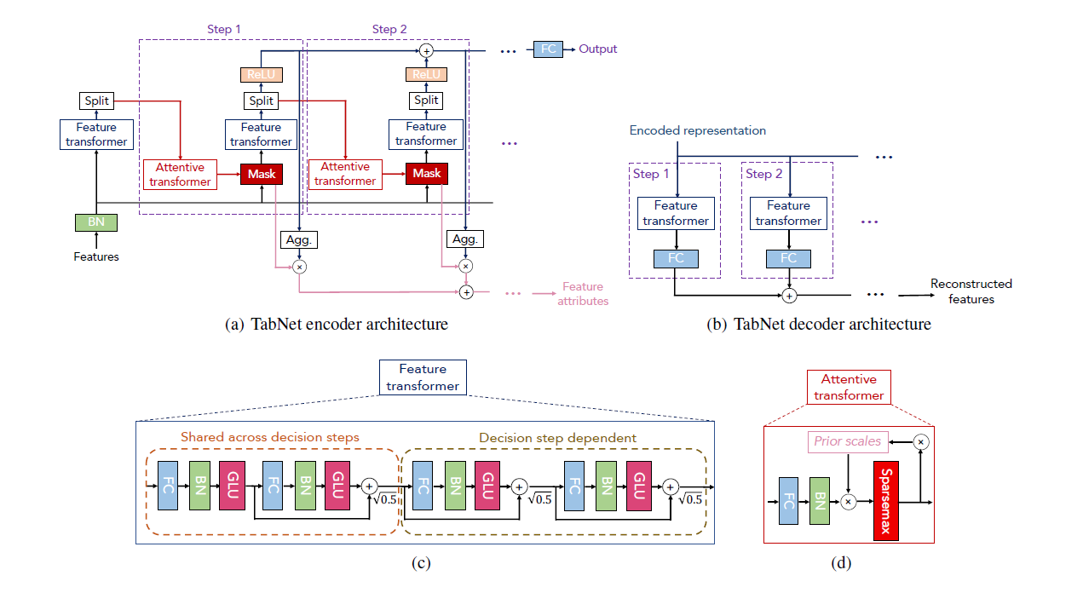
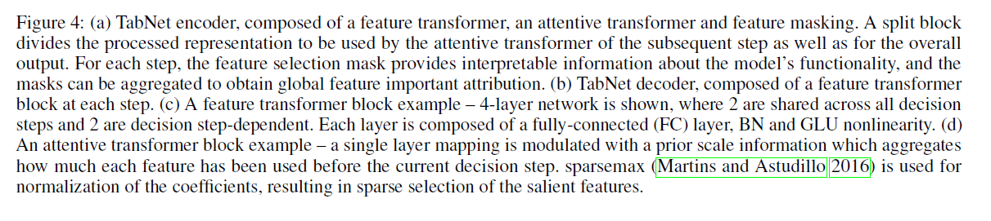
top-down attention in the sequential form

Slide 5
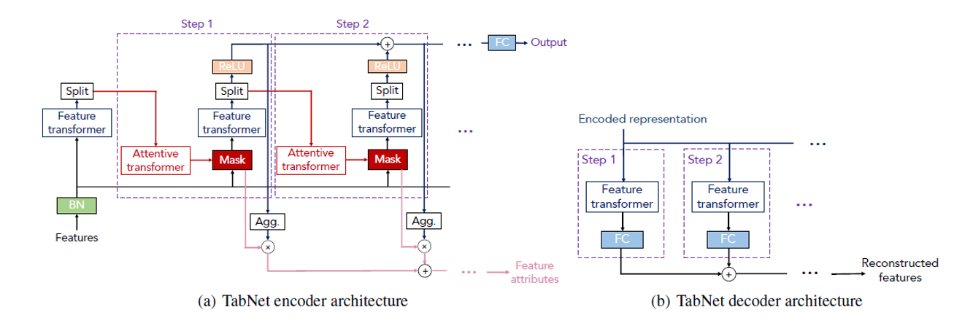
目录
结构原理
创新1：决策树+深度网络--各取所长，效果提升
创新2：sparsemax激活函数--稀疏，可解释
创新3：attention序列--软特征选择，多步叠加（集成学习）
创新4：自监督学习--填补缺失值
效果
应用
开源代码/接口
调参
优化

Slide 6
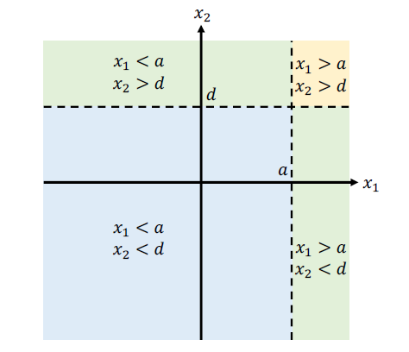
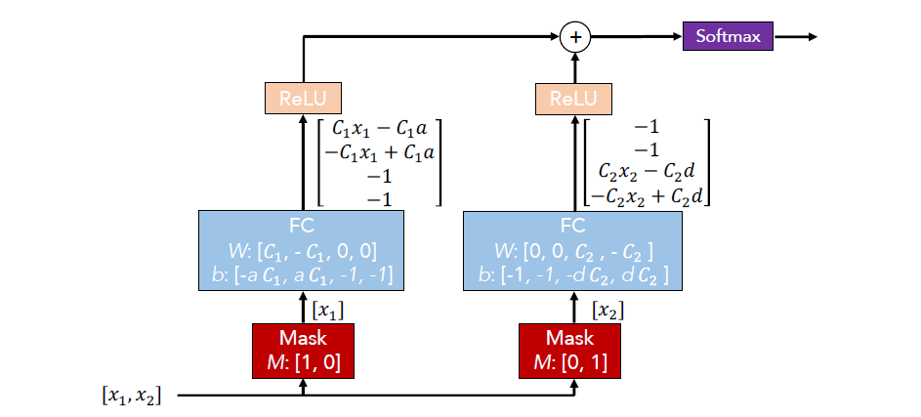
创新1：决策树+深度网络

Slide 7
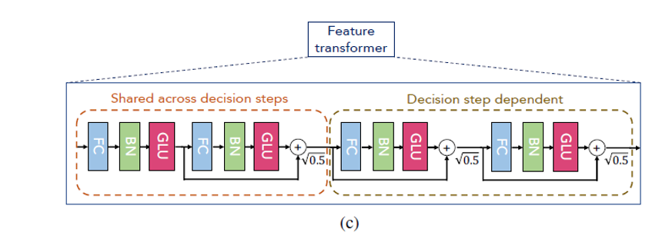
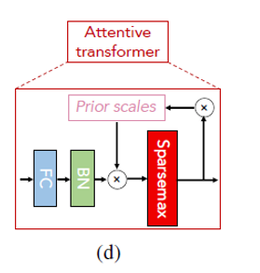
创新2：attention序列--软特征选择，多步叠加决策（集成）
Feature transformer:
2层共享参数 + 2层独立参数（decision step-dependent）
决策树：硬决策
feature mask：软决策
Notes:
This is “soft feature selection” in which the importance of each feature is evaluated by this ratio and is an extension of traditional use-or-not type feature selection.

Slide 8
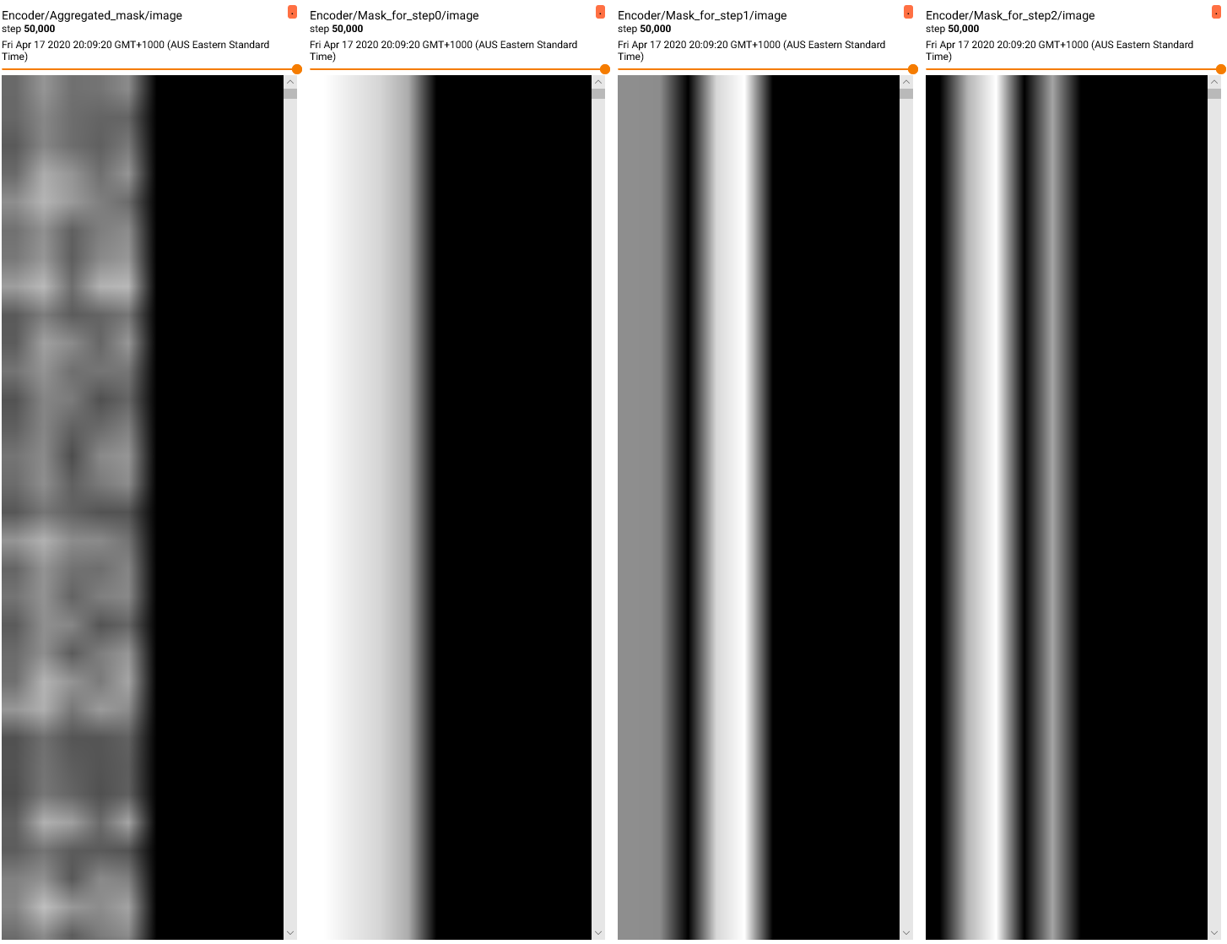


attentive transformer：mask的学习过程
Attentive transformer:
决策序列（多步）：每步对特征进行编码，使用一个可学习的mask做软特征选择
M- attention权重
Sparsemax-增强稀疏性，滤除噪声
P- Prior scales项：向后传递，控制feature在之前的step中的运用程度
learn and control how much a feature has been used before in prior decision steps
Notes:
In the figure below, we plot the masks for the aggregated mask, and masks for decision steps 1, 2 and 3 for the Poker Hands dataset⁷. The rows of the image denote the number of test samples, while each column denote a feature. We can see some feature reuse between the different steps, with importance placed on some features for some test samples.
而 是Prior scales项，其形式为： ，它用来表示某一个feature在之前的step中的运用程度，按照正常的直觉，如果一个feature已经在之前的step中用了很多次，那么它就不应该再被模型选中了，因此模型通过这个Prior scales项来减小这类feature的权重占比，从式子可以看出，如果令 ，那么每个feature只能被用一次，而当 增加时，这个约束就会变“软”一些。

Slide 9
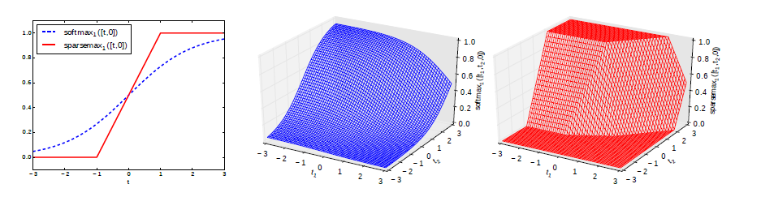


创新3：sparsemax激活函数--稀疏可解释
Softmax: 稠密分布
Sparsemax：稀疏分布
滤出噪声；稀疏性为收敛到更高的准确率提供更好的归纳偏差；
From Softmax to Sparsemax: A Sparse Model of Attention and Multi-Label Classification
Notes:
A limitation of the softmax transformation is that the resulting probability distribution always has full support, i.e., softmaxi(z) 6= 0 for every z and i. This is a disadvantage in applications where a sparse probability distribution is desired, in which case it is common to define a threshold below which small probability values are truncated to zero.
In words, sparsemax returns the Euclidean projection of the input vector z onto the probability simplex. This projection is likely to hit the boundary of the simplex, in which case sparsemax(z) becomes sparse. We will see that sparsemax retains most of the important properties of softmax, having in addition the ability of producing sparse distributions.
当数据集的大部分特征都是冗余的时候，稀疏性能够为收敛到更高的准确率提供更好的归纳偏差。我认为这里存在矛盾的地方。TabNet最大的魅力可能就在于免去表格数据繁杂的特征工程，也就是说可能做到”我有什么就输入什么“的理想状态(像CV领域一样)。但是这里的sparsemax和正则项都以特征冗余为前提，则将特征工程的活转变为了调参的活。这里能否将稀疏度本身也作为可学习的参数本身呢？

Slide 10
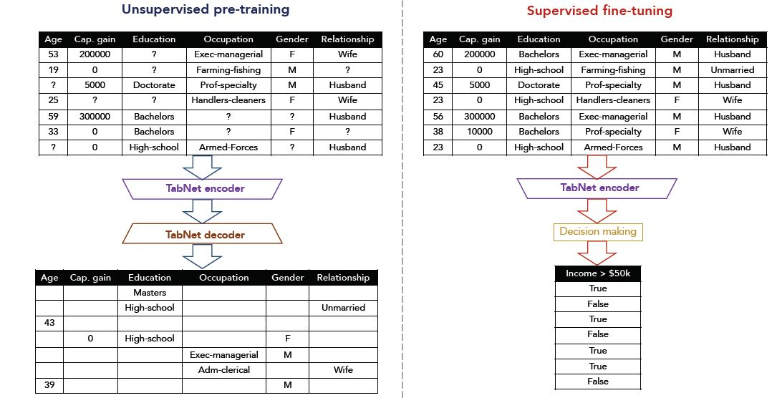
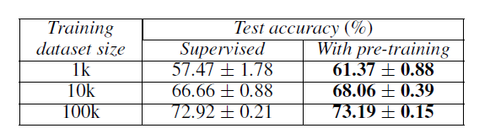
创新4：自监督学习--填补缺失值
encoder：输入masked features → encode, 但不经过FC层加和向量 → 输出encoded representation
decoder：输入encoded representation → feature transformer → 多steps加和 → 输出重构feature
结构参考bert MLM
可以很好地利用到没有label的数据
Notes:
简单来说，我们认为同一样本的不同特征之间是有关联的，因此自监督学习就是先人为mask掉一些feature，然后通过encoder-decoder模型来对mask掉的feature进行预测。我们认为通过这样的方式训练出来的encoder模型，可以有效地将表征样本的feature（可以理解为对数据进行了编码或压缩），这时再将encoder模型由于回归或分类任务，就能够事半功倍。自监督学习时的encoder模型就是上图中的模型，decoder模型如下所示：
这里的encoded representation就是encoder中没有经过FC层的加和向量，将它作为decoder的输入，decoder同样利用了Feature transformer层，只不过这次的目的是将representation向量重构为feature，然后类似地经过若干个step的加和，得到最后的重构feature。
设在一开始对feature做mask的矩阵是 ，特征数据是 ，则encoder的输入是 ，若最后decoder的输出是 ，那么自监督学习就是减小真实值 与重构值 之间的差别，考虑到不同的feature的量级不一定相同，因此采用正则化后的MSE作为loss，形式如下：

Slide 11
实验观察
优势
End-to-end, 基本不需要特征工程（除了指定数据类型）
自动处理类别不平衡
不加pretrain效果与Xgboost略差或持平，加上pretrain有时优于XGB
对超参数鲁棒性，不太依赖调参
劣势
gbdt在CPU上训练效率有绝对优势
GPU: 训练要占用整块gpu，I/O运算成本高
调参不敏感： Guidelines for hyperparameters部分
Nsteps ∈ [3,10]
Nd, Na (Nd=Na)
γ
Batch size
Notes:
I didn’t have to perform feature preprocessing beyond specifying whether my features are integer, floats, booleans or string values.
TabNet handles class imbalance automatically.
TabNet is competitive with XGBoost, and in some cases, even surpasses it. In one test, it had 9% higher accuracy than XGBoost, which is a huge margin of outperformance!
TabNet is surprisingly robust in its hyperparameters, and default hyperparameters often provided good performance. The one case where there was high sensitivity to hyperparameters was on the Poker Hand dataset, and the hyperparameters stated in the paper provided the highest accuracy.
there was no drop in performance when the feature transformer was reduced to one shared block and one decision step dependent block, unlike the original paper, at least on my datasets.

Slide 12
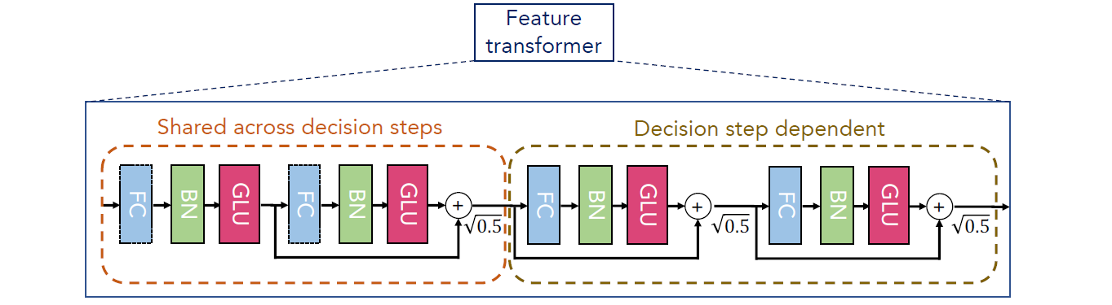
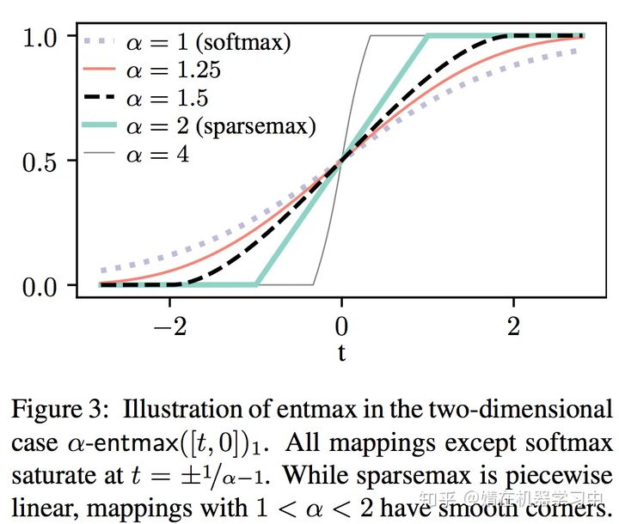
优化方向
The unreasonable ineffectiveness of deep learning on tabular data
优化：效果：
参量更小
Sharper mask
改动：
feature transformer： 2共享+2 独立→ 1共享+1独立
(减少FT层数 在文章作者和我的数据集上都没有影响)
mask: sparsemax -> 1.5-entmax，更贴近softmax分布但稀疏
*Sequential adaptivity: 动态决策步数，模型通过适应性学习自动算步数
代码：https://github.com/ptuls/tabnet-modified
https://towardsdatascience.com/the-unreasonable-ineffectiveness-of-deep-learning-on-tabular-data-fd784ea29c33
Notes:
It would be interesting if TabNet can be augmented with sequential adaptivity, so that the number of decision steps taken can be learned on the fly as per the adaptive computation trick used in recurrent neural networks⁸. Then it would be possible for the model to automatically figure out the number of decision steps it needs.
Another architecture change would be to replace the sparsemax function with EntMax instead (see below). It has been shown that EntMax performs better than sparsemax in other applications, so it would be worth trying.

