Slide 1
Explicit Parallel Call (XPC) Architecture Overview
Ji Kim
BRG Group Meeting 09/19/14
1/46
Notes:
(Potentially explain taxonomy of irregularity of applications) (Tao, irregularity paper)
Cut some uninteresting applications (redundant?)
Cornell faculty member mention
This is an experience paper: findings from parallelizing some apps, share with community
Leveraging old techniques in context of morph algorithms

Slide 2



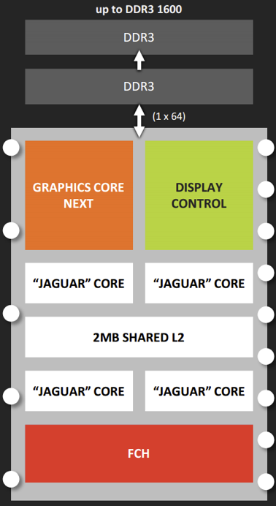
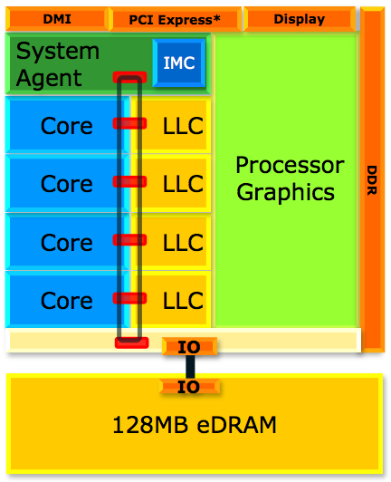
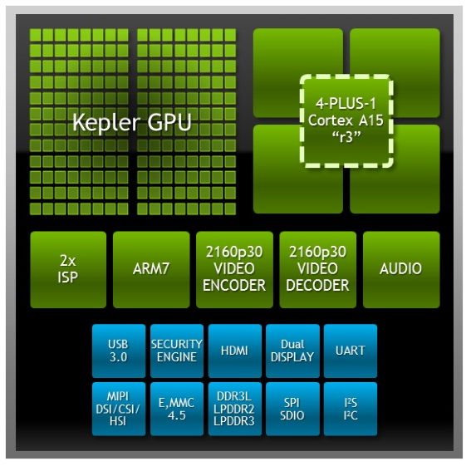
Motivation
Motivation Data Parallelism XPC Hardware XPC Software Adaptive Acceleration
How to best utilize increasing transistor density?
More constraints: energy, memory, parallelism
Age of throughput -> parallelism -> specialization
2/46

Slide 3
Motivation
Motivation Data Parallelism XPC Hardware XPC Software Adaptive Acceleration
Heterogeneous architectures introduce host of concerns:
Common programming framework
Compiler/runtime support
Scheduling work optimally (performance? utilization? energy?)
Heuristics for adaptive execution
Communication between different microarchitectures
2/46

Slide 4
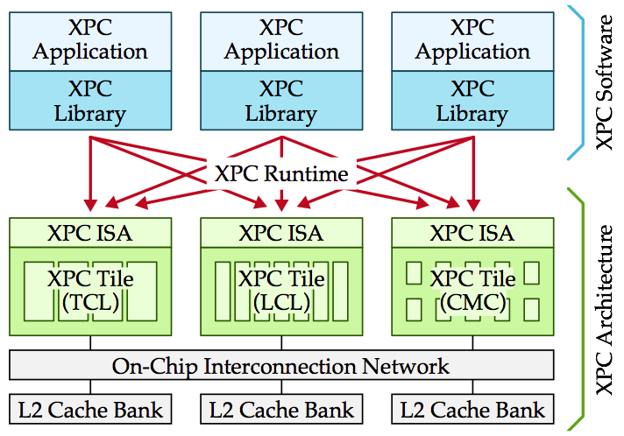
Motivation
Motivation Data Parallelism XPC Hardware XPC Software Adaptive Acceleration
Explicit Parallel Call (XPC) architecture composed of microarchitectural tiles capable of exploiting varying degrees of amorphous data parallelism exposed as parallel function calls
2/46

Slide 5
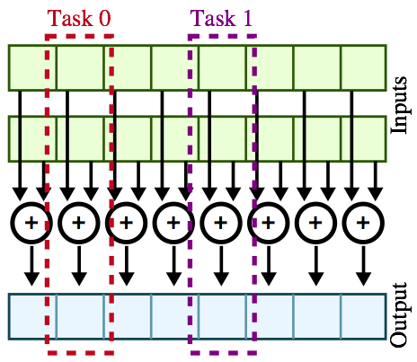
Traditional vs. Amorphous Data Parallelism
Motivation Data Parallelism XPC Hardware XPC Software Adaptive Acceleration
vvadd( int* dest, int* src0, int* src1, int size ):
for i in range( size ):
dest[i] = src0[i] + src1[i]
2/46

Slide 6
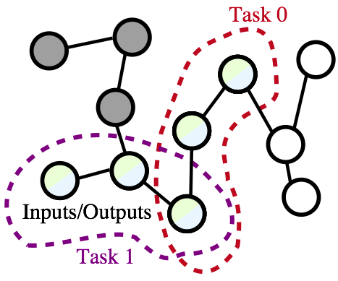
Traditional vs. Amorphous Data Parallelism
Motivation Data Parallelism XPC Hardware XPC Software Adaptive Acceleration
bfs( Node* nodes, Worklist* wl ):
while wl not empty:
index = wl->pull()
my_node = node[index]
for all neighbors of my_node:
if my_node.dist + 1 < neighbor.dist:
neighbor.dist = my_node.dist + 1
wl->push( neighbor.index )
2/46

Slide 7
Traditional vs. Amorphous Data Parallelism
Motivation Data Parallelism XPC Hardware XPC Software Adaptive Acceleration
Characteristic | Traditional | Amorphous
Control Flow | Regular | Irregular
Data Structure | Regular | Irregular
Task Inputs/Outputs | Disjoint | Overlapped
Task Generation | Static | Dynamic
2/46

Slide 8
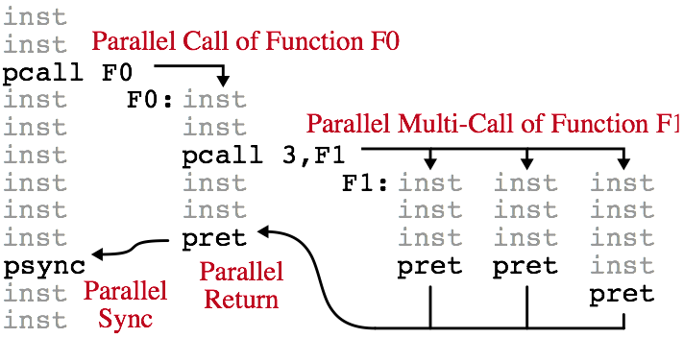
XPC Hardware: ISA
Motivation Data Parallelism XPC Hardware XPC Software Adaptive Acceleration
Instruction | Description
pcall func, n | Make n instances of function available for parallel execution (serial execution is valid)
psync | Wait for all child parallel calls to complete
pret | Return from parallel call (uses different return address from standard function call)
2/46

Slide 9
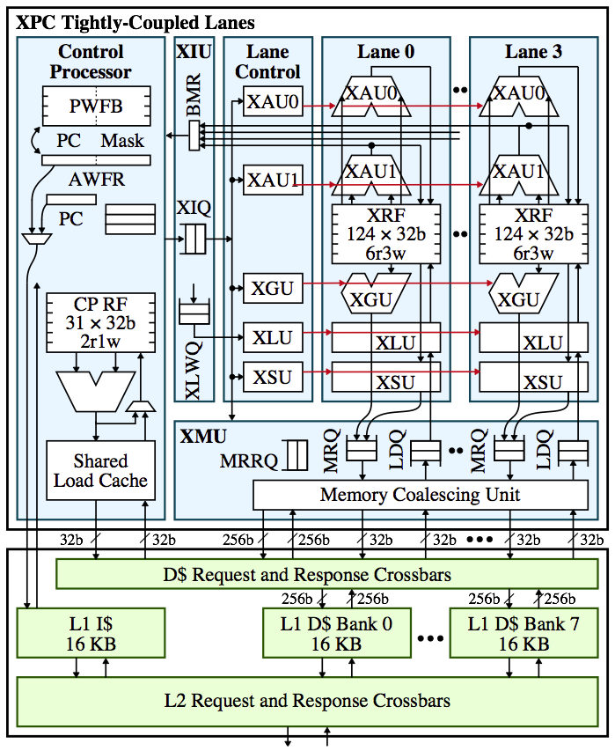
XPC Hardware: Tightly-Coupled Lanes (TCL)
Motivation Data Parallelism XPC Hardware XPC Software Adaptive Acceleration
High performance and energy efficiency for traditional data parallelism
Amortized front-end, lock-step execution
Affine execution accelerates value structure
Suffers with control and memory-access irregularity
2/46

Slide 10
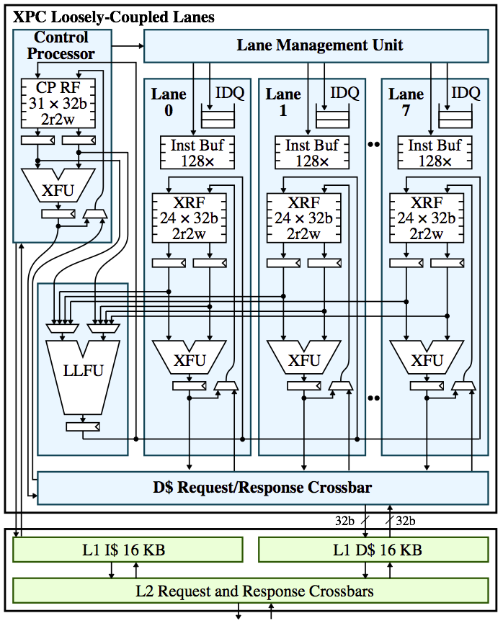
XPC Hardware: Tightly-Coupled Lanes (TCL)
Motivation Data Parallelism XPC Hardware XPC Software Adaptive Acceleration
Better tolerance for irregular amorphous data parallelism
Decoupled control flow between lanes using instruction buffers
More lightweight lanes with shared ‘expensive’ FUs
Good middle-ground specialization before resorting to general-purpose
2/46

Slide 11
XPC Hardware: Cooperative Multicore (CMC)
Motivation Data Parallelism XPC Hardware XPC Software Adaptive Acceleration
General-purpose, capable of handling highly irregular amorphous data parallelism
No significant performance or energy benefits regular control and memory-access
Internal task distribution unit
Default tile to collect heuristics for migration?
2/46

Slide 12
XPC Software: Programming API
Motivation Data Parallelism XPC Hardware XPC Software Adaptive Acceleration
Highly productive parallel programming API
Subset of PARC Parallel Primitives (PPP)
Algorithm-centric approach with a focus on exposing amorphous data parallelism
Four parallel constructs
spawn
parallel_for
atomic_for
speculative_for
2/46

Slide 13
XPC Software: Programming API
Motivation Data Parallelism XPC Hardware XPC Software Adaptive Acceleration
spawn( index, function )
Recursive divide-and-conquer
void bfs( Node* nodes ) {
ppp<xpc>::spawn( start, func = [&] ( int idx ) {
Node my_node = node[idx];
for ( i = 0; i < my_node.num_neighbors; i++ ) {
Node neighbor = my_node.neighbors[idx];
if ( my_node.dist + 1 < neighbor.dist ) {
neighbor.dist = my_node.dist + 1;
xpc::spawn( neighbor.idx, func );
}
}
});
}
2/46

Slide 14
XPC Software: Programming API
Motivation Data Parallelism XPC Hardware XPC Software Adaptive Acceleration
parallel_for( num_calls, function )
Parallelize across loop iterations (i.e., tasks)
void bfs( Node* nodes ) {
Worklist inwl, outwl;
inwl.push( start );
while ( inwl.size() > 0 ) {
ppp<xpc>::parallel_for( inwl.size(), [&] ( int idx ) {
Node my_node = node[inwl.pull(idx)];
for ( i = 0; i < my_node.num_neighbors; i++ ) {
Node neighbor = my_node.neighbors[i];
if ( my_node.dist + 1 < neighbor.dist ) {
neighbor.dist = my_node.dist + 1;
outwl.push( neighbor.idx );
}
}
});
swap( inwl, outwl );
}
}
2/46

Slide 15
XPC Software: Programming API
Motivation Data Parallelism XPC Hardware XPC Software Adaptive Acceleration
atomic_for( num_calls, function )
Similar to parallel_for except tasks are guaranteed atomicity
void mm( Edge* out_edges, Edge* in_edges ) {
bool matched[num_nodes];
ppp<xpc>::atomic_for( num_edges, [&] ( int idx ) {
int u = in_edges[idx].u;
int v = in_edges[idx].v;
if ( !matched[u] && !matched[v] ) {
matched[u] = matched[v] = true;
out_edges[idx] = in_edges[idx];
}
});
}
2/46

Slide 16
XPC Software: Programming API
Motivation Data Parallelism XPC Hardware XPC Software Adaptive Acceleration
speculative_for( num_calls, reserve_func, commit_func )
Split tasks into reserve and commit phases to ensure atomicity
void mm( Edge* out_edges, Edge* in_edges ) {
ppp<xpc>::speculative_for( num_edges,
reserve_func = [&] ( int idx ) {
int u = in_edges[idx].u;
int v = in_edges[idx].v;
if ( matched[u] || matched[v] ) return false;
reserves[u] = reserves[v] = idx;
return true;
},
commit_func = [&] ( int idx ) {
if ( reserves[u] == reserves[v] == idx ) {
matched[u] = matched[v] = true;
out_edges[idx] = in_edges[idx];
return true;
}
return false;
}
);
}
2/46

Slide 17
XPC Software: Adaptive Runtime
Motivation Data Parallelism XPC Hardware XPC Software Adaptive Acceleration
Software-based adaptive execution
Always running on idle tiles to facilitate work stealing
Ideal if lightweight to minimize software overhead
Collect heuristics to determine when/where to schedule tasks
Raw performance (compare to threshold or history)
Control irregularity (e.g., number of warp fragments)
Memory-access irregularity (e.g., number of uncoalesced accesses)
Hardware support for runtime?
Inter-tile task distribution unit exposed to runtime (not to user)
Hardware performance counters for heuristics
2/46

Slide 18
Adaptive Acceleration
Motivation Data Parallelism XPC Hardware XPC Software Adaptive Acceleration
Reasonable design point for exploring XPC
Single tile with three sub-tiles: scalar CP, TCL, LCL
CP responsible for generating work which can be stolen by TCL or LCL accelerators
Shared memory system minimizes migration overhead
2/46

Slide 19
Adaptive Acceleration
Motivation Data Parallelism XPC Hardware XPC Software Adaptive Acceleration
Design decision challenges
Role of CP: completely independent of accelerators? TCL/LCL requires separate front-end (e.g., internal CP?)
HW vs. SW migration: focusing on single-tile makes HW migration more viable vs. SW runtime, but requires finite-capacity buffer?
Mapping parallel functions: if preferred accelerator is not available, still run it on any available sub-tile (including CP)?
2/46

Slide 20
Adaptive Acceleration
Motivation Data Parallelism XPC Hardware XPC Software Adaptive Acceleration
Nested parallelism
Interesting opportunities to more generically expose previously underutilized parallelism!
Allow any level of nesting to produce generic fine-grain tasks that can map to any sub-tile (function pointer, context pointer, call count)
Hardware support for nested parallelism on TCL? (LCL can handle)
pcall instruction on TCL triggers push to special task buffer which lazily updates memory? Would not look like function call in TCL, no divergence
2/46

