Slide 1
Explicit Parallel Call (XPC) Architecture Overview
Ji Kim
BRG Group Meeting 09/19/14
1/21
Notes:
(Potentially explain taxonomy of irregularity of applications) (Tao, irregularity paper)
Cut some uninteresting applications (redundant?)
Cornell faculty member mention
This is an experience paper: findings from parallelizing some apps, share with community
Leveraging old techniques in context of morph algorithms

Slide 2



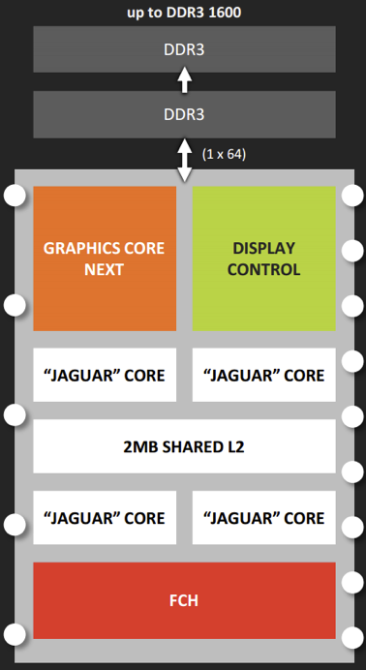
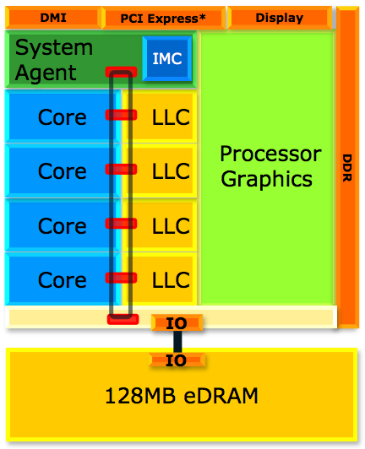
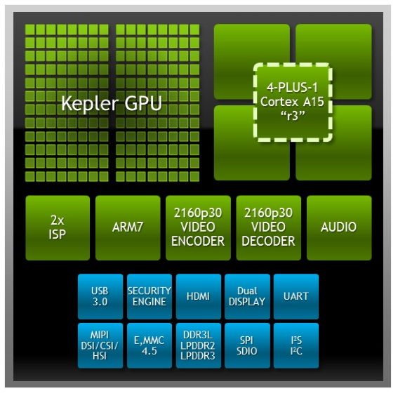
Motivation
Motivation Data Parallelism XPC Hardware XPC Software Adaptive Acceleration
Age of ILP -> DLP/TLP -> specialization
Trend toward heterogeneous architectures (Intel Haswell, AMD Kabini, NVIDIA Tegra, etc.)
2/21
Notes:
Before year 2000, chip design focused on exploiting ILP with complex, monolithic designs increasing single-threaded performance
However, at some point, this approach was not enough to make the best use of increasing transistor density, especially with emerging constraints like energy efficiency
For the next decade, the focus shifted towards exploiting DLP and TLP with multicore designs increasing multi-threaded performance
Now, it’s pretty clear that even exploiting TLP has reached its limits and we’ve entered the age of specialization
Some examples from three of the biggest companies in industry show tight coupling between general-purpose cores with specialized accelerators (mostly graphics)

Slide 3
Motivation
Motivation Data Parallelism XPC Hardware XPC Software Adaptive Acceleration
Heterogeneous architectures introduce host of concerns:
Common programming framework
Compiler/runtime support
Scheduling work optimally (performance? utilization? energy?)
Heuristics for adaptive execution
How to expose parallelism that can be commonly exploited?
3/21

Slide 4
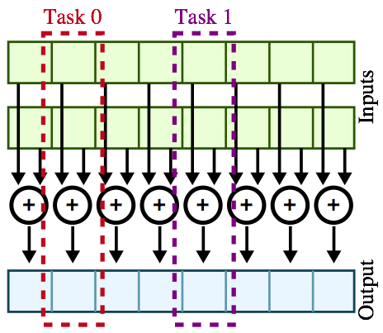
Traditional Data Parallelism
Motivation Data Parallelism XPC Hardware XPC Software Adaptive Acceleration
vvadd( int* dest, int* src0, int* src1, int size ):
for i in range( size ):
dest[i] = src0[i] + src1[i]
4/21
Notes:
Same task operates on independent pieces of data (elements)
Note that both the control flow and data structure are highly regular
Each task operates on an element of each of the source arrays and produces an element of the output array (the inputs and outputs are disjoint)

Slide 5
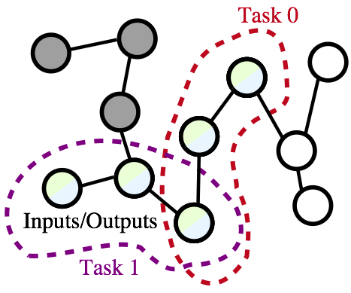
Amorphous Data Parallelism
Motivation Data Parallelism XPC Hardware XPC Software Adaptive Acceleration
bfs( Node* nodes, Worklist* wl ):
while wl not empty:
index = wl->pull()
my_node = node[index]
for all neighbors of my_node:
if my_node.dist + 1 < neighbor.dist:
neighbor.dist = my_node.dist + 1
wl->push( neighbor.index )
5/21
Notes:
Different from vvadd, elements of tasks can overlap, requiring some conflict resolution
Another key difference is that we are dynamically generating tasks as we traverse the graph, instead of having all tasks available before we start computation

Slide 6
Traditional vs. Amorphous Data Parallelism
Motivation Data Parallelism XPC Hardware XPC Software Adaptive Acceleration
Characteristic | Traditional | Amorphous
Control Flow | Regular | Irregular
Data Structure | Regular | Irregular
Task Inputs/Outputs | Disjoint | Overlapped
Task Generation | Static | Dynamic
6/21
Notes:
* Intuition is that if we can capture amorphous data parallelism, could we ubiquitously exploit this parallelism on any workload?
----- Meeting Notes (9/19/14 11:15) -----
* Data-dependent execution

Slide 7
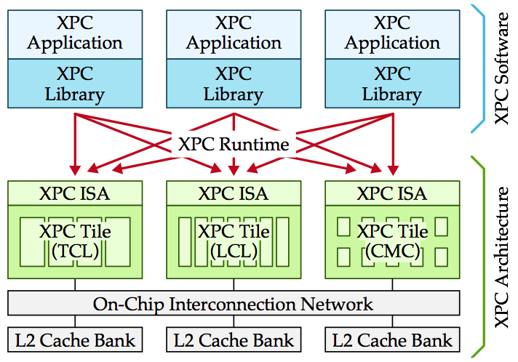
Objective
Motivation Data Parallelism XPC Hardware XPC Software Adaptive Acceleration
Explicit Parallel Call (XPC) architecture composed of microarchitectural tiles capable of exploiting varying degrees of amorphous data parallelism exposed as parallel function calls
7/21
Notes:
XPC programming API for more algorithm-centric approach to writing applications
XPC runtime which facilitates adaptive task scheduling and migration

Slide 8
Pull-Based Parallelism
Motivation Data Parallelism XPC Hardware XPC Software Adaptive Acceleration
 | Software | Hardware
Expressing opportunities for parallel tasks | Parallel function calls (tasks stored in memory) | Special memory instructions for updating tasks
Stealing parallel tasks | Adaptive runtime | Task cache
Executing parallel tasks | Application running on native multicore | Amorphous data parallel accelerators
XPC as a point in the design space of pull-based parallelism
Use hardware to accelerate some or all facets
8/21
Notes:
* Pull model where functions may or may not be executed in parallel, as opposed to push model we are more used to like bthreads where we actively push tasks onto threads

Slide 9
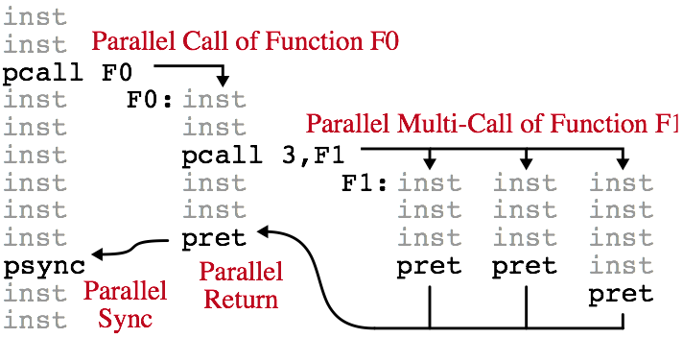
XPC Hardware: ISA
Motivation Data Parallelism XPC Hardware XPC Software Adaptive Acceleration
Instruction | Description
pcall n, func | Make n instances of function available for parallel execution (serial execution is valid)
psync | Wait for all child parallel calls to complete
pret | Return from parallel call (uses different return address from standard function call)
9/21
Notes:
* Pull model where functions may or may not be executed in parallel, as opposed to push model we are more used to like bthreads where we actively push tasks onto threads

Slide 10
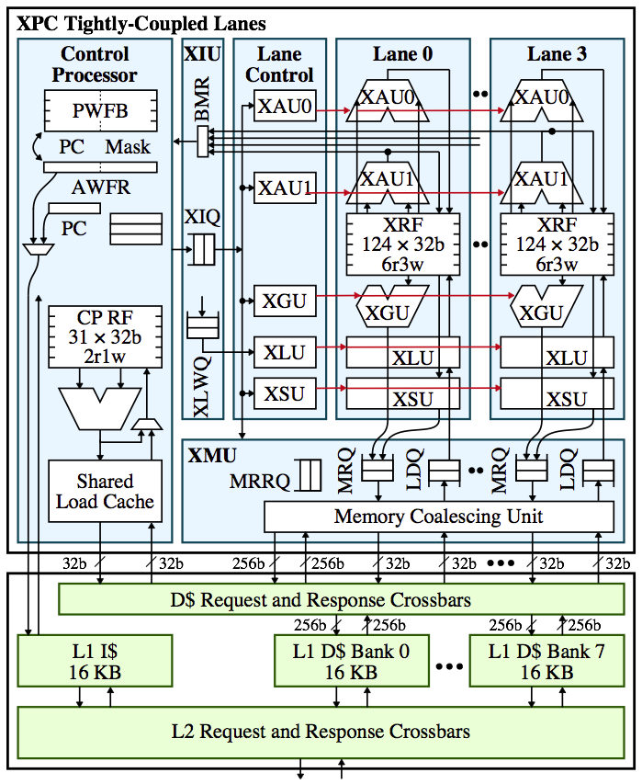
XPC Hardware: Tightly-Coupled Lanes (TCL)
Motivation Data Parallelism XPC Hardware XPC Software Adaptive Acceleration
High performance and energy efficiency for traditional data parallelism
Amortized front-end, lock-step execution
Affine execution accelerates value structure
Suffers with control and memory-access irregularity
10/21
Notes:
* Unclear how to exploit nested parallelism (traditional execution)?

Slide 11
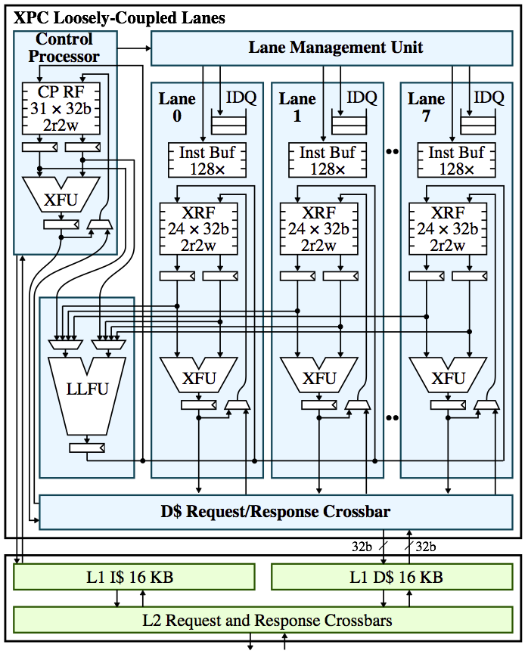
XPC Hardware: Loosely-Coupled Lanes (LCL)
Motivation Data Parallelism XPC Hardware XPC Software Adaptive Acceleration
Better tolerance for irregular amorphous data parallelism
Decoupled control flow between lanes using instruction buffers
More lightweight lanes with shared ‘expensive’ FUs
Good middle-ground specialization before resorting to general-purpose
11/21
Notes:
Dynamic bound, communicate back to lane manager?
Still depends on some level of regularity and control flow divergence constrained by size of instruction buffer

Slide 12
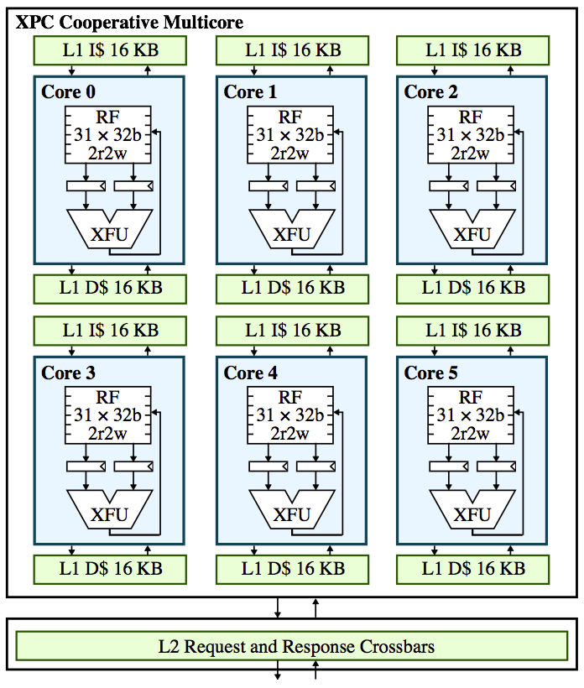
XPC Hardware: Cooperative Multicore (CMC)
Motivation Data Parallelism XPC Hardware XPC Software Adaptive Acceleration
General-purpose, capable of handling highly irregular amorphous data parallelism
No significant performance or energy benefits regular control and memory-access
Internal task distribution unit
Default tile to collect heuristics for migration?
12/21

Slide 13
XPC Software: Programming API
Motivation Data Parallelism XPC Hardware XPC Software Adaptive Acceleration
Highly productive parallel programming API
Subset of PARC Parallel Primitives (PPP)
Algorithm-centric approach with a focus on exposing amorphous data parallelism
Four parallel constructs
spawn
parallel_for
atomic_for
speculative_for
13/21

Slide 14
XPC Software: Programming API
Motivation Data Parallelism XPC Hardware XPC Software Adaptive Acceleration
spawn( index, function )
Recursive divide-and-conquer
void bfs( Node* nodes ) {
ppp<xpc>::spawn( start, func = [&] ( int idx ) {
Node my_node = node[idx];
for ( i = 0; i < my_node.num_neighbors; i++ ) {
Node neighbor = my_node.neighbors[idx];
if ( my_node.dist + 1 < neighbor.dist ) {
neighbor.dist = my_node.dist + 1;
xpc::spawn( neighbor.idx, func );
}
}
});
}
14/21

Slide 15
XPC Software: Programming API
Motivation Data Parallelism XPC Hardware XPC Software Adaptive Acceleration
parallel_for( num_calls, function )
Parallelize across loop iterations (i.e., tasks)
void bfs( Node* nodes ) {
Worklist inwl, outwl;
inwl.push( start );
while ( inwl.size() > 0 ) {
ppp<xpc>::parallel_for( inwl.size(), [&] ( int idx ) {
Node my_node = node[inwl.pull(idx)];
for ( i = 0; i < my_node.num_neighbors; i++ ) {
Node neighbor = my_node.neighbors[i];
if ( my_node.dist + 1 < neighbor.dist ) {
neighbor.dist = my_node.dist + 1;
outwl.push( neighbor.idx );
}
}
});
swap( inwl, outwl );
}
}
15/21

Slide 16
XPC Software: Programming API
Motivation Data Parallelism XPC Hardware XPC Software Adaptive Acceleration
atomic_for( num_calls, function )
Similar to parallel_for except tasks are guaranteed atomicity
void mm( Edge* out_edges, Edge* in_edges ) {
bool matched[num_nodes];
ppp<xpc>::atomic_for( num_edges, [&] ( int idx ) {
int u = in_edges[idx].u;
int v = in_edges[idx].v;
if ( !matched[u] && !matched[v] ) {
matched[u] = matched[v] = true;
out_edges[idx] = in_edges[idx];
}
});
}
16/21
Notes:
Fine subset of edges which span all nodes exactly once

Slide 17
XPC Software: Programming API
Motivation Data Parallelism XPC Hardware XPC Software Adaptive Acceleration
speculative_for( num_calls, reserve_func, commit_func )
Split tasks into reserve and commit phases to ensure atomicity
void mm( Edge* out_edges, Edge* in_edges ) {
ppp<xpc>::speculative_for( num_edges,
reserve_func = [&] ( int idx ) {
int u = in_edges[idx].u;
int v = in_edges[idx].v;
if ( matched[u] || matched[v] ) return false;
reserves[u] = reserves[v] = idx;
return true;
},
commit_func = [&] ( int idx ) {
if ( reserves[u] == reserves[v] == idx ) {
matched[u] = matched[v] = true;
out_edges[idx] = in_edges[idx];
return true;
}
return false;
}
);
}
17/21

Slide 18
XPC Software: Adaptive Runtime
Motivation Data Parallelism XPC Hardware XPC Software Adaptive Acceleration
Software-based adaptive execution
Always running on idle tiles to facilitate work stealing
Ideal if lightweight to minimize software overhead
Collect heuristics to determine when/where to schedule tasks
Raw performance (compare to threshold or history)
Control irregularity (e.g., number of warp fragments)
Memory-access irregularity (e.g., number of uncoalesced accesses)
Hardware support for runtime?
Inter-tile task distribution unit exposed to runtime (not to user)
Hardware performance counters for heuristics
18/21

Slide 19
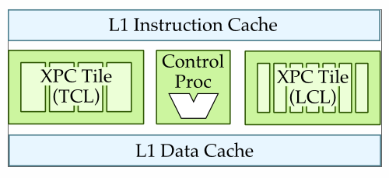
Adaptive Acceleration
Motivation Data Parallelism XPC Hardware XPC Software Adaptive Acceleration
Reasonable design point for exploring XPC
Single tile with three sub-tiles: scalar CP, TCL, LCL
CP responsible for generating work which can be stolen by TCL or LCL accelerators
Shared memory system minimizes migration overhead
19/21

Slide 20
Adaptive Acceleration
Motivation Data Parallelism XPC Hardware XPC Software Adaptive Acceleration
Design decision challenges
Role of CP: completely independent of accelerators? TCL/LCL requires separate front-end (e.g., internal CP?)
Degree of HW support: focusing on single-tile makes HW migration more viable vs. SW runtime, but requires finite-capacity buffer?
Mapping parallel functions: if preferred accelerator is not available, still run it on any available sub-tile (including CP)?
20/21

Slide 21
Adaptive Acceleration
Motivation Data Parallelism XPC Hardware XPC Software Adaptive Acceleration
Nested parallelism
Interesting opportunities to more generically expose previously underutilized parallelism!
Allow any level of nesting to produce generic fine-grain tasks that can map to any sub-tile (function pointer, context pointer, call count)
Hardware support for nested parallelism on TCL? (LCL can handle)
pcall instruction on TCL triggers push to special task buffer which lazily updates memory? Would not look like function call in TCL, no divergence
21/21

