Slide 1
Exposing, Scheduling, and Executing Fine-Grain Parallel Tasks
Ji Kim
Computer Systems Laboratory
Cornell University
10/08/2014

Slide 2



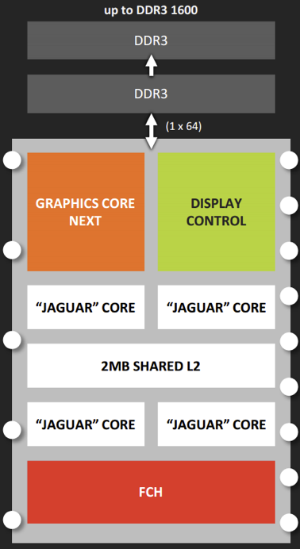
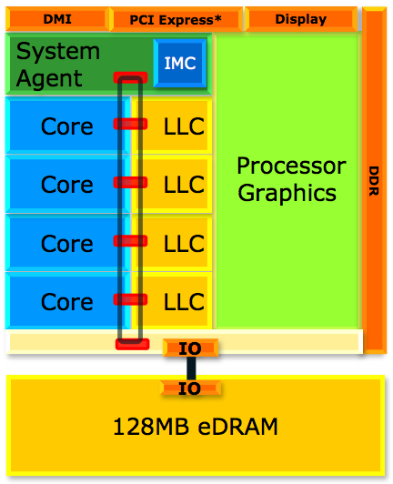
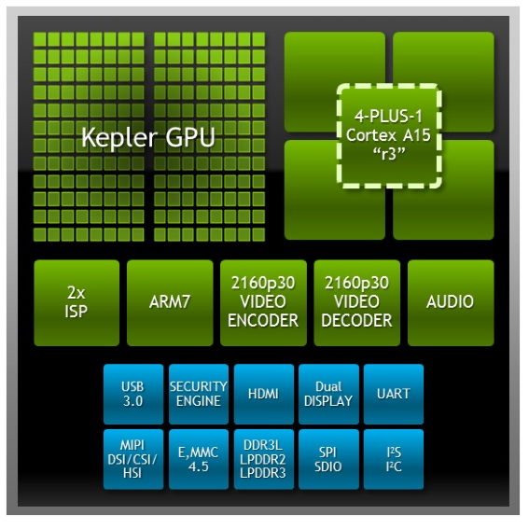
Present: Coarse-Grain Heterogeneity
Motivation FG-SIMT HWWL XPC Roadmap
Technology challenges are forcing new abstractions
Trend toward coarse-grain heterogeneous architectures (Intel Haswell, AMD Kabini, NVIDIA Tegra, etc.)
Notes:
A lot of serious technology challenges including power constraints and end of traditional CMOS scaling
Computer architects turning to new abstractions to achieve higher performance and energy efficiency
Requires innovation across HW/SW boundaries
Examples in industry with coarse-grain heterogeneity, usually a set of general-purpose cores with a data-parallel accelerator

Slide 3
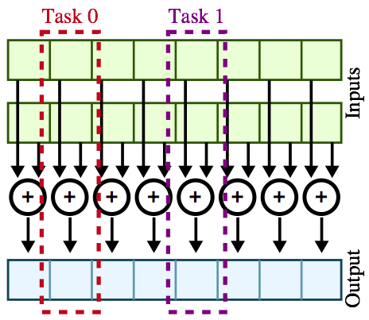
Present: Traditional Data Parallelism
Motivation FG-SIMT HWWL XPC Roadmap
vvadd( int* dest, int* src0, int* src1, int size ):
for i in range( size ):
dest[i] = src0[i] + src1[i]
Notes:
Commonly exploited on SIMD or SIMT
Same task operates on elements of independent input and output arrays
Note that both the control flow and data structure are highly regular
Not DLP, traditional data parallelism -> task-level parallelism

Slide 4
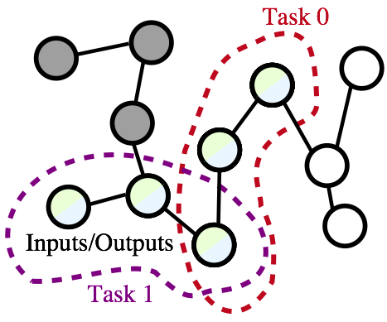
Future: Amorphous Data Parallelism
Motivation FG-SIMT HWWL XPC Roadmap
bfs( Node* nodes, Worklist* wl ):
while wl not empty:
index = wl->pull()
my_node = node[index]
for all neighbors of my_node:
if my_node.dist + 1 < neighbor.dist:
neighbor.dist = my_node.dist + 1
wl->push( neighbor.index )
K. Pingali et al. The Tao of Parallelism in Algorithms. PLDI 2011.
Notes:
Breadth-first search
A more generalized form of data parallelism first defined in Pingali paper
Extends traditional data parallelism with relaxed constraints
Elements can belong to multiple tasks, requiring some conflict resolution
Output graph is a modified version of the input graph
Tasks are dynamically generated by other tasks

Slide 5
Traditional vs. Amorphous Data Parallelism
Motivation FG-SIMT HWWL XPC Roadmap
Characteristic | Traditional | Amorphous
Control Flow | Regular | Data-Dependent
Data Structure | Regular | Irregular
Task Inputs/Outputs | Disjoint | Overlapped
Task Generation | Static | Dynamic
Notes:
Summary of differences between traditional and amorphous data parallelism
ADP extends TDP (i.e., superset)
Can we capture amorphous data parallelism, so that we can ubiquitously exploit this parallelism on any microarchitecture?
Ji: need a more explicit way of explaining how parallel function calls better expose ADP (is it more about the parallel primitives we provide?)

Slide 6
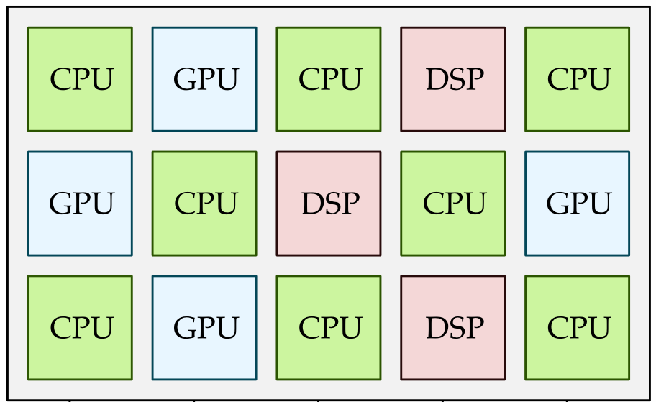
Future: Fine-Grain Heterogeneity
Motivation FG-SIMT HWWL XPC Roadmap
Sea of tightly-coupled, lightweight compute tiles
Seamless adaptive execution of fine-grain parallel tasks
Better suited for amorphous data parallelism
Improved load balancing for dynamically generated work
Flexibility to adapt to changing parallelism
Notes:
Better differentiate with coarse-grain heterogeneity
Tightly-coupled, simpler/lightweight (in-order, single-core), less overhead, sea of small compute units
Kernel launches heavyweight
SW-level fine-grain parallel function calls instead of AVX/CUDA kernel launches
Future will trend toward fine-grain heterogeneous architectures
Intermingling of fine-grain tiles (converging of CPU and GPU)
Fine-grain allows for:
Less parallelization overhead
No need to know whether programming for CPU or GPU
Better for exploiting ADP
ADP has unpredictable, changing parallelism for a single workload
ADP has dynamically generated work which would work better as fine-grain tasks for load balancing

Slide 7
Coarse- vs. Fine-Grain Heterogeneity
Motivation FG-SIMT HWWL XPC Roadmap
Characteristic | Coarse-Grain | Fine-Grain
Spawn Overhead | Large | Small
Tile Complexity | Heavyweight | Lightweight
Driver Tile | General-Purpose | Any
Feedback | Limited | Continuous
Task Scheduling (Target Tile) | Static | Dynamic
Notes:
Example parallelize a loop: coarse-grain commits entire loop to accelerator a priori, fine-grain might execute some iterations of loop on accelerator and some on general-purpose (fine-grain tasks)
Fine-grain heterogeneity allows sea of lightweight tiles to act as one entity rather than discrete processors colocated on the same chip

Slide 8
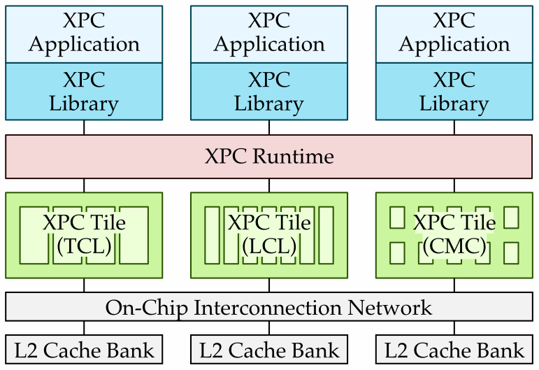
Explicit-Parallel-Call Architecture
Motivation FG-SIMT HWWL XPC Roadmap
Exposing
Parallel Tasks
HWWL. Kim et al.
MICRO 2014.
Scheduling
Parallel Tasks
Executing
Parallel Tasks
FG-SIMT. Kim et al.
ISCA 2013.
XLOOPS. Srinath et al.
MICRO 2014.
Explicitly expose fine-grain parallel tasks as parallel function calls
Notes:
Explicitly expose to SW/HW parallel function calls (makes it easier to map fine-grain heterogeneity)
At a high-level, the XPC architecture can be broken down into:
XPC programming framework, which allows users to expose opportunities for fine-grain parallel tasks
XPC runtime, which facilitates adaptive scheduling of fine-grain parallel tasks
XPC tiles (TCL, LCL, CMC, etc.), which are specialized for efficiently exploiting fine-grain parallel tasks with varying levels of amorphous data parallelism
We will draw on previous works as inspiration in designing pieces of the XPC architecture
Build exposing/scheduling/executing

Slide 9
Overview
Motivation FG-SIMT HWWL XPC Roadmap
Fine-Grain SIMT
Fine-Grain Hardware Worklists
Explicit-Parallel-Call Architecture
Roadmap

Slide 10
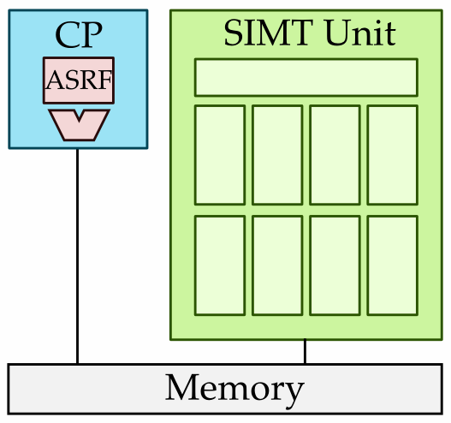
Fine-Grain SIMT at a Glance
Motivation FG-SIMT HWWL XPC Roadmap
Tightly integrated data-parallel accelerator
Focus on fine-grain parallelism and area efficiency
Exploit traditional data parallelism (value structure)
J. Kim et al. Microarchitectural Mechanisms for Exploiting Value Structure in SIMT Architectures. ISCA 2013.
Notes:
Best suited for TDP (can still handle ADP, but loses efficiency)
Groups of threads execute in lock-step across lanes and memory accesses are coalesced when possible (weak to control and memory-access irregularity)
FG-SIMT has fine-grain thread scheduling on tightly coupled CPU + SIMT unit
FG-SIMT focuses on exploiting intra-warp parallelism for area efficiency (instead of multithreading)
FG-SIMT also allows us to exploit value structure to further accelerate TDP by using compact affine execution
Looking at TDP figure, we can see missed opportunities for eliminating redundancy if elements are uniform

Slide 11
Identifying Value Structure
Motivation FG-SIMT HWWL XPC Roadmap
__global__ void
vsadd( int y[], int a ) {
int idx = // get thread index
y[idx] = y[idx] + a;
if ( y[idx] > THRESHOLD )
y[idx] = Y_MAX_VALUE;
}
vsadd:
ld.sh R_a, M[A]
ld.sh R_ybase, M[Y]
add R_yptr, R_ybase, IDX
load R_y, M[R_yptr]
add R_y, R_y, R_a
store R_y, M[R_yptr]
branch R_y, THRESHOLD
imm R_max, Y_MAX_VALUE
store R_max, M[R_yptr]
stop
R_a
R_ybase
R_yptr
R_ybase
IDX
R_yptr
R_a
R_yptr
THRESHOLD
R_max
Y_MAX_VALUE
R_max
R_yptr
2
2
2
2
Value Structure occurs when the same operation uses values across threads which can be represented as a compact function.
32
32
32
32
40
40
40
40
0
1
2
3
32
36
40
44
19
89
8
127
Affine Value Structure:
Notes:
In order to understand what value structure is, we’ll be using our ongoing example of vector-scalar add shown here on the left. The pseudo-assembly this translates to is shown here on the right.
In the C code, each thread reads its thread index, which is then used to index a unique element of the array, we add a scalar value to this element and write it back to the array. If the result is greater than a threshold, we instead write the saturated maximum value to the array.
In the assembly, we start by loading the scalar value “a” and the address of the y array. The thread index is added to the base address to obtain the address of the element in the y array that each thread wants to access. We load from that address, add the scalar “a” value, then store it back into the array. This branch condition catches the case when the result is greater than the threshold, in which case we store the maximum value to the array.
As a reminder, we define value structure as occurring when… (read the rest)
Let’s see if we can find some examples of value structure in this example.
First, we can identify some variables that are the same for all threads: the scalar “a” value, the threshold and the maximum value circled here are some examples. In the assembly, these correspond to these registers. The picture on the bottom shows a register file layout of four worker threads. You can see that the same values are redundantly stored across all threads.
We can also identify some values which increase by a set amount for increasing thread indices. An obvious example of this is the thread index itself which increments by one for each succeeding thread. Adding the thread index to the base address maintains this pattern which we can see on the bottom*.
This particular type of value structure is called “affine value structure”, and adheres to the formula shown here, where “b” is the base, “i” is the thread index, and “s” is the stride. For example, the affine value in R_yptr has a base of 16 and a stride of 1. We can compactly encode affine values as a base and stride pair. Note that the value structure seen in R_a and R_ybase are a special case of affine value structure where the stride is 0. For example, the affine value in R_a has a base of 2 and a stride of 0. We call this special case “uniform value structure”.
All other registers which do not have any type of structure, such as R_y, are called generic values. We can see that the the register values for R_y have no apparent pattern to them.
*Technically needs to be multiplied by 4, but skip for simplicity…

Slide 12
Exploiting Value Structure
vsadd:
ld.sh R_a, M[A]
ld.sh R_ybase, M[Y]
add R_yptr, R_ybase, IDX
load R_y, M[R_yptr]
add R_y, R_y, R_a
store R_y, M[R_yptr]
branch R_y, THRESHOLD
imm R_max, Y_MAX_VALUE
store R_max, M[R_yptr]
stop
vsadd:
ld.sh R_a, M[A]
ld.sh R_ybase, M[Y]
add R_yptr, R_ybase, IDX
load R_y, M[R_yptr]
add R_y, R_y, R_a
store R_y, M[R_yptr]
branch R_y, THRESHOLD
imm R_max, Y_MAX_VALUE
store R_max, M[R_yptr]
stop
vsadd:
ld.sh R_a, M[A]
ld.sh R_ybase, M[Y]
add R_yptr, R_ybase, IDX
load R_y, M[R_yptr]
add R_y, R_y, R_a
store R_y, M[R_yptr]
branch R_y, THRESHOLD
imm R_max, Y_MAX_VALUE
store R_max, M[R_yptr]
stop
Affine arithmetic
vsadd:
ld.sh R_a, M[A]
ld.sh R_ybase, M[Y]
add R_yptr, R_ybase, IDX
load R_y, M[R_yptr]
add R_y, R_y, R_a
store R_y, M[R_yptr]
branch R_y, THRESHOLD
imm R_max, Y_MAX_VALUE
store R_max, M[R_yptr]
stop
Affine arithmetic
Affine memory operations
Affine arithmetic
Affine memory operations
Affine branches
addiu
lui
addu
subu
sll/sllv
srl/srlv
sra/srav
mul
addiu
lui
addu
subu
sll/sllv
srl/srlv
sra/srav
mul
lw/lh/lb
sw/sh/sb
addiu
lui
addu
subu
sll/sllv
srl/srlv
sra/srav
mul
lw/lh/lb
sw/sh/sb
beq/bne
blez/bgez
bltz/bgtz
Eliminate redundancy to improve performance and energy efficiency
Notes:
For each type of instruction we can exploit value structure for, I’ll be highlighting the instruction in red. Here, I’m going to start with the first two shared loads highlighted since we get these for free in the baseline as well.

Slide 13
FG-SIMT Example Execution
Motivation FG-SIMT HWWL XPC Roadmap
Notes:
Affine arithmetic on operands that have affine values
Affine memory operations on loads to affine addresses (within limits)
Affine branches on uniform conditions
Affine execution allows us to eliminate redundancy and compactly execute instructions on the CP once instead of spread out across SIMT lanes
Note we cannot exploit value structure after divergence because we would need different states of the ASRF for different fragments
Performance overhead when overwriting affine register after divergence (make value available to all fragments)

Slide 14
Motivation FG-SIMT HWWL XPC Roadmap
Notes:
Improve both performance and energy efficiency

Slide 15
FG-SIMT Energy vs. Performance
Motivation FG-SIMT HWWL XPC Roadmap
Baseline
Notes:
Here is a scatter plot of energy vs. performance for all our benchmarks. Results are only shown for FG-SIMT with all affine mechanisms enabled, normalized to the baseline FG-SIMT design shown by the red dot. Most of our benchmarks are in the lower right hand side of this point, meaning they achieve greater energy-efficiency and performance, with energy-efficiency improving up to 30% in the best case. Overall, compact affine execution reduces the amount of required to complete the same task. In one of the best cases, viterbi, we saw energy savings of 54% in the combined register files from using the efficient ASRF instead of the large SIMT register files, 29% in the combined functional units from eliminating redundant computation with affine execution, and 34% in the memory system from more efficient accesses due to affine memory operations.
The benchmarks which have worse energy-efficiency still manage to do slightly better in terms of performance compared to the baseline. Much of this overhead is due to the divergent nature of these benchmarks which trigger affine destination expansions. For example, in the worst case, strsearch, energy consumption increases from 115 to 130 uJ, an increase of 12%. 89% of this 15 uJ increase is attributed to the expansion units in the SIMT lanes, corroborating this theory.
Although the apps that do not improve do not hurt performance, they do incur a noticeable energy overhead. This is due to the overhead of affine destination expansion after divergence and relatively small application vector lengths (in the case of rsort). For future work, we are looking into improving opportunities for affine execution after divergence to eliminate this overhead, as well as exploring FG-SIMT as an alternative integrated data-parallel accelerator in general.

Slide 16
Overview
Motivation FG-SIMT HWWL XPC Roadmap
Fine-Grain SIMT
Fine-Grain Hardware Worklists
Explicit-Parallel-Call Architecture
Roadmap
Notes:
HWWL as inspiration for irregular workloads which do not map well to FGSIMT
Slide on morph algorithms

Slide 17
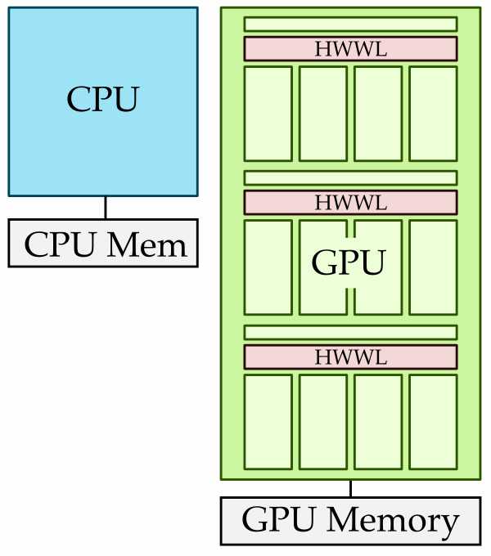
Fine-Grain Hardware Worklist at a Glance
Motivation FG-SIMT HWWL XPC Roadmap
Accelerate irregular algorithms on GPGPUs
Reduce memory contention and improve load balancing
Exploit irregular amorphous data parallelism
J. Kim et al. Accelerating Irregular Algorithms on GPGPUs with Fine-Grain Hardware Worklists. MICRO 2014.

Slide 18
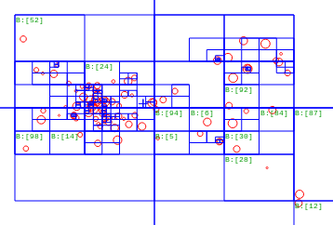
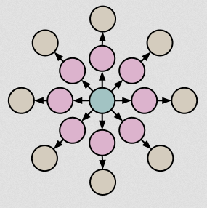
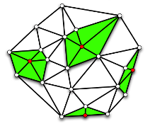
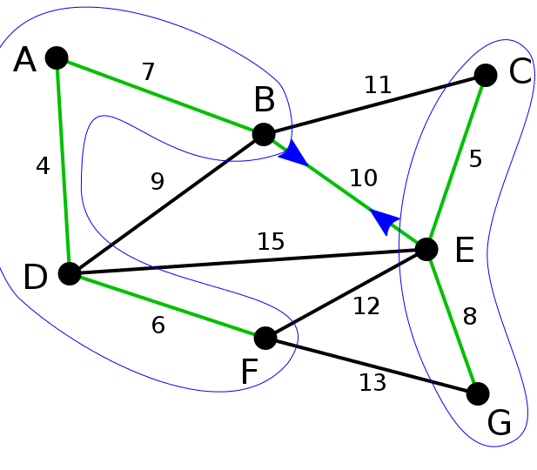
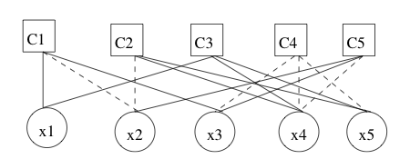
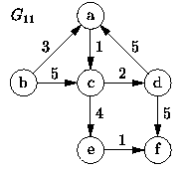
Amorphous Data Parallel Applications
Motivation FG-SIMT HWWL XPC Roadmap
Barnes-Hut N-Body
Breadth-First Search
Delaunay Mesh
Refinement
Minimum Spanning Tree
Survey Propagation
Single-Source
Shortest-Path
Notes:
Inspired by challenging, irregular amorphous data parallel applications from LSG and PBBS
Workloads that do not perform very well on FG-SIMT
Iterative apply compute operators to elements in an irregular data structure
Dynamically generate work and modify underlying data structure (morph algorithms)
How can we accelerate such workloads on data-parallel accelerators?

Slide 19
Topology-Driven Approach
Motivation FG-SIMT HWWL XPC Roadmap
Data-Driven Approach
def topo_driven:
idx = get_tid()
my_node = nodes[idx]
if check( my_node ):
compute( my_node )
*done_ptr = false;
def main:
done = false; while not done:
done = true
topo_driven<<<N>>>( nodes, &done )
def data_driven:
for wid in range( start, end ):
idx = pullwl.pull( wid )
my_node = nodes[idx]
compute( my_node )
for all neighbors of my_node:
if check( neighbor ):
pushwl.push( neighbor.idx )
def main:
init_wl<<<N>>>( nodes, pullwl )
while not pullwl.empty():
data_driven<<<M>>>( nodes, wl )
swap( pullwl, pushwl )
Determine work with thread index
Visits all nodes (even inactive)
# threads spawned = # nodes
Limited dynamic load balancing
Less work efficient
Determine work with worklist
Visits only active nodes
# threads spawned = # HW threads
No dynamic load balancing
High memory contention
Notes:
Emphasize SW techniques
Topology-driven: less work efficient, but simpler (no issues with memory contention)
Data-driven: more work efficient, but issues with memory contention due to shared worklist
Both variants have issues with load balancing
Data-driven variant usually written with double-buffering to eliminate AMOs on pulls
Single-buffering has better load balancing, but memory contention makes it unviable

Slide 20
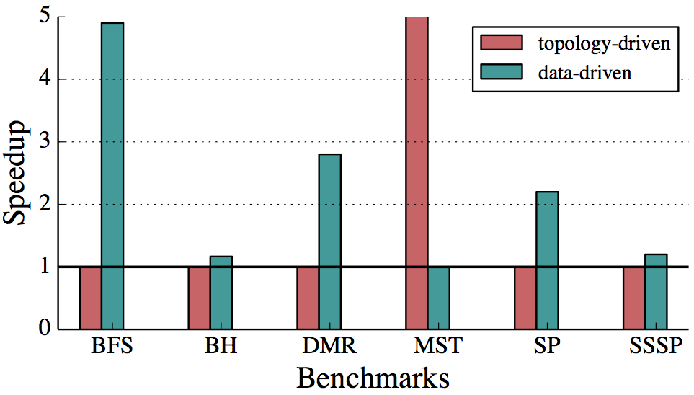
GPU Results with Optimizations
Motivation FG-SIMT HWWL XPC Roadmap
Data-driven outperforms topology-driven with optimizations
Experiments on real GPU with hand-optimized benchmarks
Focus on addressing weaknesses of data-driven approach
Notes:
Add list of optimizations?

Slide 21
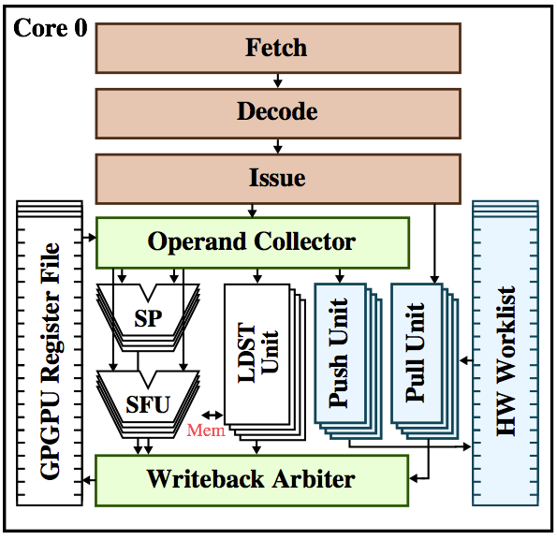
Hardware Worklist Microarchitecture
Motivation FG-SIMT HWWL XPC Roadmap
Interact with HWWL using pull/push instructions
On empty pulls, force thread to wait if more work in system
HWWL interfaces with GPGPU pipeline with special units
Arbitration required when accessing GPGPU regfile
Instruction | Description
wlpull | Pulls work ID from HWWL. If bank is empty: return WAIT if work in other banks, otherwise return DONE.
wlpush | Pushes work ID to HWWL, throws exception if overflow buffer is full.
Notes:
Pulls move work IDs from HWWL to GRF
Pushes moves work from GRF to HWWL

Slide 22
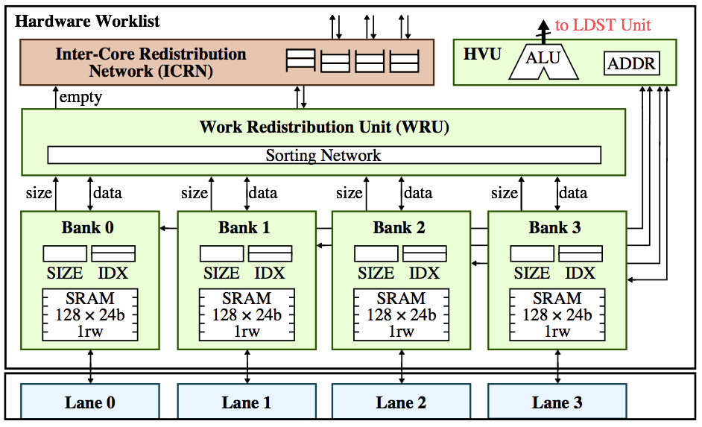
Hardware Worklist Microarchitecture
Motivation FG-SIMT HWWL XPC Roadmap
Notes:
Distributed per-lane HWWL banks to avoid memory accesses when interacting with worklist (1rw SRAMs)
WRU aggregates meta-data regarding bank occupancy to determine how to distribute work
Prioritize intra-core before inter-core work redistribution
ICRN facilitates inter-core work redistribution
HVU handles virtualization of work that does not fit in the HWWL to an overflow buffer in memory

Slide 23
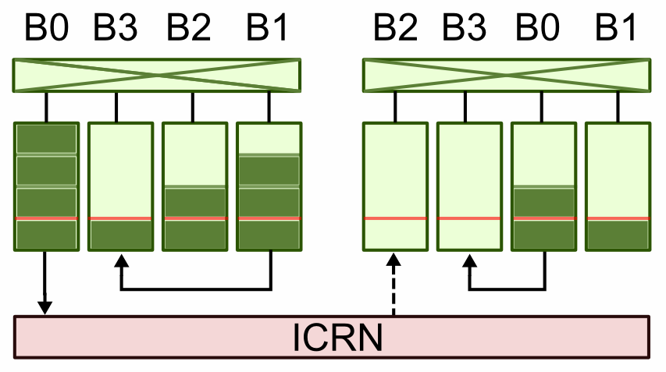
HWWL Work Redistribution
Motivation FG-SIMT HWWL XPC Roadmap
Threshold
Banks with work over threshold donate to those with work below threshold
Local Sorting
Per-core bank sorting, greediest banks donate to neediest banks
Global Sorting
Monolithic sorting network for all banks in system
Notes:
All interval-based schemes (mention on-demand?)
Redistro schemes tradeoff HW complexity for better load balancing
lsorting: even needy banks can donate to other needy banks (helps case where all banks are below threshold)
gsorting: prevents banks which are globally greedy from getting more work because it is locally needy
Top half is greedy, lower half is needy
If there are more greedy banks than needy banks in a core, that core sends work to a core with more needy banks than greedy banks via the ICRN

Slide 24
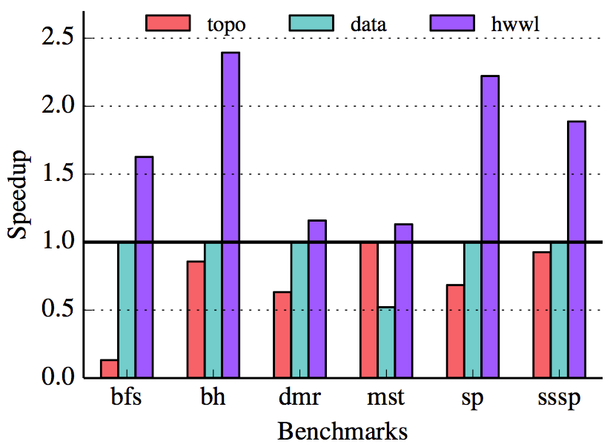
Realistic HWWL Performance
Motivation FG-SIMT HWWL XPC Roadmap
Realistic HWWL design with 512 entries per core and local-sorting work redistribution
Roughly additional area overhead of 2.5% of GPGPU regfile

Slide 25
Overview
Motivation FG-SIMT HWWL XPC Roadmap
Fine-Grain SIMT
Fine-Grain Hardware Worklists
Explicit-Parallel-Call Architecture
Roadmap

Slide 26
Explicit-Parallel-Call Design Space
Motivation FG-SIMT HWWL XPC Roadmap
 | Software | Hardware
Exposing opportunities for fine-grain parallel tasks | Programming API + Cactus stack | Parallel function call ISA
Scheduling fine-grain parallel tasks | Adaptive runtime | Task cache + distribution network
Executing fine-grain parallel tasks | Application running on traditional multicore | Amorphous data parallel accelerators (XPC tiles)
Explore different permutations of SW/HW techniques
Notes:
Essentially, XPC is a fine-grain heterogeneous architecture with SW/HW mechanisms for exposing, scheduling, and executing parallel tasks with amorphous data parallelism
SW managed cactus stack
pcall in HW ISA

Slide 27
Exposing Parallel Tasks: Programming API
Motivation FG-SIMT HWWL XPC Roadmap
Highly productive parallel programming API
Algorithm-centric approach with a focus on exposing amorphous data parallelism
Four parallel constructs
spawn
parallel_for
atomic_for
speculative_for
and more…
Notes:
Provide a highly productive parallel programming API which allows users to write applications with an algorithmic-centric approach instead of an implementation-centric approach
For instance, users could write a recursive and frontier-based algorithms of an application like BFS, without thinking about what microarchitecture it would map to, just expose tasks as function calls
Offer four parallel primitives to facilitate this with an eye toward making exposing different levels of ADP easier

Slide 28
Exposing Parallel Tasks: Programming API
Motivation FG-SIMT HWWL XPC Roadmap
spawn( function )
Recursive divide-and-conquer
void bfs( Node* nodes ) {
auto func = [&] ( int idx ) {
Node my_node = nodes[idx];
for ( i = 0; i < my_node.num_neighbors; i++ ) {
Node neighbor = my_node.neighbors[idx];
int old = xpc::fetch_min( neighbor.dist, my_node.dist + 1 )
if ( my_node.dist + 1 < old)
xpc::spawn( std::bind( func, neighbor.idx ) );
}
}
xpc::spawn( std::bind( func, start ) );
}
Notes:
The spawn primitive is suited for recursive divide-and-conquer algorithms, and takes one argument, a functor of the task you want to parallelize
BFS computes the number of hops from a source node to all other nodes in the graph
This algorithm starts with the source node and recursively calls the distance calculation function on its neighbors until all nodes are visited
An important point is that we’re only exposing opportunities for parallelism, this means that a serial execution is entirely valid

Slide 29
Exposing Parallel Tasks: Programming API
Motivation FG-SIMT HWWL XPC Roadmap
parallel_for( num_calls, function )
Parallelize across loop iterations (i.e., tasks)
void bfs( Node* nodes ) {
Worklist inwl, outwl;
inwl.push( start );
while ( inwl.size() > 0 ) {
xpc::parallel_for( inwl.size(), [&] ( int idx ) {
Node my_node = node[inwl.pull(idx)];
for ( i = 0; i < my_node.num_neighbors; i++ ) {
Node neighbor = my_node.neighbors[i];
int old = xpc::fetch_min( neighbor.dist, my_node.dist + 1 )
if ( my_node.dist + 1 < old )
outwl.push( neighbor.idx );
}
});
swap( inwl, outwl );
}
}
Notes:
BFS is parallelized across the current frontier and uses a current and next frontier worklist which is swapped every super-step
AMOs are used to handle conflicts between tasks

Slide 30
Exposing Parallel Tasks: Programming API
Motivation FG-SIMT HWWL XPC Roadmap
atomic_for( num_calls, function )
Similar to parallel_for except tasks are guaranteed atomicity
void mm( Edge* out_edges, Edge* in_edges ) {
bool matched[num_nodes];
xpc::atomic_for( num_edges, [&] ( int idx ) {
int u = in_edges[idx].u;
int v = in_edges[idx].v;
if ( !matched[u] && !matched[v] ) {
matched[u] = matched[v] = true;
out_edges[idx] = in_edges[idx];
}
});
}
Notes:
Find subset of edges which span all nodes exactly once
Could write this with a parallel_for and AMOs, but atomic_for might be more efficient
Maps well to TM if HW supports it

Slide 31
Exposing Parallel Tasks: Programming API
Motivation FG-SIMT HWWL XPC Roadmap
speculative_for( num_calls, reserve_func, commit_func )
Split tasks into reserve and commit phases to ensure atomicity
void mm( Edge* out_edges, Edge* in_edges ) {
xpc::speculative_for( num_edges,
reserve_func = [&] ( int idx ) {
int u = in_edges[idx].u;
int v = in_edges[idx].v;
if ( matched[u] || matched[v] ) return false;
reserves[u] = reserves[v] = idx;
return true;
},
commit_func = [&] ( int idx ) {
if ( reserves[u] == reserves[v] == idx ) {
matched[u] = matched[v] = true;
out_edges[idx] = in_edges[idx];
return true;
}
return false;
}
);
}
Notes:
Less restrictive version of atomic_for, allows concurrent speculative reservation of nodes and tasks only commit if they successfully reserved all their nodes
Essentially two parallel_for, could write yourself, but we provide a special primitive to make this type of reserve/commit phasing easier

Slide 32
Exposing Parallel Tasks: Cactus Stack
Motivation FG-SIMT HWWL XPC Roadmap
A
A
C
B
C
Spawn Queue
A
D
A
C
Current Frame
E
D
E
Based on Cilk’s pull-based parallelism
Parallel primitives trigger creation of activation frame
Stores state of stack and continuation point
Frames are pushed onto spawn queues in memory
Notes:
Cite Cilk paper

Slide 33
Scheduling Parallel Tasks: Adaptive Runtime
Motivation FG-SIMT HWWL XPC Roadmap
T0
T1
T2
A
Spawn Queue
C
Current Frame
D
B
E
SW runtime to facilitate work stealing
Handles frame creation and spawn queue management
Other threads can steal frames and push into own spawn queue
Collect heuristics to determine when/where to schedule tasks
Profile tasks on different tiles based on raw performance
Control irregularity (e.g., number of warp fragments)
Memory-access irregularity (e.g., number of uncoalesced accesses)
Notes:
Runtime on idle tiles need to poll other spawn queues in memory to see if there is a task available for stealing
Serial execution is valid and one tile could serially execute all function calls
Could also steal pieces of a task (e.g., decrement call count by 1 in F1 task)

Slide 34
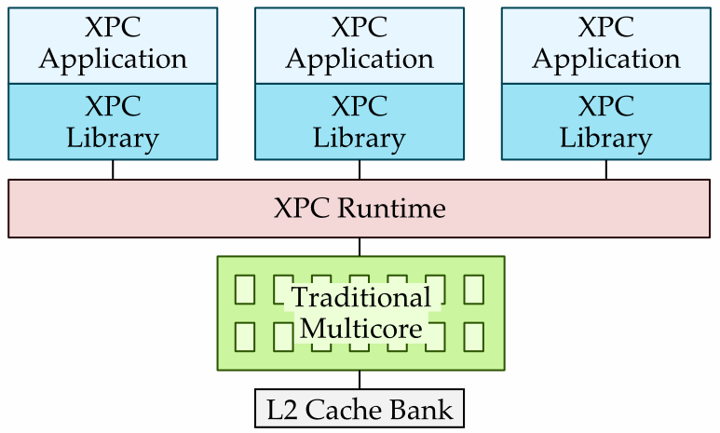
Executing Parallel Tasks: Traditional Multicore
Motivation FG-SIMT HWWL XPC Roadmap
Write applications with XPC programming framework
Run applications using XPC runtime
No need for adaptive execution or heuristics
Work stealing between cores, but no HW acceleration!

Slide 35
Explicit-Parallel-Call Design Space
Motivation FG-SIMT HWWL XPC Roadmap
 | Software | Hardware
Exposing opportunities for fine-grain parallel tasks | Programming API + Cactus stack | Parallel function call ISA
Scheduling fine-grain parallel tasks | Adaptive runtime | Task cache + distribution network
Executing fine-grain parallel tasks | Application running on traditional multicore | Amorphous data parallel accelerators (XPC tiles)
Notes:
Essentially, XPC is a fine-grain heterogeneous architecture with SW/HW mechanisms for exposing, scheduling, and executing parallel tasks with amorphous data parallelism

Slide 36
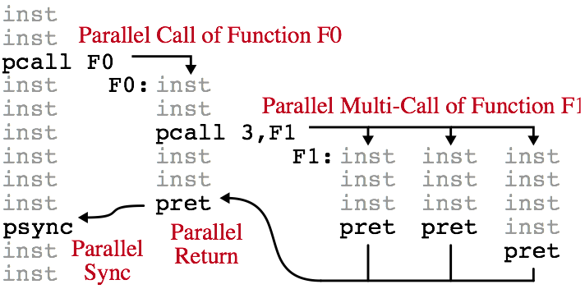
Exposing Parallel Tasks: XPC ISA
Motivation FG-SIMT HWWL XPC Roadmap
Instruction | Description
pcall n, func | Make n instances of function available for parallel execution (serial execution is valid)
psync | Wait for all child parallel calls to complete
pret | Return from parallel call (uses different return address from standard function call)
Notes:
Pull model where functions may or may not be executed in parallel, as opposed to push model we are more used to like bthreads where we actively push tasks onto threads
Any of the four primitives we discussed eventually get compiled down to some form of using pcall
In the example, the tile that encounters the first pcall may either continue to execute independent instructions and leave tasks to be stolen by other tiles, or it may choose to execute it on its own
Each tile has a different way of interpreting a pcall (e.g., TCL might execute tasks across lanes, whereas CMC might execute serially or across cores)
It is up to the whatever is scheduling the tasks (runtime or task cache) to determine when and which tiles the task should run on based on collected heuristics
Generically express nested parallelism which can be exploited on multiple tiles

Slide 37
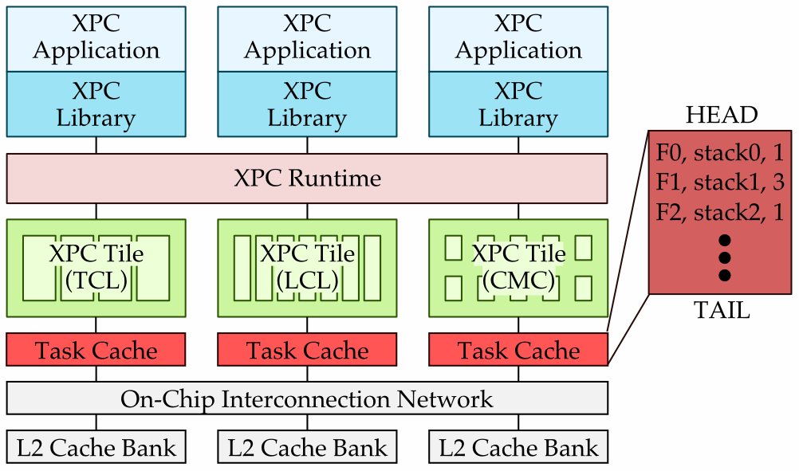
Scheduling Parallel Tasks: Task Cache
Motivation FG-SIMT HWWL XPC Roadmap
Non-trivial memory overhead to create tasks
HW acceleration for intra-tile accesses to spawn queues
pcall or stealing triggers accesses to special task cache

Slide 38
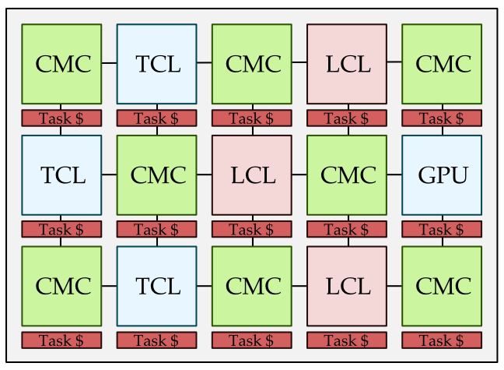
Scheduling Tasks: Task Distribution Network
Motivation FG-SIMT HWWL XPC Roadmap
T3
T2
T1
T5
T0
T4
T6
SW runtime randomly picks spawn queues for work stealing
HW acceleration for inter-tile work stealing
Broadcast steal request to neighbors’ task caches
Meta-data to facilitate task affinity (adaptive execution)
Notes:
Use special instruction or CP0 mapped register to allow runtime to access network
Careful consideration required for coherence of each task cache
Broadcasting to neighbors helps scalability
Allow osmosis effect by having tiles steal even when it is not idle to encourage spreading of work

Slide 39
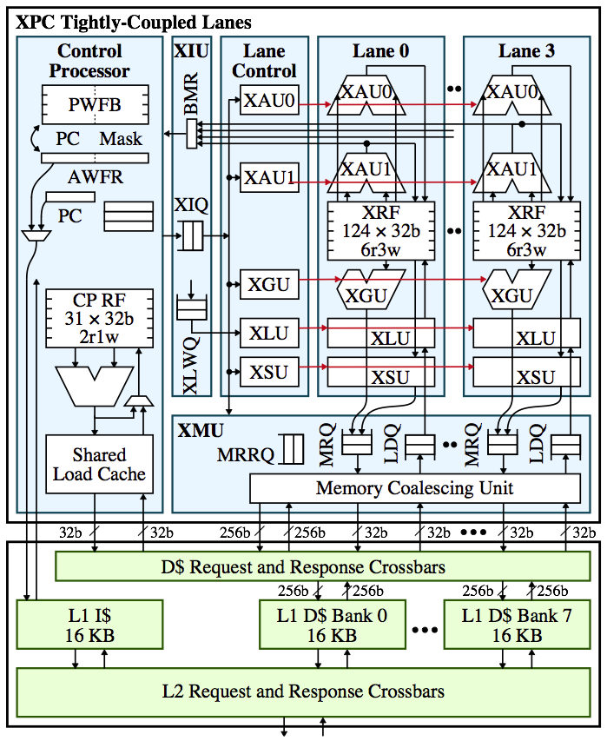
Executing Tasks: Tightly-Coupled Lanes (TCL)
Motivation FG-SIMT HWWL XPC Roadmap
High performance and energy efficiency for traditional data parallelism
Amortized front-end, lock-step execution
Exploit value structure to further accelerate traditional data parallelism
How do we handle nested parallelism? (e.g., pcall-n within pcall-n)
10/21
Notes:
Traditional execution is difficult
Memory communication (vs. registers)
No support for nested parallelism
Single pcall n is fine, just execute parallel functions across lanes
pcall n within pcall n is trickier, just pick one task to execute on TCL and push rest onto spawn queue?
Handling conditional nested pcalls
Can always execute serially!

Slide 40
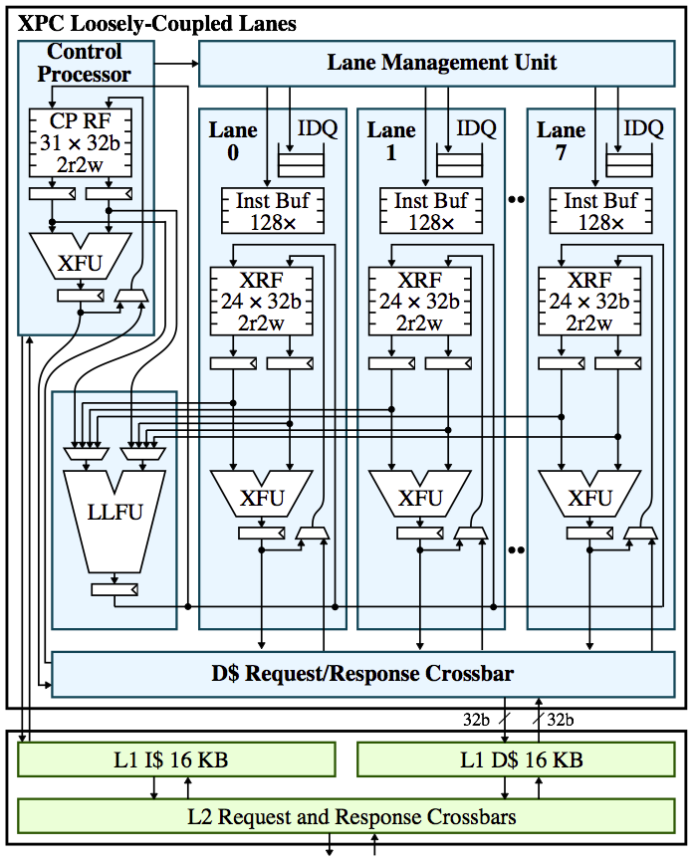
Executing Tasks: Loosely-Coupled Lanes (LCL)
Motivation FG-SIMT HWWL XPC Roadmap
Better tolerance for irregular amorphous data parallelism
Decoupled control flow between lanes using instruction buffers
More lightweight lanes with shared ‘expensive’ FUs
Good middle-ground specialization before resorting to general-purpose
11/21
Notes:
Dynamic bound, communicate back to lane manager?
Still depends on some level of regularity and control flow divergence constrained by size of instruction buffer
Might allow for spawn deque per lane in LCL since more control flow flexibility is allowed, intra-tile vs. inter-tile stealing?

Slide 41
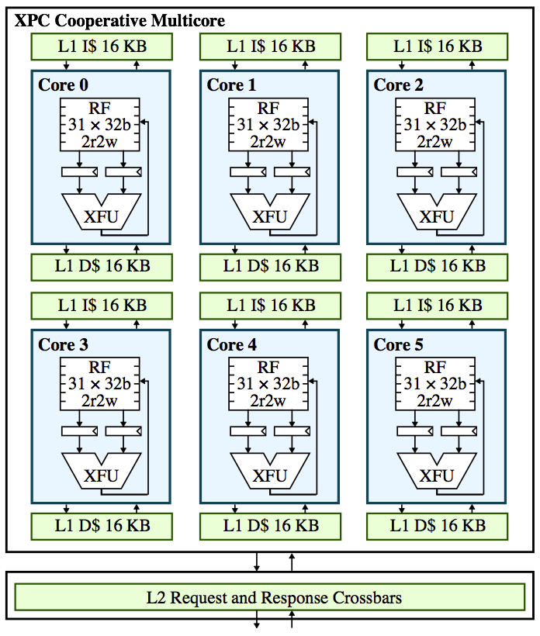
Executing Tasks: Cooperative Multicore (CMC)
Motivation FG-SIMT HWWL XPC Roadmap
General-purpose, capable of handling highly irregular amorphous data parallelism
No significant performance or energy benefits regular control and memory-access
Intra-tile task distribution network?
Default tile for profiling?
12/21
Notes:
Combine into summary slide of all XPC tiles

Slide 42
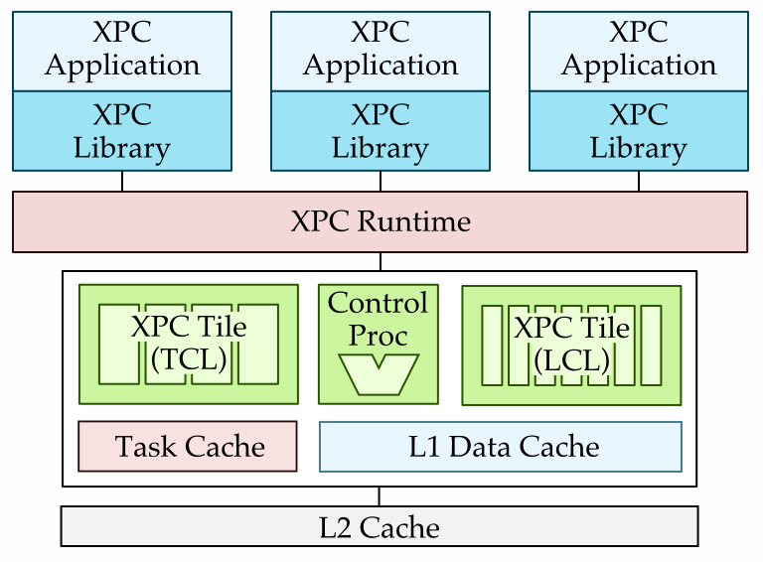
XPC Subset Design
Motivation FG-SIMT HWWL XPC Roadmap
Reasonable design point for exploring XPC
Single tile with three sub-tiles: scalar CP, TCL, LCL
TCL and LCL modified with separate front-ends
Shared L1 cache simplifies inter-tile work stealing
19/21
Notes:
Add HW acceleration elements

Slide 43
Overview
Motivation FG-SIMT HWWL XPC Roadmap
Fine-Grain SIMT
Fine-Grain Hardware Worklists
Explicit-Parallel-Call Architecture
Roadmap

Slide 44
Roadmap
Motivation FG-SIMT HWWL XPC Roadmap
XPC SW Baseline
Programming framework
SW runtime
Mapping to Multicore
XPC HW Acceleration
ISA
Task cache
Task distribution network
Integrating XPC tiles
XPC Subset Design
Chip tapeout
Internship
SUB
WORK
SW
HW
CHIP
Fall 2014
Spring 2015
Summer 2015
Fall 2015
Spring 2016

Slide 45
Thesis Question
Motivation FG-SIMT HWWL XPC Roadmap
Can a XPC subset design with HW acceleration for exposing, scheduling, and executing fine-grain amorphous data parallel tasks achieve higher performance and energy efficiency than a traditional multicore?

Slide 46
Backup Slides
Fine-Grain SIMT
Fine-Grain Hardware Worklists
Explicit-Parallel-Call Architecture
Roadmap

Slide 47
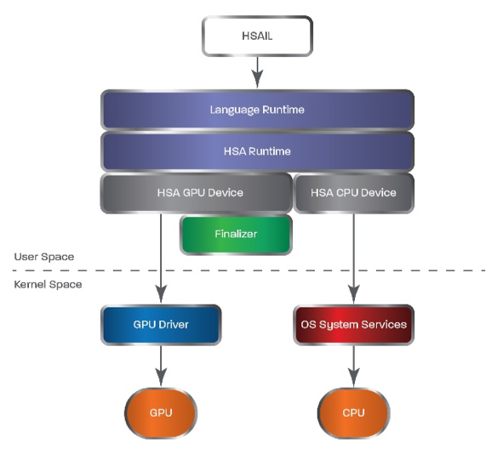
Present: Coarse-Grain Heterogeneity
AMD Heterogeneous System Architecture (HSA) aims to unify heterogeneous tiles with an intermediate SW layer
OpenCL -> Virtual ISA -> tile-specific ISA
Unified virtual memory to simplify inter-tile data transfer
Runtime for optimal scheduling
Coarse-grain tasks (i.e., kernel launch)
Exposes traditional data parallelism
Heterogeneous System Architecture: A Technical Review. AMD Whitepaper, 2012.
http://www.hsafoundation.com/publications/
Notes:
AMD’s HSA is one approach to unifying heterogeneous architectures
Uses an intermediate virtualization layer in SW to map kernels to various microarchitectures
Essentially a clean wrapper for existing microarchitectures with their own ISAs
Reduce inter-tile communication latency with unified virtual memory
Fine-grain function calls may be preferable with applications where most of the work is dynamically generated, allowing for more flexible, adaptive load balancing
Find more opportunities for HW acceleration of amorphous data parallelism within tiles

Slide 48
Data-Driven Optimizations
Double-Buffering
Eliminate memory contention on pulls
Cannot overlap super-steps anymore!
Work Chunking
Amortize push over multiple elements
Reduce memory contention on pushes
Work Donating
Donate excess work to other threads in the same block via GPU shared mem
Helps load balancing
Variable Kernel Configuration
Adjust number of threads spawned if super-step has less work than HW threads
Helps work efficiency
def data_driven_2buf:
start = tid * N/M
end = tid + N/M
for wid in range( start, end ):
idx = pullwl.pull( wid )
my_node = nodes[idx]
compute( my_node )
for all neighbors of my_node:
if check( neighbor ):
pushwl.push( neighbor.idx )
def main:
init_wl<<<N>>>( nodes, pullwl )
while not pullwl.empty():
data_driven<<<M>>>( nodes,
pullwl, pushwl )
swap( pullwl, pushwl )
def data_driven:
while not wl.empty():
idx = wl.pull()
my_node = nodes[idx]
compute( my_node )
for all neighbors of my_node:
if check( neighbor ):
wl.push( neighbor.idx )
def main:
init_wl<<<N>>>( nodes, wl )
data_driven<<<M>>>( nodes, wl )
Notes:
Even though data-driven is more algorithmically efficient, the high memory contention due to accessing a shared worklist makes it inferior to topology-driven without signficant optimizations.

Slide 49
Explicit-Parallel-Call Architecture
Expose amorphous data parallelism as parallel function calls
Parallel calls can be nested for dynamic task generation
Pull-based model means creating opportunities for parallelism
Notes:
Pull-based model (i.e., work-stealing) means we can always fall back to executing serially if resources are busy or non-existent
SW runtime dynamically handles which function calls are parallelized
NVIDIA dynamic parallelism allow nested kernel launches too, but is a coarse-grain approach and only for GPGPUs (not heterogeneous)

Slide 50
Explicit-Parallel-Call Design Space
Motivation FG-SIMT HWWL XPC Roadmap
 | Software | Hardware
Exposing opportunities for fine-grain parallel tasks | Programming API + Cactus stack | Parallel function call ISA
Scheduling fine-grain parallel tasks | Adaptive runtime | Task cache + distribution network
Executing fine-grain parallel tasks | Application running on traditional multicore | Amorphous data parallel accelerators (XPC tiles)
Explore different permutations of SW/HW techniques
Notes:
Cut this, talk more about this XPC section
Can describe XPC with three key facets of fine-grain parallel tasks
Mix and match SW and HW techniques for three key facets of XPC architecture
Baseline uses all SW techniques by default
Most interesting and compelling permutation is using HW acceleration for all facets of XPC
HW acceleration for ADP
Conflict detection for overlapped tasks (speculative_for, atomic_for)
Dynamic task generation (task cache?)

Slide 51
FG-SIMT Example Execution
12/27
Notes:
In order to understand how FG-SIMT works, we’ll look at an example execution of the vector-scalar example code. Shown here is a cartoon of the FG-SIMT microarchitecture. The control processor, which is a simple 5-stage MIPS core on its own, acts as the front-end of the system and issues instructions from the kernel to the SIMT issue unit (SIU), the SIU schedules micro-instructions to all of the SIMT lanes which contain the SIMT register file, and both integer and floating point functional units. The SIMT memory unit manages all memory transactions generated by the SIMT lanes and handles coalescing.

Slide 52
Tracking Value Structure
Store affine values in Affine SIMT Register File (ASRF)
ASRF encodes affine values as base and stride pair with uniform/affine tags
Registers are tagged as affine when:
Shared loads (e.g., ld.param, ld.sh)
Thread index (e.g., tid.x, IDX)
Result of affine arithmetic
14/27
Notes:
Affine values are stored in a special register file called the affine SIMT register file (ASRF). The ASRF encodes an affine value as a base and stride pair, and tags each entry as uniform or affine.
As I alluded to before, registers can be tagged as affine if it is the destination of a shared load, thread index, or affine arithmetic.
We can exploit value structure in arithmetic, control, and memory instructions.

Slide 53
Affine Expansion
Cannot exploit value structure after divergence
Would require multiple states of affine registers
Best case with traditional data parallelism
Overhead from overwriting affine register after divergence
5
6
20/27

Slide 54
FG-SIMT Performance
Motivation FG-SIMT HWWL XPC Roadmap

Slide 55
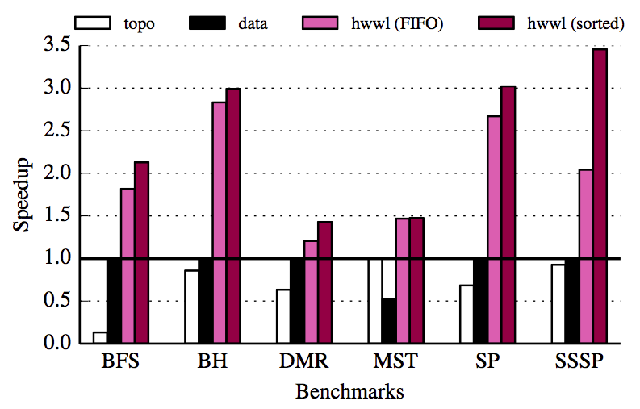
HWWL Idealized Performance

Slide 56
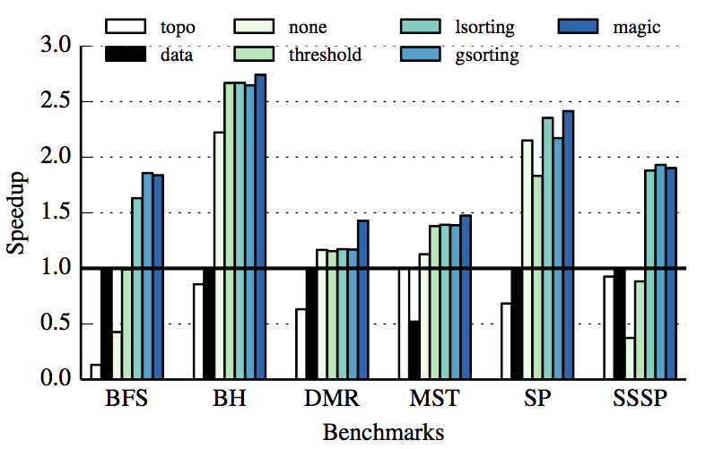
HWWL Work Redistribution Comparison
Motivation FG-SIMT HWWL XPC Roadmap

Slide 57
Scheduling Parallel Tasks: Adaptive Runtime
Motivation FG-SIMT HWWL XPC Roadmap
stack1
local_vars
args
parent_ptr
stack0
local_vars
args
parent_ptr
F0, stack0, 1
F1, stack1, 3
SW runtime to facilitate work stealing
Each tile has its own spawn queue for generated tasks
pcall triggers runtime to create new task to push onto spawn queue
Collect heuristics to determine when/where to schedule tasks
Profile tasks on different tiles based on raw performance
Control irregularity (e.g., number of warp fragments)
Memory-access irregularity (e.g., number of uncoalesced accesses)
Notes:
Runtime on idle tiles need to poll other spawn queues in memory to see if there is a task available for stealing
Serial execution is valid and one tile could serially execute all function calls
Could also steal pieces of a task (e.g., decrement call count by 1 in F1 task)

Slide 58
Nested Parallelism
Nested parallelism
Interesting opportunities to more generically expose previously underutilized parallelism!
Allow any level of nesting to produce generic fine-grain tasks that can map to any sub-tile (function pointer, context pointer, call count)
Hardware support for nested parallelism on TCL? (LCL can handle)
pcall instruction on TCL triggers push to special task buffer which lazily updates memory? Would not look like function call in TCL, no divergence
21/21

