Slide 1
FastGA
Numerical Software Development Final Presentation
Jim Lin (@jylin34)
June 8, 2026 | 08:15 – 08:30
Notes:
Hi everyone, my name is Jim, and my project name is called FastGA.

Slide 2
Outline
GA and FastGA introduction
A little bit implementation details
Benchmark
Notes:
The presentation outline will be
First, I will introduce what is GA, and FastGA.
Second, I will go over a little bit implementation details.
Last but not least, I will present evaluation results.

Slide 3
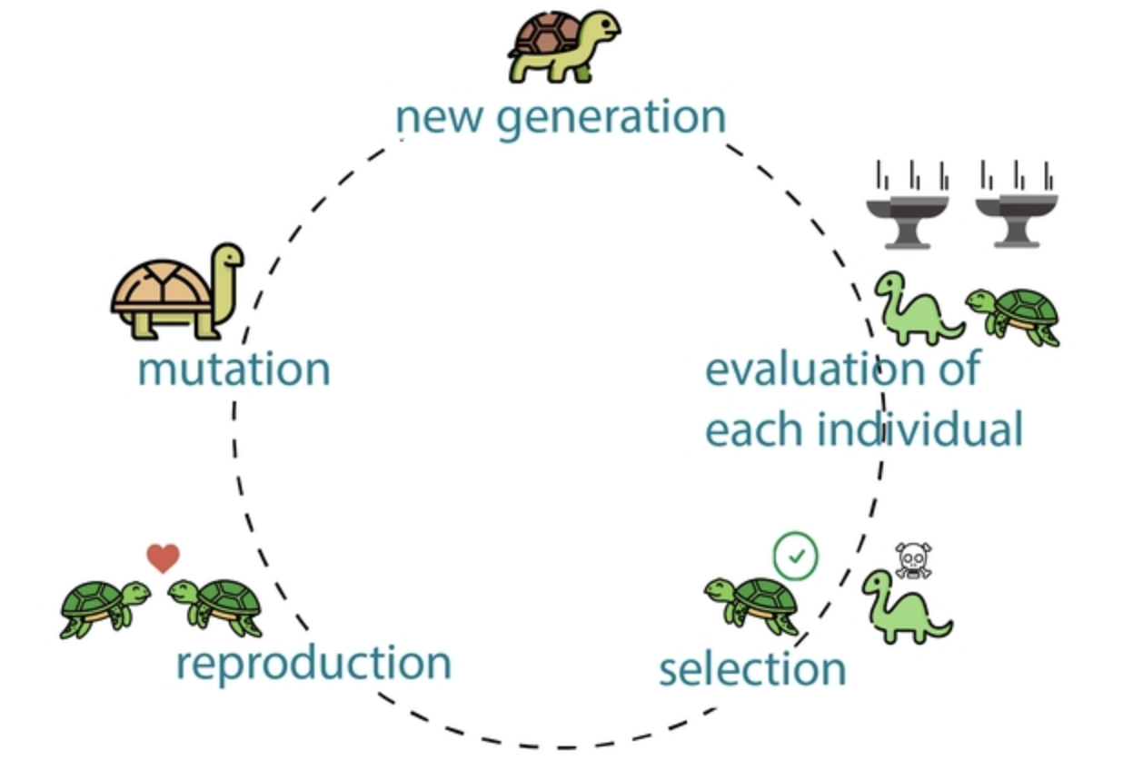
Genetic Algorithm (GA)
Genetic Algorithm is a heuristic algorithm inspired by Darwin natural selection
Solve complex optimization problems by involving a population of solutions
Includes dozens of individuals
Input: fitness_function()
for each generation:
for each individual:
evaluate(individual)
selection()
reproduction()
mutation()
Output: Fittest individual
Use fitness function to score each individual
1 individual = 1 solution
Keeps the fittest individuals
Notes:
So what is GA, GA is the abbreviation of Genetic Algorithm.
A Genetic Algorithm is a heuristic search algorithm inspired by Darwin's theory of natural selection. It is primarily used to solve complex optimization problems by evolving a population of potential solutions over time.
To understand how it works, let‘s look at the cycle on the left. It simulates biological evolution.
We start with a new generation, which includes dozens or even thousands of individuals, each representing a single solution.
Next, we use a fitness function to evaluate and score every individual.
Based on these scores, the selection phase keeps those individuals with best fitness score.
Finally, these survivors go through reproduction and mutation to produce the next generation, and the cycle continues.”
So the whole process pseudo code will look like this, where we input the fitness function we want, and the outer loop for the generations, inner loop to evaluate each individual.
In the end, we output the best score of individual as the optimal solution.

Slide 4
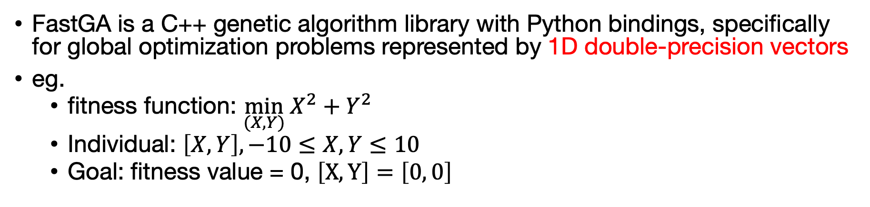
FastGA
FastGA is a C++ genetic algorithm library with Python bindings, specifically for global optimization problems represented by 1D double-precision vectors
eg.
fitness function: $\min_{(X, Y)} X^{2}+Y^{2}$
Individual: $\left[X, Y\right], −10≤X,Y≤10$
Goal: fitness value = 0, $\left[X, Y\right]=\left[0, 0\right]$
Input: fitness_function()
for each generation:
for each individual:
evaluate(individual)
selection()
reproduction()
mutation()
Output: Fittest individual
Thousands of generations amplify the minor interpreter overhead into significand delays
Calling the Python fitness function for every single individual incurs massive overhead from C++-to-Python context switching
Notes:
This brings us to the core of my project: FastGA, it is a C++ genetic algorithm library with Python bindings, specifically for global optimization problems represented by 1 dimensional double precision vectors.
Here is a quick example, if our goal is to minimize a simple function like X^2 + Y^2, an individual in this case will be vector [X,Y].
The fitness function calculates this value, and the ultimate goal for the algorithm is to evolve the population towards the optimal solution, which is [0,0].
The key part here is that the fitness function must be defined by user in Python.
Here lies a critical challenge in hybrid architecture. Let`s look at the pseudo-code again. When evaluate(), we need to call the Python fitness function from C++ one time.
However, here we need to call it for each generation and individual, which incurs massive overhead from C++ to Python context switching.

Slide 5
Project Architecture
individual.cpp
m_genes
m_fitness
main.py
binding.cpp
import fastga
solver = fastga.GASolver
solver.set_fitness_func()
solver.solve(generations)
solver.get_best()
set_fitness_func()
solve()
get_best()
ga_solver.cpp
set_fitness_func()
solve()
evaluate()
selection()
reproduction()
mutation()
get_best()
Notes:
Before we talk about the implementation details, I will give you an overview of the project architecture.
As you can see, I divided the system into three main parts: the C++ Core on the left, the Pybind11 Bridge in the middle, and the Python Frontend on the right.
Individual.cpp is the class responsible for storing genes and fitness scores.
Ga_solver.cpp, which is the core engine of fastga, this is where the heavy lifting happens, the entire evolution loop, including evaluation, selection, reproduction, mutation, runs entirely in C++.
Now look at main.py, the interface our users interact with, it feels just like any standard Python library, simply import fastga, initialize the solver and their custom fitness function, and hit solve().

Slide 6
set_fitness_func() & evaluate()
main.py
ga_solver.cpp
solver.set_fitness_func(x)
void GASolver::evaluate(){
for each individual:
py::array_t<double> genes();
result = m_fitness_func(genes);
}
Stores the python fitness function as a callable reference in C++
Wrap C++ memory into a Numpy array, passing it to Python via zero-copy
ga_solver.cpp
void set_fitness_func(py::function func){
m_fitness_func = func;
}
Can we make it faster?
Notes:
Here, we dive deep into the implementation of how Python and C++ actually communicate, focusing on the fitness function.
Let‘s start on the left. In main.py, the user passes their custom Python fitness function into the solver. In ga_solver.cpp, we store it as a function reference.
Next, lets talk about evaluate() function on the right, when C++ need to score an individual, it must send the gene data over to Python. To maximize performance, we avoid deep-copying the data. We use zero-copy mechanism, warp the native C++ memory into a numpy array.
So when the Python fitness function is running, it thinks its operating on a numpy array, but it is actually reading directly from C++ memory.
Here, we achieved zero-copy data transfer, which is great. But the fitness_func is begin called inside a for loop for each individual, if we have a population of 100, we need to call fitness function for 100 times, which is a massive bottleneck.
Leads to the question in the bottom right, Can we make it faster?

Slide 7



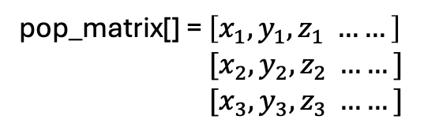
evaluate() vs. batch_evaluate()
evaluate()
batch_evaluate()
for each individual:
py::array_t<double> genes();
result = m_fitness_func(genes);
py::array_t<double> pop_matrix({
pop_size, genome_size
});
for each individual:
pop_matrix[i] = ind[i].genes();
result = m_fitness_func(pop_matrix);
Individual = $[x_{1}, y_{1}, z_{1} ……]$
fitness_func()
Individual = $[x_{2}, y_{2}, z_{2} ……]$
pop_matrix[] = $\left[x_{1}, y_{1}, z_{1} ……\right]$
$[x_{2}, y_{2}, z_{2} ……]$
$[x_{3}, y_{3}, z_{3} ……]$
fitness_func()
Individual = $[x_{3}, y_{3}, z_{3} ……]$
fitness_func()
Pros: fast
fitness_func()
.
.
.
Cons: requires users write batch-compatible fitness function
Notes:
To answer that question, yes, we can do it by batch evaluation.
Lets look at the comparison, on the left the original evaluate() method, the python function call is trapped inside to for loop.
If we have 100 individuals, we are forcing the system to switch between C++ and Python 100 times.
Now, look at batch_evaluate() on the right. Here, we changed the strategy.
We allocate a 2D NumPy array matrix in C++, and pack all individuals genes into this matrix.
Here, we send the entire population matrix to Python in one single shot. By doing this, we compress thousands of cross-language context switches into exactly one single call per generation.
However, doing this has trade-off.
The pro is obvious, the performance becomes incredibly fast.
However, the cons is that it requires users to write batch-compatible fitness functions to handle 2D matrix.

Slide 8
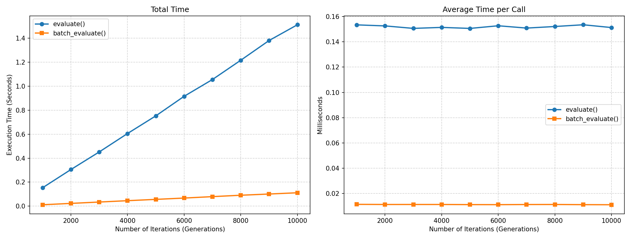
evaluate() vs. batch_evaluate()
Test number of generations (1k~10k) under different evaluate() methods
Notes:
And here I do a little bit experiment evaluating the scalability of batch and without batch evaluation as we increase the number of generations from 1,000 to 10,000.
On the left, we have the Total Execution Time plotted against the number of generations. The blue line represents the standard evaluate() method. As you can see, the time skyrockets linearly as iterations increase, reaching about 1.5 seconds at 10,000 generations.
In contrast, look at the orange line representing batch_evaluate(). It remains incredibly flat, taking almost zero time even at 10,000 generations. The gap between these two lines is purely the accumulated cost of context switching."
the chart on the right is the Average Time per Call.
As you can see, the average time per call on batch evaluate() is way faster than original evaluate().

Slide 9
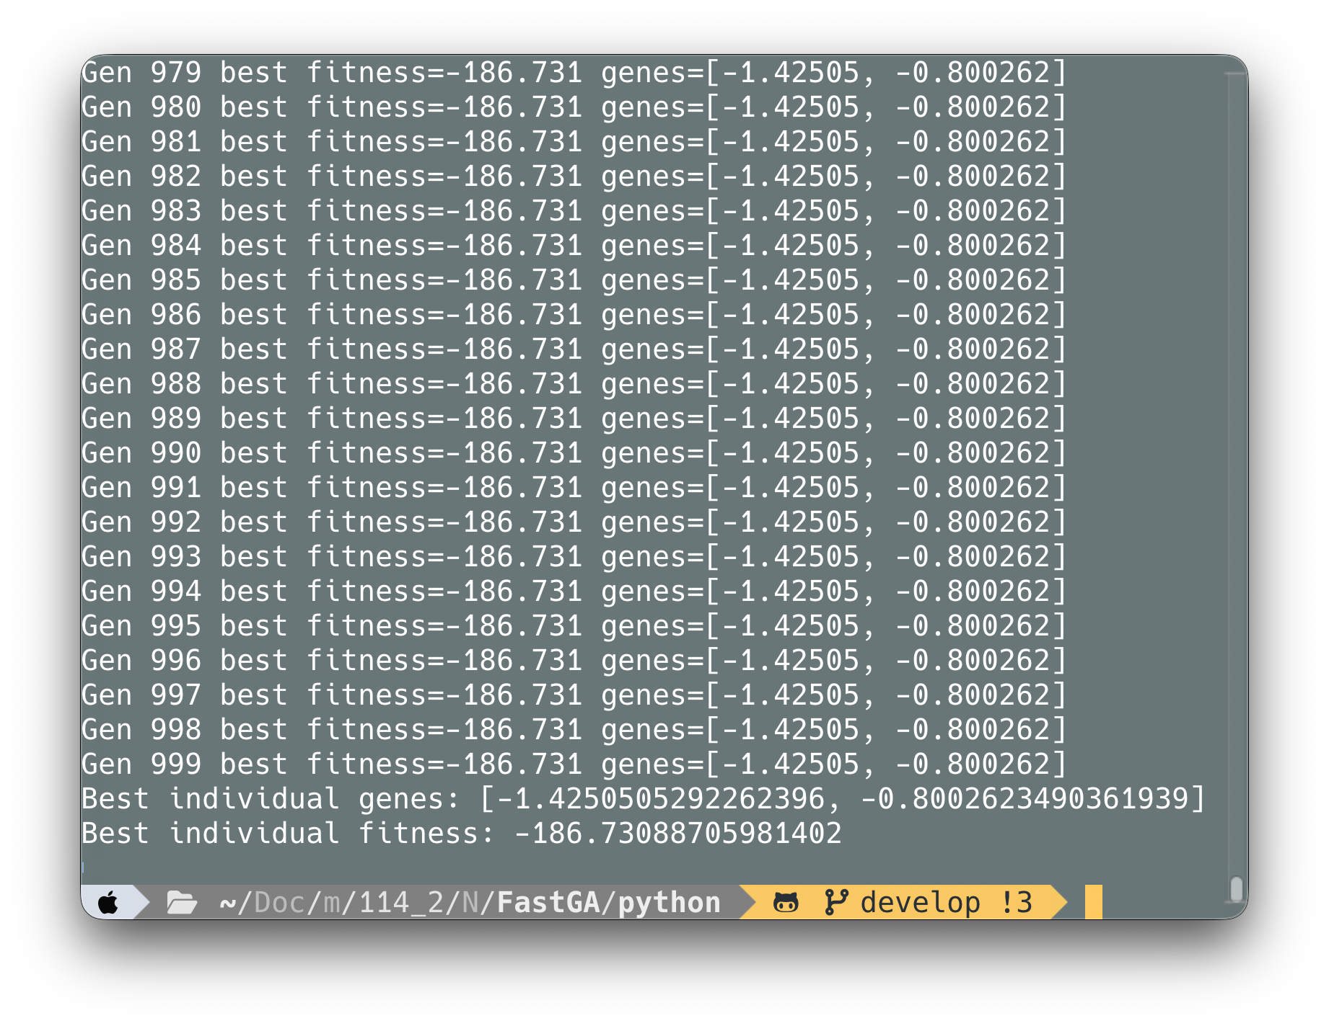
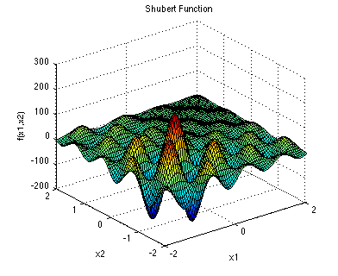
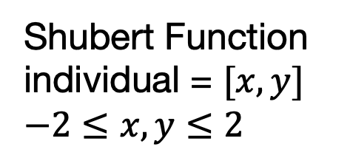

Use Case Example
Shubert Function
individual = $[x, y]$
$$−2≤x, y≤2$$
$$f\left(x^{∗}\right)=−186.7309$$
Notes:
Here, I demonstrate a real-world use case example
I used Shubert function as the case, which visualization looks something like below.
For this test, an individual is represented by a 2D vector, constrained within the bounds of -2 to 2. The theoretical global minimum for this function in this domain is -186.7309
On the right, you can see the actual terminal output from FastGA running this problem.
Within 1000 generation, FastGA successfully converged and found the best fitness value, which is nearly identical to the optimum.

Slide 10
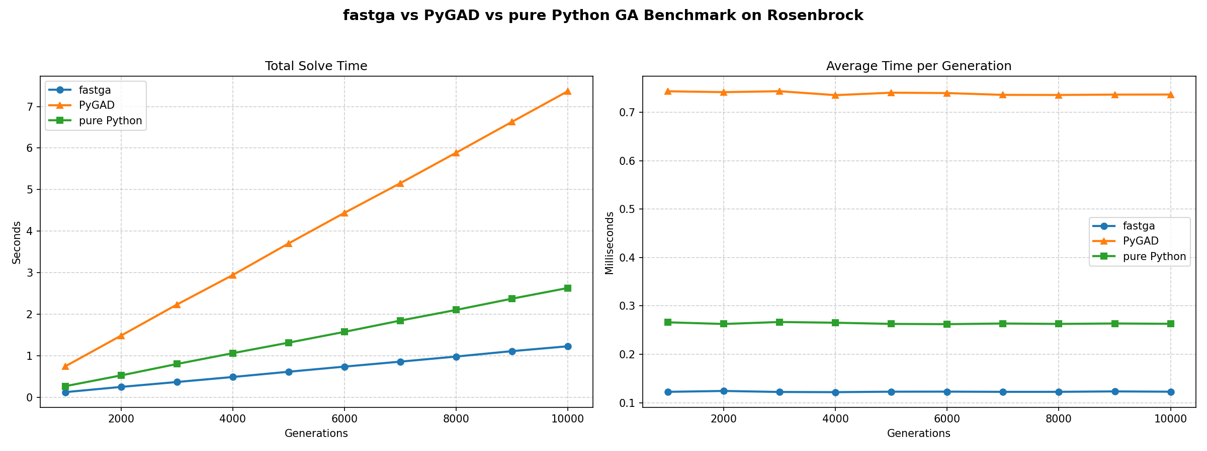
FastGA vs. PyGAD vs. pure Python
PyGAD is an open-source Python library for building the genetic algorithm
Test number of generations (1k~10k) under different implementation
FastGA is fastest
Notes:
And here is the final performance comparison, evaluating the scalability of different genetic algorithm implementations as we increase the number of generations from 1,000 to 10,000.
The blue one is my proposal which is fastGA.
The orange one is PyGAD which is an open source Python library dedicated for building the genetic algorithm
And the green one use pure python to implement the algorithm.
As you can see, left hand side is the Total Solve Time. PyGAD actually use the longest time to finish the work. While FastGA is the fastest one due to its lightweight framework.
the right hand side is Average Time per Generation. The lines are horizontal, meaning the cost per generation is constant. But the gap between them is staggering. FastGA takes significantly less time per generation than both PyGAD and pure Python.

Slide 11
References
What is a Genetic Algorithm? https://www.generativedesign.org/02-deeper-dive/02-04_genetic-algorithms/02-04-01_what-is-a-genetic-algorithm
Genetic Algorithm Wikipedia https://en.wikipedia.org/wiki/Genetic_algorithm
Shubert Function https://www.sfu.ca/~ssurjano/shubert.html
PyGAD Github https://github.com/ahmedfgad/GeneticAlgorithmPython

