Slide 1
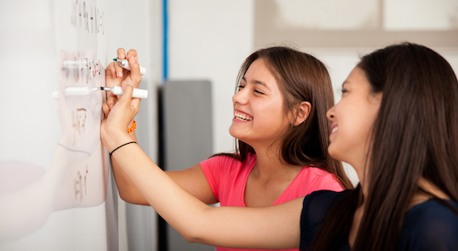
Problem Solving Session
The remainder of today’s class will comprise the problem solving session (PSS).
Your instructor will divide you into teams of 3 or 4 students.
Each team will work together to solve the following problems over the course of 20-30 minutes.
You may work on paper, a white board, or digitally as determined by your instructor.
You will submit your solution by pushing it to GitHub before the end of class.
Your instructor will go over the solution before the end of class.
If there is any time remaining, you will begin work on your homework assignment.
Class participation is a significant part of your grade (20%). This includes in class activities and the problem solving session.
Your graders will grade your participation by verifying that you pushed your solutions before the end of the class period each day.

Slide 2
Relative Coordinates
Some coordinate systems. Which one does turtle use?
While most 2-dimensional coordinate systems are based on an x,y axis pair, the location of the x/y intersection can vary. Rather than thinking of the whole system as one set of coordinates you can think of each object having its own relative coordinate system where the x/y intersection is a point on the larger world coordinate system.
For problem solving today we'll explore a couple coordinate systems and ways to move between them. For the homework, you'll use one of them as the relative coordinate system for drawing shapes in turtle.

Slide 3
Problem 1
200
Assume you are working in a turtle window of size 200x200. Using the draw_square from class, draw a picture of the following code:
turtle.pendown ()
draw_square (50, "")
Using the color "" will cause the square to not be filled

Slide 4
Problem 2
200
Now consider a common alternative coordinate system where everything is based on the upper left-hand corner. Thus 0, 0 in this system would be the upper, left-most location. Increasing x moves to the right, increasing y moves down.
Assume you are working in a turtle window of size 200x200. Using the draw_square from class, draw a picture of the following code:
turtle.pendown ()
draw_square (50, "")

Slide 5
Problem 3
Write the algorithm for converting the x coordinate from the upper-left coordinate system to the turtle (center) coordinate system.
Assume you have the constants MIN_X and MAX_X which contain the minimum and maximum pixel values for the current turtle window.
center upper=left-coordinate_x+ MIN_X

Slide 6
Problem 4
center_y = MAX_Y – upper-left-coordinate_y
Write the algorithm for converting the y-coordinate from the upper-left coordinate system to the turtle (center) coordinate system.
Assume you have the constants MIN_Y and MAX_Y which contain the minimum and maximum pixel values for the current turtle window.
Remember, the y-coordinate is inverted

