Slide 1
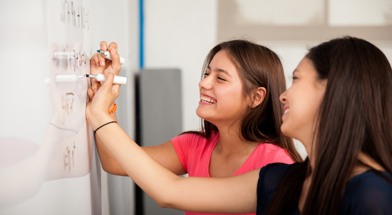
Problem Solving Session
The remainder of today’s class will comprise the problem solving session (PSS).
Your instructor will divide you into teams of 3 or 4 students.
Each team will work together to solve the following problems over the course of 20-30 minutes.
You may work on paper, a white board, or digitally as determined by your instructor.
You will submit your solution by pushing it to GitHub before the end of class.
Your instructor will go over the solution before the end of class.
If there is any time remaining, you will begin work on your homework assignment.
Class participation is a significant part of your grade (20%). This includes in class activities and the problem solving session.
Your graders will grade your participation by verifying that you pushed your solutions before the end of the class period each day.

Slide 2

Problem 1
Get_x(x)
Get_y(y)
Ltc_goto(x,y)
Draw_rectangle
Turtle_position
Given the code written on Monday, what functions do we need to write a test for and why?

Slide 3
Problem 2
500 → -300
125 → 75
300→ -100
Provide 3 test cases and their expected results for the and get_y function
✓
✓
✓

Slide 4

Problem 3
X = turtle.xcor()
y= = turtle.ycor()
Def test_goto():
Goto (100,100)
Assert (x== -100)
Assert (y= 100)
turtle.xcor() returns the turtles current x-coordinate.
turtle.ycor () returns the turtles current y-coordinate.
Use these two functions to write a test for goto(x, y).
Should I be here?

Slide 5
Problem 4
If the x,y coordinates are the same
If the color is what we defined
Size of the shape
Perimeter of the shape
Which direction the turtle is facing
draw_rectangle is mostly visual. What are some things we could programmatically test for?
Take a quick look at the turtle documentation to see what all is available. Python Turtle Docs

