Slide 1

Problem Solving Session
The remainder of today’s class will comprise the problem solving session (PSS).
Your instructor will divide you into teams of 3 or 4 students.
Each team will work together to solve the following problems over the course of 20-30 minutes.
You may work on paper, a white board, or digitally as determined by your instructor.
You will submit your solution by pushing it to GitHub before the end of class.
Your instructor will go over the solution before the end of class.
If there is any time remaining, you will begin work on your homework assignment.
Class participation is a significant part of your grade (20%). This includes in class activities and the problem solving session.
Your graders will grade your participation by verifying that you pushed your solutions before the end of the class period each day.

Slide 2
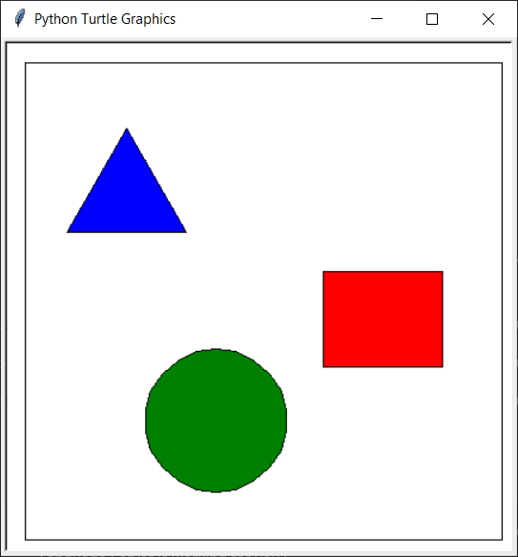
Problem Statement
This week we will introduce the Turtle drawing environment
It is very primitive
No support for drawing shapes except circles
For this week's problem, we would like to create a set of utility functions to make drawing in turtle simpler
The supported shapes will be:
Rectangle (length and width)
Circle (radius)
Equilateral Triangle (length of base)
Additionally we want to use the more conventional upper-left coordinate system
0, 0 is the upper, left-most point
Increasing X moves to the right
Increasing Y moves down
The top-level functions will include:
draw_shape (shape, color code, x, y, l, w)
shape and color code will be one-character strings
goto (x, y)
moves to given point in the new coordinate system
draw_shape ("r", "r", 250, 175, 100, 80)
draw_shape ("c", "g", 100, 240, 60)
draw_shape ("t", "b", 35, 55, 100)

Slide 3
Problem 1
goto0,0, length 400, height 400
goto375, 400, length 50, height 100
Goto 25, 10, length 100, height 400
Goto 399,399, length 500, length 10
Determine 4 test cases for checking if a rectangle will fit within the drawing area
You are given the upper left coordinate and the length and height of the rectangle
Two tests should be at a valid location
Two tests should use valid starting points that result in a portion of the rectangle going out of bounds
Everything at this point will be using the upper-left coordinate system and the 400x400 drawing area
Example: Start (100, 100), Length 100, Height 200 – draws a valid rectangle

Slide 4
Problem 2
Def draw_shapefit():
if get_x() < 0 then
return None
elif: get_y() < 0 then
return None
elif: ( get_x() + lengthx) > MAX_X
return None
elif: ( () + lengthy) > MAX_X
return None
else:
print(“The shape fits”)
Write the algorithm to determine if a rectangle will fit within the bounding box
You are given the starting upper-left coordinate and the length and height of the rectangle
Did I fit?

Slide 5

Problem 3
Pros:
Inverts the shape horizontally or vertically if we want to draw backwards than forward
Can support any coordinates
Cons:
. Unconventinal
. Could be confusing for the user
Should we allow negative values for length and height?
List at least two pros and cons for allowing it.
-8
-8

Slide 6
Problem 4
goto(100,150), length -200 height -150
goto (100,100), length -500, height -100
Since turtle allows negative values, we should support that for our drawing program
Write 2 test cases for drawing a rectangle using a negative length and height
One test case should draw a rectangle within the bounding box
One test case should draw a rectangle with a valid starting point that does not stay within the bounding box when drawn

Slide 7
Problem 5
Def draw_shapefit():
if get_x() > 0 then
return None
elif: get_y() > 0 then
return None
elif: ( get_x() + lengthx) < MAX_X
return None
elif: ( () + lengthy) < MAX_X
return None
else:
print(“The shape fits”)
Modify your algorithm from problem 2 to work correctly with negative length and height values
Did I fit?
Start Here

