Slide 1

7.2.3
Your Turn
Complete the Merge Sort diagram provided below
10 | 3 | 5 | 6 | 1 | 4 | 8 | 7
10 | 5 | 1 | 8
3 | 6 | 4 | 7
10 | 1
5 | 8
3 | 4
6 | 7
10
1
5
8
3
4
6
7
1 | 10
5 | 8
3 | 4
6 | 7
1 | 5 | 8 | 10
3 | 4 | 6 | 7
See the activities.pptx file to enter your solution
1 | 3 | 4 | 5 | 6 | 7 | 8 | 10

Slide 2
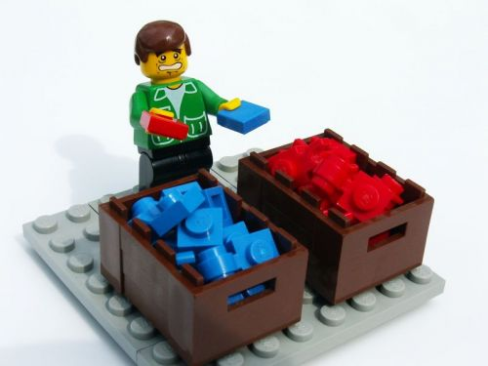
7.2.5
Odd Number of Elements
Complete the merge sort diagram provided below
Remember the rules for splitting
7 | 3 | 5 | 13 | 1 | 9 | 11
7 | 5 | 1 | 11
3 | 13 | 9
7 | 1
5 | 11
3 | 9
13
7
1
5
11
3
9
13
1 | 7
5 | 11
3 | 9
13
1 | 5 | 7 | 11
3 | 9 | 13
1 | 3 | 5 | 7 | 9 | 11 | 13

Slide 3
7.2.9
Already Sorted
Complete the following merge sort diagram
Make note of how many steps it took to complete
2 | 4 | 6 | 8 | 9 | 11 | 13 | 15

Slide 4
7.3.2
Your Turn
Complete the Quicksort diagram provided below
10 | 3 | 5 | 6 | 1 | 4 | 8 | 7

Slide 5
7.3.6
Duplicates
Complete the quicksort diagram provided below
The quicksort algorithm works with duplicate values
3 | 1 | 4 | 2 | 3 | 5 | 1 | 4
For the same array, add all pivot value to it and mark them all as pivot
For all other values, partition works the same as normal

Slide 6
7.3.9
Already Sorted
Complete the following quicksort diagram
Make note of how many steps it took to complete
An already sorted list is a common edge case for sorting algorithms
2 | 4 | 6 | 8 | 9 | 11 | 13 | 15
Let's see how well quicksort handles it

