Slide 1

Problem Solving Session
The remainder of today’s class will comprise the problem solving session (PSS).
Your instructor will divide you into teams of 3 or 4 students.
Each team will work together to solve the following problems over the course of 20-30 minutes.
You may work on paper, a white board, or digitally as determined by your instructor.
You will submit your solution by pushing it to GitHub before the end of class.
Your instructor will go over the solution before the end of class.
If there is any time remaining, you will begin work on your homework assignment.
Class participation is a significant part of your grade (20%). This includes in class activities and the problem solving session.
Your Course Assistants will grade your participation by verifying that you pushed your solutions before the end of the class period each day.

Slide 2

Problem Solving Team Members
Record the name of each of your problem solving team members here.
Do not forget to add every team member’s name! Your instructor (or course assistant) may or may not use this to determine whether or not you participated in the problem solving session.

Slide 3
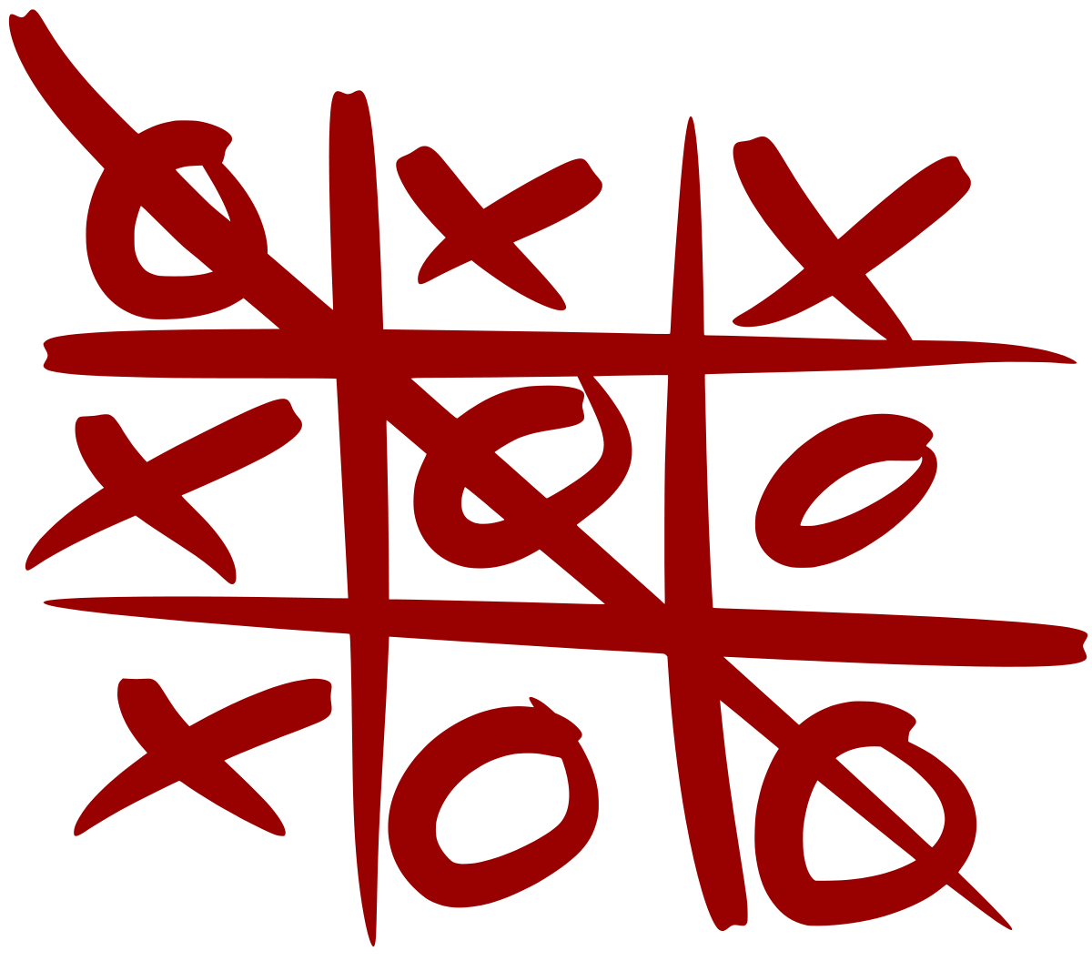
Problem Solving Problem
Today's problem solving, and homework, will involve working with the tic-tac-toe game we wrote last unit as an activity
The complete solution for it has been provided to you in the repo
You are not allowed to make any changes to the file
Before you start problem solving, take a minute or two to look over the solution and refresh your memory about what we did

Slide 4
Problem 1
We will need to compare the output from making a move with the expected output. We can either write our expected output as some type of string or convert the actual output back into a 2D array.
Using the latter approach, what would the 2D array look like for the following board?
| |X
-----
O| |
-----
|X|

Slide 5
Problem 2
Write the code to convert the printed output of a board back into a 2D list.
The string to be converted will be provided as a parameter
Return the 2D list
Sample string:
' |O| \nX|O| \n |X| \n'
Which corresponds to the board:
|O|
-----
X|O|
-----
|X|

Slide 6
Problem 3
Just because our convert_to_board function (previous problem) will be written in the test file does not mean it doesn't need to be tested itself.
Write the code to test convert_to_board (board_string).
You can use the following string for the test input.
board_str =
' |O| \n-----\nX|O| \n-----\n |X| \n'
In which file should this test be located?

Slide 7
Problem 4
Write the code for the Setup portion of test_make_move().
Since make_move uses input, you will need to call the io.StringIO function to create the input string
You will then use monkeypatch to use that string instead of 'sys.stdin'
Don't forget to setup the existing board and the expected result

Slide 8
Problem 5
In the past we haven't tested main. However, that holds the control logic for the game so we will need to do so.
In order to fully test it we need to run through one game, but this means capsys will have all of the boards and input strings in it as well as the final "Game Over!" string.
Write the Analysis code for test_main (). This will involve getting the last line of output from capsys and asserting it is "Game Over!"

