Slide 1
CMPT 225
Data Structures and Programming
Week 05

Slide 2
Trees

Slide 3
Trees
So far we have only seen data structures representing lists of objects
But it may consider more complicated structures.
For example,
How would you represent the inheritance relation between classes in Java?
How would you represent the hierarchy of folders in a file system?
How would you represent the hierarchy of animal

Slide 4
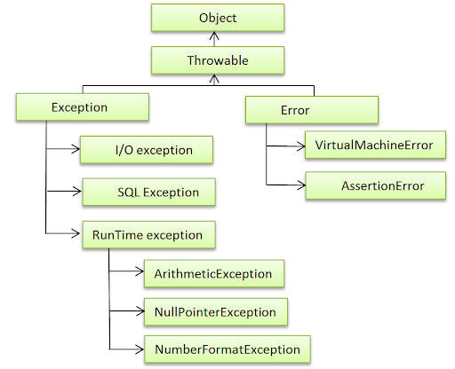

Slide 5
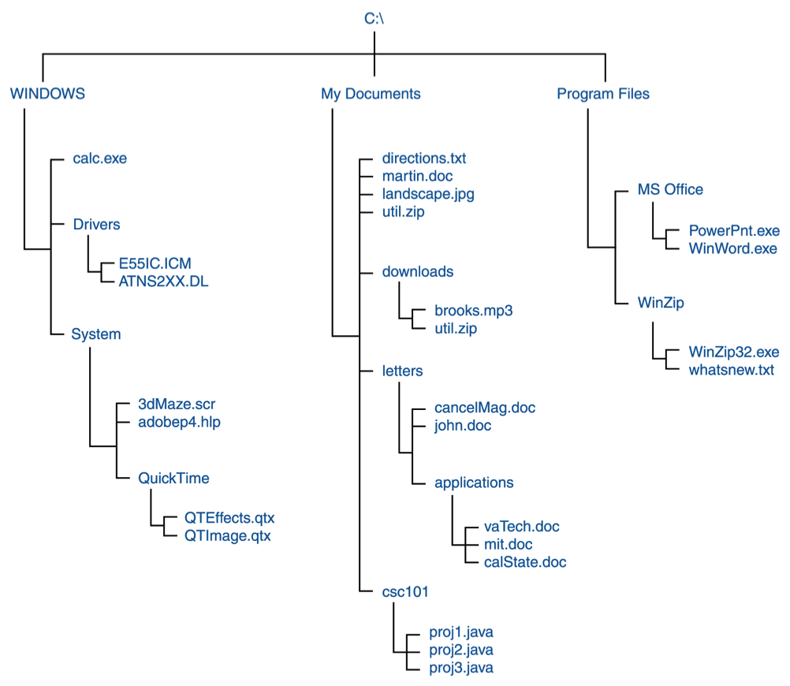
Trees

Slide 6
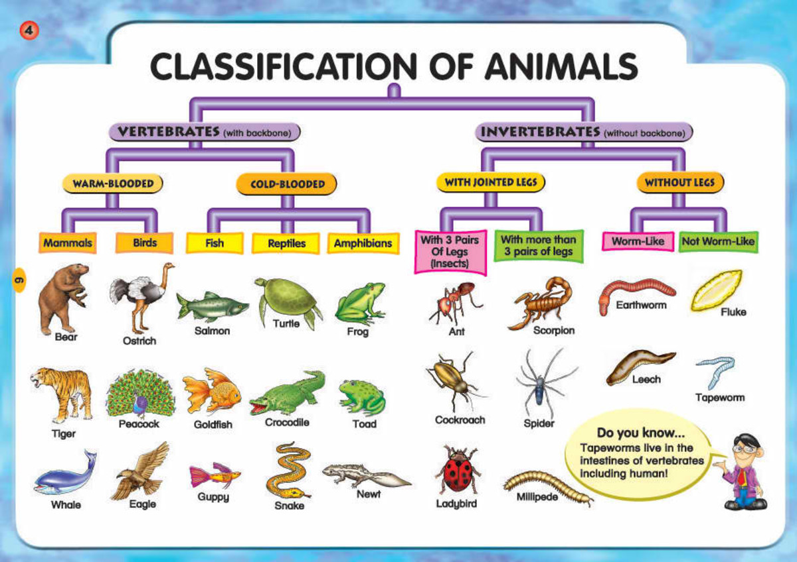
Trees
So far we have only seen data structures representing lists of objects
But it may consider more complicated structures.
For example,
How would you represent the inheritance relation between classes in Java?
How would you represent the hierarchy of folders in a file system?
How would you represent the hierarchy of animal

Slide 7
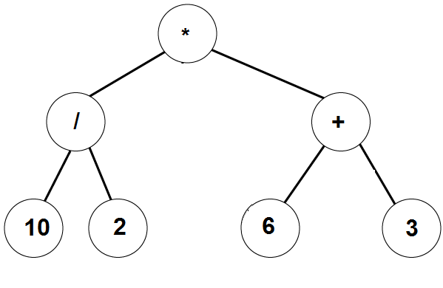
Arithmetic expressions using binary trees
All inner nodes are operators
All leaves are numbers
(10 / 2) * (6 + 3)

Slide 8
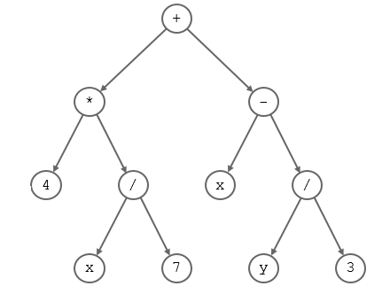
A Tree

Slide 9
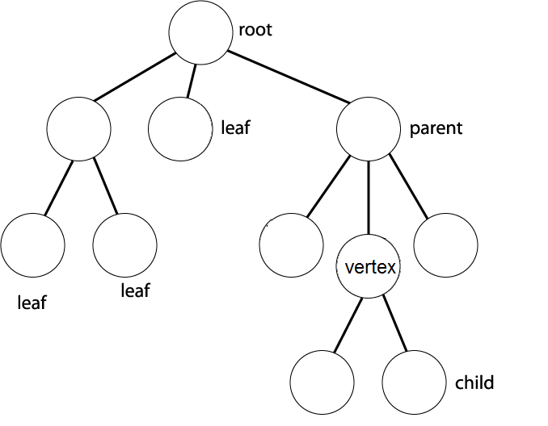
A Tree

Slide 10
Trees
All nodes are connected by edges
There are no cycles
The top node in a tree is called a root
Successors of a node are called its children
The unique predecessor of a node is called its parent
A node with no children is called a leaf
Every node naturally defines a subtree, where this node is the root.

Slide 11
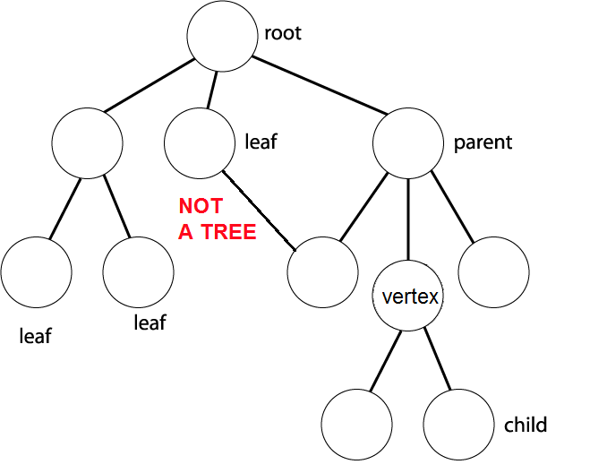
Not a tree

Slide 12
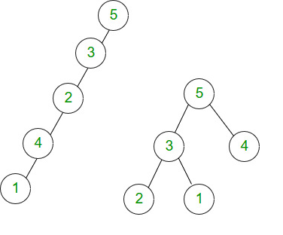
Not a tree
This is not a tree because the structure is not connected
There are two connected components, and each component is a tree

Slide 13
Basic terminology
For every vertex in the tree there is a unique shortest path from the root to this vertex.
Depth of a node is the length from the root to this node.
Example: Depth(root) = 0, depth of its children is 1, and so on.
Depth/Height of a tree is the maximal depth of a node in the tree.
Size of a tree is the number of nodes in the tree.

Slide 14
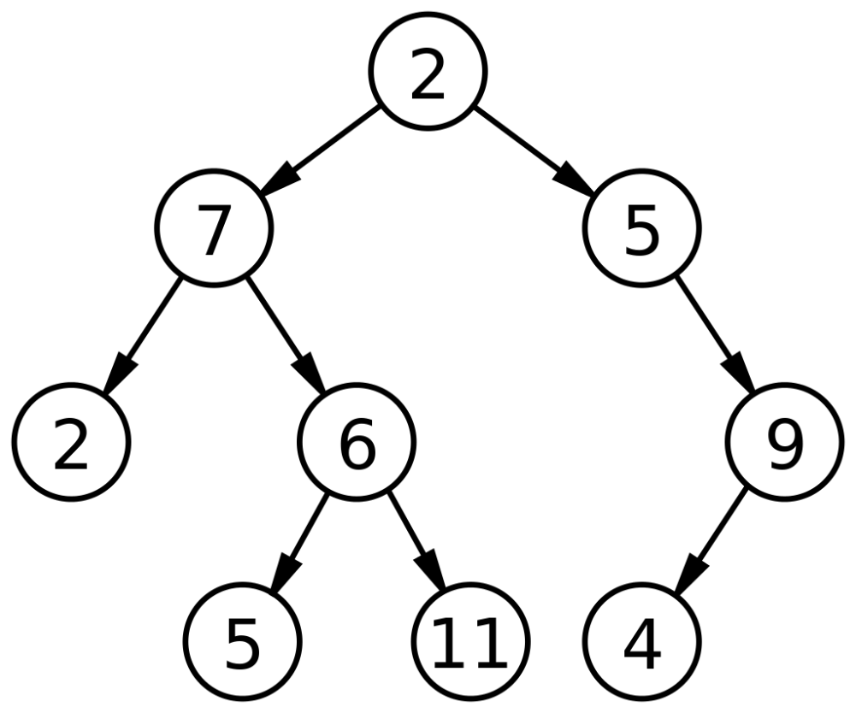
A Tree
The depth of 2 is 0
The depth of 9 is 2
The depth of 11 is 3
Q: What is the size of the tree?
A: 9
Q: What is the depth of the tree?
A: 3
Q: What is size, depth of the subtree rooted at 7?
A: size = 5, depth = 2

Slide 15
Trees in Java
public class Node {
private int data; private Node[] children; private Node parent; }
public class Tree {
private Node root;
}

Slide 16
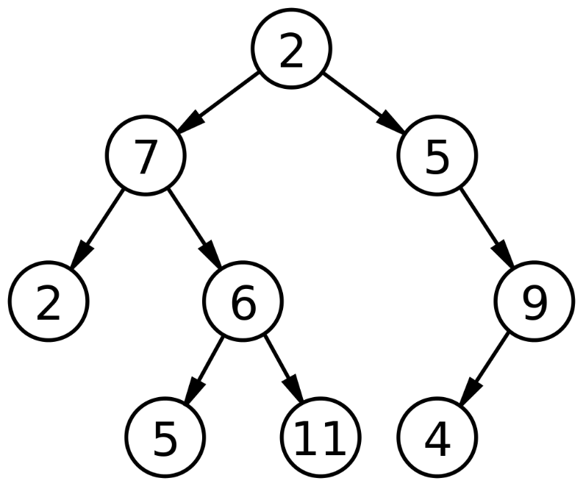
Binary Trees
A special kind of tree where each node has at most 2 children.
In binary tree there are at most 2^{k} nodes in level k.
Therefore, a binary tree of depth d, has at most
1+2+4+…+2^{d} = 2^{d+1}-1 nodes.

Slide 17
Binary Trees
If a binary tree has N vertices, then its depth is at least Ω(log(N)).
If a binary tree has N vertices, then its depth is at most N-1.
Q: prove the above.
Hint for 1: use the fact that if depth his d, then N<2^{d+1}

Slide 18
Binary Trees
public class BTNode<T> {
private T data; private BTNode<T> leftChild; private BTNode<T> rightChild; private BTNode<T> parent; }
public class BinaryTree<T> {
private BTNode<T> root;
}

Slide 19
Binary Trees
Write a method that computes the size of a tree.
Write a method that computes the depth of a tree.
getSize (BTNode root):
if ( root == null )
return 0
else return getSize (root.left ) + getSize (root.right ) +1
getHeight(BTNode root):
if ( root == null )
return -1
else return max( getHeight(root.left ), getHeight(root.right ) ) +1

Slide 20
Binary Trees
Write a method that computes the depth of a tree.
Write a method that computes the size of a tree.
Write a non-recursive solution.

Slide 21
Traversing Binary Trees

Slide 22
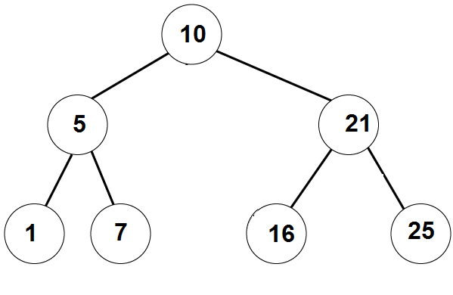
Traversing Binary Trees
InOrder traversal:
First visit the left subtree,
Then the root,
Then the right subtree.
Example:
_left_ , 10, __right__
_, 5, _, 10, _, 21, _
1, 5, 7, 10, 16, 21, 25
A: [1,5,7,10, 16, 21, 25]

Slide 23
Traversing Binary Trees
PreOrder traversal:
First visit the root,
Then the left subtree,
Then the right subtree.
Example:
10, ___left___, ___right___
10, 5, _, _, 21, _, _
10, 5, 1, 7 21, 16, 25
Answer: [10, 5, 1, 7, 21, 16, 25]

Slide 24
Traversing Binary Trees
PostOrder traversal:
First visit the left subtree,
Then the right subtree,
Then the root.
Example:
__left__, __right__, 10
_, _, 5, _, _, 21, 10
1,7,5, 16, 25, 21, 10
Answer: [1,7,5,16, 25, 21,10]

Slide 25
Traversing Binary Trees
// prints the tree in PreOrder
PreOrderTraversal (BTnode root):
If root==null
1.1 do nothing
Else
2.1 print( root.data )
2.2 PreOrderTraversal(root.left)
2.3 PreOrderTraversal(root.right)
Q:Change the algorithm to get the InOrder/PostOrder traversal
A: change the order of 2.1 2.2 and 2.3

Slide 26
4
2
6
1
3
5
7
8
9
Preorder: 4, 2,1,8, 3, 6, 5,9, 7
InOrder: 8, 1, 2, ,3, 4, ,5,9, 6, 7
PostOrder: 8, 1, 3, 2 , 9, 5, 7, 6 , 4

Slide 27
Questions?
Comments?

