Slide 1
CMPT 225
Data Structures and Programming
Week 06

Slide 2
Binary Trees

Slide 3
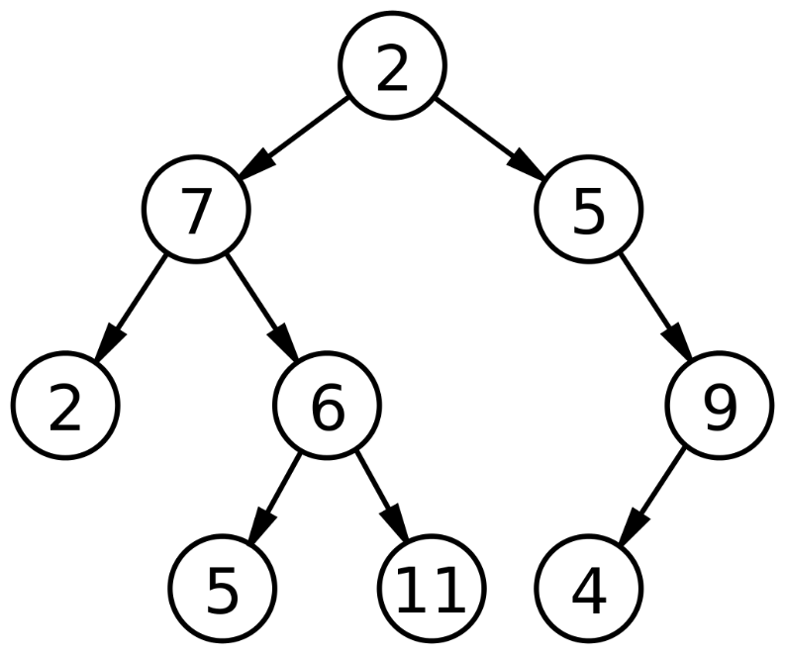
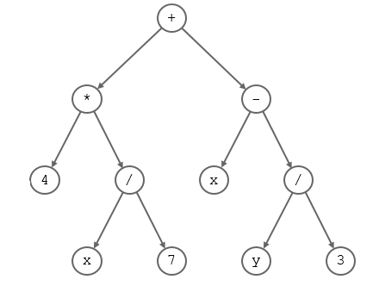
Binary Trees
A special kind of tree where each node has at most 2 children.
In binary tree there are at most 2^{k} nodes in level k.
Therefore, a binary tree of depth d, has at most
1+2+4+…+2^{d} = 2^{d+1}-1 nodes.

Slide 4
Binary Trees
public class BTNode<T> {
private T data; private BTNode<T> leftChild; private BTNode<T> rightChild; private BTNode<T> parent; }
public class BinaryTree<T> {
private BTNode<T> root;
}

Slide 5
Traversing Binary Trees

Slide 6
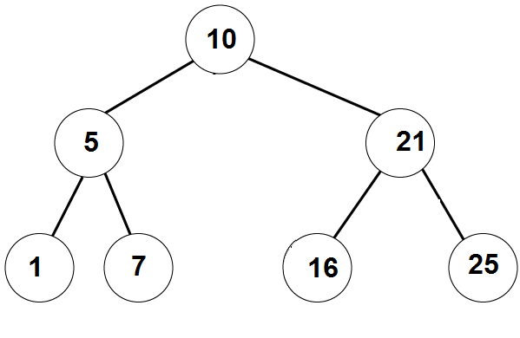
Traversing Binary Trees
InOrder traversal:
First visit the left subtree,
Then the root,
Then the right subtree.
Example:
_left_ , 10, __right__
_, 5, _, 10, _, 21, _
1, 5, 7, 10, 16, 21, 25
A: [1,5,7,10, 16, 21, 25]

Slide 7
Traversing Binary Trees
PreOrder traversal:
First visit the root,
Then the left subtree,
Then the right subtree.
Example:
10, ___left___, ___right___
10, 5, _, _, 21, _, _
10, 5, 1, 7 21, 16, 25
Answer: [10, 5, 1, 7, 21, 16, 25]

Slide 8
Traversing Binary Trees
PostOrder traversal:
First visit the left subtree,
Then the right subtree,
Then the root.
Example:
__left__, __right__, 10
_, _, 5, _, _, 21, 10
1,7,5, 16, 25, 21, 10
Answer: [1,7,5,16, 25, 21,10]

Slide 9
Traversing Binary Trees
// prints the tree in PreOrder
PreOrderTraversal (BTnode root):
If root==null
1.1 do nothing
Else
2.1 print( root.data )
2.2 PreOrderTraversal(root.left)
2.3 PreOrderTraversal(root.right)
Q:Change the algorithm to get the InOrder/PostOrder traversal
A: change the order of 2.1 2.2 and 2.3

Slide 10
4
2
6
1
3
5
7
8
9
Preorder: 4, 2,1,8, 3, 6, 5,9, 7
InOrder: 8, 1, 2, ,3, 4, ,5,9, 6, 7
PostOrder: 8, 1, 3, 2 , 9, 5, 7, 6 , 4

Slide 11
Traversing Binary Trees
For each of the traversals write an Iterator implementing it.
public class BinaryTreeIterator<T> implements Iterator<T> {
public BinaryTreeIterator();
public boolean hasNext();
public T next();
}
public class BinaryTree<T> {
public Iterator<T> iterator();
}

Slide 12
PreOrder Traversal - Iterative
PreOrder(BTnode root):
s = create stack of nodes
s.push(root)
while (s is not empty):
node = s.pop()
printf(node.data)
if (node.right != NULL)
s.push(node.right)
if (node.left != NULL)
s.push(node.left)

Slide 13
PreOrder Traversal - Iterative
PreOrder(BTnode root):
s = create stack of nodes
s.push(root)
while (s is not empty):
node = s.pop()
printf(node.data)
if (node.right != NULL)
s.push(node.right)
if (node.left != NULL)
s.push(node.left)
10
5
21
1
7
21
7
21
21
16
25
25

Slide 14
PreOrder Traversal - Iterative
PreOrder(BTnode root):
s = create stack of nodes
s.push(root)
while (s is not empty):
node = s.pop()
printf(node->value)
if (node->right != NULL)
s.push(node->right)
if (node->left != NULL)
s.push(node->left)
What if we replace the stack with a queue?

Slide 15
Breadth First Search
BFS(BTnode root):
q = create queue of nodes
q.enqueue(root)
while (q is not empty):
node = q.dequeue()
printf(node->value)
if (node->left != NULL)
q.enqueue(node->left)
if (node->right != NULL)
q.enqueue(node->right)
Print 10
Print 5
Print 21
Print 1
Print 7
Print 16
Print 25
10
5 | 21
21 | 1 | 7
1 | 7 | 16 | 25
7 | 16 | 25
16 | 25
25

Slide 16
Running time
Q: what is the running time of all traversal algorithms we saw today?
A: O(size of the tree)
Because each node is processed in O(1) time.

Slide 17
Binary Search Trees

Slide 18
Binary Search Trees
A binary search tree (BST) is a binary tree with the following property:
For every node, the value in the node is greater or equal than the values in its left child and all its descendants.
For every node, the value in the node is smaller or equal than the values in its right child and all its descendants.

Slide 19
Binary Search Trees
Example 1:
A binary search tree can be balanced

Slide 20
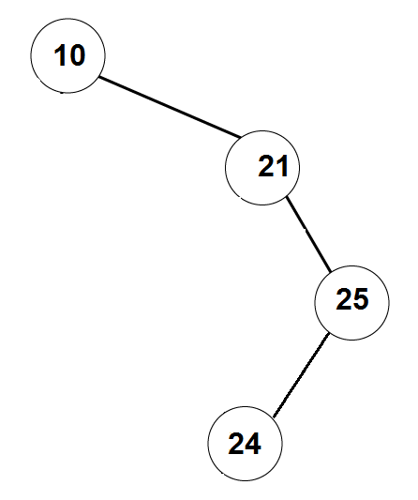
Binary Search Trees
Example 2:
A binary search tree can be
unbalanced

Slide 21
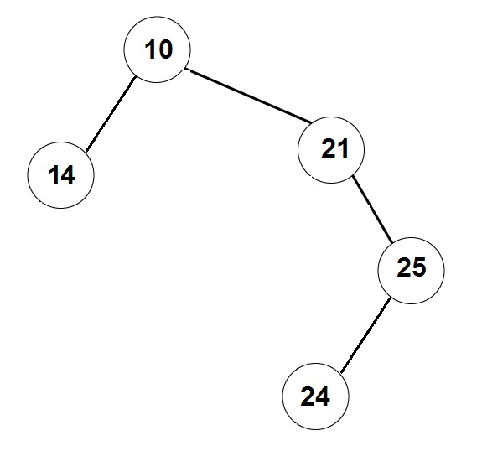
Not a Binary Search Tree

Slide 22
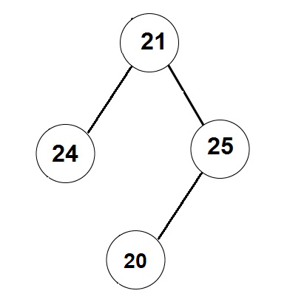
Not a Binary Search Tree

Slide 23
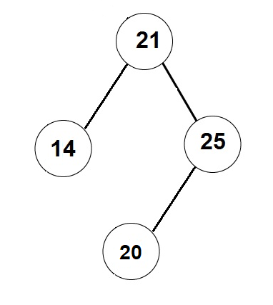
Not a Binary Search Tree

Slide 24
Binary Search Trees
Write a function that prints the values in a BST in the non-decreasing order.
void printSorted (BTNode root) {
if ( root == null)
return;
printSorted(root.leftChild)
print(root.data)
printSorted(root.rightChild)
}
This is the InOrder traversal

Slide 25
Binary Search Trees
Write a function that finds a given item in a BST (or returns NULL).
BTNode find (BTNode root, T item) {
if ( root == null )
return null;
if (root.data.compareTo(item) == 0)
return root;
if (root.data.compareTo(item) > 0)
return find(root.left, item);
if (root.data.compareTo(item) < 0)
return find(root.right, item);
}
find( 7 )
Found

Slide 26
Binary Search Trees
The running time is: O(depth of the tree)
Write a function that finds a given item in a BST (or returns null).
public <T extends <Comparable<T>> BTNode find (BTNode root, T item) {
if ( root == null )
return null;
if (root.data.compareTo(item) == 0)
return root;
if (root.data.compareTo(item) > 0)
return find(root.left, item);
if (root.data.compareTo(item) < 0)
return find(root.right, item);
}
find( 8 )
Not found

Slide 27
Binary Search Trees
Write an iterative function that finds a given item in a BST (or returns null).
BTnode find (BinarySearchTree bst, T item) {
BTnode current = bst.root;
while ( current != null && current.data.compateTo(item) != 0) {
if (current.data.compareTo(item) > 0)
current = current.left.
else // current.data.compareTo(item) < 0
current = current.right;
}
return current;
}
Running time: O(depth of the tree)
find( 16 )
Found

Slide 28
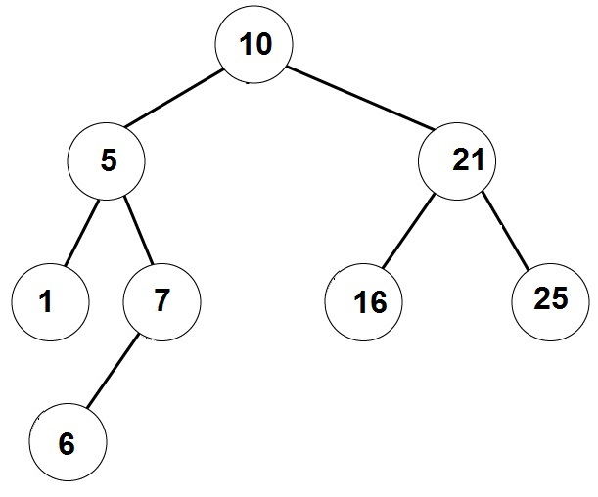
Binary Search Trees
Write a function that adds a given element to a binary search tree
/** returns the added node */
BTNode addItem (BinarySearchTree bst, T item) {
…
if (parent.data.compareTo(item)>0)
parent.addLeftChild(item)
else
parent.addRightChild(item)
}
addItem( 6 )

Slide 29
Binary Search Trees
See examples: https://www.cs.usfca.edu/~galles/visualization/BST.html

Slide 30
Binary Search Trees
Create a Binary Search Tree from the following list of insertions:
[4, 6, 2, 3, 1, 5, 8]
4
2
6
1
3
5
8

Slide 31
Binary Search Trees
Create a Binary Search Tree from the following list of insertions:
[4, 2, 6, 1, 3 , 5, 6, 6, 8,6]
Let’s say if item is already in the tree, we add it to the right
4
2
6
1
3
5
6
6
8
6

Slide 32
Binary Search Trees
Create a Binary Search Tree from the following list of insertions:
[1, 2, 3, 4, 5, 6, 7]
1
2
3
4
5
6
7

Slide 33
Binary Search Trees
Create a Binary Search Tree from the following list of insertions:
[1, 2, 3, 7, 6, 5, 4]
1
2
3
7
6
5
4

Slide 34
Binary Search Trees
Create a Binary Search Tree from the following list of insertions:
[4, 3, 2, 1, 5, 6, 7]
4
3
5
2
6
1
7

Slide 35
Binary Search Trees
Create a Binary Search Tree from the following list of insertions:
[4, 1, 2, 3, 5, 6, 7]
4
1
5
2
6
3
7

Slide 36
Binary Search Trees
Create a Binary Search Tree from the following list of insertions:
[1, 7, 2, 6, 3, 5, 4]
1
7
2
6
3
5
4

Slide 37
Binary Search Trees
Describe all sequences of numbers 1…n that give a BST of max depth.
Write an algorithm that outputs all the sequences.
First number must be either 1 or n
What next?

Slide 38
Removing an element from Binary Search Trees
Write a function that removes a given element from a BST
What if we want to remove an element that is not in the tree?
What if the remove element has no children?
What if the remove element has one child?
What if the remove element has two children?

Slide 39
Removing an element from Binary Search Trees
Step 1: Get a pointer to the node we want to remove
Removing a node with no children:
Just remove the vertex, and update its parent.
Removing a node with one child:
Update the parent to skip over the removed node, and point to its (unique) child.
Note that if the removed node is the root, then we should update the pointer to the root accordingly.

Slide 40
Remove node with no children
removeNode(BinarySearchTree tree, BTNode node)
if (tree.root == node)
tree.root = null;
else
if (node.parent.getLeftChild() == node)
node.parent.setLeftChild(null)
else // node.parent.getRightChild() == node
node.parent.setRightChild(null)
4
2
6
1
3
5
7
remove( 3 )

Slide 41
Remove node with one child
4
removeNode(BinarySearchTree tree, BTNode node)
child = getChild(node)
if (tree.root == node)
root = child
else
if (node.parent.left == node)
node.parent.setLeftChild(child)
else // node.parent.right == node
node.parent.setRightChild(child)
3
5
7
2
1
6
remove( 3 )
remove( 7 )

Slide 42
Remove node with two children
remove( 4 )
removeNode(BinarySearchTree tree, BTNode node)
next = find successor of node in the tree
// next has ≤1 child
node.data = next.data
removeNode(tree, next)
4
2
6
1
3
5
5
7
Putting the predecessor in the root also works
Successor of 4 is 5

Slide 43
Remove node with two children
removeNode(BinarySearchTree bst, BTNod node)
next = findSuccessor(node)
node.data = next.data
removeNode(bst, next)
// assuming node has right child
findSuccessor(BTNode node) {
findMin(node.right);
}
// assuming node != NULL
findMin(BTNode node) {
BTNode current = node;
while (current.left != null)
current = current.left
return current
}

Slide 44
Running time of the operations
What is the running time of findElement () ?
What is the running time of addElement() ?
What is the running time of removeElement() ?
Answer = O(depth of tree)
Conclusion: we want the tree to be balanced, i.e., have no long strings.
We saw that for a tree with n vertices the depth must be >log(n)-1.
So the best we can hope for in O(log(n)) for each operation.

Slide 45
Balancing a BST

Slide 46
Balancing the tree
How can we make sure that the tree is balanced?
A possible solution: have a method makeBalanced() that balances the tree.
makeBalanced()
create a sorted array with all the values in the tree
can be done using inOrder traversal
create a new tree from the array
WRONG SOLUTION!!!
DON’T LISTEN TO THIS GUY!

Slide 47
Creating a balanced tree from a sorted array
Idea:
1) Set the median to be the root
2) Construct left and right subtrees recursively.
addArrayToTree(array, first, last)
if (first <= last)
mid = (first+last)/2
root = new BTNode(array[mid])
root.setLeftChild(addArrayToTree( array, first , mid-1))
root.setRightChild(addArrayToTree( array, mid+1, last))
return root

Slide 48
Creating a balanced tree from a sorted array
Example: Array = [1,2,3,4,5,6,7,8]
Root = 5
Create left subtree from [1,2,3,4]
Root = 3
Create subtree from [1,2]
Create subtree from [4]
Create right subtree from [6,7,8]
Root = 7
Create subtree from [6]
Create subtree from [8]
5
3
7
2
4
6
8
1

Slide 49
Balancing the tree
Disadvantages of the solution using makeBalanced()
Add responsibility to the user to invoke makeBalanced()
The user will need to wait linear time in every invocation of makeBalanced().
A better solution would be to have a self-balancing tree that is makes sure the tree is balanced after each modification (add/remove)
AVL trees
B-trees
RedBlack trees
2-3 trees
We will see AVL trees (definitely) and B-trees(?) next.

Slide 50
Practice Problems

Slide 51
Practice problem 1
Create a Binary Search Tree from the following list of insertions:
List 1: 4, 2, 8, 1, 3 , 6, 5, 9, 10, 7
Remove 5 from the tree
Remove 9 from the tree
Remove 4 from the tree
4
2
8
3
6
1
6
9
5
7
10

Slide 52
Practice problem 2
Write an algorithm that gets a PreOrder traversal of a BST, and returns the tree. Prove that such BST is unique.
Example: Suppose the PreOrder is: [6,4,3,1,5,9,8,7]. What is the BST?
Root=6
Left subtree of 6: [4,3,1,5]
The root is 4. Left = [3 1] Right = [5] Look at [3,1] – 3 is the root, 1 is on the left
Right subtree of 6 is [9,8,7]
9 is the root [8,7] are both on the left
[8,7]: 8 is the root and 7 is on the left
6
4
9
3
5
8
1
7

Slide 53
Practice problem 3
Add to the BST a feature that allows for each node to get the size of the subtree under it in O(1) time.
The running time of the other operations should be
Find – O(depth of the tree)
Insert – O(depth of the tree)
Remove – O(depth of the tree)
getSize – O(1)
A: (1) add a field int size to BTNode
(2) maintain size for all nodes in each operation. Try it!
For example, insert updates the size of all ancestors of the new node.

Slide 54
Self balancing Binary Search Trees

Slide 55
AVL trees

Slide 56
Balanced Binary Search Trees
We saw that if BST is balanced, then operations cost O(log(n)) time.
Examples of balanced trees:
4
5
2
8
2
8
1
3
6
9
1
4
6
9
5
7
3
7
10

Slide 57
Balanced Binary Search Trees
We saw that if our BST is balanced, then operations cost O(log(n)) time.
Examples of unbalanced trees:
4
5
2
8
8
7
6
6
9
5
7
10
6

Slide 58
AVL Trees
AVL trees: named after the inventors Georgy Adelson-Velsky and Evgenii Landis (paper from 1962).
AVL tree is a Binary Search Tree, with the following property:
For vertex v of the tree
|height(v.leftSubtree) - height(v.rightSubtree)| ≤ 1
5
3
4
3
2
2
2
8
2
1
2
8
1
1
0
1
1
0
1
4
6
9
0
1
0
3
6
9
0
0
0
0
0
3
7
10
5
7

Slide 59
AVL Trees
Bad examples:
4
3
4
3
2
1
2
8
0
2
8
2
1
1
1
0
1
0
3
6
6
6
9
0
0
0
0
0
5
7
5
7
10

Slide 60
Smallest AVL Trees
h=0
h=1
h=2
h=3
C
F
J
A
F
B
E
G
I
E
G
D
H
D

Slide 61
AVL Trees
Claim: If for vertex v of the tree
|height(v.leftSubtree) - height(v.rightSubtree)| ≤ 1
Then height ≤ 2 log₂(size). Equivalently size ≥ 2^{height/2}
Proof: induction on the height of the tree.
Base case: height=0 ➔ size=1
Base case: height=1 ➔ size≥2.
Therefore, height = 1 < 2 = 2*log₂(2) ≤ 2 log₂(size)
Suppose height = h ≥ 2. Then
size ≥ 1+min-size(h-1)+min-size(h-2) ≥ 1+ 2^{(h-1)/2} + 2^{(h-2)/2} > 2^{h/2}.

Slide 62
AVL Trees
Claim: If for vertex v of the tree
|height(v.leftSubtree) - height(v.rightSubtree)| ≤ 1
Then size ≥ Fib(height+1) > 1.6^{h}
Fib(0)=1, Fib(1)=1, Fib(2)=2, Fib(3)=3, Fib(h) = Fib(h-1)+Fib(h-2)
Proof: induction on the height of the tree.
height=0 ➔ size = 1 = Fib(1)
height=1 ➔ size ≥ 2 = Fib(2).
Suppose height=h for h≥2. Then
size ≥ 1+min-size(h-1)+min-size(h-2) > Fib(h)+Fib(h-1) = Fib(h+1).

Slide 63
AVL Trees
Claim: If for vertex v of the tree
|height(v.leftSubtree) - height(v.rightSubtree)| ≤ 1
Then size ≥ Fib(height+1) > 1.6^{h}
Conclusion: if an AVL tree has N nodes, then height(tree) < log_{1.6}(N)
N > 1.6^{h} ⬅➔ log_{1.6}(N) > h
⬅➔ h < log_{1.6}(N) = log_{1.6}(2) * log₂(N) = O(log(N))
Goal for today, next time:
- Insertion/deletion that preserves that AVL property

Slide 64
AVL trees
basic operations

Slide 65
AVL Trees –insertion (an idea)
2
3
2
4
4
2
1
0
2
8
9
1
0
2
1
9
0
0
0
8
10
10
0

Slide 66
AVL Trees –insertion (an idea)
2
2
3
4
4
2
0
8
1
1
0
2
10
2
0
8
9
10
1
0
0
0
9

Slide 67
AVL Trees –insertion (an idea)
4
4
d+2
80
d+1
2
90
2
…
d+1
70
…
70
d
d-1
90
T₄
d
d-1
80
d
T₁
d-2
d-1
d-1
d-1
T₂
T₃
T₄
T₁
d-2
d-1
T₂
T₃
Added a node in T₃

Slide 68
AVL Trees
See https://www.cs.usfca.edu/~galles/visualization/AVLtree.html

Slide 69
AVL Trees
Implementation:
public class AVLNode<T extends Comparable<T>> {
private T data;
private AVLNode<T> leftChild;
private AVLNode<T> rightChild;
private AVLNode<T> parent;
private int height;
// private byte balance; = leftChild.height – rightChild.height OPTIONAL
}

Slide 70
AVL trees - insertion

Slide 71
AVL Trees – insertion (an idea)
Add(element)
Insert a new node as usual, i.e., add as a leaf in BST
Update the heights of all ancestors of the added node
If a node becomes unbalanced (balance becomes +2 or -2)
Apply “rotation” to fix the balance in this node.

Slide 72
AVL Trees – insertion (an idea)
2
3
2
4
4
2
1
0
2
8
9
1
0
2
1
9
0
0
0
8
10
Insert 10
10
0
That’s better!
Need to update heights for each ancestor of 10
Oh, no!
8 violates the AVL property

Slide 73
AVL Trees – insertion (an idea)
2
2
3
4
4
2
0
8
1
1
0
2
10
2
0
8
9
10
1
0
0
9
0
Insert 9
That’s better!
Need to update heights for each ancestor of 9

Slide 74
AVL Trees – insertion (an idea)
4
4
d+2
80
d+1
2
90
2
…
d+1
70
…
d
d-1
70
90
T₄
d
0
d-1
80
d
T₁
d-2
d-1
d-1
d-1
T₂
T₃
T₄
T₁
d-2
d-1
T₂
T₃
Added a node in T₃

Slide 75
AVL Trees – insertion
Add(element)
Insert a new node as usual, i.e., add as a leaf in BST
Update the heights of all ancestors of the added node
If a node becomes unbalanced (balance becomes +2 or -2)
Apply “rotation” to fix the balance in this node.
Rotation is done on the grand child with greatest height

Slide 76
More examples:
See https://www.cs.usfca.edu/~galles/visualization/AVLtree.html

Slide 77
AVL trees - deletion

Slide 78
AVL Trees – deletion (an idea)
remove (element)
remove a node as in a BST (depending on the number of children)
Update the heights of all ancestors of the added node
If a node becomes unbalanced (balance becomes +2 or -2)
Apply “rotation” to fix the balance in this node.
Rotation is done on the grand child with greatest height
If two grandchildren have the same height, we rotate using the grandchild in the same direction as the child

Slide 79
AVL Trees – deletion (an idea)
Rotate on the deepest grandchild
3
2
3
4
4
8
9
2
9
1
9
2
2
0
4
1
2
1
1
0
1
0
8
10
2
0
8
10
6
10
1
0
0
0
6
6
0
0
That’s better!
Oh, no!
4 violates the AVL property
Remove 1

Slide 80
AVL Trees – deletion (an idea)
Rotate on the deepest grandchild, prefer going in the same direction
2
2
2
4
4
9
1
4
1
10
9
1
9
0
2
0
0
0
0
0
0
8
8
10
8
10
Remove 2
Oh, no!
4 violates the AVL property
That’s better!

Slide 81
More examples:
See https://www.cs.usfca.edu/~galles/visualization/AVLtree.html

Slide 82
AVL Tree compared to plain BST
AVL Trees Pros:
The tree is always balanced – all operations run in O(log(n)) time
Rebalancing costs a constant factor of each operation
AVL Trees Cons:
Rebalancing is not free
Maybe having O(n) time operations sometimes is no big deal, as long as it’s O(log(n)) on average
Inefficient when done in database systems on disk – writing on disk is costly, especially when the writing is in different blocks.
Difficult to program (you’d be surprised, but this is a real consideration in the industry.) GOOD CODERS ARE APPRECIATED

Slide 83
AVL Trees – practice problems
Practice problems:
For each question answer T/F. Prove your answer:
Every AVL tree of height 3 has at least 7 vertices
Every AVL tree of height 4 has less than 30 vertices
If an AVL tree has n vertices, then its height is at most log₂(n).
Removal from an AVL tree always removes a leaf
Insertion into an AVL tree always increases the number of leaves

Slide 84
AVL Trees – practice problems
Practice problems:
For each question answer T/F. Prove your answer:
When a new element is added as a leaf using the normal BST insertion, it is possible that more than one node becomes unbalanced.
Adding a new element to an AVL tree, we may require rebalancing at most one vertex.
If adding a vertex to an AVL tree requires a rebalancing of some node, then the height of the tree does not change.
When a removing a node from an AVL tree, we may require rebalancing at most one vertex.

Slide 85
B-trees
and
2-3 trees

Slide 86
2-3 trees
2-3 tree properties
Every non-leaf vertex has 2 or 3 children
Every vertex stores 1 or 2 values (as opposed to standard BSTs)
The values in a node are more than everything on the right, and less than everything on the left
All leaves has the same depth
A
A B
R₁
R₂
T₁
T₂
T₃
R₁ ≤ A ≤ R₂
T₁ ≤ A ≤ T₂ ≤ B ≤ T₃

Slide 87
2-3 trees - depth
Every non-leaf vertex has 2 or 3 children
All leaves has the same depth
Therefore, in a tree of height h and N nodes we have
N ≥ 1 + 2 + 2² + … + 2^{h} ≥ 2^{h}
N ≤ 1 + 3 + 3² + … + 3^{h} ≤ 3^{h+1}
In other words, the height of the tree is
log₃(size)-1 ≤ h ≤ log₂(size)
In other words, we ha ve height = Θ(log(size))

Slide 88
B-trees
B-tree or order m
Root has between 2 and m children
Every non-leaf non-root has between m/2 and m children
Every vertex stores a value between every two children
The values in a node are more than everything on the right, and less than everything on the left
All leaves has the same depth
A B C
T₁
T₂
T₃
T₄
T₁ ≤ A ≤ T₂ ≤ B ≤ T₃ ≤ C ≤ T₄

Slide 89
B-trees – some history (from wiki)
Invented by Bayer and M. McCreight while working at Boeing Research Labs.
The goal was to efficiently manage index pages for large random access files.
The basic assumption was that the trees are huge so that only small chunks of the tree could fit in main memory.
Bayer and McCreight never explained what, if anything, the B stands for: Boeing, balanced, broad, bushy, and Bayer have been suggested.
McCreight has said "the more you think about what the B in B-trees means, the better you understand B-trees.

Slide 90
B-trees – insertion
Add the new value in a leaf
If after the addition the leaf has 2 values
STOP
If the leaf has 3 values (the leaf is “overfilled”)
We split it into two nodes:
Take the median to be the parent
Values < than the median are put in the new left node
Values > than the median are put in the new right node
Push the median up to the parent
** Fix the parent if needed (e.g. using recursion)

Slide 91
B-trees – insertion
Examples:
https://www.cs.usfca.edu/~galles/visualization/BTree.html

Slide 92
B-trees – deletion
Find the value in the tree
If the value is not in the leaf
Find it’s predecessor (in a leaf)
move the predecessor to the deleted value
So we need to handle only deletions from leaves
When deleting a node from a leaf, the leaf can become empty
This sometimes called “underflow”
In this case we need to rebalance the node

Slide 93
B-trees – deletion
When deleting a node from a leaf, the leaf can become empty
This sometimes called “underflow”
In this case we need to rebalance the node
Rebalancing:
If possible, borrow from the right sibling
Otherwise, if possible, borrow from the left sibling
Else, all siblings have only one value
Merge the parent with the right sibling, if possible
Otherwise merge the parent with the left sibling
** Fix the parent if needed (e.g. using recursion)

Slide 94
B-trees – insertion
Examples:
https://www.cs.usfca.edu/~galles/visualization/BTree.html

Slide 95
B-trees – conclusion
B-trees are often used in databases
B-trees are commonly used in file systems
Apple's filesystem HFS+
Microsoft's NTFS
Some Linux file systems
B-trees are useful for filesystems because records (nodes) are grouped in the same block on disk.
On average the rebalancing time is O(1).
This is much better than AVL trees where we need to update the entire path from the modified node to the root.

Slide 96
Questions?
Comments?

