Slide 1
CMPT 225
Data Structures and Programming
Week 08

Slide 2
Plan for the rest of the term
Midterm – Oct 21
Two more assignments
Final project - Dec 2
Final exam – Dec 5

Slide 3
Plan for the rest of the term
Material left to cover
For the final project you will need
Algorithms for graph exploration – We’ll cover them this week
Hash tables (just a bit) – We’ll get to java.util.HashMap next week
After that, depending on the pace:
Union-find
Huffman Coding (a very simple compression algorithm)
AI / ML / rocket science…

Slide 4
Final Project

Slide 5
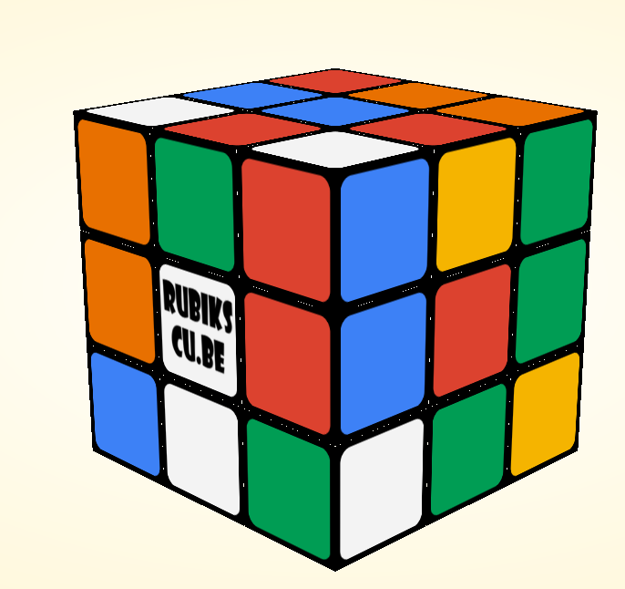
Final project
For the final project you will write a solver for Rubiks cube.
You can work on in alone or in pairs
Submit your solutions by December 2.

Slide 6
Final project
For the final project you will write a solver for rubik’s cube.
You get an input file.
You will need to solve and write the solution in the output file.
Your solver should be in the class rubikscube.Solver
Solver will take the parameters from command line:
>> java rubikscube.Solver "cmpt225project/scramble01.txt", "cmpt225project/sol01.txt“
For the exact format will be in the assignment.

Slide 7
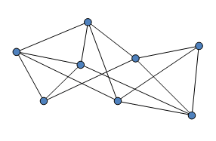
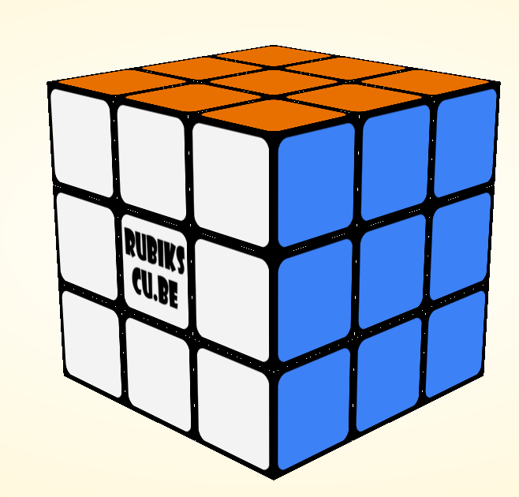
Final project
Key concept we will need is graph traversal.
Given a starting node in a graph, traverse/explore the graph, and find a path to some target node.
Target node
Starting node

Slide 8
Final project
A standard idea to solve this puzzle (or other similar puzzles) is the following:
Consider the graph of all possible states on the game.
We put an edge between two states if we can go from one to the other in one move
There is a state that represent a solved game
You are given a starting vertex in a graph
Your goal is to find a path from the starting vertex to a target. Note that there is exactly one target vertex.
You don’t need to find the shortest path – any solution is ok
Main problem: the total number of states/vertices is HUGE!

Slide 9
Final project
This week we will discuss graph traversals.
Specifically, we will learn three algorithms:
Breadth First Search
Depth First Search
A*
There are many more traversal algorithms, that consider graphs with lengths on the edges.
We will focus on algorithms where each edge has length 1.

Slide 10
Graphs

Slide 11
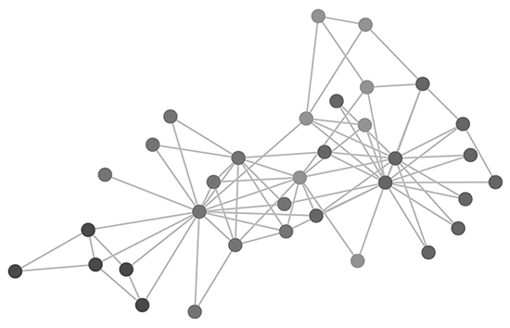
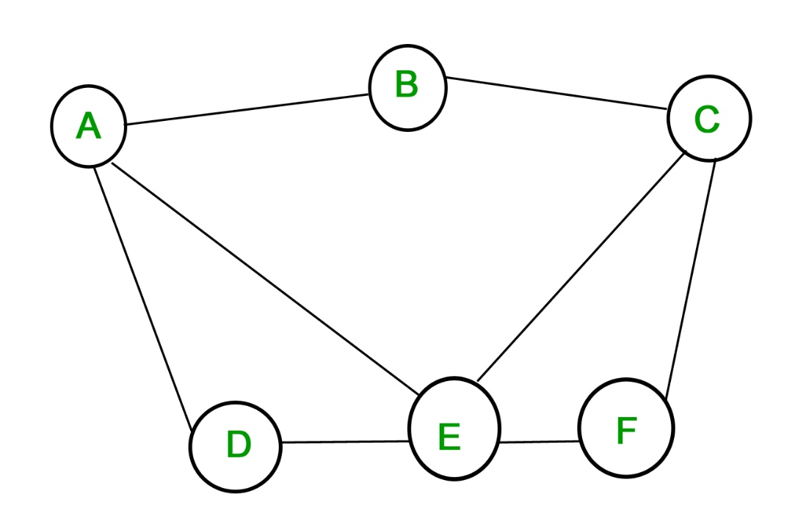
Graphs
Graph: a collection of nodes and a collection of edges, where each edge connects a pair of nodes. Usually denoted G=(V,E).
For us the graphs are always:
undirected (no direction on the edges)
connected:

Slide 12
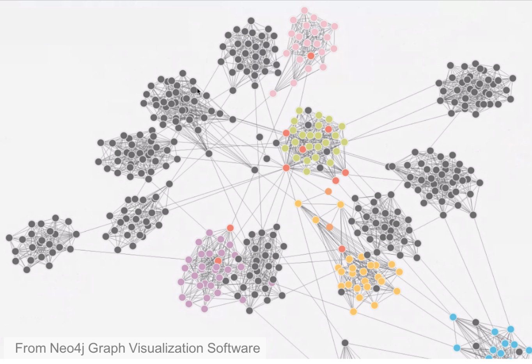
Graphs
Graph: a collection of nodes and edges, where each edge connects a pair of nodes.

Slide 13
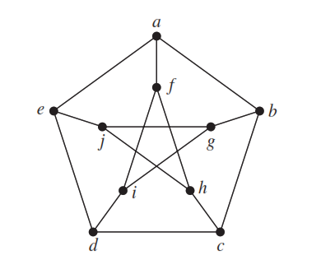
Graphs
Graph: a collection of nodes and edges, where each edge connects a pair of nodes.

Slide 14
Graph representation
There are 2 standard representations:
Matrix representation
Adjacency List representation

Slide 15
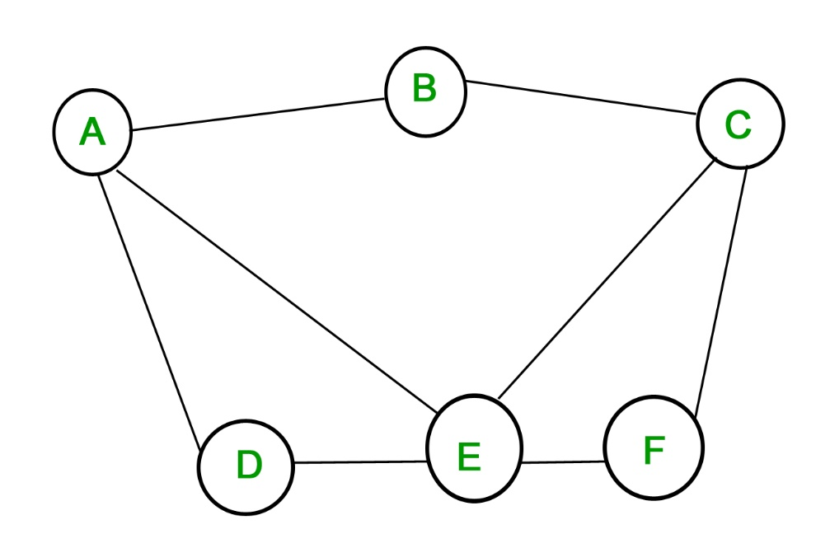
Matrix representation
Given a graph G=(V,E) with |V|=N vertices
A symmetric matrix of size NxN with
M[i,j]=1 if (i,j)∈E
M[i,j]=0 if (i,j)∉E
 | A | B | C | D | E | F
A | 0 | 1 | 0 | 1 | 1 | 0
B | 1 | 0 | 1 | 0 | 0 | 1
C | 0 | 1 | 0 | 0 | 1 | 1
D | 1 | 0 | 0 | 0 | 1 | 0
E | 1 | 0 | 1 | 1 | 0 | 1
F | 0 | 1 | 1 | 0 | 1 | 0

Slide 16
Adjacency list representation
Given a graph G=(V,E) with |V|=N vertices
We have N lists (linked list or array), one for each vertex
The list of a vertex v∈V hold all neighbours of v.
A: | B | D | E
B: | A | C
C: | B | E | F
D: | A | E
E: | A | C | D | F
F: | C | E

Slide 17
Implicit graph representation
It is also possible to do it without having the graph explicitly
For example, because the graph is too large to hold in the memory
We can only store the nodes that we have seen so far.
Similar to exploring a new territory, and creating a map on the fly.
For the project, this is probably the best way.

Slide 18
Breadth First Search

Slide 19
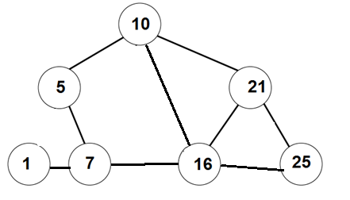
Breadth First Search
Goal: an algorithm that gets a graph G = (V,E), and a starting vertex, and computes the distance from start to all other vertices in G.
BONUS: if for each node v∈V we have the distance from start to v, then we can also compute a shortest path from start to v.
0
1
1
3
2
1
2

Slide 20
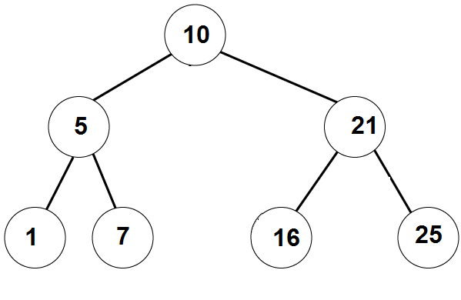
Recall BFS on trees
Breadth Frist Search(Node root):
q = create a queue of nodes
q.enqueue(root)
while (q is not empty):
node = q.dequeue()
print(node.value)
for each child of node
q.enqueue(child)
Print 10
Print 5
Print 21
Print 1
Print 7
Print 16
Print 25
10
5 | 21
21 | 1 | 7
1 | 7 | 16 | 25
7 | 16 | 25
16 | 25
25

Slide 21
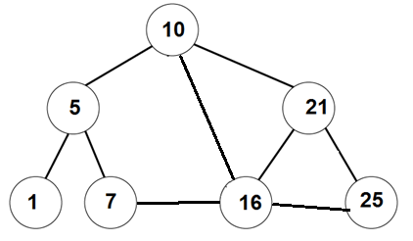
Breadth First Search
Breadth Frist Search(Node start):
q = create a queue of nodes
q.enqueue(start)
while (q is not empty):
v = q.dequeue()
print(v.value)
for each u neighbour of v
q.enqueue(u)
Print 10
Print 5
Print 16
10
5 | 16 | 21
16 | 21 | 1 | 7
21 | 1 | 7 | 7 | 21 | 25
Something is not right here. We return to same nodes more than once.
Solution: mark nodes that have already been visited
Wait, a minute…. When we explored 5, why didn’t we add 10 to the queue?

Slide 22
Breadth First Search
V
V
V
Breadth Frist Search(Node start):
q = create a queue of nodes
Mark all nodes as unvisited
q.enqueue(start)
Mark start as visited
while (q is not empty):
v = q.dequeue()
print(v.value)
for each u neighbour of v
if u is unvisited
q.enqueue(u)
Mark u as visited
V
V
V
V
Print 10
Print 5
Print 16
Print 21
Print 1
Print 7
Print 25
10
5 | 16 | 21
16 | 21 | 1 | 7
21 | 1 | 7 | 25
1 | 7 | 25
7 | 25
25

Slide 23
Breadth First Search
In fact, we can get a bit more out of this algorithm.
Theorem: The vertices of G are added/removed from the queue in the order respecting their distances from the starting node.
That is, all node at distance 1 from start are added to the queue before all nodes at distance 2, etc…
Also, we can get a tree using only edges of G such that
the distance of each node v from the start is it’s depth in the tree
dist_{G}(start, v) = dist_{Tree}(start, v) = depth_{Tree}(v) for all v∈V

Slide 24
Breadth First Search
V
V
V
Breadth Frist Search(Node start):
q = create a queue of nodes
Mark all nodes as unvisited
q.enqueue(start)
Mark start as visited
while (q is not empty):
v = q.dequeue()
print(v.value)
for each u neighbour of v
if u is unvisited
q.enqueue(u)
Mark u as visited
Set parent(u) = v in the tree
V
V
V
V
Print 10
Print 5
Print 16
Print 21
Print 1
Print 7
Print 25
10
5 | 16 | 21
16 | 21 | 1 | 7
21 | 1 | 7 | 25
1 | 7 | 25
7 | 25
25

Slide 25
Running time
Q: what is the running time of the Breadth First Search algorithm?
A: Observe that we touch every edge exactly twice (once from each side).
This is assuming that G is connected.
Therefore, the total running time is O(|E|) in the adjacency list model.
If the graph is not connected, then the running time is linear in the number of edges in the connected component of start.
*In the matrix representation the running time is O(|V|²)

Slide 26
Depth First Search

Slide 27
Breadth First Search
Almost the same algorithm as BFS,
but we use a stack instead of a queue.

Slide 28
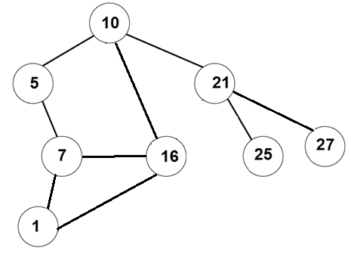
Depth First Search
Depth Frist Search(Node start):
s = create a stack of nodes
Mark all nodes as unvisited
s.push(start)
Mark start as visited
while (s is not empty):
v = s.pop()
print(v.value)
for each u neighbour of v
if u is unvisited
s.push(u)
Mark u as visited
Set parent(u) = v in the tree

Slide 29
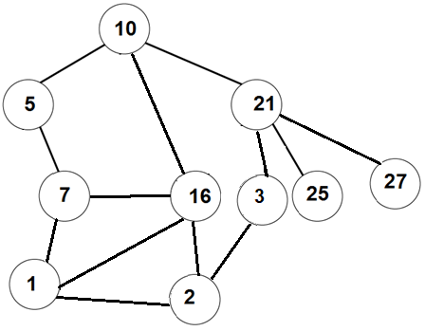
Depth First Search
V
Depth Frist Search(Node start):
s = create a stack of nodes
Mark all nodes as unvisited
s.push(start)
Mark start as visited
while (s is not empty):
v = s.pop()
print(v.value)
for each u neighbour of v
if u is unvisited
s.push(u)
Mark u as visited
Set parent(u) = v in the tree
V
V
V
V
V
V
V
V
V

Slide 30
Depth First Search
V
Depth Frist Search(Node start):
s = create a stack of nodes
Mark all nodes as unvisited
q.enqueue(start)
Mark start as visited
while (q is not empty):
v = q.dequeue()
print(v.value)
for each u neighbour of v
if u is unvisited
q.enqueue(u)
Mark u as visited
Set parent(u) = v
V
V
V
V
V
V
V
V
V
10
5
16
21
7
16
21
1
16
21
2
16
21
3
16
21
16
21
21
25
27
27

Slide 31
Running time
Q: what is the running time of the Breadth First Search algorithm?
A: Same as for BFS, we touch every edge exactly twice (once from each side).
This is assuming that G is connected.
Therefore, the total running time is O(|E|) in the adjacency list model.
If the graph is not connected, then the running time is linear in the number of edges in the connected component of start.
*In the matrix representation the running time is O(|V|²)

Slide 32
BFS vs DFS
BFS | DFS
Finds the shortest distance from the starting vertex to all v∈V. | Usually does not give the shortest distance.
Efficient if the target is close to the starting vertex. | Reaches far away vertices quicker.
More structured | More useful for solving puzzles than BFS.
 | Useful for other applications (topological search)
Both create a spanning tree of the connected component.
Both algorithms are uninformed. That is, they don’t have a guess about distance to the target.
Next time: A* - algorithm that uses estimated distance to the target.

Slide 33
A* algorithm

Slide 34
A* algorithm
We get a graph G = (V,E), a starting vertex and a target vertex.
Goal: Find a path from start to the target.
More generally: we can have more than one target.
Goal: Find a path from start to any target.
Main difference between A* and BFS/DFS:
A* uses an estimate about the distance from each node to a target.

Slide 35
A* algorithm
BFS and DFS perform an uninformed search.
That is, they don’t have a guess about distance to the target.
A* - an algorithm that uses estimated distance to the target.
Observation: if for each node v we knew exactly dist(v,target), then we could fine the target easily.
Q: How?
A: If dist(current, target) = 10, then one of the neighbors of current has dist(neighbour, target) = 9.
Move to that neighbour, and now look for a vertex with dist=8.

Slide 36
A* algorithm
A* - an algorithm that uses estimated distance to a target.
Fact: even if we don’t know the distance exactly, A* can find a target faster than BFS/DFS.
Let’s look at the A* algorithm.

Slide 37
A* algorithm
Input:
Graph G = (V,E),
a starting node, a target node,
h(v) – estimated distance from v to target for every node v.h
h stands for heuristic
Goal: find a path from start to target

Slide 38
A*
A* (Node start, Node target):
For each node define:
g(v) - distance travelled from start to v
h(v) – estimated distance from v to target - heuristic
f(v) = g(v) + h(v)
Let OpenQueue be a Priority Queue ordering vertices by f(v), min goes out first
Will be used to hold nodes that are currently processed
Let ClosedSet be a Set
Will be used to hold nodes that have already been processed
Probably implemented using HashSet.
We’ll discuss Sets and HashSets in a bit.
For now, ClosedSet is just a Set, supporting the operations: insert, remove, find

Slide 39
A* (Node start, Node target)
If h(v)=0 for all v, and we use max-PriorityQueue,
we get the DFS algorithm
OpenQueue.add(start)
while (OpenQueue is not empty)
2.1 v = OpenQueue.getMin() -- // min w.r.t f(v) takes O(1) time
2.2 for each u∈v.neighbours() do
2.2.1 if u is a target
Set g(u) = g(v) + 1, set u.parent = v
Return u
2.2.2 Otherwise:
If u is already in OpenQueue with a higher f(u), then update f(u)
Else if u is in the ClosedSet with a higher f(u), then update f(u) and move it to OpenQueue
Otherwise add u to OpenQueue
2.2.3 In all three cases in 2.2.2 set u.parent = v
2.3 Move v to ClosedSet
If h(v)=0 for all v with min-PriorityQueue,
we get the BFS algorithm
If h(v)=dist(v,target) for all v,
we go straight to the target

Slide 40
A* with admissible heuristics
Theorem: if we use min-PriorityQueue and h(v) ≤ dist(v, target) for all v, then A* will *eventually* find the target.
Note that *eventually* depends on:
Computing of h(v) – trade-off between efficiency and precision
Exact implementation of OpenQueue, ClosedSet
How fast .equals() works.
Size of the search space / total number of vertices
Memory used / size of each node
Some luck
(e.g., use randomness to compute h, or prune some branches in the computation)

Slide 41
Variations on these algs

Slide 42
Bidirection BFS
Simultaneously runs two BFS traversals
one from the start node
and one from the target node
Hope: find a node that is in both BFS trees of start
The algorithm is more efficient in terms of memory used:
The search space in reduced by finding the intersection point where the two searches meet
Typically, the exploration requires roughly half the length from each side

Slide 43
IDA* - Iterative Deepening A*
Combines A* with DFS. The high-level idea is
set a threshold T
run DFS algorithm but stop at the nodes for which g(v)+h(v)>T
Increase T gradually until the target is found

Slide 44

Some tips for the project
For OpenQueue use Priority Queue ordering vertices by f(v), min goes out first.
For ClosedSet use a HashSet.
Start with the most basic implementation of the puzzle
Implement hashCode() for your nodes, and use them to quickly check if two vertices are equal.
Consider computing hash in the constructor and just return the value in hashCode().
Some of you will probably see OutOfMemoryError. Try saving the memory in the representation of the cube
You may consider trying to find some intermediate steps, e.g., solve only first row.
Good luck!

Slide 45
Questions?
Comments?

