Slide 1
CMPT 225
Data Structures and Programming
Week 08

Slide 2
Final Project

Slide 3
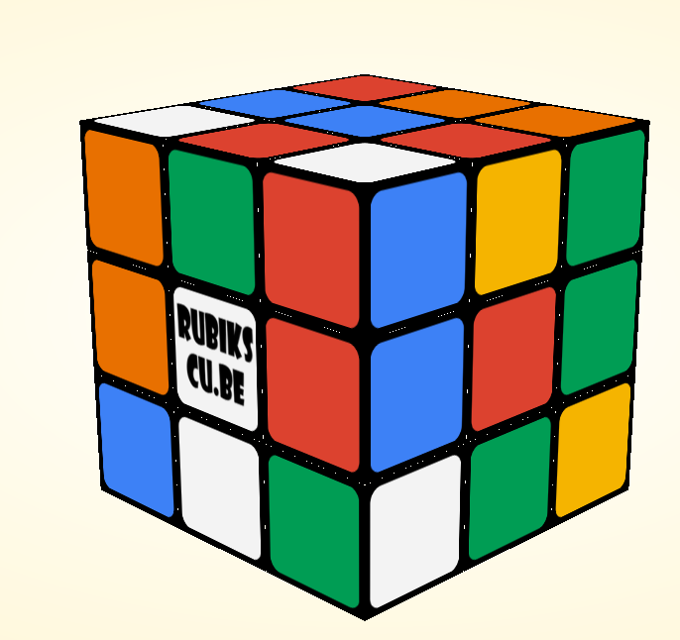
Final project
For the final project you will write a solver for Rubiks cube.
You can work on in alone or in pairs
Submit your solutions by December 2.

Slide 4
Final project
For the final project you will write a solver for rubik’s cube.
You get an input file.
You will need to solve and write the solution in the output file.
Your solver should be in the class rubikscube.Solver
Solver will take the parameters from command line:
>> java rubikscube.Solver "cmpt225project/scramble01.txt", "cmpt225project/sol01.txt“
For the exact format will be in the assignment.

Slide 5
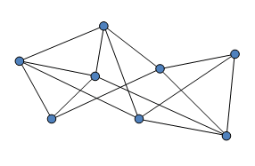
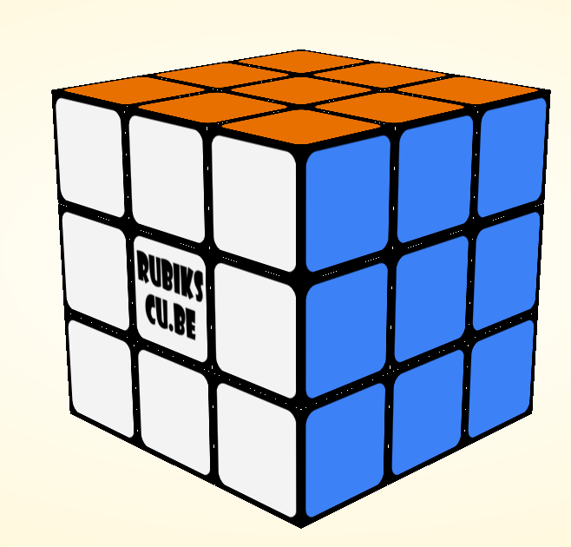
Final project
Key concept we will need is graph traversal.
Given a starting node in a graph, traverse/explore the graph, and find a path to some target node.
Target node
Starting node

Slide 6
Final project
A standard idea to solve this puzzle (or other similar puzzles) is the following:
Consider the graph of all possible states on the game.
We put an edge between two states if we can go from one to the other in one move
There is a state that represent a solved game
You are given a starting vertex in a graph
Your goal is to find a path from the starting vertex to a target. Note that there is exactly one target vertex.
You don’t need to find the shortest path – any solution is ok
Main problem: the total number of states/vertices is HUGE!

Slide 7
Final project
This week we will discuss graph traversals.
Specifically, we will learn three algorithms:
Breadth First Search
Depth First Search
A*
There are many more traversal algorithms, that consider graphs with lengths on the edges.
We will focus on algorithms where each edge has length 1.

Slide 8
Breadth First Search

Slide 9
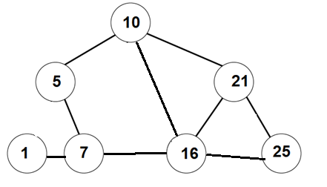
Breadth First Search
Goal: an algorithm that gets a graph G = (V,E), and a starting vertex, and computes the distance from start to all other vertices in G.
BONUS: if for each node v∈V we have the distance from start to v, then we can also compute a shortest path from start to v.
0
1
1
3
2
1
2

Slide 10
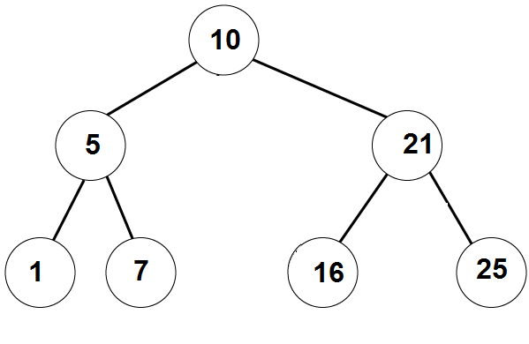
Recall BFS on trees
Breadth Frist Search(Node root):
q = create a queue of nodes
q.enqueue(root)
while (q is not empty):
node = q.dequeue()
print(node.value)
for each child of node
q.enqueue(child)
Print 10
Print 5
Print 21
Print 1
Print 7
Print 16
Print 25
10
5 | 21
21 | 1 | 7
1 | 7 | 16 | 25
7 | 16 | 25
16 | 25
25

Slide 11
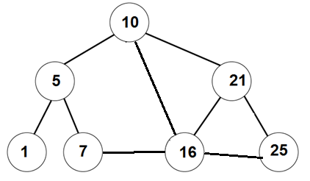
Breadth First Search
Breadth Frist Search(Node start):
q = create a queue of nodes
q.enqueue(start)
while (q is not empty):
v = q.dequeue()
print(v.value)
for each u neighbour of v
q.enqueue(u)
Print 10
Print 5
Print 16
10
5 | 16 | 21
16 | 21 | 1 | 7
21 | 1 | 7 | 7 | 21 | 25
Something is not right here. We return to same nodes more than once.
Solution: mark nodes that have already been visited
Wait, a minute…. When we explored 5, why didn’t we add 10 to the queue?

Slide 12
Breadth First Search
V
V
V
Breadth Frist Search(Node start):
q = create a queue of nodes
Mark all nodes as unvisited
q.enqueue(start)
Mark start as visited
while (q is not empty):
v = q.dequeue()
print(v.value)
for each u neighbour of v
if u is unvisited
q.enqueue(u)
Mark u as visited
V
V
V
V
Print 10
Print 5
Print 16
Print 21
Print 1
Print 7
Print 25
10
5 | 16 | 21
16 | 21 | 1 | 7
21 | 1 | 7 | 25
1 | 7 | 25
7 | 25
25

Slide 13
Breadth First Search
In fact, we can get a bit more out of this algorithm.
Theorem: The vertices of G are added/removed from the queue in the order respecting their distances from the starting node.
That is, all node at distance 1 from start are added to the queue before all nodes at distance 2, etc…
Also, we can get a tree using only edges of G such that
the distance of each node v from the start is it’s depth in the tree
dist_{G}(start, v) = dist_{Tree}(start, v) = depth_{Tree}(v) for all v∈V

Slide 14
Breadth First Search
V
V
V
Breadth Frist Search(Node start):
q = create a queue of nodes
Mark all nodes as unvisited
q.enqueue(start)
Mark start as visited
while (q is not empty):
v = q.dequeue()
print(v.value)
for each u neighbour of v
if u is unvisited
q.enqueue(u)
Mark u as visited
Set parent(u) = v in the tree
V
V
V
V
Print 10
Print 5
Print 16
Print 21
Print 1
Print 7
Print 25
10
5 | 16 | 21
16 | 21 | 1 | 7
21 | 1 | 7 | 25
1 | 7 | 25
7 | 25
25

Slide 15
Running time
Q: what is the running time of the Breadth First Search algorithm?
A: Observe that we touch every edge exactly twice (once from each side).
This is assuming that G is connected.
Therefore, the total running time is O(|E|) in the adjacency list model.
If the graph is not connected, then the running time is linear in the number of edges in the connected component of start.
*In the matrix representation the running time is O(|V|²)

Slide 16
Depth First Search

Slide 17
Breadth First Search
Almost the same algorithm as BFS,
but we use a stack instead of a queue.

Slide 18
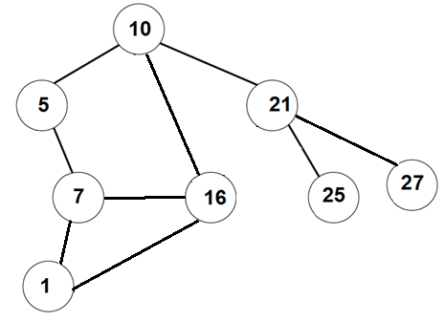
Depth First Search
Depth Frist Search(Node start):
s = create a stack of nodes
Mark all nodes as unvisited
s.push(start)
Mark start as visited
while (s is not empty):
v = s.pop()
print(v.value)
for each u neighbour of v
if u is unvisited
s.push(u)
Mark u as visited
Set parent(u) = v in the tree

Slide 19
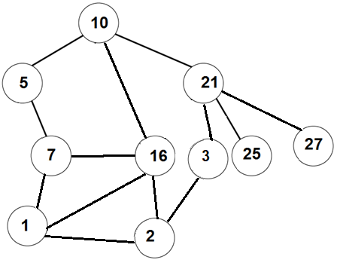
Depth First Search
V
Depth Frist Search(Node start):
s = create a stack of nodes
Mark all nodes as unvisited
s.push(start)
Mark start as visited
while (s is not empty):
v = s.pop()
print(v.value)
for each u neighbour of v
if u is unvisited
s.push(u)
Mark u as visited
Set parent(u) = v in the tree
V
V
V
V
V
V
V
V
V

Slide 20
Depth First Search
V
Depth Frist Search(Node start):
s = create a stack of nodes
Mark all nodes as unvisited
q.enqueue(start)
Mark start as visited
while (q is not empty):
v = q.dequeue()
print(v.value)
for each u neighbour of v
if u is unvisited
q.enqueue(u)
Mark u as visited
Set parent(u) = v
V
V
V
V
V
V
V
V
V
10
5
16
21
7
16
21
1
16
21
2
16
21
3
16
21
16
21
21
25
27
27

Slide 21
Running time
Q: what is the running time of the Breadth First Search algorithm?
A: Same as for BFS, we touch every edge exactly twice (once from each side).
This is assuming that G is connected.
Therefore, the total running time is O(|E|) in the adjacency list model.
If the graph is not connected, then the running time is linear in the number of edges in the connected component of start.
*In the matrix representation the running time is O(|V|²)

Slide 22
BFS vs DFS
BFS | DFS
Finds the shortest distance from the starting vertex to all v∈V. | Usually does not give the shortest distance.
Efficient if the target is close to the starting vertex. | Reaches far away vertices quicker.
More structured | More useful for solving puzzles than BFS.
 | Useful for other applications (topological search)
Both create a spanning tree of the connected component.
Both algorithms are uninformed. That is, they don’t have a guess about distance to the target.
Next time: A* - algorithm that uses estimated distance to the target.

Slide 23
A* algorithm

Slide 24
A* algorithm
We get a graph G = (V,E), a starting vertex and a target vertex.
Goal: Find a path from start to the target.
More generally: we can have more than one target.
Goal: Find a path from start to any target.
Main difference between A* and BFS/DFS:
A* uses an estimate about the distance from each node to a target.

Slide 25
A* algorithm
BFS and DFS perform an uninformed search.
That is, they don’t have a guess about distance to the target.
A* - an algorithm that uses estimated distance to the target.
Observation: if for each node v we knew exactly dist(v,target), then we could fine the target easily.
Q: How?
A: If dist(current, target) = 10, then one of the neighbors of current has dist(neighbour, target) = 9.
Move to that neighbour, and now look for a vertex with dist=8.

Slide 26
A* algorithm
A* - an algorithm that uses estimated distance to a target.
Fact: even if we don’t know the distance exactly, A* can find a target faster than BFS/DFS.
Let’s look at the A* algorithm.

Slide 27
A* algorithm
Input:
Graph G = (V,E),
a starting node, a target node,
h(v) – estimated distance from v to target for every node v.h
h stands for heuristic
Goal: find a path from start to target

Slide 28
A*
A* (Node start, Node target):
For each node define:
g(v) - distance travelled from start to v
h(v) – estimated distance from v to target - heuristic
f(v) = g(v) + h(v)
Let OpenQueue be a Priority Queue ordering vertices by f(v), min goes out first
Will be used to hold nodes that are currently processed
Let ClosedSet be a Set
Will be used to hold nodes that have already been processed
Probably implemented using HashSet.
We’ll discuss Sets and HashSets in a bit.
For now, ClosedSet is just a Set, supporting the operations: insert, remove, find

Slide 29
A* (Node start, Node target)
If h(v)=0 for all v, and we use max-PriorityQueue,
we get the DFS algorithm
OpenQueue.add(start)
while (OpenQueue is not empty)
2.1 v = OpenQueue.getMin() -- // min w.r.t f(v) takes O(1) time
2.2 for each u∈v.neighbours() do
2.2.1 if u is a target
Set g(u) = g(v) + 1, set u.parent = v
Return u
2.2.2 Otherwise:
If u is already in OpenQueue with a higher f(u), then update f(u)
Else if u is in the ClosedSet with a higher f(u), then update f(u) and move it to OpenQueue
Otherwise add u to OpenQueue
2.2.3 In all three cases in 2.2.2 set u.parent = v
2.3 Move v to ClosedSet
If h(v)=0 for all v with min-PriorityQueue,
we get the BFS algorithm
If h(v)=dist(v,target) for all v,
we go straight to the target

Slide 30
A* with admissible heuristics
Theorem: if we use min-PriorityQueue and h(v) ≤ dist(v, target) for all v, then A* will *eventually* find the target.
Note that *eventually* depends on:
Computing of h(v) – trade-off between efficiency and precision
Exact implementation of OpenQueue, ClosedSet
How fast .equals() works.
Size of the search space / total number of vertices
Memory used / size of each node
Some luck
(e.g., use randomness to compute h, or prune some branches in the computation)

Slide 31
Variations on these algs

Slide 32
Bidirectional BFS
Simultaneously runs two BFS traversals
one from the start node
and one from the target node
Hope: find a node that is in both BFS trees of start
The algorithm is more efficient in terms of memory used:
The search space in reduced by finding the intersection point where the two searches meet
Typically, the exploration requires roughly half the length from each side

Slide 33
IDA* - Iterative Deepening A*
Combines A* with DFS. The high-level idea is
set a threshold T
run DFS algorithm but stop at the nodes for which g(v)+h(v)>T
Increase T gradually until the target is found

Slide 34

Some tips for the project
For OpenQueue use Priority Queue ordering vertices by f(v), min goes out first.
For ClosedSet use a HashSet.
Start with the most basic implementation of the puzzle
Implement hashCode() for your nodes, and use them to quickly check if two vertices are equal.
Consider computing hash in the constructor and just return the value in hashCode().
Some of you will probably see OutOfMemoryError. Try saving the memory in the representation of the cube
You may consider trying to find some intermediate steps, e.g., solve only first row.
Good luck!

Slide 35
Hashing and Hash Tables

Slide 36
Hashing
We want a data structure that supports the following operations:
Insert(element)
Remove(element)
Contains?(element)
We want all operations to be as efficient as possible.
Ideally O(1) time for each operation

Slide 37
Hashing
Fine print:
* usually, O(1) on average.
* worst case running time is O(n)
 | insert | remove | contains
Linked List | O(1) | O(n) | O(n)
Sorted Array | O(n) | O(n) | O(log(n))
Balanced Binary Search Tree (AVL tree) | O(log(n)) | O(log(n)) | O(log(n))
Hashing | O(1)* | O(1)* | O(1)*

Slide 38
Hashing – basic idea
We want a data structure that supports the following operations:
Insert(element)
Remove(element)
Contains?(element)
Want all operations to be as efficient as possible.
Idea:
A hash table: an array of some fixed size.
A hash function: mapping objects into the array
E.g. hash(“CMPT225”, ”Spring2021”)=9
Q: what if hash(“CMPT125”, ”Fall2022”)=9 ?
0
1
2
3
4
5
6
7
8
9
10
11
12
13
(“CMPT125”, ”Fall2018”)
(“CMPT125”, ”Fall2020”)
(“CMPT409”, ”Fall2019”)
(“CMPT225”, ”Spring21”)
(“CMPT125”, ”Fall2019”)
(“CMPT805”, ”Spring2019”)

Slide 39
Hash functions
hashCode()

Slide 40
Hash function
We need a hash function that converts any key (string, number, or more complicated class) into an int.
In Java the standard function is called hashCode()
hashCode() is declared in java.lang.Object

Slide 41
hashCode() – javadocs
Whenever it is invoked on the same object more than once, hashCode() must return the same integer.
hashCode() need not remain consistent from one execution to another.
If two objects are equal according to the equals(Object) method, then calling the hashCode method on each of the two objects must produce the same integer result.
It is not required that if two objects are unequal according to the equals(java.lang.Object) method, then calling the hashCode method on each of the two objects must produce distinct integer results.
However, the programmer should be aware that producing distinct integer results for unequal objects may improve the performance of hash tables.

Slide 42
Hash function
A hash function converts any key (any class) into an int.
The value of the hash function will be an index in the hash table.
Want different keys to be usually mapped to different values.
Example: Let’s say the hash table is of size 100.
hash(name, number) = (name.hashCode() + number) mod 100
and name.hashCode() = name[0]*31^{n-1}+name[1]*31^{n-2} +…+name[n-1]
Then
hash(“CMPT”, 225) = (hash(“CMPT”) + 225) mod 100
hash(“CMPT”, 125) = (hash(“CMPT”) + 125) mod 100
Both hashes are the same.

Slide 43
Hash function
Another example: Let’s say the hash table is of size 100.
hash(name, date of birth, SFU-ID)
= (first two digits of year of birth + first 2 digits of SFU ID) % 100
Then:
hash(“Jack”, 1997, 3018765432) = 19 + 30 = 49
hash(“John”, 1967, 301012333) = 19 + 30 = 49
hash(“Bob”, 1999, 3019123456) = 19 + 30 = 49
Doesn’t look very good

Slide 44
Hash function
Another example: Let’s say the hash table is of size 127.
Hash(id, name, age, height)
= (id*31 + 19*age*height² + name.hashCode()) % 127
and name.hashCode() = name[0]*31^{n-1}+name[1]*31^{n-2} +…+name[n-1]
Looks more difficult to find a collision.

Slide 45
Hashing strings
Java implementation of String.hashCode() is
hashCode(“a”) = ‘a’ = 97
hashCode(“b”) = ‘b’ = 98
hashCode(“ab”) = ‘a’*31 + ‘b’ = 3105
hashCode(“d”) = ‘d’ = 100
hashCode(“da”) = ‘d’*31 + ‘a’ = 3197
hashCode(“abc”) = ‘a’*31²+’b’*31+’c’ = 97*31²+98*31+99 = 96354
hashCode(“bac”) = ‘b’*31²+’a’*31+’c’ = 97*31²+98*31+99 = 97284
hashCode(“cab”) = ‘c’*31²+’a’*31+’c’ = 97*31²+98*31+99 = 98244
Check it!

Slide 46
Hash function
A hash function converts any key (an arbitrary object) into an int.
Should be computable very efficiently
We want different keys to be usually mapped to different values.
Of course, it is impossible to always have different values, because there are more keys than the size of the hash table.
Want to utilize all slots in the table
But we can at least try avoid “obvious” collisions.
For example, using modulo prime is better than using modulo 100.
In general, hash functions are a form of art more than science.
… or maybe I just don’t get it…

Slide 47
Hash function
Hash functions are also used for cryptography.
For these applications we want a function that is hard to invert.
For example, it is hard to find a string str such that hash(str) = 12345
Example: (I think it is a true story) when your email passwords are stored on sfu servers, actually, only their hashes are stored.
So any string whose hashCode(string) gives the correct hashValue, will allow access to the email.
e.g. hash(“Igor12345”) = 0x9123afbcd13
So any password attempt with the same hash value will work
But that’s a completely different story

Slide 48
Back to Hash Tables

Slide 49
Hashing
Recall our goal in the beginning of the lecture:
We want a data structure that supports the following operations:
Insert(element)
Remove(element)
Contains?(element)
We want all operations to be as efficient as possible.
Ideally O(1) time for each.

Slide 50

Hash tables
A possible solution for this data structure would be the following:
Create an array of some fixed size, say 1019 (some large prime)
Add(element):
- array[ element.hashCode() % 1019 ] = element;
Remove(element)
- array[ element.hashCode() % 1019] = null;
Contains(element)
- return (array[ element.hashCode() % 1019 ] != null);
Q: What if two elements are mapped to the same index?
How should we handle collisions?

Slide 51
Hash tables - collisions
hash(“CMPT125”, ”Fall2018”)=2
0
1
2
3
4
5
6
7
8
9
10
11
12
13
(“CMPT125”, ”Fall2018”)
(“CMPT125”, ”Fall2020”)
(“CMPT409”, ”Fall2019”)
(“CMPT225”, ”Spring2021”)
(“CMPT125”, ”Fall2019”)
(“CMPT805”, ”Spring2019”)
Two standard solutions:
Separate Chaining / Closed addressing
Open Addressing / Probing
hash(“CMPT225”, ”Spring2021”)=9
hash(“CMPT125”, ”Fall2021”)=9
hash(“CMPT125”, ”Fall2019”)=12

Slide 52
Separate Chaining

Slide 53
Separate Chaining
Idea: each entry in the hash table contains a linked list of all elements mapped here.
When creating the hash table, we create an empty LinkedList for each hash value.
contains?(element)
index = element.hashCode()
list = table[index]
return list.contains(element)
//equiv.
return table[element.hashCode()].contains(element)

Slide 54
Separate Chaining
Idea: each entry in the hash table contains a linked list of all elements mapped here.
add(element)
index = element.hashCode()
list = table[index]
If (!list.contains(element))
3.1 list.add(element) – let’s say add to front

Slide 55
Separate Chaining
Idea: each entry in the hash table contains a linked list of all elements mapped here.
remove(element)
index = element.hashCode()
list = table[index]
If (list.contains(element))
3.1 list.remove(element)
For hash tables all lists will be typically of size, say <10.

Slide 56
Separate Chaining
See animation here
https://www.cs.usfca.edu/~galles/visualization/OpenHash.html

Slide 57
Rehashing
Load factor = number of elements / size of the array
To guarantee good performance, the load factor should be less than 1 (often it is expected to be below 0.75).
When array becomes too full (i.e. the load factor exceeds some predefined value), all the values stored in the table need to be rehashed to a larger table
Look at the implementation of HashMap.class
It is a pretty complicated class, but you will learn quite a bit from it.

Slide 58
Separate Chaining – variants:
Variants:
Instead of having a linked list in each entry, replace it with other structure:
a binary search tree using comparison by some field
Or a “smaller” hash table based on another hash function
Or other data structure

Slide 59
Open Addressing / Probing

Slide 60
Open Addressing – linear probing
Linear probing: when insertion causes collision, check if the next entry is empty, and put the element there. If not go to the right one more…
add(element)
index = element.hashCode()
if (table[index] == null)
2.1 table[index] = element
else, // try adding at index+1, index+2…

Slide 61
Open Addressing – linear probing
Linear probing: when insertion causes collision, check if the next entry is empty, and put the element there. If not go to the right one more…
add(element)
index = element.hashCode()
while (table[index] != null)
2.1 index = index+1 (mod table.length)
table[index] = element

Slide 62
Open Addressing – linear probing
Linear probing: when insertion causes collision, check if the next entry is empty, and put the element there. If not go to the right one more…
add(element)
 |  | A | D | L | Q |  |  |  | O
Add R
 |  | A | D | L | Q |  |  | R | O
Add S
 |  | A | D | L | Q | S |  | R | O

Slide 63
Open Addressing – linear probing
Linear probing: when insertion causes collision, check if the next entry is empty, and put the element there. If not go to the right one more…
contains(element)
index = element.hashCode()
while (table[index] != null && !(table[index].equals(element)) )
2.1 index = index+1 (mod table.length)
return (table[index] != null)

Slide 64
Open Addressing – linear probing
Linear probing: when insertion causes collision, check if the next entry is empty, and put the element there. If not go to the right one more…
contains(element)
 |  | A | D | L | Q | S |  | R | O
Contains(S)
Contains(C)
Contains(M)
Contains(R)

Slide 65
Open Addressing – linear probing
Idea: when insertion causes collision, check if the next entry is empty, and put the element there. If not go to the right one more…
remove(element)
How should we handle removals?
Let’s say we went to remove from table[i], but there is another element with same hash, that we added to table[i+1]. What should we do?
Or that element was added to table[i+3] because table[i,i+1,i+2] were taken.
What should we do?

Slide 66
Open Addressing – linear probing
Idea: when insertion causes collision, check if the next entry is empty, and put the element there. If not go to the right one more…
When removing mark that location as “deleted”
remove(element)
index = element.hashCode()
table[index] = deleted
Here deleted is a special object used by our Hash, e.g.
private static final Object deleted = new Object();
This will require us to revise our insert and contains() methods.

Slide 67
Open Addressing – linear probing
Linear probing: when insertion causes collision, check if the next entry is empty, and put the element there. If not go to the right one more…
We have a special object deleted
private static final Object deleted = new Object();
add(element)
index = element.hashCode()
while (table[index] != null && table[index] != deleted )
2.1 index = index+1 (mod table.length)
table[index] = element

Slide 68
Open Addressing – linear probing
Linear probing: when insertion causes collision, check if the next entry is empty, and put the element there. If not go to the right one more…
add(element)
 |  | A | D | L | del |  |  |  | O
Add R
 |  | A | D | L | del |  |  | R | O
Add S
 |  | A | D | L | S |  |  | R | O

Slide 69
Open Addressing – linear probing
Linear probing: when insertion causes collision, check if the next entry is empty, and put the element there. If not go to the right one more…
contains(element)
index = element.hashCode()
while (table[index] != null && !element.equals(table[index]))
2.1 index = index+1 (mod table.length)
return (element.equals(table[index]) != null)

Slide 70
Open Addressing – linear probing
Linear probing: when insertion causes collision, check if the next entry is empty, and put the element there. If not go to the right one more…
contains(element)
 |  | A | D | L | del | S |  | R | O | del
Contains(S)
Contains(C)
Contains(M)
Contains(R)

Slide 71
Open Addressing – linear probing
Linear probing: when insertion causes collision, check if the next entry is empty, and put the element there. If not go to the right one more…
We have a special object deleted
private static final Object deleted = new Object();
remove(element)
index = element.hashCode()
while (table[index] != null && !element.equals(table[index]) )
2.1 index = index+1 (mod table.length)
if (table[index] != null)
3.1 table[index] = deleted

Slide 72
Open Addressing – linear probing
Linear probing: when insertion causes collision, check if the next entry is empty, and put the element there. If not go to the right one more…
delete (element)
 |  | A | D | L | del | S |  | R | O | del
delete(S)
 |  | A | D | L | del | del |  | R | O | del

Slide 73
Open Addressing – linear probing
Linear probing: when insertion causes collision, check if the next entry is empty, and put the element there. If not go to the right one more…
What about add(element)
Fix: before adding element, check that it is not already in the table
 |  | A | D | L | del | S |  | R | O | del
add(S)

Slide 74
Linear probing - clustering
Cluster: A consecutive block of keys
Problem: New keys disproportionately likely to hash into big clusters.
This causes long insertions,
Solution: resize the table to reduce the load factor.
For example:
if load factor > ½, double the length
if load factor < ¼ , halve the length
Remember: when resizing we rehash all keys, which takes long time.
W |  |  |  | F | N | X |  |  |  | A | D | L | del | S |  | R | O | del | Z

Slide 75
Open Addressing variants

Slide 76
Open Addressing – variants
Quadratic probing:
add(element)
index = element.hashCode()
i=0
while (table[index + i²] != null)
2.1 i++
table[index + i²] = element

Slide 77
Open Addressing – variants
Quadratic probing:
contains(element)
index = element.hashCode()
i=0
while (table[index] != null && element.equals(table[index]))
2.1 i++
2.2 index = index + i*i
return (table[index] != null)

Slide 78
Open Addressing – variants
Double hashing: have two hash functions
contains(element)
index = element.hashCode()
while (table[index] != null && !element.equals(table[index]))
2.1 index = index + hash₂(element)
return (table[index] != null)

Slide 79
Linear hashing – variant
Back to Linear Hashing: when removing elements, we can set it to null instead of marking it at deleted. But this requires looking forward at the block, and see if we some elements need to be moved
 |  | A | D | L | M |  |  | R | O | T
add(S)
 |  | A | D | L | M | S |  | R | O | T
delete(L)
 |  | A | D | S | M |  |  | R | O | T

Slide 80
Application: 3-SUM

Slide 81
3-SUM
Input: an array A[0…n-1] of ints
Goal: find i,j,k such that A[i] + A[j] = A[k].
The indices don’t have to be all different
Naïve solution in O(n³) time:
Sort the array A, and remember for each value its index in A
For i=0…n-1
For j=0…n-1
For k=0…n-1
Check A[i]+A[j] = A[k]

Slide 82
3-SUM
Input: an array A[0…n-1] of ints
Goal: find i,j,k such that A[i] + A[j] = A[k].
The indices don’t have to be all different
Solution in O(n² log(n)) time:
Sort the array A, and remember for each value its index in A
For i=0…n-1
For j=0…n-1
Use binary search to find A[i]+A[j] in the sorted array.
If found, return i,j, and the index of the value in the array

Slide 83
3-SUM
Input: an array A[0…n-1] of ints
Goal: find i,j,k such that A[i] + A[j] = A[k].
The indices don’t have to be all different
Solution in O(n²) time (on average):
Store all elements of A in a hash table of size O(n)
For i=0…n-1
For j=0…n-1
If A[i]+A[j] is in the hash table,
return i,j, and the index of the value in the array
Question: How should we design a hash table for this specific problem?

Slide 84
3-SUM
Input: Array A[0…n-1]
Goal: Design a hash table for A so that
Adding / searching can be done in O(1) on average
The size of the table is O(n)
Idea 0: compute M = max(A[i]), create an array of length M, and store each A[i] is HashTable[A[i]].
Problem: the values in A might be huge compared to n.
So most of the table will be empty…

Slide 85
3-SUM
Input: Array A[0…n-1]
Goal: Design a hash table for A so that
Adding / searching can be done in O(1) on average
The size of the table is O(n)
Idea 1: Choose a prime p∈[10n, 20n], defined a hash table of size p.
For each i=0…n-1
add A[i] to HashTable[A[i] mod p]
Problem: If an “adversary” knows p, the input could be such that all A[i]’s are equal modulo p, and hence go to the same cell.
So we will have all values in the same hash cell

Slide 86
3-SUM
Input: Array A[0…n-1]
Goal: Design a hash table for A so that
Adding / searching can be done in O(1) on average
The size of the table is O(n)
Idea 2: Choose a random prime p∈[10n, 20n], and declare a hash table of size p.
Define hash(x) = x mod p
For each i=0…n-1
add A[i] to HashTable[ hash(A[i)]
Looks better now…

Slide 87
3-SUM
Take home message: learn serious math,
it will make you a better programmer
Input: Array A[0…n-1]
Goal: Design a hash table for A so that
Adding / searching can be done in O(1) on average
The size of the table is O(n)
Idea 3: Choose a random prime p∈[10n, 20n]
Declare a hash table of size p.
Choose random a,b ∈ {0,1…p-1}
Define hash(x) = ax+b mod p
For each i=0…n-1
add A[i] to HashTable[hash(x)]
Looks confusing enough…
Using some number theory,
one can show that this gives
us what we want
(with high probability)

Slide 88
Questions?
Comments?

