Slide 1
Apex Project
Tyler Williamson
Jiyoung Min

Slide 2
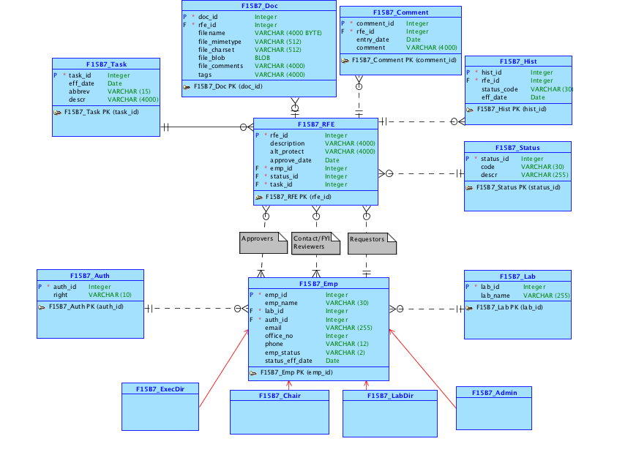
Conceptual
Model

Slide 3
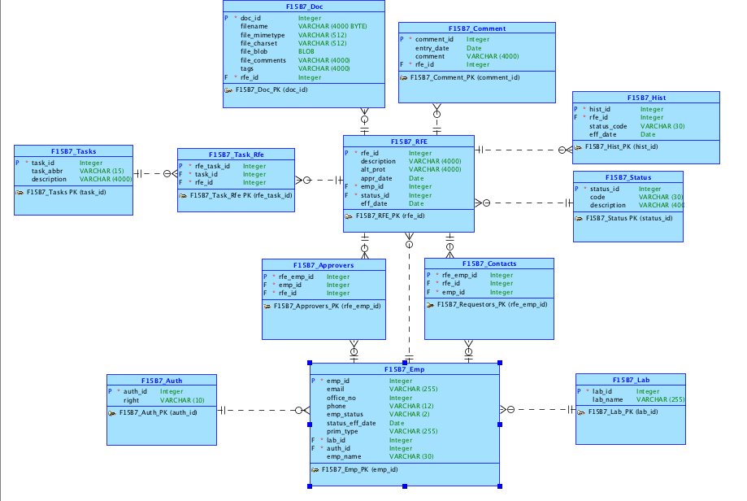
Logical
Model

Slide 4
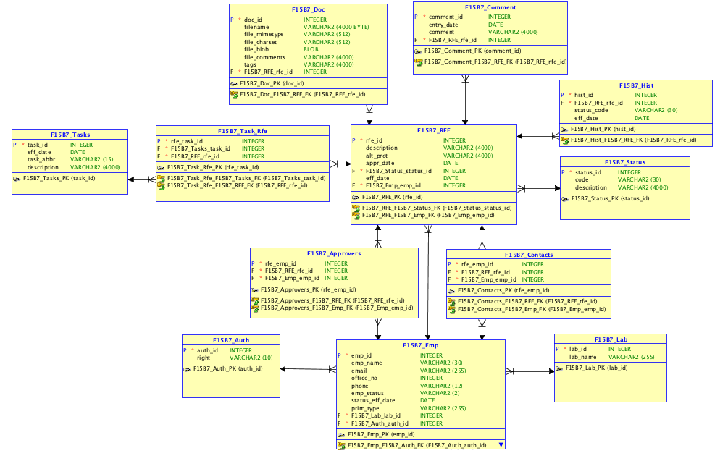
Relational
Model

Slide 5
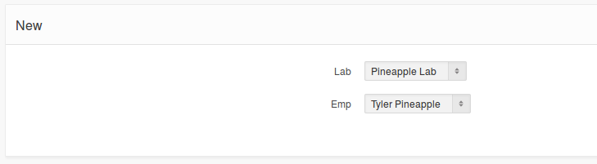
Login Form:
RFE List:

Slide 6
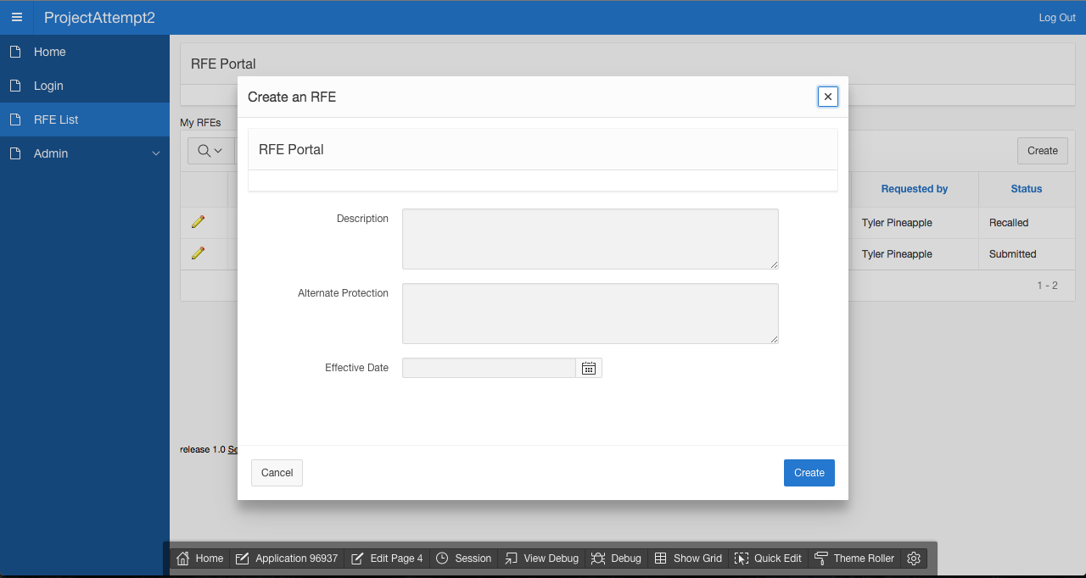
Creating an RFE

Slide 7
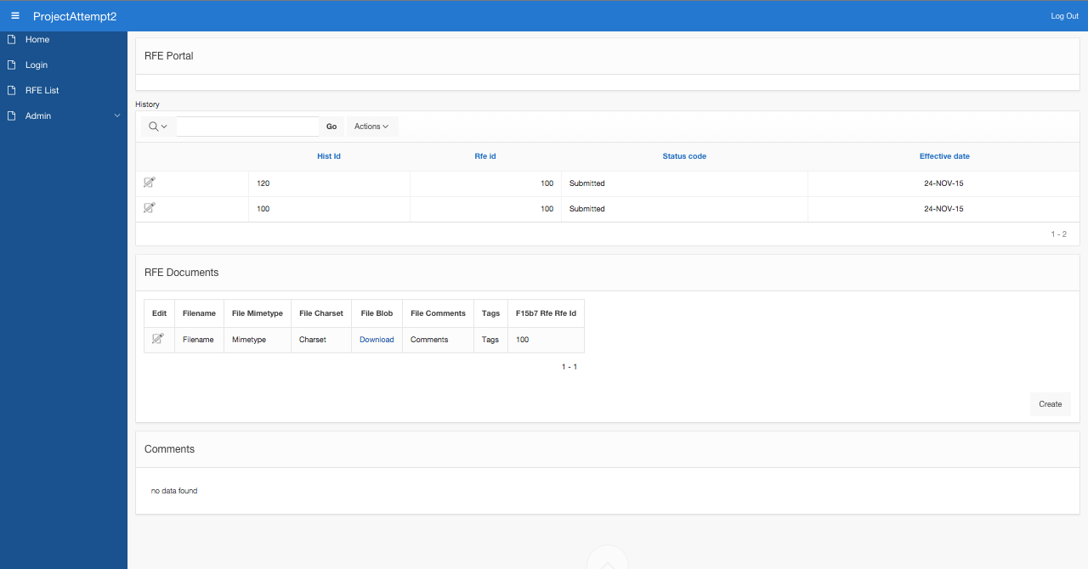
RFE Details Page
History
Upload a File
Comments

Slide 8
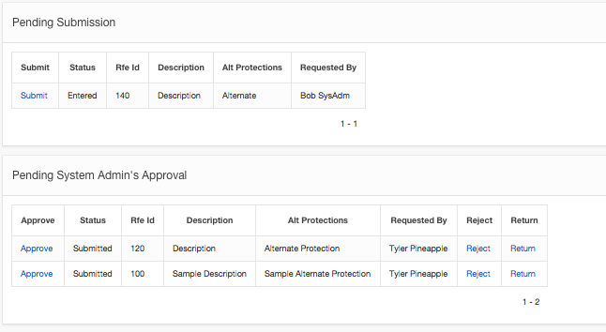
Submission and Approval
(when logged in as a System Administrator)

Slide 9
RFE Approval Flow
System
Admin
Lab Director
Requestor
REJECTED
Approved!
Executive Director
Chair Person

Slide 10


Part 2: League of Legends Schema

Slide 11
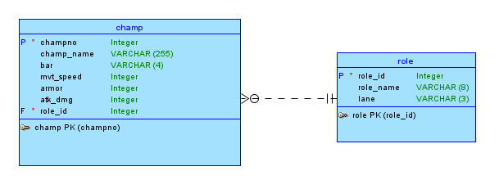
Part 2 Conceptual

Slide 12
League of Legends Champion Database
Database for League of Legends, a Japanese Anime Cartoon about racing
Many Champions race for “bars”
As Champions race, their stats come into play
Every Champion, or champ, has a specific role
Matches are always different, due to champs having specific stats
Navigate an application built to allow you to see champions, and their stats.
End user can toggle the viewing of whatever stats you would like to see
Keep Graphs comparing the stats visually.
Statistics shown visually for easy comparison.

Slide 15
Github Link:
https://github.com/jymin94/f15b7proj1.git

