Slide 1
Apex Project
Tyler Williamson
Jiyoung Min

Slide 2
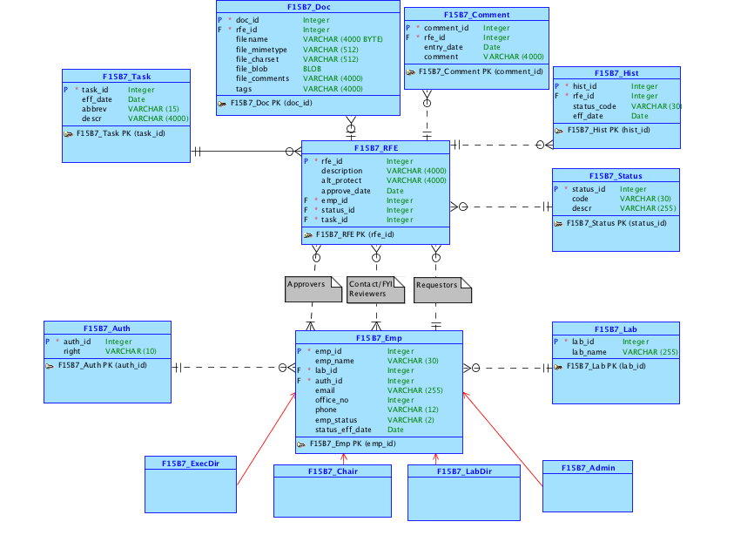

Slide 3
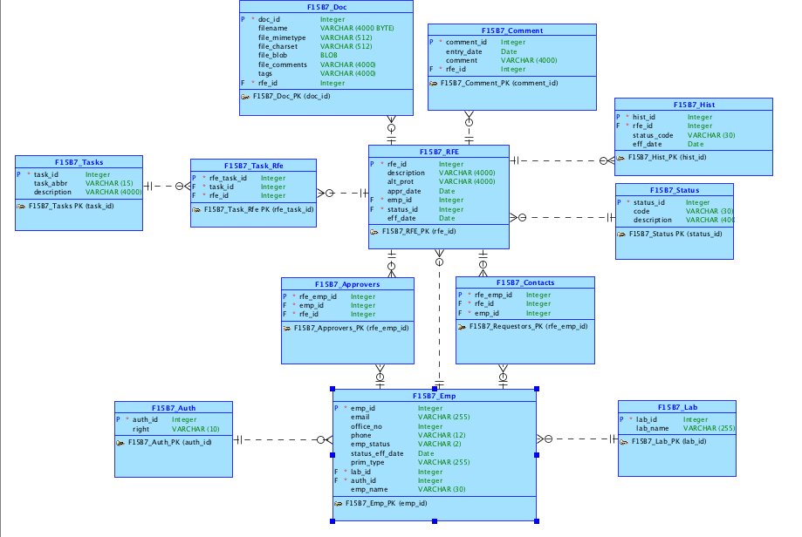

Slide 4
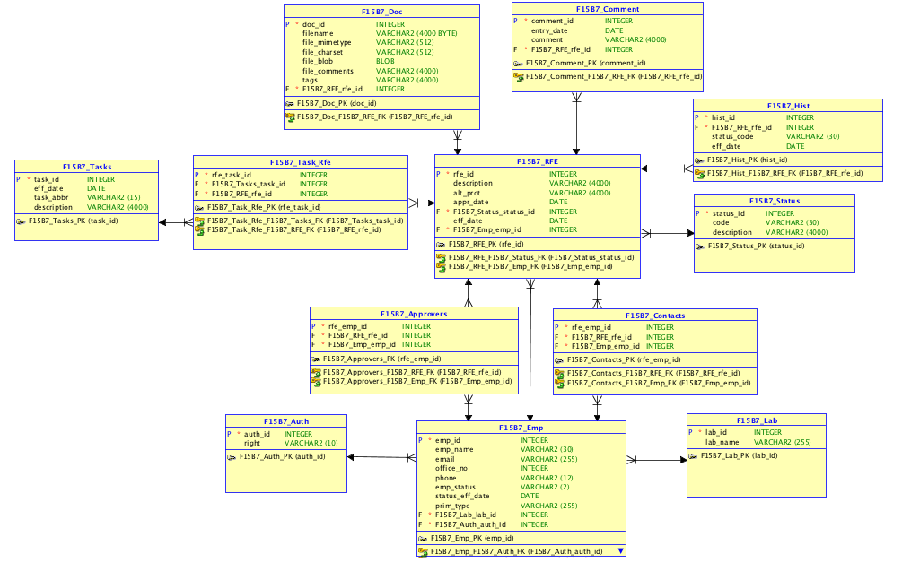

Slide 5
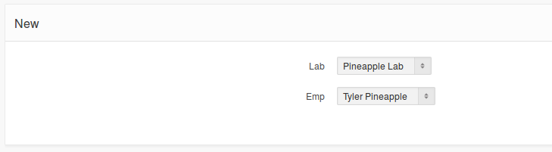
Login Form:
RFE List:

Slide 6
RFE Approval Flow
System
Admin
Lab Director
Requestor
REJECTED
Approved!
Executive Director
Chair Person

Slide 7
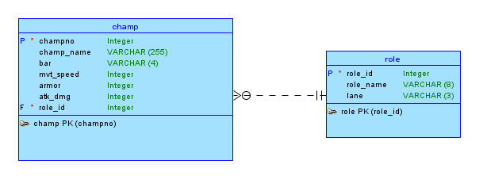
Part 2 Conceptual

Slide 8
League of Legends Champion Database
Database for League of Legends, a Japanese Anime Cartoon
Many Champions race for “bars”
As Champions race, their stats come into play
Every Champion, or champ, has a specific role
Matches are always different, due to champs having specific stats
Navigate an application built to allow you to see champions, and their stats.
End user can toggle the viewing of whatever stats you would like to see
Keep Graphs comparing the stats visually.
Statistics shown visually for easy comparison.

Slide 11
Github Link:
https://github.com/jymin94/f15b7proj1.git

